Slide 1

A COMPUTER VISION PROJECT
NIGHTTIME
POTHOLE
DETECTION
Detecting road damage when visibility is at its worst.
IMAGE PROCESSING AND COMPUTER VISION
Motilal Nehru National Institute of Technology Allahabad
Ruchir Tripathi · 20235068
Tanmay Paul · 20233292
Souvik Sarkar · 20233275
Tavishi Sharma · 20233577
PROJECT PRESENTATION
IMAGE PROCESSING & COMPUTER VISION / MNNIT ALLAHABAD

Slide 2
CONTEXT
02
The road does not become safer after dark.
The same road defects become harder to notice when illumination and contrast are low.
The problem
The objective
The question
Potholes can be difficult to spot in low-light road images, especially when visibility is limited.
Build an object-detection pipeline that identifies pothole regions and localises them with bounding boxes.
Can synthetically darkened daytime images stand in for real night images when training a pothole detector?
PROJECT AIM
Evaluate YOLOv8n and YOLOv8s baselines trained on the synthetic-night dataset, then run a controlled YOLO11m test: is a day-to-night transformation a successful substitute for real nighttime training images?
IMAGE PROCESSING & COMPUTER VISION / MNNIT ALLAHABAD

Slide 3
OVERVIEW
03
One project. Two experiment groups.
YOLOv8n and YOLOv8s baselines on the synthetic dataset, plus a controlled YOLO11m test of the day-to-night transformation.
2,679
7,270
1,987
18
TOTAL SYNTHETIC IMAGES
POTHOLE INSTANCES
PAIRED DAY–NIGHT IMAGES
CONTROLLED YOLO11m MODELS
YOLOv8n
YOLOv8s
YOLO11m
Nano · 640 × 640
Small · 640 × 640
Medium · 640 × 640 · 3 seeds
Evaluation
YOLOv8: synthetic-night test split + YOLO11m: balanced day / synthetic-night / real-night benchmark
IMAGE PROCESSING & COMPUTER VISION / MNNIT ALLAHABAD

Slide 4
METHODOLOGY
04
Building a pothole-only dataset
The original source had three labels. The final detection task retained potholes only.
01
02
03
04
Keep pothole images
Remove crack labels
Remap the class
Create night-like appearance
Retain every image containing at least one pothole, even if cracks are also present.
Delete crack-only images and remove crack annotations from retained images.
Convert pothole class ID 2 → 0; configure a single class: pothole.
Adjust brightness, contrast and colour. No geometric transform was applied in this darkening step.
DATASET SPLIT
Split | Images | Pothole instances
Train | 1,876 | 5,149
Validation | 533 | 1,444
Test | 270 | 677
Integrity checks reported no corrupt images, orphan labels, empty label files or out-of-bounds coordinates.
IMAGE PROCESSING & COMPUTER VISION / MNNIT ALLAHABAD

Slide 5
METHODOLOGY
05
How the darkening works
Six image-processing steps turn daytime road scenes into synthetic nighttime training images.
01
Linear light
02
Remove daylight
03
Add night lighting
Convert sRGB pixel values to linear light (γ = 2.2) so the brightness behaves like physical light., .
Blur broad illumination, then divide out 85% of it. Sun patches flatten, local details(potholes) stay.
Blend a warm headlight cone, strongest at the bottom and fading outward, with dim blue ambient light.
04
Auto-exposure
05
Camera noise
06
Finish
Search gain, image’s mean brightness lands on target. Target brightness is capped at 70% of the source.
Add Poisson(shot) noise and Gaussian (read) noise.
Convert to sRGB and desaturation by 30% as colour fades in low light.
IMAGE PROCESSING & COMPUTER VISION / MNNIT ALLAHABAD

Slide 6
METHODOLOGY
06
From images to detections
A shared synthetic-night source for the YOLOv8 baselines; paired day–night images for the controlled test.
SOURCE DATA
FILTER + REMAP
DARKEN
TRAIN
EVALUATE
→
→
→
→
3-class pothole dataset
Pothole-only labels
Brightness · contrast · colour
YOLOv8n / v8s / 11m
Synthetic + real night
YOLOv8 experiments
YOLO11m controlled test
640 × 640 inputs · Ultralytics validation · synthetic train/validation/test.
640 × 640 · day vs synthetic-night vs real-night training sets of equal size · 3 seeds · one evaluator.
Important: the YOLOv8 baselines and the YOLO11m test use different splits and evaluation paths; compare models only within each experiment.
IMAGE PROCESSING & COMPUTER VISION / MNNIT ALLAHABAD

Slide 7
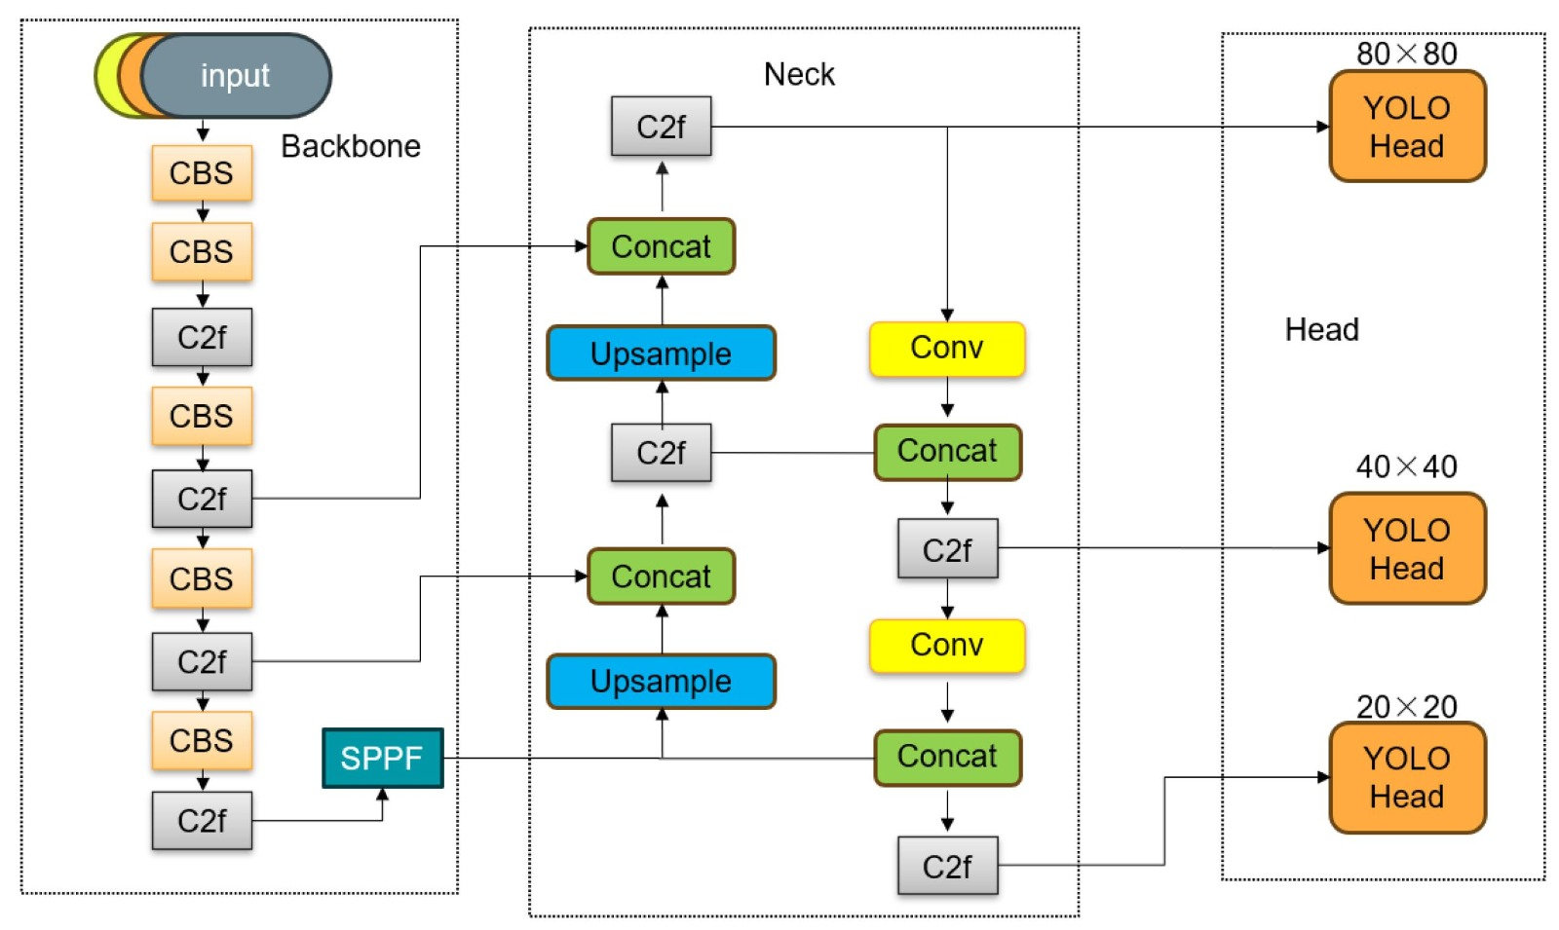
MODEL ARCHITECTURE
07
YOLOv8 architecture
Backbone feature extraction → neck feature fusion → multi-scale detection heads.
IMAGE PROCESSING & COMPUTER VISION / MNNIT ALLAHABAD

Slide 8
EXPERIMENTS
08
The YOLOv8 experiments
A lightweight baseline and a larger model were trained on the same synthetic-night split.
YOLOv8n · Nano
YOLOv8s · Small
3.13M parameters
8.6 GFLOPs
640 × 640 input
Validation: 533 images | Test: 270 images
11.13M parameters
28.4 GFLOPs
640 × 640 input
100-epoch maximum; early stopped at epoch 86
Best checkpoint: epoch 76
The Small model required more computation; the Nano model offered a much lighter deployment footprint.
Training environment: Ultralytics 8.4.183 · Python 3.13.15 · PyTorch 2.11.0+cu130 · NVIDIA Tesla T4
IMAGE PROCESSING & COMPUTER VISION / MNNIT ALLAHABAD

Slide 9
EXPERIMENTS
09
The controlled test: day vs night vs real
Same detector, same images, same boxes — only the lighting of the training set changes.
Three training sets
Fair benchmark
Training setup
Day: the original daytime images
Night-synthetic: the same images, darkened
Night-real: real night photographs
931 training images each
Same 931 / 200 / 114 train/val/test count in every domain
Perceptual-hash leak audit
Grouped real-night split (70/15/15)
Size-matched training boxes
COCO-pretrained YOLO11m, 1-class head
640 × 640 · 60 epochs · batch 16
3 seeds × 2 preprocessings × 3 sets
= 18 models; own-val thresholds
Image processing
“Raw” keeps the pixels as they are. “Aligned” lifts each image's brightness toward a common level (gamma), then applies CLAHE, identically in every domain at train and test time. Each model is scored on all three domains (a 3 × 3 transfer matrix).
IMAGE PROCESSING & COMPUTER VISION / MNNIT ALLAHABAD

Slide 10
RESULTS
10
Synthetic test results: YOLOv8
YOLOv8s led the Nano model on all four test metrics, although the differences were modest.
Metric | YOLOv8n | YOLOv8s
Precision | 67.25% | 68.50%
Recall | 53.62% | 54.80%
mAP@0.5 | 58.59% | 59.98%
mAP@0.5:0.95 | 28.99% | 30.43%
59.98%
58.59%
YOLOv8s TEST mAP@0.5
YOLOv8n TEST mAP@0.5
Interpretation
Nano slightly led validation; Small led the held-out test split. One run per model is not enough to establish statistical superiority.
mAP values are reported from the original YOLOv8 validation pipeline.
IMAGE PROCESSING & COMPUTER VISION / MNNIT ALLAHABAD

Slide 11
EXPERIMENT DESIGN
11
A fair, balanced benchmark
Equal image counts per domain, with pairing and leakage audited.
Domain | Images (train / val / test) | Brightness raw → aligned
Day | 931 / 200 / 114 | 131 → 129
Night (synthetic) | 931 / 200 / 114 | 55 → 111
Night (real) | 931 / 200 / 114 | 79 → 101
Pairing day ↔ night
1,987 of 2,679 images (74%) matched by filename
Boxes must agree at IoU ≥ 0.70
Leak audit
Perceptual hashing (Hamming ≤ 6, mirrors included) found nearly half of paired val/test images had a near-duplicate in training; they were removed. Not applied to the YOLOv8 runs.
Every domain: 931 train · 200 val · 114 test images — the transformation is the only variable.
IMAGE PROCESSING & COMPUTER VISION / MNNIT ALLAHABAD

Slide 12
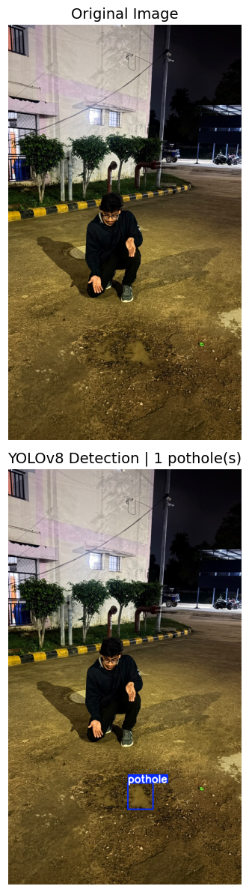
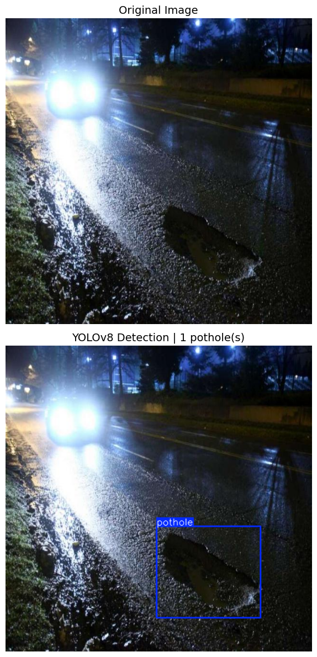
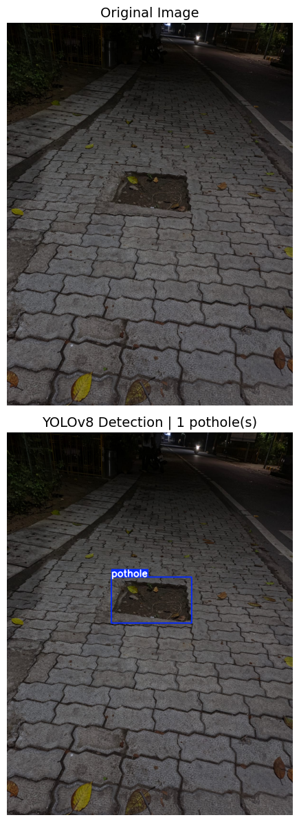

Slide 13
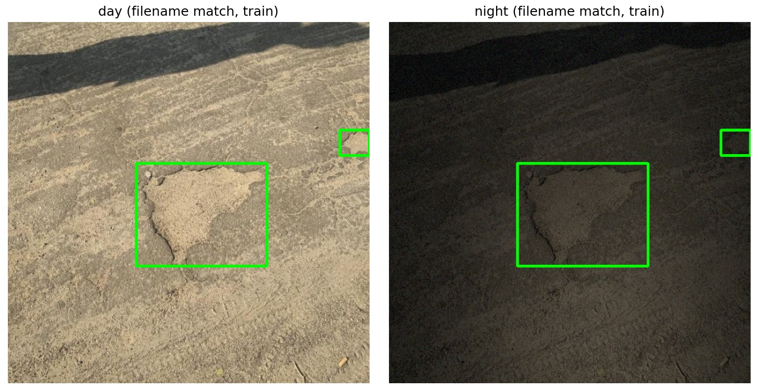
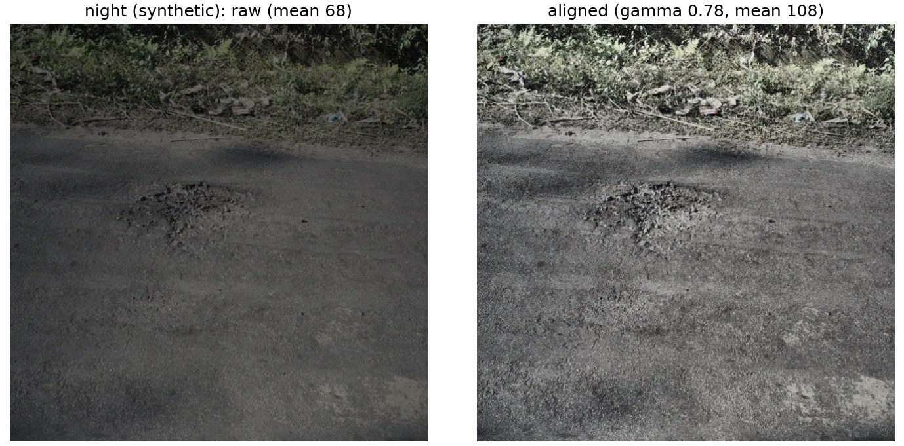
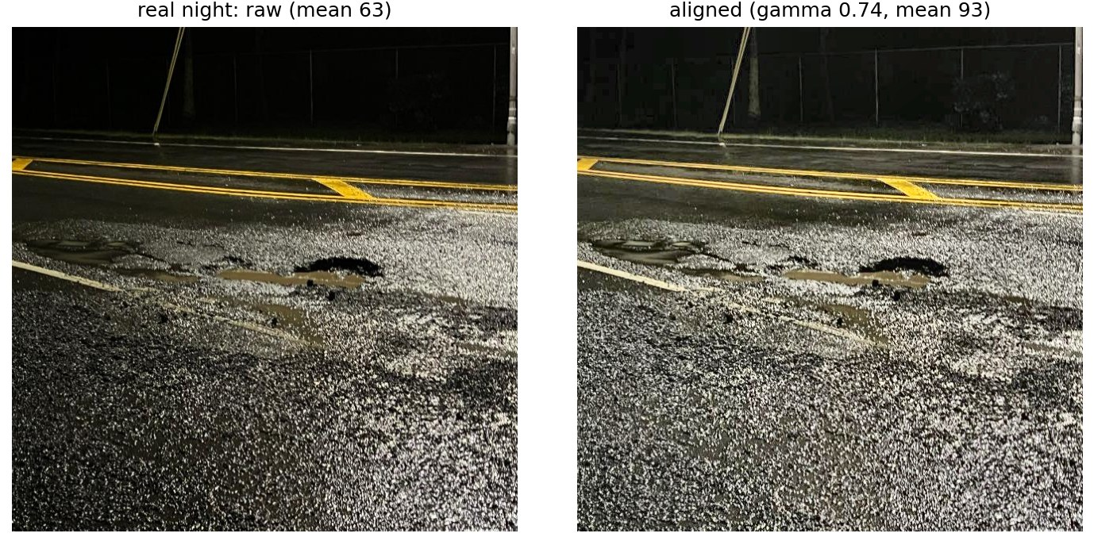
VISUAL RESULTS
12
Same scene, different lighting
The transformation keeps boxes and sizes; alignment then brings every domain to a similar brightness.
01 DAY → NIGHT PAIR
02 SYNTHETIC NIGHT
03 REAL NIGHT
Same image and boxes, darkened
Raw vs aligned (gamma 0.78)
Raw vs aligned (gamma 0.74)
Aligned preprocessing lifts every domain to a similar brightness (mean ≈ 100–130), so lighting level alone is not what the detector learns from.
IMAGE PROCESSING & COMPUTER VISION / MNNIT ALLAHABAD

Slide 14
RESULTS
13
Transformation helps in-domain
Training on darkened images beats day training on darkened test images.
Test set | Day-trained | Night-synthetic-trained
Day · raw | 0.652 | 0.586
Synthetic night · raw | 0.462 | 0.576
Day · aligned | 0.646 | 0.568
Synthetic night · aligned | 0.416 | 0.587
0.587
0.416
NIGHT-TRAINED ON SYNTH NIGHT
DAY-TRAINED ON SYNTH NIGHT
Darkened training data gives +0.17 mAP@0.5 on synthetic night (aligned; +0.11 raw), at a cost of 0.08 on day images. That is the in-domain benefit, and it was consistent across seeds.
mAP@0.5, mean of 3 seeds (42, 43, 44); detection thresholds chosen on each model's own validation set.
IMAGE PROCESSING & COMPUTER VISION / MNNIT ALLAHABAD

Slide 15
RESULTS
14
On real night, it is not a replacement
Synthetic night recovers only 28–36% of what real night data gives.
Training set | Raw | Aligned | Ceiling reached (aligned)
Day (original) | 0.227 | 0.193 | 33%
Night (synthetic) | 0.167 | 0.212 | 36%
Night (real) | 0.600 | 0.583 | 100%
Transformation gain
Raw: -0.061 CI [-0.101, -0.025]
Aligned: +0.019 CI [-0.019, 0.051]
Gain = synthetic-night minus day-trained on real night. Alignment turns a clear loss into a small gain whose interval includes zero. Real-night training scores 0.58–0.60, about 2.8× the synthetic-night model.
IMAGE PROCESSING & COMPUTER VISION / MNNIT ALLAHABAD

Slide 16
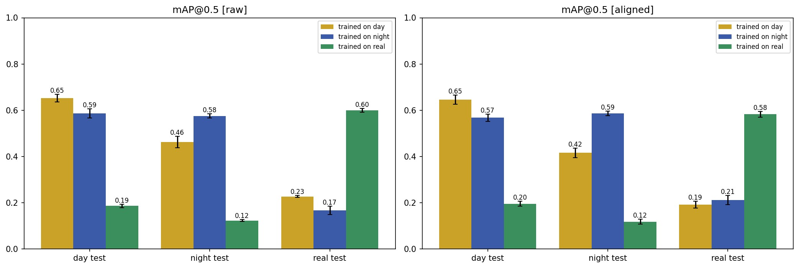
VISUAL RESULTS
15
The full transfer matrix
Each colour is a training set; each group is a test domain (mAP@0.5, mean ± std over 3 seeds).
The synthetic-night model (blue) wins on its own domain but not on real night, where the real-night model (green) is far ahead.
IMAGE PROCESSING & COMPUTER VISION / MNNIT ALLAHABAD

Slide 17
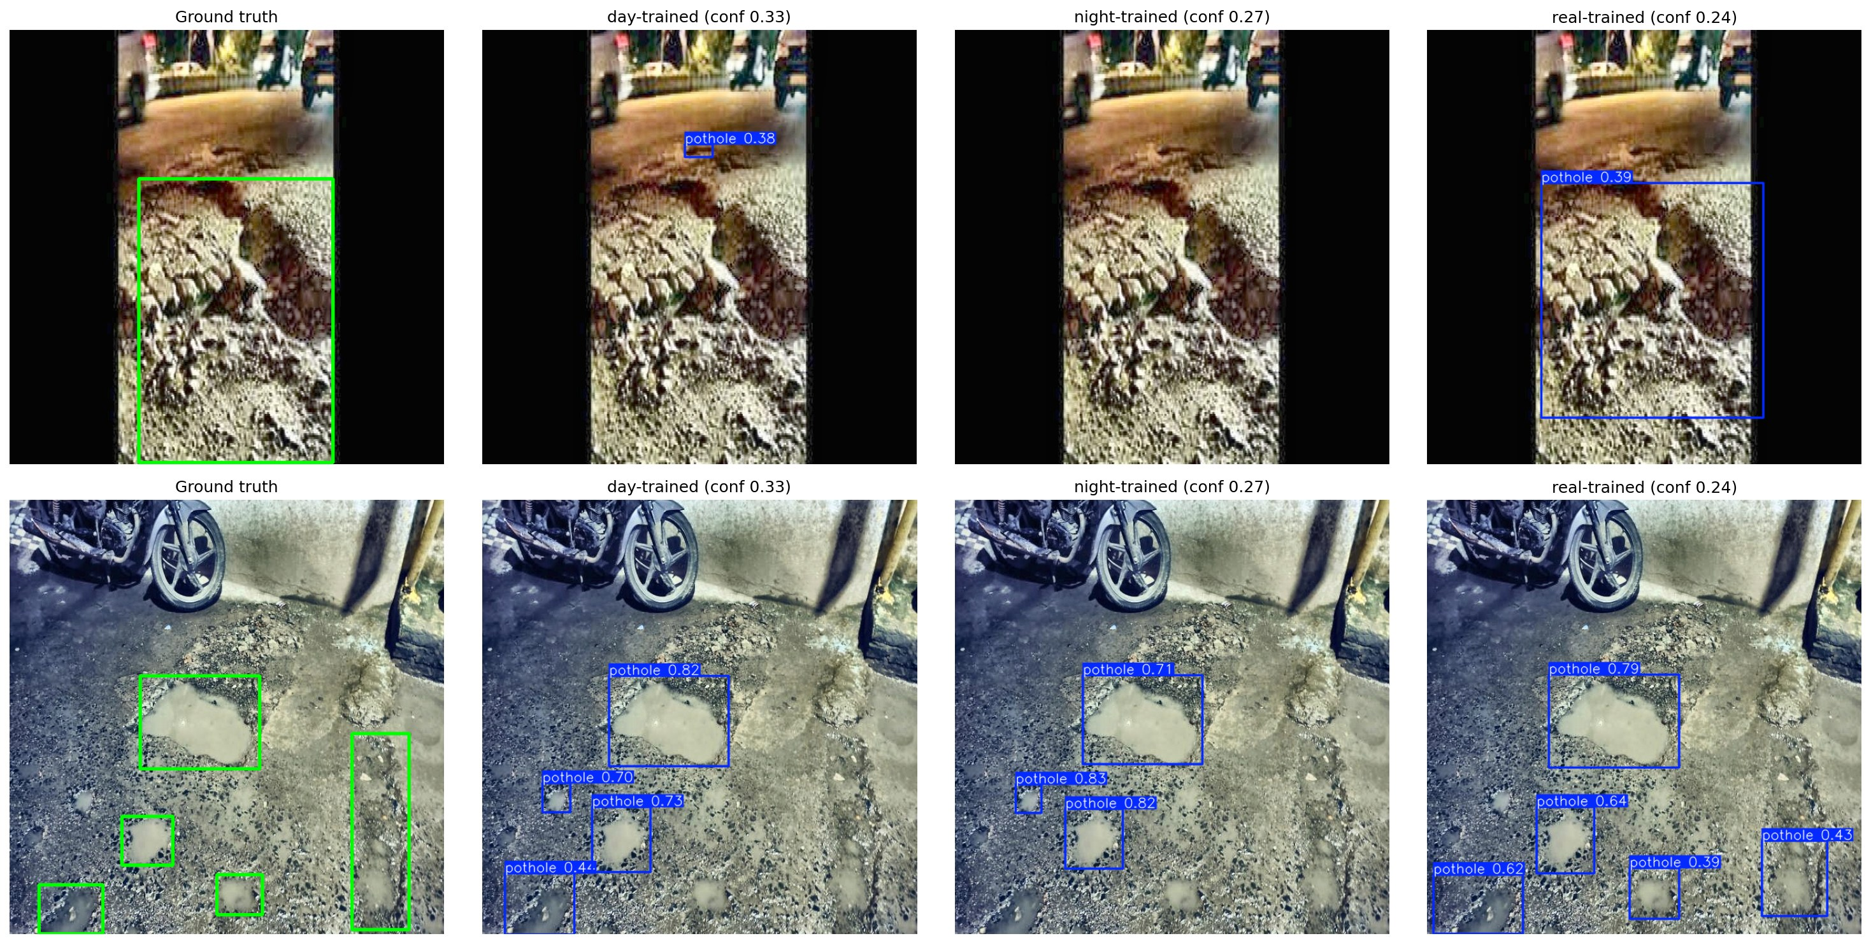
VISUAL RESULTS
16
Real night images: what each model finds
Left to right: ground truth, day-trained, night-synthetic-trained and real-trained detectors (aligned).
How to read the examples
The real-trained detector localises more of the ground-truth potholes.
The day- and synthetic-night-trained detectors often miss them or draw one large box.
Wet roads, motion blur and very dark frames remain hard for every model.
Each row is one real-night test image; predicted boxes are drawn at each model's own operating threshold.
IMAGE PROCESSING & COMPUTER VISION / MNNIT ALLAHABAD

Slide 18
DISCUSSION
17
What the results tell us
Beneficial, but not a replacement for real night images.
What worked
What did not
What remains hard
Darkened training data scored 0.59 on synthetic night versus 0.42 for day-trained. Alignment helped the synthetic-night model on real night in all 3 seeds.
On real night the synthetic-night model reached 0.17–0.21 mAP@0.5, against 0.58–0.60 for real-night training.
Real scenes differ in noise, blur, wet surfaces and object size; the gain over day data is not proven (aligned CI spans zero).
Interpret results with care
– YOLOv8n/s and YOLO11m use different splits and evaluators; do not compare scores across them.
– The YOLO11m benchmark has 114 test images per domain and 3 seeds; one real-night source.
– Real-night boxes are larger (median 4.1% of the image vs 1.9% for day).
– The YOLOv8 splits were not leak-audited, so their absolute scores may be somewhat optimistic.
IMAGE PROCESSING & COMPUTER VISION / MNNIT ALLAHABAD

Slide 19
CONCLUSION
18
Synthetic night helps —
but real roads
still need real data.
TAKEAWAY
Synthetic-night-trained
real-night mAP@0.5
0.17–0.21
YOLOv8n and YOLOv8s learned the synthetic-night dataset. A controlled YOLO11m test showed darkened day images help in-domain, but reached only 0.17–0.21 mAP@0.5 on real night versus 0.58–0.60 for real-night training.
Real-night-trained
real-night mAP@0.5
0.58–0.60
THANK YOU
IMAGE PROCESSING & COMPUTER VISION / MNNIT ALLAHABAD

