Slide 1
Credit Risk
Predicting Loan Default with Machine Learning
A walkthrough of what I learned, what broke, and what worked:
Roderick J Taylor
ITAI Machine Learning · Final Project
Notes:
OPENING. This project is a binary classification project using the Kaggle Credit Risk Dataset. The main goal was predicting loan_status, where 1 represents default risk and 0 represents non-default. At first I thought the hardest part would be training the models themselves, but while building the notebook I realized most of the real work was actually in preprocessing - cleaning the data, engineering features, and understanding why certain transformations mattered. The workflow includes cleaning the dataset, engineering features, training multiple classifiers, comparing metrics, and testing ensemble approaches. I want to emphasize this project was very iterative. A lot of the final decisions came from testing, researching, asking questions, and correcting earlier mistakes - not from already knowing the perfect answer at the start. I'll start with some vocabulary so we are all on the same page, then walk through what I built and what I learned.

Slide 2
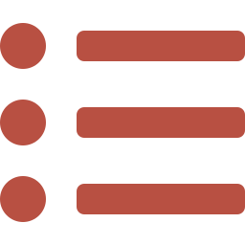
What we'll cover
1
Vocabulary
Three quick slides so we share a language
2
The problem
What we're predicting and from what data
3
Splitting data
Why we hold some of it back, and how
4
Cleaning
Logs, caps, imputation, and engineered ratios
5
Models
Six classifiers, what each one is, who won
6
Ensembles
Two ways to combine models, and why one beat the other
7
Takeaways
What I would do differently next time
Credit Risk Final Project
2 / 12
Notes:
SLIDE 2 - ROADMAP. Quick map of where we're going so nobody gets lost. First, three slides of vocabulary. I'll define every term I'm about to use so the whole audience - whether you're comfortable writing ML code or not - can follow the rest of the talk. Then the actual project: what we're predicting, how we split the data, how we cleaned it, what models we tried, how we combined them, and what I learned. Stop me at any point if a term needs more explanation. I'd rather slow down here than have anyone lost by the end.

Slide 3

Vocabulary 1 of 3 - The basics
If you've never trained a model before, start here.
Feature
Target
Binary classification
An input column the model sees - income, age, loan amount, etc.
The column we're trying to predict. Here it's loan_status: did this loan default?
Predicting one of two labels - in our case, default (1) or no default (0).
Think of it as: the questions on a loan application form
Think of it as: the answer key the model is being graded against
Think of it as: answering a yes-or-no question
Class imbalance
Train / test split
Model
When one label is much more common than the other. Our data is 78% non-default and 22% default.
Show the model some data to learn from, then quiz it on data it hasn't seen.
A function that learns patterns from features and predicts the target.
Think of it as: a class where 78 students passed and 22 failed
Think of it as: studying with practice problems, then taking a real exam
Think of it as: a student who studies the practice problems and tries to ace the exam
Credit Risk Final Project
3 / 12
Notes:
SLIDE 3 - VOCAB 1. I'm going to define everything I'm about to use so nobody is left behind. A FEATURE is an input column - income, age, loan amount. A TARGET is what we're trying to predict - here it's loan_status. BINARY CLASSIFICATION just means the answer is yes or no, default or no default. CLASS IMBALANCE is when one answer is way more common. Our data is 78 percent non-default. That matters because a model that always says "no default" is right 78 percent of the time without doing anything useful. A TRAIN/TEST SPLIT is the most basic discipline in ML. You let the model see some of your data to learn from, then you quiz it on data it has never seen. That second number is the only honest measure of how good the model actually is. A MODEL is just a function that takes the features and predicts the target. Different model types - decision trees, neural networks, linear regression - learn patterns in different ways, but they all play the same role.
Everything else builds on these six terms.

Slide 4

Vocabulary 2 of 3 - How we grade the model
Accuracy alone lies on imbalanced data. These four metrics tell the real story.
Accuracy
Precision
Recall
Out of all predictions, how many did the model get right?
When the model says "this loan will default", how often is it actually right?
Out of all the loans that really did default, how many did the model catch?
Think of it as: a test grade on every question, easy and hard alike
Think of it as: a smoke alarm: precision is how often the alarm means real fire
Think of it as: the same alarm: recall is how many real fires it actually caught
F1-score
ROC-AUC
Threshold
A balanced average of Precision and Recall. Useful when you care about both.
How well the model separates risky from safe loans across every possible cutoff. Range 0.5 to 1.0.
The cutoff for turning a probability into yes/no. Default is 0.50, but you can tune it.
Think of it as: an average grade across two subjects
Think of it as: 0.5 means coin-flip, 1.0 means perfect separation
Think of it as: the line on a thermometer above which you call it "fever"
Credit Risk Final Project
4 / 12
Notes:
SLIDE 4 - VOCAB 2, METRICS. These are the metrics I'll be quoting throughout the rest of the talk. They are the language of model evaluation. ACCURACY is what most people think of first - what fraction of predictions are correct. The catch is that on imbalanced data, accuracy lies. A model that always predicts "no default" is automatically 78 percent accurate on our data. That is not a useful model. PRECISION and RECALL are the smoke-alarm pair. PRECISION asks: when the alarm goes off, how often is there really a fire? RECALL asks: out of all the actual fires, how many did the alarm catch? You almost always have to trade them off against each other. F1-SCORE is a balanced average of precision and recall - it's a single number that punishes you for being weak on either side. ROC-AUC is the metric I leaned on most. It measures how well the model separates the two classes across every possible threshold, not just the default 0.5. A score of 0.5 is a coin flip. A score of 1.0 is perfect separation. We hit 0.93 on the best models, which is strong. THRESHOLD is the cutoff that turns a probability into a yes-or-no prediction. Default is 0.5, but you can move it. Lower threshold catches more defaulters but raises more false alarms. This is the knob you'd tune in a real lending system. After researching all four metrics, ROC-AUC ended up being the most useful overall comparison metric for this dataset.

Slide 5

Vocabulary 3 of 3 - Concepts we'll lean on
These come up later. Quick definitions now save us five tangents later.
Skew
Log transform
Data leakage
When most values cluster low but a few are huge. Income is the classic example.
Replace each value with log(value). Pulls huge numbers down so they stop dominating.
When info from the test set sneaks into training. Inflates scores; ruins honesty.
Think of it as: Most people earn $40k-$80k, but a few earn millions. The chart looks lopsided.
Think of it as: shrinking a giant on a chart so the rest of the data is visible
Think of it as: studying tomorrow's exam answers, then bragging about your grade
Encoding
Scaling
Ensemble
Turning text categories into numbers the model can use. Different types for different meanings.
Squeezing all features into a similar range, e.g. 0 to 1. Helps many models behave.
Combining several models so they vote, average, or otherwise correct each other's mistakes.
Think of it as: translating from English to math
Think of it as: putting different units on the same ruler
Think of it as: a panel of judges instead of one judge
Credit Risk Final Project
5 / 12
Notes:
SLIDE 5 - VOCAB 3. Last vocabulary slide. These six come up repeatedly in the rest of the talk. SKEW is when most values are clustered low but a few are huge. Income is the textbook example - most people earn 40 to 80k, but a few earn millions. That makes the data look lopsided. LOG TRANSFORM fixes skew. You take the log of each value, which compresses huge numbers down. The math is just log of the value, but the effect is dramatic - I'll show you the actual numbers in a few slides. DATA LEAKAGE is the scariest mistake in ML. It's when information from your test set accidentally sneaks into your training process. Your scores look great, but they're a lie. The whole reason we hold the test set out is to prevent this. ENCODING turns text categories into numbers because models can only do math on numbers, not words. But how you do it matters.
For ordered things like loan grades A through G, I used 1 through 7. The model now sees G as "further from" A than B is, which matches reality.
For unordered things like loan intent — education, medical, debt consolidation — that approach fails. If I numbered them 1 through 6, the model would assume venture (5) is closer to personal (6) than to education (1), inventing an order that isn't there.
So those use one-hot encoding instead: each category gets its own yes/no column. Loan intent becomes six columns, with a 1 in exactly one of them per row. No false ordering, because every category sits at the same "distance" from every other.
Rule of thumb: if categories have a real order, use ordered numbers in one column. If not, give each its own column.
SCALING squeezes all your features into a similar range, usually 0 to 1. Some models get confused when one feature ranges 0 to 10 and another ranges 0 to 1,000,000. Scaling levels the playing field. ENSEMBLE means combining multiple models. Instead of trusting one model, you let several of them vote or average their predictions. We'll see two ensemble strategies later, and they don't behave the same way. After this slide we're out of the vocabulary zone and into the real project.

Slide 6

The problem and the data
Rows of data
Columns
Default rate
32,581
11 + answer
22%
Kaggle Credit Risk dataset
Features + loan_status
Most loans are paid back
What we're predicting
The catch: imbalance
Will this loan default?
Inputs: income, age, employment length, loan amount
Plus: loan grade, interest rate, intent, home status
Plus: credit history length and prior default flag
78% of loans are NOT default
A model that always says "no" scores 78% accuracy
...without learning anything useful
So I track Precision, Recall, F1, AND ROC-AUC
Credit Risk Final Project
6 / 12
Notes:
SLIDE 6 - THE PROBLEM AND THE DATA. The dataset has about 32,000 rows and is imbalanced - most loans are non-default. One thing I learned pretty quickly was that accuracy by itself can be misleading on imbalanced datasets. A model could achieve high accuracy just by predicting the majority class. That's why I started paying much more attention to ROC-AUC, Precision, Recall, and F1-score. We just defined those a moment ago. After researching the metrics more deeply, ROC-AUC ended up being the most useful overall comparison metric for this dataset because it doesn't depend on the threshold and it isn't fooled by the imbalance.

Slide 7

Splitting the data: 70 / 15 / 15
70%
Training (~22,800 rows)
Where the model learns
15%
Validation
Compare models
15%
Test
LOCKED until end
Stratified - each split keeps the same 78/22 default ratio
Why I split it twice
Why stratified sampling
First I tried just 70/30
After researching, I cut the 30 in half
Validation = where I compare models
Test = touched ONCE, at the very end
Random splits could get unlucky
Imagine a test set with almost no defaulters in it
Stratified sampling forces each split to keep the 78/22 ratio
Stable metrics, no surprises
Credit Risk Final Project
7 / 12
Notes:
SLIDE 7 - SPLITTING THE DATA. One of the biggest things I learned during this project was how important train/test separation is. Originally I thought about the assignment as a simple 70/30 split, but after researching validation workflows I restructured it into 70 percent training, 15 percent validation, 15 percent testing. The way I explain it to myself is that the original 30 percent holdout was split in half. Validation is for comparing models and building the ensemble. The final test set stayed untouched until the very end. I also used stratified sampling, which means each split keeps roughly the same percentage of default vs non-default loans. That helps prevent misleading metrics caused by unlucky random splits. This is the discipline that prevents data leakage, which I defined a couple slides ago. If I peeked at the test set during model selection, I'd be studying the exam answers, and my final score would be a lie.

Slide 8

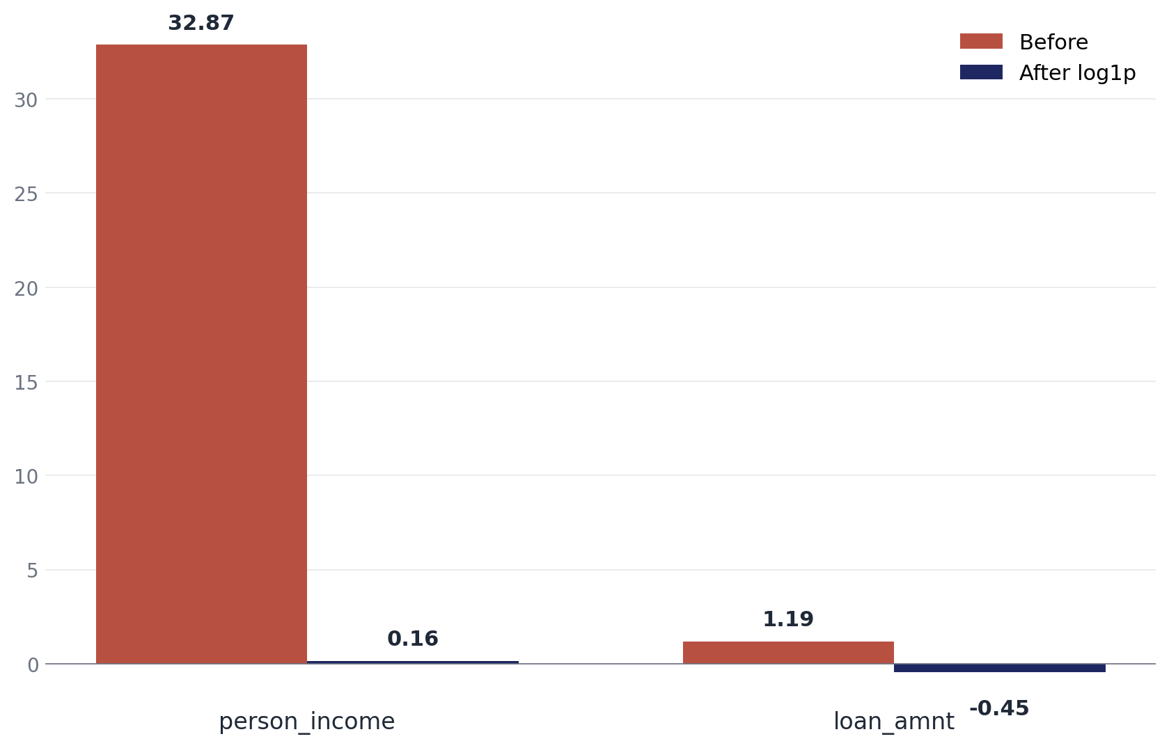
The log transform: taming huge numbers
What I did
Why I needed this
np.log1p(x) = ln(1 + x)
A few people in the data earn millions
Those huge numbers were dominating the model
Log compresses them so the rest of the data shows
Applied to person_income and loan_amnt
log1p handles zero safely; plain log can't
Skew before vs after - measured directly on the data
What clicked for me
32.87 → 0.16
(Income skew, raw vs after log)
$6M earner used to be 110× the median
After log: only 1.4× the median
The model finally sees them as just
"a high earner", not a wrecking ball
Credit Risk Final Project
8 / 12
Notes:
SLIDE 8 - THE LOG TRANSFORM. This section ended up being one of the most important parts of the project. The dataset had major skew in person_income and loan_amnt because a small number of borrowers had extremely large financial values. After researching preprocessing methods and experimenting with different approaches, I used np.log1p. Simple explanation: the log transform compresses extremely large values so they stop dominating the model. One thing that finally made the idea click for me was seeing how a six-million-dollar income value stopped behaving like a massive outlier after the transform. Before the transform, that person was 110 times the median income - completely out of scale. After the transform, they were only 1.4 times the median. The model can finally treat them as just "a high earner" instead of a wrecking ball that dominates everything else. I also learned why log1p matters specifically - normal log breaks at zero, but log1p safely handles zero values. The skew reduction was dramatic: income skew dropped from 32.87 to almost symmetric at 0.16. That helped me understand how heavily preprocessing can influence machine learning results.

Slide 9

Other cleaning steps
1. Cap impossible values
2. Fill in missing values
3. Build new features
4. Encode and scale
Age clipped to 18-100
Employment length clipped to 100
Original data had a 144-year-old and a 123-year employment value
Clipping fixes the impossible without dropping the row
Some employment lengths and interest rates were blank
Filled employment length with the training median
Filled interest rate with median for each loan grade
Grade and rate are tightly linked, so this is more accurate
debt_to_income_ratio = loan / income
income_per_credit_year
credit_history_to_age_ratio
Built BEFORE log transform, so they stay in real dollars
Loan grade A...G → 1...7 (it's ordered)
Default flag → 0/1
Home ownership, loan intent → one-hot
Everything scaled to [0, 1]
NO DATA LEAKAGE. Every median, category, and scaling range comes from the training data only. Validation and test reuse those values - they never compute their own.
Credit Risk Final Project
9 / 12
Notes:
SLIDE 9 - OTHER CLEANING STEPS. The preprocessing logic changed several times while building the notebook. ONE - CAPPING. One grading correction involved person_emp_length. Originally the extreme 123-year employment value was effectively being scaled with everything else. After researching why that was incorrect, I changed the logic so the value gets capped at 100 instead. Same fix for the 144-year-old age. TWO - FILLING IN BLANKS. Some interest rates and employment lengths were missing. I filled employment length with the training median. For interest rate, I learned that filling with the median PER LOAN GRADE was much more accurate than a single global median, because grade and rate are tightly linked. THREE - NEW FEATURES. I engineered three ratio features - debt-to-income, income per credit year, and credit-history-to-age. One thing I learned while implementing these was that the ratios needed to be created BEFORE the log transform so they still represented meaningful financial relationships in dollar terms. FOUR - ENCODING. Originally I used one-hot encoding for loan_grade, but after thinking about the meaning of the grades more carefully, ordinal encoding made more sense because the grades already represent ordered levels of risk. A=1 through G=7. Other categorical features like home_ownership stayed as one-hot since they don't have a natural order. The footer at the bottom is the discipline that ties everything together. Every value learned during cleaning - medians, categories, scaling ranges - comes from the training set only. That's how we keep the metrics honest.

Slide 10

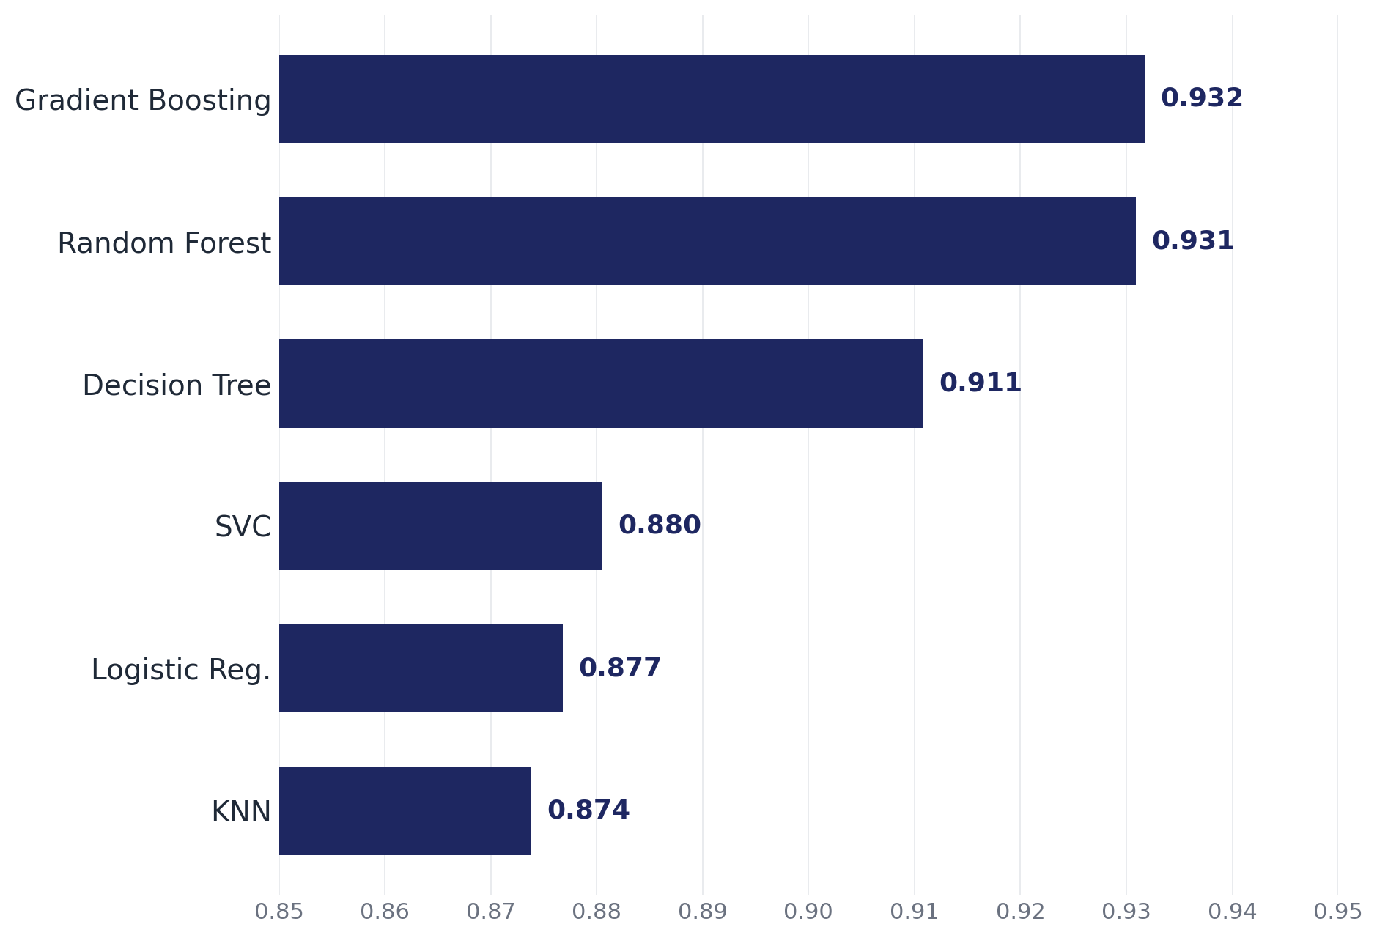
Six models, ranked
ROC-AUC on the locked test set, sorted high to low
What I noticed
Tree models took the top 3 spots
Linear models ~5 points behind
Validation and test almost identical (no overfitting)
Why trees won
Default depends on combinations of features
(grade × income × loan size, etc.)
Trees handle those combos naturally
Linear models can only draw a straight line
Credit Risk Final Project
10 / 12
Notes:
SLIDE 10 - MODEL RESULTS. The project trained six classification models, each from a different family.
Logistic Regression draws a straight line (or hyperplane) to separate defaulters from non-defaulters. Simple, fast, interpretable.
Decision Tree asks a series of yes/no questions — "is the loan grade above 4? is income below 50k?" — and follows the answers down to a prediction. Easy to explain to a human.
Random Forest trains 150 different decision trees on random slices of the data and lets them vote. The averaging cancels out the mistakes of any one tree.
Gradient Boosting also uses many trees, but trains them sequentially — each new tree focuses on the mistakes the previous trees made. Usually the strongest model on tabular data.
KNN — K-Nearest Neighbors — doesn't really "learn" a model at all. To predict a new loan, it finds the 7 most similar loans in the training data and lets them vote. Think of it as: show me the 7 loans most like this one, and I'll predict whatever the majority of them did. Simple idea, but sensitive to scaling and to having too many features.
Support Vector Classifier finds the line that separates the two classes with the widest possible margin between them. Robust, but slower on big datasets.
One thing I noticed quickly was that the tree-based models consistently performed better than the linear models. After researching the results more, that started making sense because credit risk relationships are not really linear - default risk depends on combinations of features like grade times income times loan size, and trees handle those interactions naturally. Random Forest and Gradient Boosting both performed around 0.93 ROC-AUC, while the linear models trailed behind around 0.88. Another thing I learned was that recall stayed lower than precision because the dataset is imbalanced and the default threshold was still conservative. Remember from the vocab slide - the threshold is the cutoff that turns probabilities into yes/no. We're using the default 0.50. If this were a real lending tool, you'd tune that threshold based on whether you care more about catching defaulters or avoiding false alarms. Validation and test scores being almost identical is a really good sign - it means the models aren't overfitting to the validation set.

Slide 11

Combining models: a surprise
Try 1: Voting Ensemble
Try 2: Weighted average
Top 3 models · majority vote wins
Same 3 models · average their confidence scores
Accuracy
0.9351
Accuracy
0.9339
F1-Score
0.8289
F1-Score
0.8259
ROC-AUC
0.8575
ROC-AUC
0.9316
Surprise!
I assumed combining models always helped every metric.
F1 and accuracy went UP, but ROC-AUC went DOWN.
Why? Hard voting only outputs yes/no - no confidence score for ROC-AUC to use.
Fix:
Average the continuous confidence scores instead of voting yes/no.
Better-performing models get slightly heavier weights.
Same models, different combination - +0.07 ROC-AUC recovered.
Credit Risk Final Project
11 / 12
Notes:
SLIDE 11 - COMBINING MODELS. The ensemble section ended up being one of the more interesting parts of the project because I originally assumed combining models would automatically improve every metric. That turned out to be wrong, and the way it was wrong taught me a lot. TRY 1 - VOTING ENSEMBLE. I combined the top three models - Random Forest, Gradient Boosting, Decision Tree. Each model votes yes or no, majority wins. F1-score and accuracy went UP, beating every single base model. But ROC-AUC actually DROPPED, from 0.93 down to 0.86. After researching why, I learned that hard voting only outputs discrete yes/no predictions while ROC-AUC works better with continuous confidence scores. So I had thrown away the information ROC-AUC needs. TRY 2 - WEIGHTED AVERAGE. Instead of each model only voting yes or no, each model contributes a confidence score. The better-performing models receive slightly larger weights based on validation ROC-AUC. The weights ended up close to equal - about one-third each - because the top three models performed very similarly. So this is mostly an unweighted average of confidence scores, with a slight tilt toward Random Forest. This approach recovered the ROC-AUC performance that hard voting lost. Same three models, different combination strategy, +0.07 ROC-AUC. One thing I learned here is that combining models is not just about averaging predictions. The way the predictions are combined matters a lot. I called it "Bayesian-style" because the structure - weighted averaging of model predictions - is similar to Bayesian Model Averaging. But the weights I used are a heuristic based on validation ROC-AUC, not a true posterior probability. So "Bayesian-style" is the honest label.

Slide 12
What I learned
1
2
3
Cleaning > modeling
Discipline matters
Combining is subtle
Most of the real improvement came from preprocessing - log transforms, imputation, encoding choices - not from the model code.
Training-only fits and a locked test set kept the metrics honest. The proof: validation and test scores nearly matched.
Hard voting helped F1 but hurt ROC-AUC. Weighted averaging fixed it. How you combine matters as much as what you combine.
If I kept building: threshold tuning · feature importance · cross-validation · probability calibration · fairness analysis
Questions?
Notes:
SLIDE 12 - WHAT I LEARNED. The biggest takeaway from this project was realizing that machine learning is much more dependent on preprocessing and data preparation than I originally expected. The model code itself is the easy part. The hard part is figuring out what to feed the model. ONE - CLEANING BEAT MODELING. Most of the improvements came from handling skew correctly, preventing data leakage, engineering better features, and choosing more appropriate encodings. TWO - DISCIPLINE MATTERS. Fitting all preprocessing on training only, locking the test set away, and using stratified sampling. The proof that it worked: validation and test scores nearly matched. No overfitting, no leakage. THREE - COMBINING IS SUBTLE. Hard voting helped F1 but hurt ROC-AUC. Weighted averaging fixed it. The way you combine models matters as much as which models you combine. I also learned that experimentation and iteration matter a lot. Most of the final workflow came from correcting earlier assumptions, researching the feedback, and rebuilding sections of the notebook more carefully. If I kept expanding this project, I'd explore threshold tuning, feature importance analysis, cross-validation for more stable model selection, probability calibration so the scores are interpretable as actual probabilities, and fairness analysis to make sure the model isn't producing disparate outcomes across demographic groups.

