Slide 1
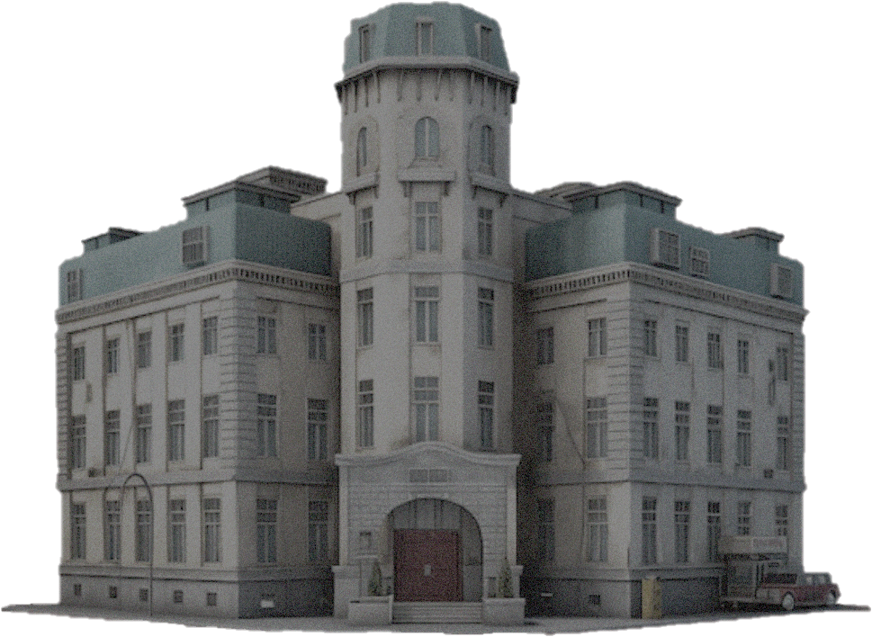
SAFECARE: CRYPTOGRAPHIC MEASURES

Slide 2
Agenda
TASK I - types of threats
Cryptographic countermeasures
Feasibility
Task ii - DIGITAL SIGNATURE IMPORTANCE
Digital signature prototype
DEPLOYMENT REQUIREMENTS
DISCUSSIONS
REFERENCES

Slide 3
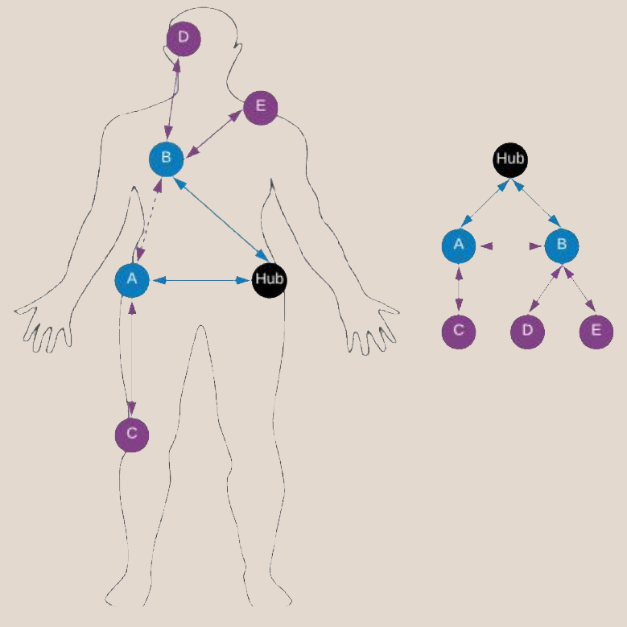
Types of threats
Data interception (threat against confidentiality)
Man in the middle (threat against confidentiality and integrity)
Replay attack (threat against integrity)
Denial of Service (threat against availability)
Data modification (threat against integrity)
CIA – Confidentiality, Integrity, Availability
WBAN Topology

Slide 4
Cryptographic countermeasures
Threat
Data interception (threat against confidentiality)
Countermeasures
Advanced Encryption Standard (AES) for data encryption
128 bit key size, 10 rounds of permutations
RSA cryptosystem for private key sharing, using a 2048 bits key

Slide 5
Cryptographic countermeasures
Threat
Man in the middle attack, and data modifications
(threat against confidentiality and integrity)
Countermeasures
Digital signatures using Hash based Message Authentication Code (HMAC) [3]
Hash function SHA256
AES

Slide 6
Cryptographic countermeasures
Threat
Replay attacks (threat against integrity)
Countermeasures
Timestamps

Slide 7
Cryptographic countermeasures
Threat
Denial of Service (threat against availability)
Countermeasures
Traffic limiting
Blocking IPs

Slide 8
Feasibility
Cryptographic choices
AES for data encryption – 128 bit key size with 10 rounds of permutations
RSA for key distribution – 2048 bit key size
Digital signatures – HMAC using SHA256 [3]
OS and data transfer protocol
Riot OS – sensor’s and hub’s operating system [1]
Zigbee – wireless data transfer protocol [2]

Slide 9
Digital Signature Importance
A digital signature provides authenticity and integrity.
Prevents attackers from:
modifying the contents of the prescription
impersonating the person who’s prescription belongs to
resending the same prescription twice, creating a replay attack

Slide 10
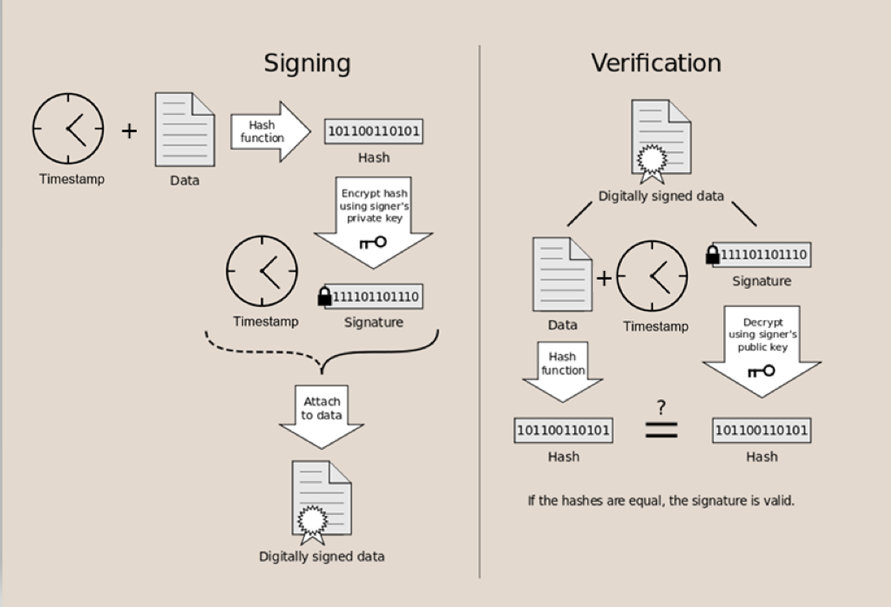
How a digital signature works

Slide 11
Deployment plan
1. Production-ready application
Integration with current system
Testing
2. System Compatibility
Linux, Windows, macOS
Web server – Nginx
Hardware requirements
3. Security considerations
Sensitive data encryption
Database privilege control
Secure file transfer protocols
Audit logging
4. User training
Seminars regarding security best practices
Training material
Technical documentation

Slide 12
Discussions
Strong cryptographic measures are essential
Avoiding health risks and financial loss
Task 1 – AES, RSA, HMAC using SHA256
Task 2 – RSA, Digital signature, SHA256

Slide 13
References
1. Baccelli, E., Gündoğan, C., Hahm, O., Kietzmann, P., Lenders, M., Petersen, H., ... Wahlisch, M. (2018). RIOT: an Open Source Operating System for Low-end Embedded Devices in the IoT. IEEE Internet of Things Journal, 1-1. DOI: 10.1109/JIOT.2018.2815038.
2. Tatachar, A., Kondur, S., R, A., C, V., C, K., & K V, V. (2021). Zigbee, Its Applications and Comparison with Other Short Range Network Technologies. International Journal of Engineering and Technical Research, 10, 891-897.
3. Alshawish, I., & Al-Haj, A. (2022). An efficient mutual authentication scheme for IoT systems. The Journal of Supercomputing, 78. DOI: 10.1007/s11227-022-04520-5.

Slide 14
THANK YOU
GitHub project link RTiberiu/CM3104-SafeCare-Cryptography-Project (github.com)
TIBERIU ROCIU
STUDENT ID: 2006061

