Slide 1
Subsea Systems & Drilling ISO 9001:2015 , API Q1 & API Q2 Standardised Quality Management Review Template (QO-OFE-GLO-QUA-004 – Rev 3.0)
ADD SITE NAME
All text in red to be replaced by site based information
ADD DATE OF REVIEW

Slide 2
Guidance slide remove from deck prior to use
Ensure you select the correct Agenda and supporting slides based on site certification or compliance requirements

Slide 3
Safety / Quality Moment
To Be Added

Slide 4
Quality Management Review Agenda
Input Requirements
Output Requirements
Quality Policy
Quality Objectives - Performance & Trends
Status and effectiveness of Previous QMR Actions
Internal and External known issues with relevant impact
Results of Internal and External Audits
Changes that may affect the QMS including legal and other applicable requirements such as industry standards
Analysis of Customer Feedback, Satisfaction & Complaints
Process Performance
Evaluation of resource adequacy
Results of Risk Assessment
Status of Preventive & Corrective actions
Analysis of Supplier Performance
Review of the analysis of Product Conformance and, if applicable, nonconformities after delivery and use
Recommendations for Improvements
List of Attendees
Summary Assessment of the QMS Effectiveness to include required changes to QMS processes and decisions, actions
Required resources
Improvement to the processes and products in meeting Customer Requirements
Top Management’s review and approval of the QMR outputs
Continued suitability, adequacy & effectiveness of Quality Policy and QMS
QO-OFE-GLO-QUA-004 Rev 3.0

Slide 5
Agenda Requirements – API Q1
(Delete Slide if Not Applicable)
API Q1 (9th Edition) 6.5 Management Review
6.5.1 General
The organization‘s quality management system shall be reviewed at least every 12 months by the organization’s management to evaluate the quality management system’s continuing suitability, adequacy, and effectiveness. This review shall include assessing opportunities for improvement and the need for changes to the quality management system, including the quality policy and quality objectives.
6.5.2 Input Requirements
The input to management review shall include, as a minimum:
a) effectiveness of actions resulting from previous management reviews;
b) results of audits (see 6.2.2);
c) changes that could affect the quality management system, including changes to legal and other
applicable requirements (such as industry standards);
d) analysis of customer satisfaction, including customer feedback (see 6.2.1);
e) process performance [see 6.2.3 and 6.3 d)]; (including Internal GE Oil & Gas addition on Cost of Quality Review)
f) results of risk assessment (see 5.3);
g) status of corrective and preventive actions (see 6.4.2 and 6.4.3);
h) analysis of supplier performance (see 5.6);
i) review of the analysis of product conformity, including nonconformities identified after delivery or use
(see 5.10); and
j) recommendations for improvement.
6.5.3 Output Requirements
The output from the management review shall include a summary assessment of the effectiveness of the
quality management system. The assessment shall include any required changes (see 5.11) to the
processes and any decisions and actions, required resources, and improvement to products in meeting
customer requirements.
Top management shall review and approve the output of management reviews. Management reviews
shall be documented and records of these reviews shall be maintained (see 4.5).
QO-OFE-GLO-QUA-004 Rev 3.0

Slide 6
Agenda Requirements – API Q2
(Delete Slide if Not Applicable)
API Q2 (First Edition) 6.5 Management Review
6.5.1 General
The organization’s quality management system shall be reviewed at least annually by the organization’s management
to evaluate the quality management system’s continuing suitability, adequacy and effectiveness. This review shall
include assessing opportunities for improvement and the need for changes to the quality management system,
including the quality policy and quality objectives.
6.5.2 Input Requirements
The input to management review shall include, but not be limited to:
a) effectiveness of actions resulting from previous management reviews;
b) results of internal audits (see 6.2.2);
c) changes, including legal and other applicable requirements, that could affect the quality management system;
d) customer feedback (see 6.2.1);
e) process effectiveness, including the results of risk assessment (see 5.3);
f) status of corrective and preventive actions (see 6.4.2 and 6.4.3); and
g) review and analysis of failures in service and/or service-related products (see 6.3).
6.5.3 Output Requirements
The output from the management review shall include a summary assessment of the status of the quality
management system. The assessment shall include any required changes to the processes and any decisions and
actions, required resources, and improvement of service and service-related products in meeting customer
requirements.
Top management shall review and approve the output of management reviews. Management reviews shall be
documented and records of these reviews shall be maintained (see 4.5).
QO-OFE-GLO-QUA-004 Rev 3.0

Slide 7
Agenda Requirements – ISO 9001:2015
(Delete Slide if Not Applicable)
ISO 9001:2015 9.3 Management review
9.3.1 General
Top management shall review the organization’s quality management system, at planned intervals, to
ensure its continuing suitability, adequacy, effectiveness and alignment with the strategic direction of
the organization.
9.3.2 Management review inputs
The management review shall be planned and carried out taking into consideration:
a) the status of actions from previous management reviews;
b) changes in external and internal issues that are relevant to the quality management system;
c) information on the performance and effectiveness of the quality management system, including
trends in:
1) customer satisfaction and feedback from relevant interested parties;
2) the extent to which quality objectives have been met;
3) process performance and conformity of products and services;
4) nonconformities and corrective actions;
5) monitoring and measurement results;
6) audit results;
7) the performance of external providers;
d) the adequacy of resources;
e) the effectiveness of actions taken to address risks and opportunities (see 6.1);
f) opportunities for improvement.
9.3.3 Management review outputs
The outputs of the management review shall include decisions and actions related to:
a) opportunities for improvement;
b) any need for changes to the quality management system;
c) resource needs.
The organization shall retain documented information as evidence of the results of management reviews.
QO-OFE-GLO-QUA-004 Rev 3.0

Slide 8
Agenda – ISO / Q1 / Q2 Combined
(Delete Slide if Not Applicable)
Combined agenda to cover requirements of API Q1, API Q2 and ISO 9001:2015
6.5.1 General
The organization‘s quality management system shall be reviewed at least every 12 months by the organization’s top management to evaluate the quality management system’s continuing suitability, adequacy, and effectiveness and alignment with the strategic direction of the organisation.
The Quality Management Review shall include assessing opportunities for improvement and the need for changes to the quality management system, including the quality policy and quality objectives.
Input requirements for the QMR are as follows and shall include, as a minimum:
effectiveness of actions resulting from previous management reviews;
information on the performance and effectiveness of the quality management system, including trends in:
the extent of which quality objectives have been met;
changes that could affect the quality management system, including changes to legal, other applicable requirements & external and internal issues (such as industry standards);
process performance and conformity of products and services including nonconformities identified after delivery or use;
internal GE Oil & Gas addition on Cost of Quality Review
monitoring and measurement results;
analysis of customer satisfaction, including customer feedback from relevant interested parties
results of audits;
results of risk assessments and actions taken to address risk & opportunities
status of corrective and preventive actions
analysis of supplier & other external providers performance;
adequacy of resources
and
l) recommendations for improvement.
Output Requirements for the QMR are as follows and shall include as a minimum:
a summary assessment of the effectiveness of the quality management system. The assessment shall include:
any required changes to the QMS & its associated processes and any decisions and actions to support this;
opportunities for improvement;
required resources;
and improvement to products in meeting customer requirements.
Top management shall review and approve the output of management reviews and in addition management reviews shall be documented and records of these reviews shall be maintained.
QO-OFE-GLO-QUA-004 Rev 3.0

Slide 9
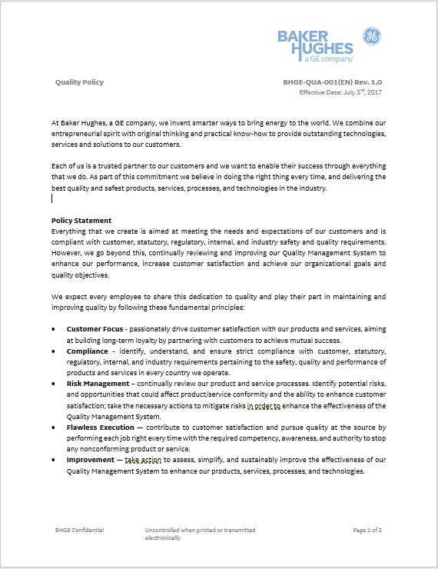
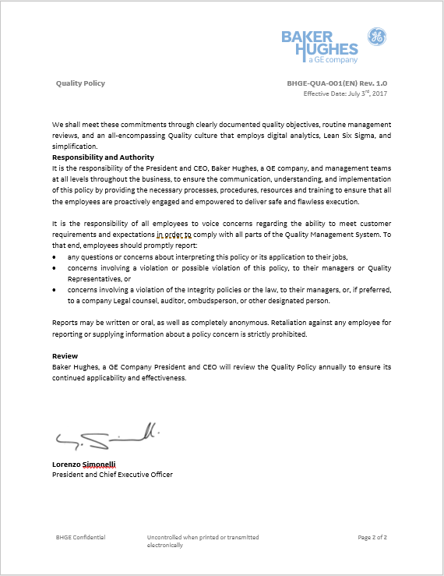
BHGE Quality Policy
Do your sites Quality Objectives match the revised requirements of the BHGE Quality Policy? Risk Management / Flawless Execution?
QO-OFE-GLO-QUA-004 Rev 3.0
Notes:
Confirm the Oil & Gas Quality Policy is fit for purpose at the site level.

Slide 10
Previous QMR Actions
Review previous minutes / actions were they effective? If NO – action should have been taken
Note:
Best practice is to capture the QMR in Gensuite Compliance Calendar & capture new actions as “Requires Correction” in the Gensuite Action Tracking System.
QO-OFE-GLO-QUA-004 Rev 3.0

Slide 11
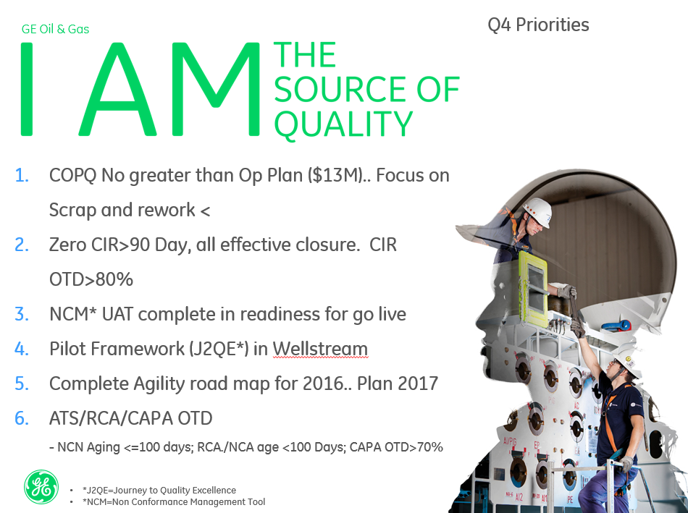
Quality Objectives
Review relevant Business / Site / Quality Objectives
If we see failure / poor performance against an objective - action should be taken
EXAMPLE ONLY
QO-OFE-GLO-QUA-004 Rev 3.0

Slide 12
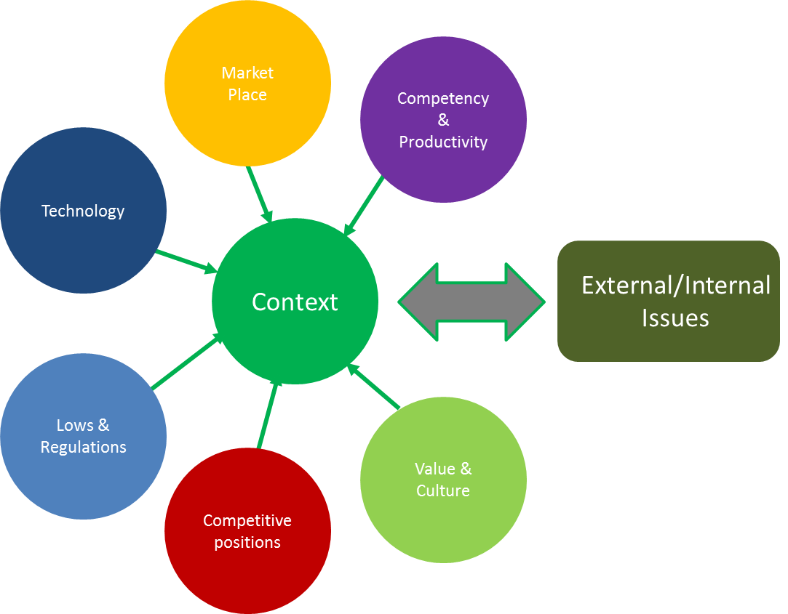
Changes affecting the QMS
Minimum Requirements:
External & Internal Issues such as
New / Revised Standards – API / ISO Including Industry standards – ASME / Norsok etc
TRS Requirements – including consideration of errata and addenda changes
New O&G / Subsea Procedures (Training & Competency etc)
Change in sites purpose / manufacturing / services capabilities
Key organisational change
Remember: Management of Change will be required if a change identified MAY negatively affect the QMS.
QO-OFE-GLO-QUA-004 Rev 3.0

Slide 13

Changes affecting the QMS
External issues
Internal issues
Company Synergies
Services Penetration
Variability of Workload
Communication
Trainings
Local QMS
Oil price
Transformation
New Product Introduction
Lead Time/Planning
JV’s, Customer Qual’s
Less paper documents
Less prescriptions
More accountability
Competition
Simplification
Industrial Internet
Predix/Value Proposal
GE Digital
Customer Interfaces
Integration
Reshape organizations
Merge processes/KPI
Leverage Best Practices
Green Technologies
Product Certifications
Documentation
Brilliant factory
Reduce Human Errors
Merge processes/KPI
Leverage Best Practices
TRS
g
Transition to
ISO9001:2015
Leader Responsibilities
Risk Based Thinking
Simplification
GE Beliefs
Empower and Inspire
Learn and Adapt
Stay Lean
QO-OFE-GLO-QUA-004 Rev 3.0
Notes:
External and Internal Issues (or factors) shall be relevant because of their inpact on the QMS. Oil Price for example shall be monitored because the changes in our customer demands can have an impact of the product lines, on the product qualification, on the reorganization of product companies, on the ways we manage workload in the shop.

Slide 14
ISO 9001:2015 – Main Changes
ISO 9001:2015 requires Top Management to :
“... demonstrate leadership and commitment...by”
“…taking accountability...”
“…ensuring...”, “…promoting...”, “…communicating...”,
“… engaging, directing and supporting ...”
No delegation is permitted for actions Leadership owns ... except for actions related to “ensuring”
The “Management Representative” role is no longer mandatory in the new Standard
Organizational Context
QMS Scope
Risk-based thinking
Process approach
External provision
Leadership Engagement
Organizational Knowledge
Improvement
Documentation
Clarity
Terminology
ANNEX SL
Annexes ISO 9001:2015
EXAMPLE ONLY
What’s in it for you?

Slide 15
Process Performance
How are critical processes / applications performing?
Examples could include
Oracle?
Team Centre?
MRB Compilation?
Non-Conformance Management?
Calibration?
Digital Technologies?
New Equipment?
Etc
QO-OFE-GLO-QUA-004 Rev 3.0

Slide 16
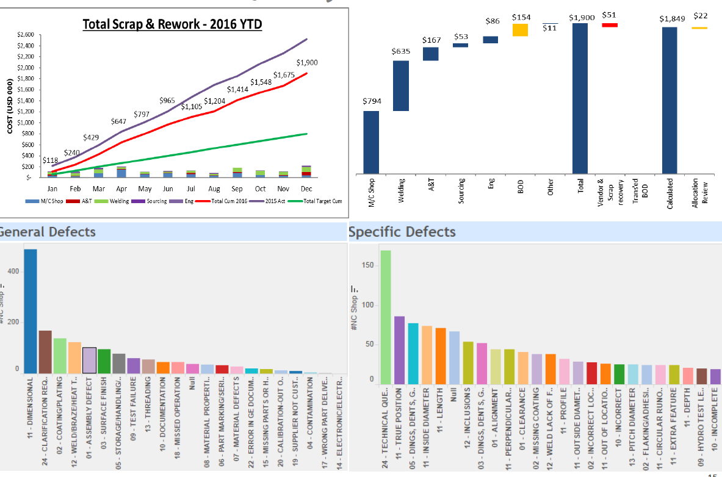
Conformity of Product & Services
Minimum Requirements:
Results of Product and / or Service (Non) Conformity
Including Non-conformities identified after delivery or use.
Both to internal & external customers
EXAMPLE ONLY
QO-OFE-GLO-QUA-004 Rev 3.0

Slide 17
COPQ (Optional)
($ in millions)
Drivers
4
Eng redesign
2
Rec. Losses
Inv. Obso
Prem.Trans.
LDs, Conces
EXAMPLE ONLY
Warranty
5
S&R, Test
1.6%
1.6%
1.6%
2.2%
2.1%
% sales
CoQ by Functional Driver
Focus
QO-OFE-GLO-QUA-004 Rev 3.0

Slide 18
COPQ (Optional)
($ in millions)
Key drivers analysis
Key Drivers Analysis
Site 1
Site 2
Site 3
EXAMPLE ONLY
1.6%
1.6%
1.6%
2.1%
% sales
Top site by CoQ impact
Project Deck
Project area/Descriptions, Owner, Due Date, CoQ Impact
QO-OFE-GLO-QUA-004 Rev 3.0

Slide 19
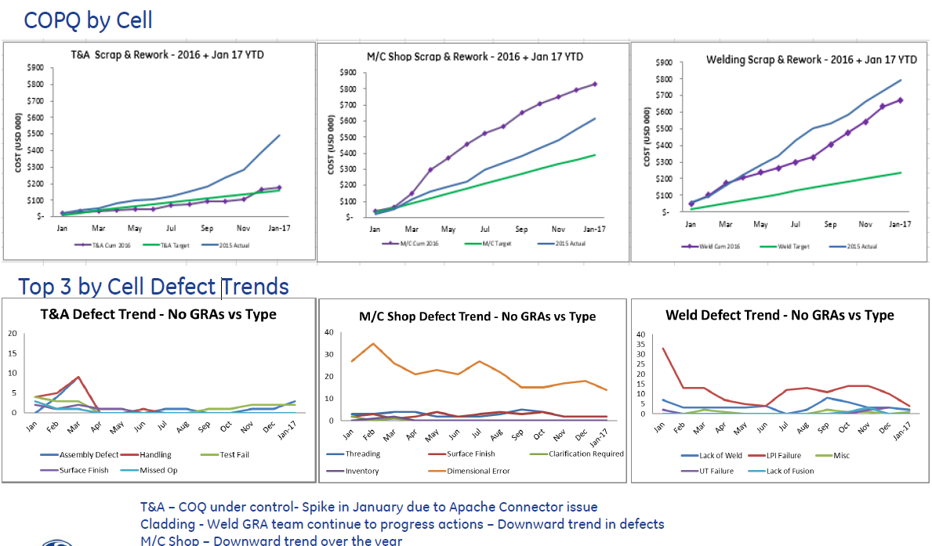
Monitoring & Measurement
Review of Key Quality Metrics
If we see failure / poor performance against an objective - actions should be taken
EXAMPLE ONLY
QO-OFE-GLO-QUA-004 Rev 3.0

Slide 20
Customer Satisfaction / Feedback from relevant interested parties
Minimum Requirements:
Analysis of Customer Satisfaction
Net Promoter Score (if applicable)
Quality Concerns
Customer Related Audits
CIR / Ask Drilling (if applicable)
FPAL (if applicable)
Feedback from relevant interested parties
Records of customer satisfaction must be maintained.
QO-OFE-GLO-QUA-004 Rev 3.0

Slide 21
Results of Audits
Minimum Requirements:
Areas for Management Attention
Majors
Repeat Issues
External – API / 3rd Party / Client
Internal – ISA / Site Audits / Site Audits of Subcontractors on Site.
“Outsourced” Activities (if applicable)
QO-OFE-GLO-QUA-004 Rev 3.0

Slide 22
MOC / Risk Assessment / Opportunities / Contingency Planning
Minimum Requirements:
Review of Risks & Opportunities identified from:
Changes to the context of the organisation
Changes to interested parties
Changes in organizational structure
Changes in essential personnel
Changes to the QMS
Changes resulting for corrective & preventive actions
Project Risk (if applicable)
Additional Topics could include:
Facility / Equipment Changes
Supplier Performance
Delivery of Non-Conforming Product
Availability of Competent Personnel
A review of the risks associated with Interested parties and the effectiveness of the action taken to address risks & opportunities identified shall also be covered to meet the requirements of ISO 9001:2015.
QO-OFE-GLO-QUA-004 Rev 3.0

Slide 23
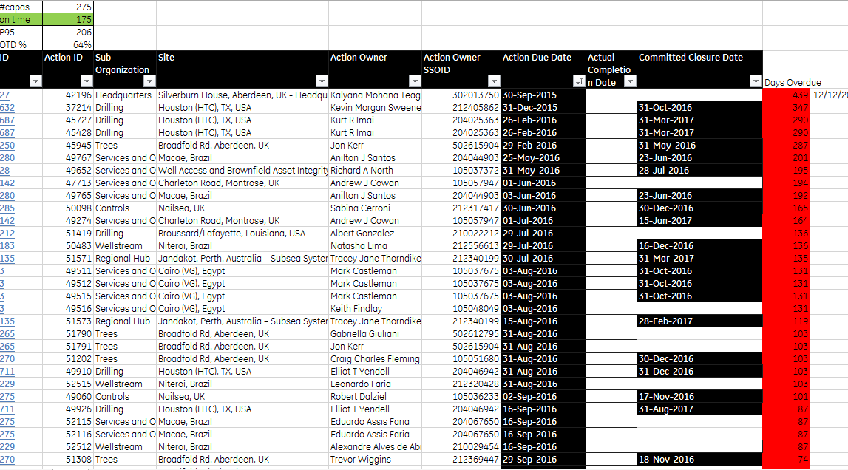
Status of CA/PA
Minimum Requirements:
Areas for Management Attention
Escalated Cases
Open Past Due Actions
Repeat Cases
Status of all CI Cases
Corrective Actions
Preventative Actions
EXAMPLE ONLY
QO-OFE-GLO-QUA-004 Rev 3.0

Slide 24
Supplier & other external providers performance
Minimum Requirements:
Critical Suppliers / External Providers Performance
Supplier related product non-conformances
Supplier related service non-conformances
Control of outsourcing (if applicable)
QO-OFE-GLO-QUA-004 Rev 3.0

Slide 25
Adequacy of resources
Minimum Requirements:
Leadership Engagement
People
Equipment
Technology
QO-OFE-GLO-QUA-004 Rev 3.0

Slide 26
Opportunities for improvement
Minimum Requirements:
Lean Six Sigma Activities
Blackbelt, Greenbelt, NIKE
New Processes
New Equipment
Best Practice / Lessons Learned
Project Reviews (if applicable)
QO-OFE-GLO-QUA-004 Rev 3.0

Slide 27
Output Requirements
Minimum Requirements:
Ensure the following are effectively recorded & documented:
A summary assessment of the effectiveness of the quality management system. The assessment shall include:
any required changes to the QMS & its associated processes and any decisions and actions to support this;
opportunities for improvement including results of MoC Activities / Corrective & Preventative Actions
required resources;
and improvement to products and / or services in meeting customer requirements.
Top management shall review and approve the output of management reviews and in addition management reviews shall be documented and records of these reviews shall be maintained.
Note: The records of this Quality Management Review will be formally approved by appropriate Top Management using the minutes of meeting template linked to here & shall be recorded and maintained (ideally in Compliance Calendar)
QO-OFE-GLO-QUA-004 Rev 3.0

Slide 28
QMS Revision Details
QO-OFE-GLO-QUA-004 Rev 3.0

Slide 29
Approval & Revision Details
Document Details
Current Doc Title | Quality Management Review Template | Revision Number | 3.0
Current Document # | QO-OFE-GLO-QUA-004 | Date of Issue | 21.08.2018
Previous Doc Title |  | Previous Revision #
Previous Doc No# | QO-SS-GLO-QUA-004 | Previous Date of Issue | 2.3
* Full compliance by 2 weeks after issue date ** Next review date 3 years after issue date - Unless otherwise specified |  | **** Revision Details: Draft Revisions: Is denoted by letters (A, B, C etc) Approved Revisions with Major changes: Changes the whole number (1.0, 2.0, 3.0 etc) Approved Revisions with Minor changes: Changes the second number (1.1, 1.2, 1.3, 2.3 etc)
Revision History
Revision # | Section Modified / Description of Change |  | Author | Modified Date | Approver | Date
1.0 | Initial Release. To be used when preparing and conduction Management Reviews |  | Linn Falt | 17.12.15 | Duncan Collins | 17.12.2015
2.0 | Updated template to meet requirements for ISO 9001:2015, API Q1 and Q2 Standard |  | Duncan Collins | 11/04/2017 | Nick Edmunds | 11/04/2017
2.1. | Updated slides to the BHGE template |  | Pauliina Kovalainen | 26/07/2017 | Duncan Collins | 01.08.2017
2.2 | 1st slide revision status changed to 2.2 12th slide after TRS Requirements I have added “including consideration of errata and addenda changes” Changed document name to Quality Management Review Template |  | Kat Mackay | 06/10/2017 | Duncan Collins | 06/10/2017
2.3 | Amended Slide 20 to include ISO 9001:2015 requirement for feedback from relevant interested parties; Amended Slide 22 note to include the risks associated with Interested parties |  | J. McCabe | 26/03/2018 | Duncan Collins | 27/03/2018
3.0 | Updated to revise Quality Policy statement, and added requirement to project risk. Document number changed to QO-OFE-GLO-QUA-004 |  | L. Falt | 21.08.2018 | Duncan Collins | 21.08.2018
QO-SS-GLO-QUA-004 Rev 3.0

Slide 30
Reference Documents
Documents that were Referenced to Create this Document
BHGE-QUA-013 – Record Control Procedure
Other Documents this Documents Makes Reference to or is Referenced In
QT-SS-GLO-QUA-010 – QMR Minutes of meetings template
Document Links Also Located At
QO-SS-GLO-QUA-004 Rev 3.0

