Slide 1
Jandakot OFE-Svc
Lessons Learned Process Tutorial

Slide 2
Jandakot OFE-Svc
Lessons Learned Process Tutorial
Lessons learned are a valuable means to avoid the mistakes of the past and/or manage risk & opportunity.
Lessons learned can be reviewed during ITO, contract review, handover, kick-off, etc. with mitigation actions implemented as part of risk management.
Lessons learned can be reviewed at project / service campaign execution tollgates or at close out and be maintained for the next project or service campaign review. This completes the circle of lessons learned to risk management back to lessons learned.
Lessons Learned
Risk & Opportunity Management
The means of documenting / maintaining / archiving lessons learned is not prescriptive; rather they should be managed in such a way as to provide an effective tool for Operations Delivery Managers (ODM), Integrated Service Leads (ISL), Rental Tool Asset Managers etc. to work with.
Accordingly, specific project or service campaign lessons learned can be held for example in an appropriate GE Box folder, such as ‘Customer Records (ITO-OTR)’. This will allow an ODM or ISL to investigate a similar project or service campaign & thereby develop risk mitigations for a current scope of work.

Slide 3
Jandakot OFE-Svc
Lessons Learned Process Tutorial
During the course of OFE-Svc work, discrete incidents may occur that could impact or benefit future work scope. Quality tools can be implemented to investigate such issues and thus arrive at a process improvement.
At an entry level a Gensuite Quality Concern Report (QCR) should be raised to kick off investigation, improvement, escalation etc.
In some instances the practical outcome from investigation is to record the incident as a lessons learned. Why?
It is not always the case that an identical situation will occur in the future, however a ‘similar’ lesson may prompt a risk assessment of any current work scope, thereby kicking off an appropriate risk mitigation.
Individual lessons learned entered by your Quality team can be accessed at:
APA Lessons Learned tool or via Jandakot Quality (follow the link in the site).
You can request a lesson learned to be entered via a Gensuite QCR. Your Quality team will assess the request to ascertain if a lessons learned is suitable or whether another action is more effective (e.g. procedure revision).

Slide 4
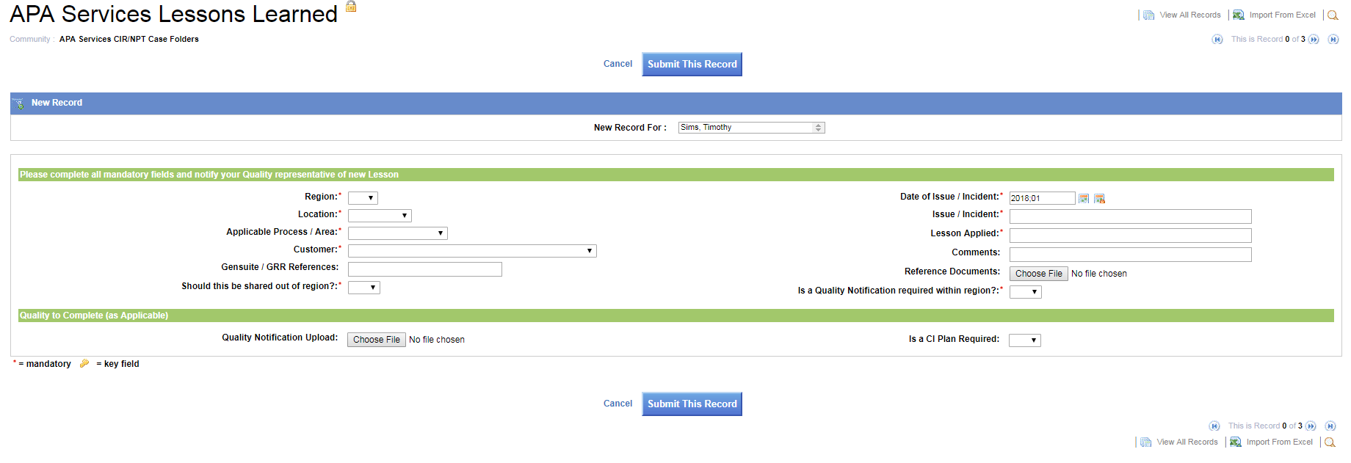
Jandakot OFE-Svc
Lessons Learned Process Tutorial
Click here in the site to view all records or download an excel for a key word search

Slide 5
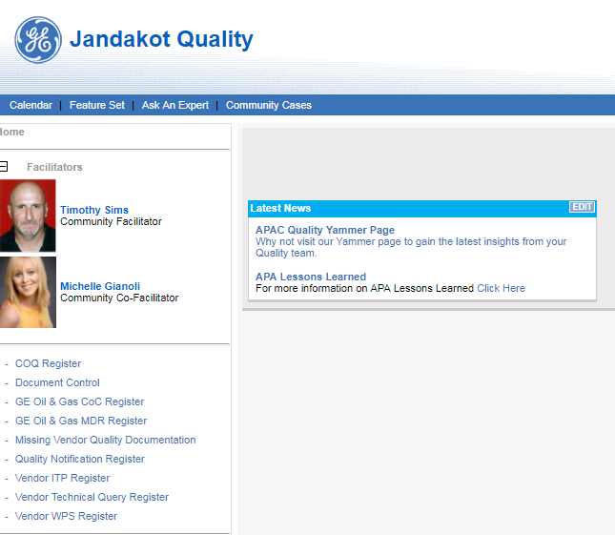
Jandakot OFE-Svc
Lessons Learned Process Tutorial
Follow this link

Slide 6
