Slide 1
ANZ Subsea Services Oilfield Equipment Management of Change (MOC) Guidelines
QO-PER-040_Rev2.0

Slide 2


Management of Change (MOC)
Change
Identify any new and/or residual risks
Required approvals
Implement controls
Communicate the change
Amend relevant documents

Slide 3
Visualize change that requires management
API-Q2 5.11.2 MoC Implementation
Note1
cl b) & c) … whose absence or departure could negatively impact the service.
Note2
cl d) … including temporary changes and improvements resulting from corrective and preventive actions
Note3
cl f) … including those that were originally agreed upon by the customer and those required by changes in legal and other applicable requirements
Note 4
cl e) changes to original equipment manufacturers specifications, applications, and/or software for service related product
MOC
Change or proposed change in the organizational structure
Changes in key or essential personnel
(Note 1)
Changes in critical suppliers
(Note 1)
Equipment/ Facility
Product Design
Process
Customer scope
API-Q2 mandatory
API-Q2 mandatory
API-Q2 mandatory
Changes to management system procedures
(Note 2)
API-Q2 mandatory
API-Q2 mandatory
API-Q2 mandatory
Changes to OEM specifications
(Note 4)
Changes in approved design
(Note 3)

Slide 4
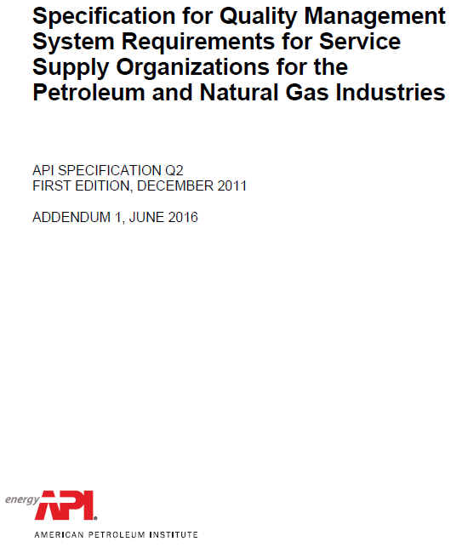
API-Q2 Management of Change (SS&OE)
API-Q2
5.11 | Management of Change
5.11.1 | General | The organization shall maintain a documented procedure for management of change (MOC). For the management of change, the organization shall identify the potential risks (see 5.3) associated with the change and any required approvals prior to the introduction of such changes.
5.11.2 | MOC Implementation | The organization shall use the MOC process for any of the following that may impact the execution of a service:
 |  | a) changes or proposed changes in the organizational structure;
 |  | b) changes in key or essential personnel, whose absence or departure could negatively impact the service;
 |  | c) changes in critical suppliers whose absence or departure could negatively impact the service;
 |  | d) changes to the management system procedures, including temporary changes and improvements resulting from corrective and preventive actions (see 6.4);
 |  | e) changes to original equipment manufacturer’s specifications, applications and/or software for service-related product; and
 |  | f) changes in approved design (see 5.4) including those that were originally agreed upon by the customer and those required by changes in legal and other applicable requirements.
5.11.3 | MOC Evaluation, Notification and Controls | The organization shall conduct a risk assessment (see 5.3) when evaluating a potential change. The organization shall notify relevant personnel, including the customer, of the change and residual or new risk due to changes that have either been initiated by the organization or requested by the customer. The organization shall ensure that relevant documents are amended. The organization shall maintain records (see 4.5) of MOC activities.
Where else does MOC occur in API-Q2?
5.2 Planning
5.4.6 Control of Design and Development Changes
QMS Documentation …
Management of Change Procedure QP-SER-GLO-QUA-011
DRL of Document :
http://edms.pw.ge.com/dctmquality/home/components/drl/drl.jsp?objectId=0900f5ea80862e60&showRendition=true

Slide 5
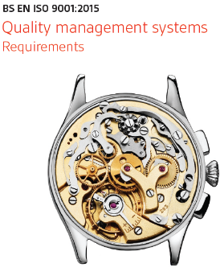
ISO9001:2015 Planning of Changes
ISO9001:2015
6.3 Planning of changes | When the organization determines the need for changes to the quality management system, the changes shall be carried out in a planned manner (see 4.4).
 | The organization shall consider:
 | a) the purpose of the changes and their potential consequences;
 | b) the integrity of the quality management system;
 | c) the availability of resources;
 | d) the allocation or reallocation of responsibilities and authorities.
Changes additional to those specified in API-Q2
Customer scope
Equipment / Facility

Slide 6
Process Map

Slide 7
Step-1
1.1- Discuss the identified change with your immediate team (including leadership when required).
1.2- If the Change Management has not been addressed with an existing process (e.g. Project risk using ARM tool, Engineering change using ePims/ EDM) raise a MOC request using the link below:
https://app.smartsheet.com/b/form?EQBCT=05f6fc89ebae4e4b8311440527fe7604

Slide 8
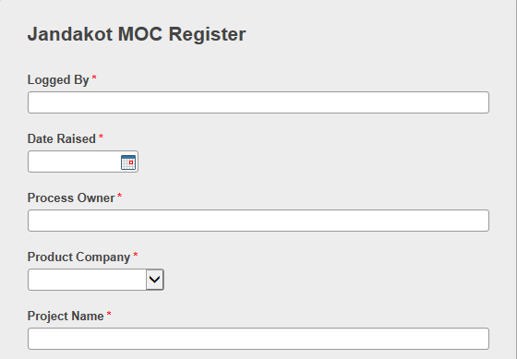
Step-2
2.1- Complete the form with the details of the identified change source

Slide 9
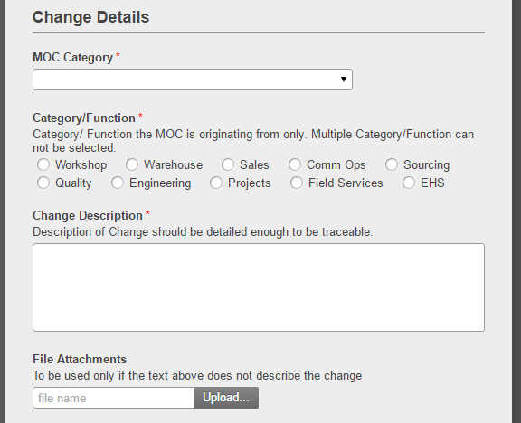
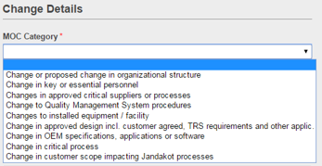
Step-3
3.1- Select the change Category and select Function

Slide 10
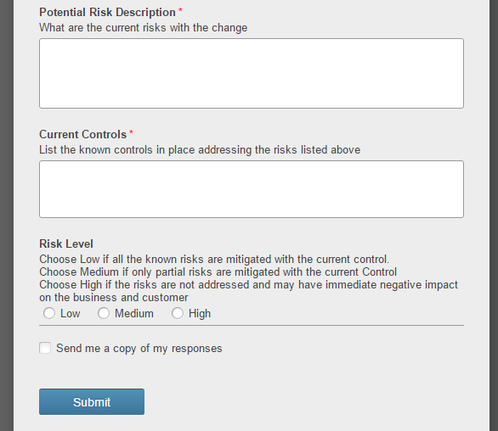
Step-3
3.2- List the known Risk and the Current controls.
3.3 Select the Risk level and
3.4 Submit for Review

Slide 11
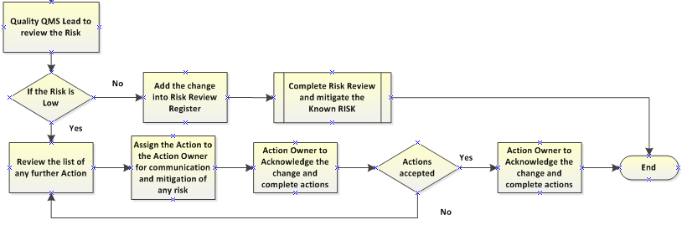
Quality Review Process
The MOC request will be tracked as per the process above using SMARTSHEET TOOL.
Link to the MOC tracker: https://app.smartsheet.com/b/home?lx=_d3q_ClIEYDJozo0OMVtdQ

Slide 12
Approval & Revision Details
Document Details
Current Doc Title | ANZ SS&OE Management of Change (MOC) Guidelines | Revision Number | 2.0
Current Document # | QO-PER-040 | Date of Issue | 19.07.2017
Approver Name / Title | Rameshwari Rajan – APAC Quality Leader | Approver Name / Title | Richard Edwards – SS&OE Quality Manager
Approver Signature | Approval held at https://ge.ent.box.com/folder/32422859219 | Approver Signature | Approval held at https://ge.ent.box.com/folder/32422859219
* Full compliance on publishing in the QMS/BMS
Revision History
Revision # | Section Modified / Description of Change |  | Author | Date
1.0 | Original issue for Jandakot site controls |  | Rameshwari Rajan | 05.08.2016
2.0 | Inclusion of API-Q2 requirements for SS&OE |  | Tim Sims 300009974 | 18.07.2017

