Slide 1
Testing Group-Based Trajectory Modeling (GBTM) SAS Macros
ZIP Poisson + Ordinal-Probit + continuous outcome + zero-inflated negative binomial (ZINB) (simulate → fit → plot) | IFH analyst test brief
Deliverables from testing: fit tables (AIC/BIC), trajectory plots, and notes from edge cases.

Slide 2
What these macros do (at a glance) Single-run pipelines in PROC NLMIXED that start from wide data and end with tables + plots
Simulate (optional)
%sim_data
Prep wide table
BASE_FILE_SRS
Fit K-class model
PROC NLMIXED
Outputs
plots + fit tables
ZIP Poisson trajectories
Ordinal-probit trajectories
ZIP Poisson macro
Ordinal-probit macro
Outcome: integer counts per time point (wide)
Mixture: class-specific mean + zero inflation
User-controlled starting values via %let (unset → 0)
Outputs: pe_zip (ParameterEstimates), fit_zip (FitStatistics), plots
Outcome: ordered categories (e.g., 0–3)
Class A mixing intercept fixed to 0 (identifiability)
Exactly one PARMS statement (defaults + overrides)
Outputs: prefix_EST_Kk, prefix_FIT_Kk, prefix_ESTS_Kk + plots

Slide 3
Data requirements (wide format) Both pipelines expect 1 row per person with repeated measures in columns
ZIP Poisson input
Ordinal-probit input
Minimum columns
Minimum columns
ID: BENE_ID (or pass id=)
Outcomes: SUM_Q1 … SUM_QT (integer counts)
Missing values allowed as . (likelihood skips missing)
Macro args to align: T=, yvars=, nclass=, class_labels=
ID: BENE_ID (or pass id=)
Outcomes: Y1_1 … Y1_T (ordinal)
Time index: quar1…quarT values 0..T-1
Observed values must be listed in ycodes=
Minimal prep snippet (ordinal):
data BASE_FILE_SRS;
set MY_WIDE;
array quar[12] quar1-quar12;
do i=1 to 12; quar[i]=i-1; end;
drop i;
rename my_id = BENE_ID;
run;

Slide 4
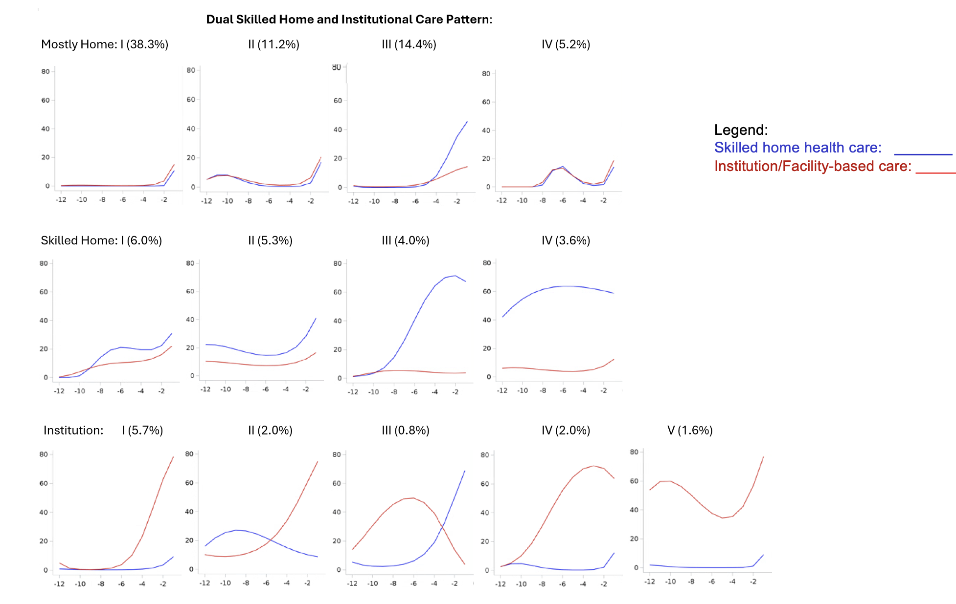
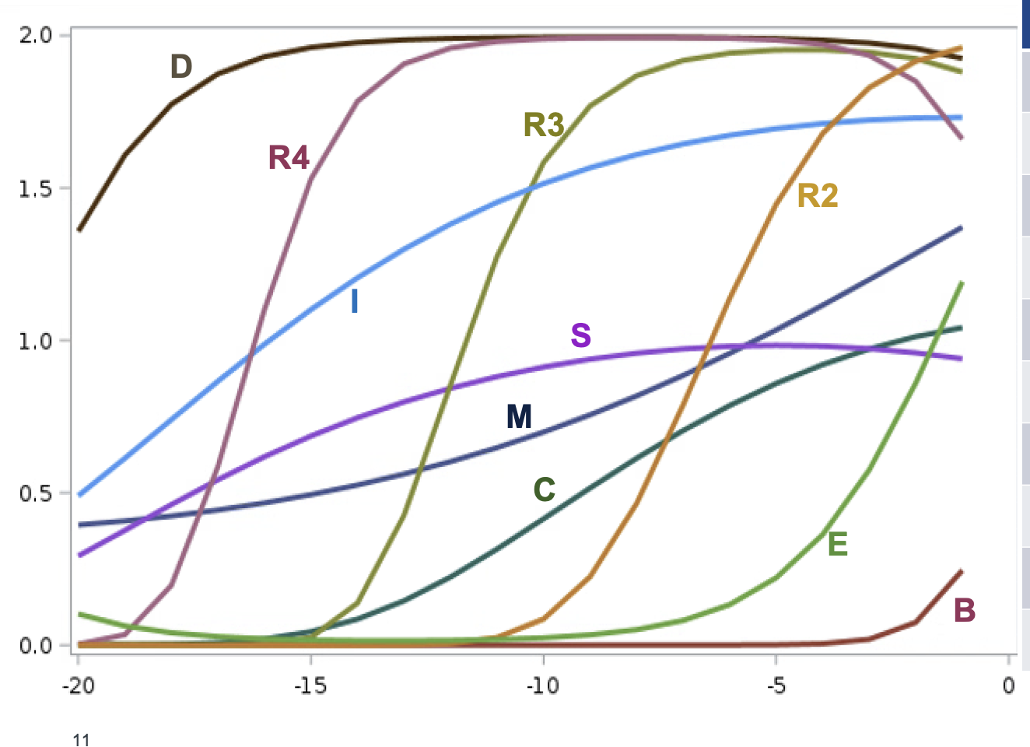
Example outputs (plots) Representative formats produced by the macros
Continuous-style multi-class curves
Ordinal Plot

Slide 5
Quick start: run on simulated data (recommended for testing) Confirm simulate → fit → plot end-to-end before using real data
ZIP Poisson (sim)
Ordinal-probit (sim)
/* 1) Create toy data */
%sim_data(dist=BIN4, class=4, n=5000, T=12, seed=1);
/* 2) Build BASE_FILE_SRS (Section [B] template) */
/* ensures BENE_ID and SUM_Q1-SUM_Q12 exist */
/* 3) Fit 4-class, then plot */
%ct_zip_pois_nlmixed(nclass=4, class_labels=A B C D, T=12);
%ct_zip_plots(pe=pe_zip, T=12);
/* 1) Create toy ordinal data */
%sim_data(dist=BIN4, class=4, n=2000, T=12, seed=1, cap=4);
/* 2) Build BASE_FILE_SRS (quar1..quar12, BENE_ID) */
%build_base_from_simwide(T=12);
/* 3) Fit + plot */
%let K=4; %let M=4; %let DEG=2;
%ordprob_mix_fit_one(k=&K, m=&M, deg=&DEG, qpoints=40, prefix=ordprob_K4);
%ordprob_mix_plot_one(k=&K, ttotal=12, m=&M, prefix=ordprob_K4);

Slide 6
Run on your data (what to change) Swap in your wide dataset + outcome column spans; keep the rest identical
ZIP Poisson: replace data= / id= / yvars= / T=
Ordinal-probit: replace data= / id= / yvars= / tvars= and set ycodes=
%ct_zip_pois_nlmixed(
data=MY_WIDE,
id=person_id,
yvars=cnt_t1-cnt_t12,
T=12,
nclass=6, class_labels=A B C D E F,
order=2, p_order=0,
/* bounds=... optional */
);
%ct_zip_plots(pe=pe_zip, T=12);
%ordprob_mix_fit_one(
data=MY_WIDE, id=person_id,
yvars=ord_t1-ord_t12,
tvars=quar1-quar12, ttotal=12,
m=4, ycodes=0 1 2 3,
deg=2, k=6, qpoints=40,
start_values=, bounds=,
outestlib=work, prefix=ordprob_K6
);
%ordprob_mix_plot_one(prefix=ordprob_K6, k=6, ttotal=12, m=4, ycodes=0 1 2 3);
Checklist before fitting
Wide data has exactly T outcome columns and an ID column
ZIP outcomes are integer counts; Ordinal outcomes are within ycodes=
class_labels length matches nclass (ZIP) / k (Ordinal)
Start values optional: defaults are safe; override only what you need

Slide 7
Recommended test plan (small + focused) Run 4- and 6-class models + selected edge cases; record test IDs + log snippets
Environment
ZIP Poisson
Ordinal-probit
G01 PROC NLMIXED + ODS Graphics run
Z06 4-class fit + plots
O03 4-class fit + plotting
G02 WORK writable (no permission/disk issues)
Z07 6-class fit (example config)
O04 6-class fit
Z11 Missing Y values skipped
O06 Category mismatch behavior
Z12 Export PNG via ODS HTML5
O08 start_values override works
Z15 bounds= stabilizes tricky case
Tip: run the 4-class model first; if it converges and plots, move to 6-class.

Slide 8
How long will testing take? (realistic estimate) Ballpark ranges; actual time depends on hardware, N, T, convergence, and qpoints
Hands-on analyst time (typical)
Compute (wall-clock) time (sequential runs)
Setup + sanity checks (G01–G02): 15–30 min
Run ZIP 4/6-class + confirm outputs: 20–40 min
Run Ordinal 4/6-class + confirm outputs: 30–60 min
Edge cases + note logs: 30–60 min
Package results (logs + screenshots): 10–20 min
ZIP Poisson (qpoints=1): 4-class ~2–10 min; 6-class ~5–25 min
Ordinal-probit (often slower, e.g., qpoints=40): 4-class ~10–45 min; 6-class ~20–90 min
Total compute: ~40 min to ~2.5 hours
Factors that stretch runtime: larger N, more time points, extreme starts, near-empty classes, and higher qpoints. If possible, run K=4 first, then K=6.

