Slide 1
14:332:451-566
Parallel and Distributed Computing
Extra Notes on Lecture 1
Electrical and Computer Engineering Department
Professor Maria Striki
ECE Department, Rutgers University
Office: EE-115
maria.striki@rutgers.edu

Slide 2
Demo 1 - Demo 2 Setup

Slide 3
Demo 3 Setup

Slide 4
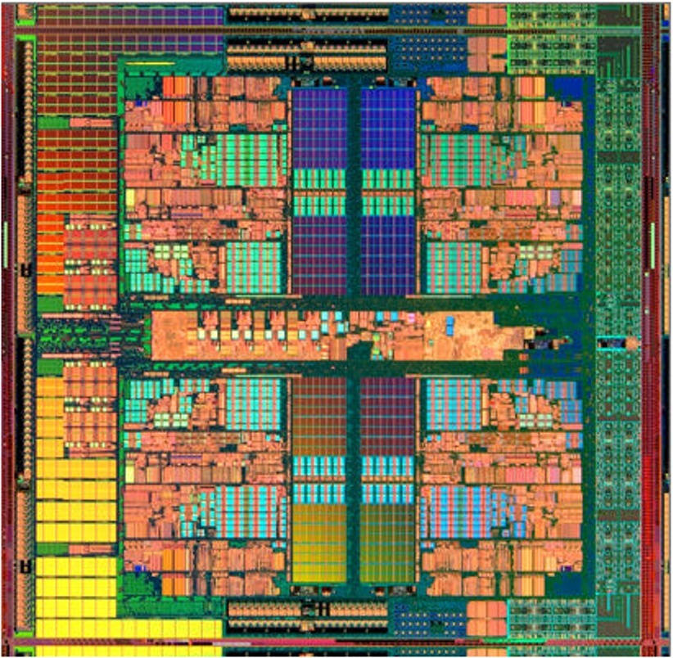
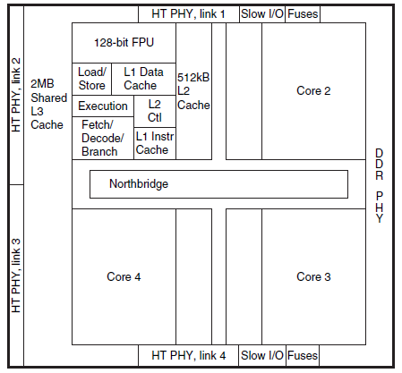
AMD Barcelona multi-core chip
Cache memory uses Static RAM (SRAM), faster but less dense and more expensive that Dynamic RAM (DRAM)
Each core has Level 1 and Level 2 cache, while L3 is shared

Slide 5
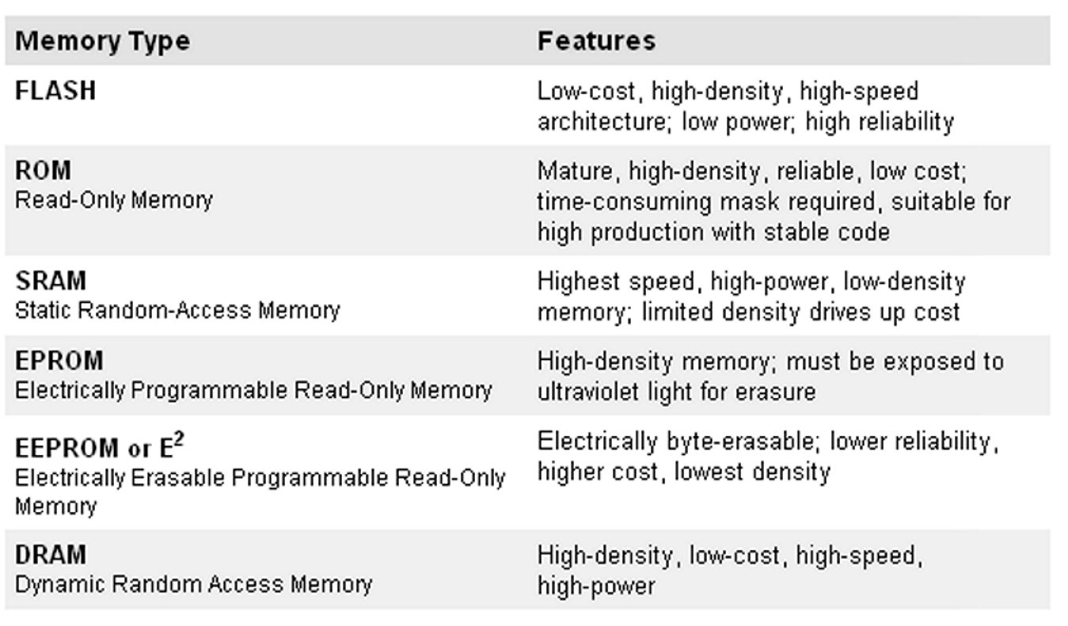
Solid-state Memory types
Volatile (DRAM – Dynamic Random Access Memory)
Non-volatile – like EPROM, FLASH, DVD.
Cache
Main Memory

Slide 6
Core 1 Core 2 Core 3 Core 4
Register
L1 Cache
L2 Cache
L3 Cache
DRAM
Hard Disk

Slide 7
CPU Power (and the “Power Wall”)
We know that P=V x I (watts)
The CPU voltage V is the DC voltage supplied to the CPU.
The amount of power a CPU uses, and thus the amount of heat it dissipates, is the product of the voltage applied to the CPU and the current it draws.

Slide 8
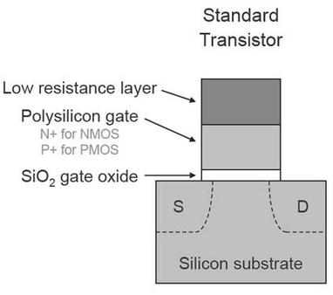
CPU Power
In modern CPUs made using CMOS technology, the current is almost proportional to the clock speed
CPU drawing almost no current between clock ticks.
Almost because there
still are leakage currents

Slide 9
CPU Power - the Heat Issue
We know that CPU clock frequency increase reduces CPU time thus improves performance
So let’s make clocks even faster …
BUT Power consumption and power loss are correlated with the clock frequency because
Dynamic power (consumed during switching) = V(t) x I(t):
V(t) x (C x dV/dt on a capacitor) =
V(t) x (C x (V(T)-0)/T_{clock_period})) =
V(t) x (C x V(t) x Clock_Freq) =
Voltage² × Capacitive load × Clock frequency

Slide 10
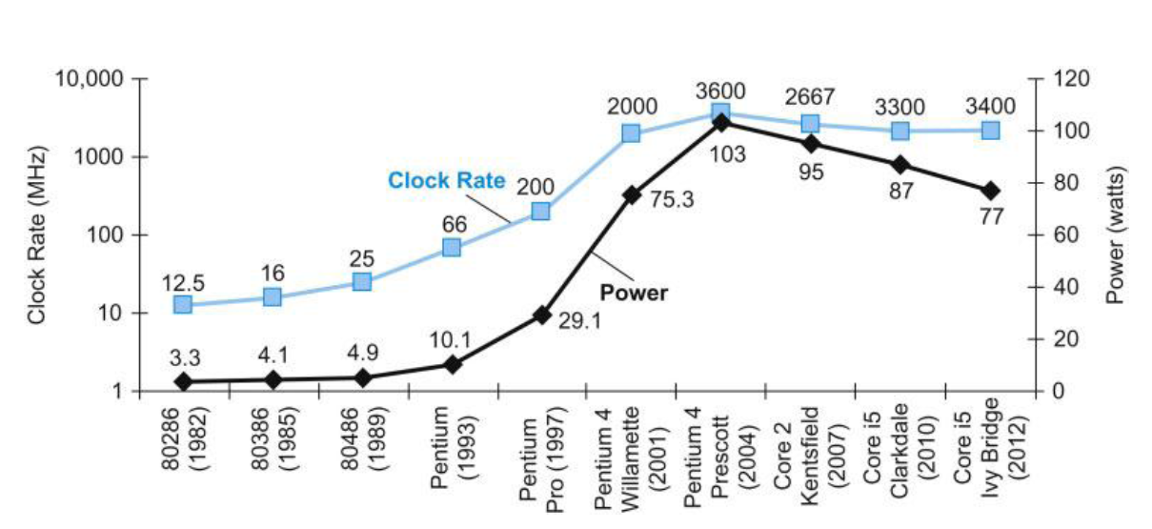
Why the clock frequency plateau?
Single core
Multi core
5V → 1V
×1000

Slide 11
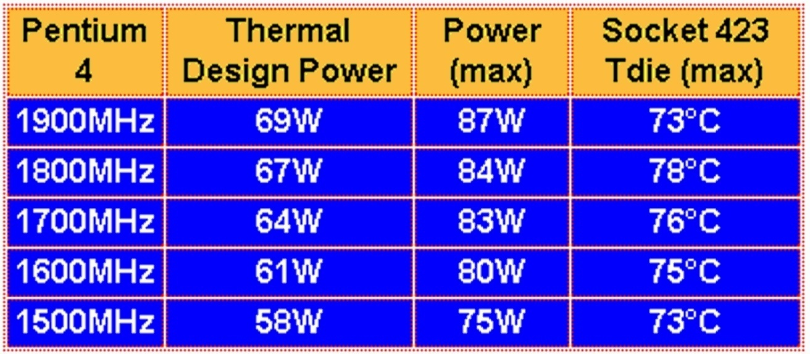
CPU Power- continued
The energy consumption of single-core CPUs (70 - 100 W – is the power of a light bulb). So the CPU generates lots of heat
Heat makes CPU gates less stable – can lead to errors

Slide 12
What can be done to reduce heat generation?
Heat removal
Voltage lowering (has its own perils)
Reduction in leakage current
Architectural changes (change the way the CPU is designed) so to reduce clock speed without reducing performance

Slide 13
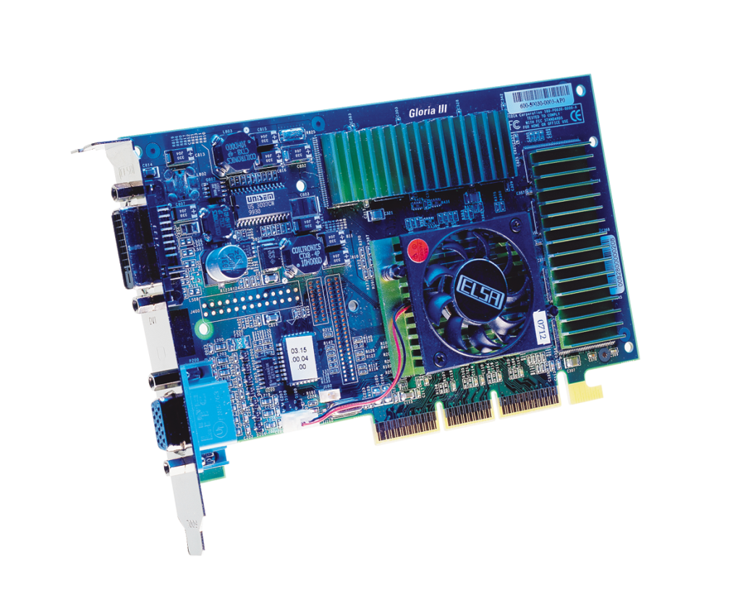
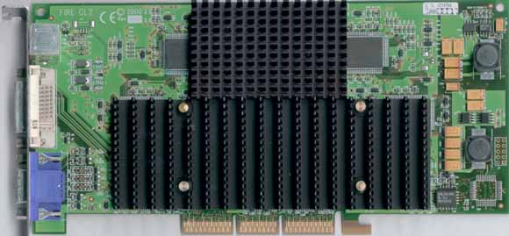
Heat removal
Heat needs to be dissipated somehow to cool down the CPU to reduce errors!
Active cooling
Passive cooling (old solution)

Slide 14
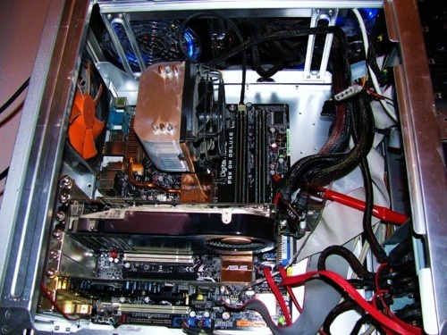
Heat removal- continued
Measures to remove (wasted energy) heat have limits
Fan
Fan
Fan
Fan

Slide 15
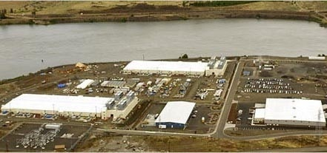
Heat Removal- continued
Now multiply this with a million computers, such as Google server farms…
Organized in container parks. Each shipping container can hold up to 1,160 servers, and uses 250 kilowatts of power, giving the container a power density of more than 780 watts per square foot
Heat goes in the river

Slide 16
Voltage Reduction
Dynamic power = Capacitive load×Voltage² × Clock frequency
Reduce voltage - Voltage went from 5 V down to 1 V today
Lowering the voltage further increases static power losses due to leakage – when transistors are “off” – more transistors, more leakage (static power).

Slide 17
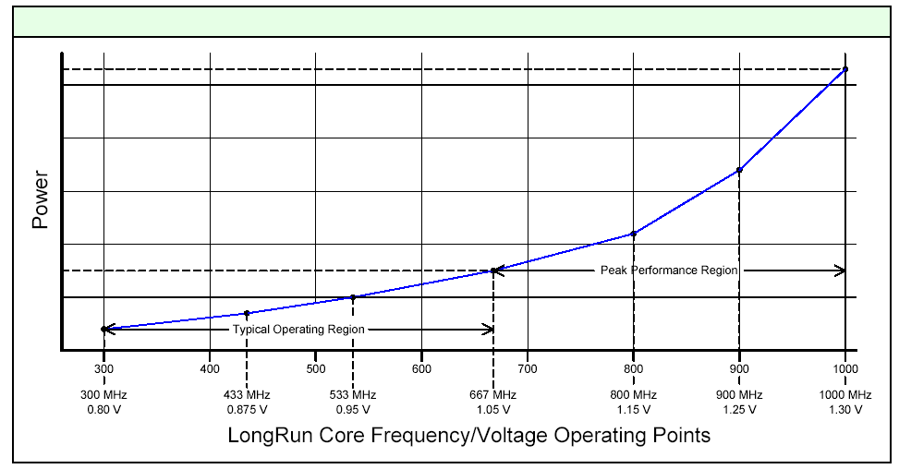
Benchmarks and Energy efficiency
Reducing power means reducing voltage and/or reducing clock frequency – a technique used in laptops and other mobile applications;
Processors then have three modes: max clock, adaptive clock, minimum clock (minimum power).

Slide 18
Low Voltage Effect On CPU Accuracy
Not all transistors work
Unstable system
Increase error rate
Keep retrieving data from input.
Lower computer speed.

Slide 19
Architectural Changes – Multi-core
Multi-core is different from multi-CPU
(in the bad old days) Multi-CPU meant several CPUs on the same motherboard.
Multi-CPUs with 1 core each had lower performance than 1 multi-core CPU due to slow busses
Single-core CPU had less execution parallelism
Making 2 CPUs instead of single 2-core one more expensive
Multi-core improves performance by parallelization of application execution of several cores (at lower clock speed)
BUT – programmers need to re-write apps for multi-core processing – not easy!

