Slide 1
5-Steps approach to Sentiment Analysis
Sentiment Analysis has become a hot-trend topic of scientific and market research in the field of Natural Language Processing (NLP) and Machine Learning.
Social Media are the main resource
Before starting the Sentiment Analysis
How to classify Sentiment?
Evaluation metrics
Visualize Results

Slide 2
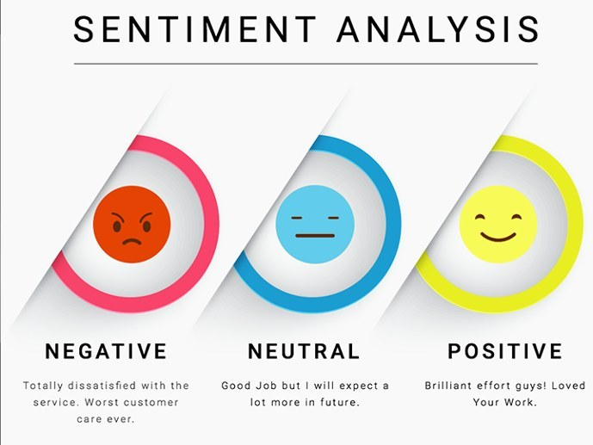
1. Social Media are the main resource

Slide 3
2. Before starting the Sentiment Analysis
Datasets
Many evaluations and labeled sentiment datasets have been created, especially for Twitter posts and Amazon product reviews.
The most popular and widespread are:
Stanford Twitter Sentiment
Sentiment Strength Twitter Dataset
Amazon Reviews for Sentiment Analysis
Large Movie Review Dataset
Sanders Corpus
SemEval (Semantic Evaluation) dataset
Also, anyone using the APIs provided by many platforms and forums can crawl and collect data. Most popular: Twitter API
Pre-processing
An initial step in text and sentiment classification is pre-processing. A significant amount of techniques is applied to data in order to reduce the noise of text, reduce dimensionality, and assist in the improvement of classification effectiveness. The most popular techniques include:
Remove numbers
Stemming
Part of speech tagging
Remove punctuation
Lowercase
Remove stopwords

Slide 4
3. How to classify Sentiment?
Machine Learning
This approach, employs a machine-learning technique and diverse features to construct a classifier that can identify text that expresses sentiment. Nowadays, deep-learning methods are popular because they fit on data learning representations.
Lexicon-Based
This method uses a variety of words annotated by polarity score, to decide the general assessment score of a given content. The strongest asset of this technique is that it does not require any training data, while its weakest point is that a large number of words and expressions are not included in sentiment lexicons.
Hybrid
The combination of machine learning and lexicon-based approaches to address Sentiment Analysis is called Hybrid. Though not commonly used, this method usually produces more promising results than the approaches mentioned above.

Slide 5
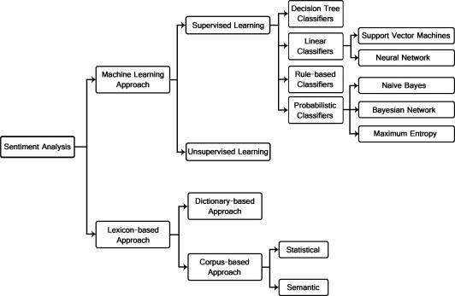
Sentiment classification techniques

Slide 6
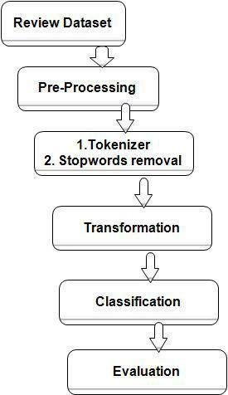
4. Steps-to-Evaluate-Sentiment-Analysis

Slide 7
5. Visualize Results
Sentiment Analysis results can be visualized via well-known techniques, such as :
graphs, histograms, and confusion matrices
Presence of multiple data domains and tasks has influenced visualizations approaches like :
Word Cloud, Interactive maps, Sparkline-style plots

Slide 8
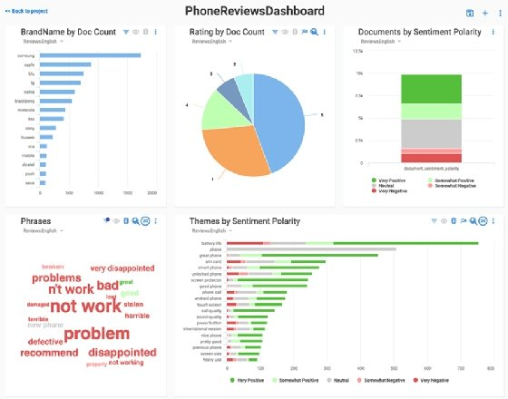
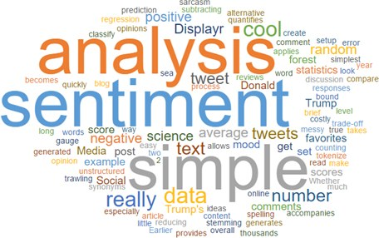
Sentiments Visualization techniques:

