Slide 1

CropAI
Detect early. Act safely. Escalate intelligently.
Problem Statement – 26131
Problem – Crop disease & pest infestation early detection
Theme – Agriculture / FoodTech / Rural Development
Category – Software
Team – Trouble Shooters

Slide 2
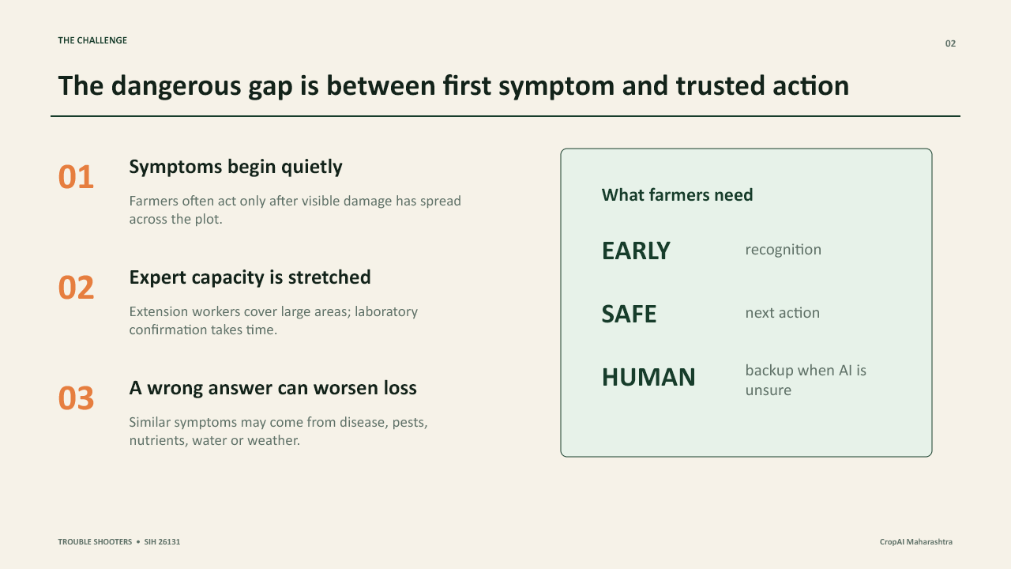
THE CHALLENGE
Trouble Shooters

Slide 3
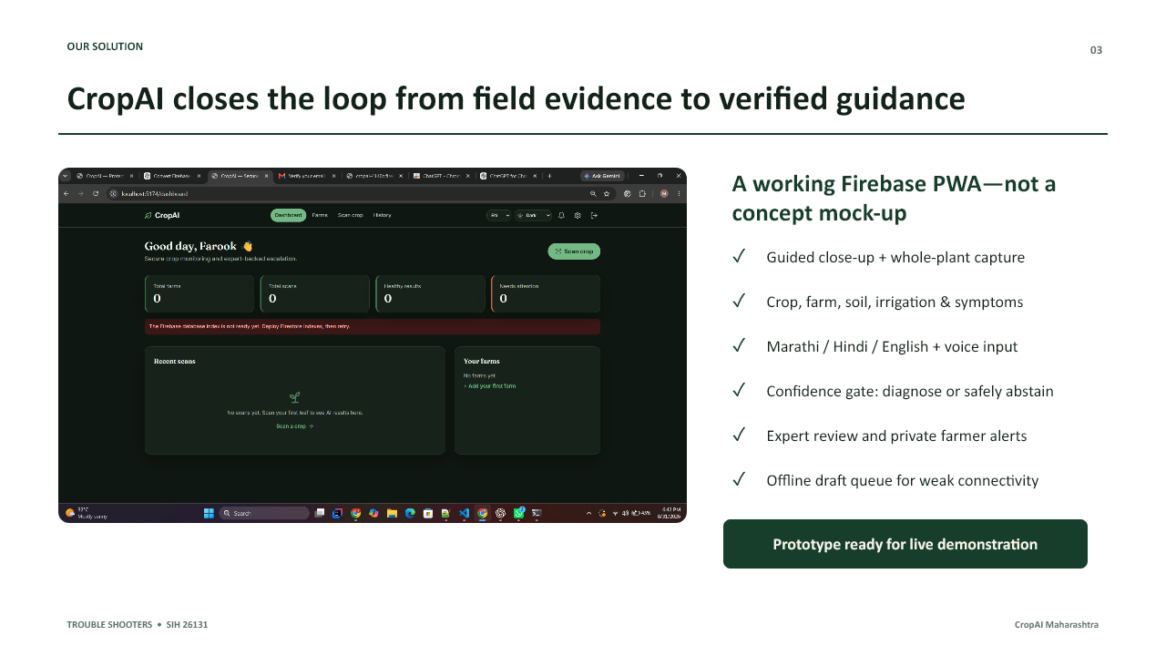
OUR SOLUTION
Trouble Shooters

Slide 4
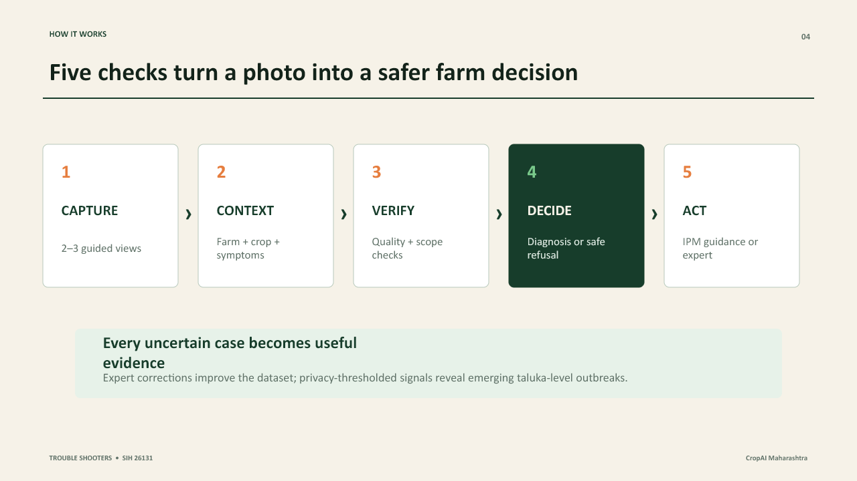
HOW IT WORKS
Trouble Shooters

Slide 5
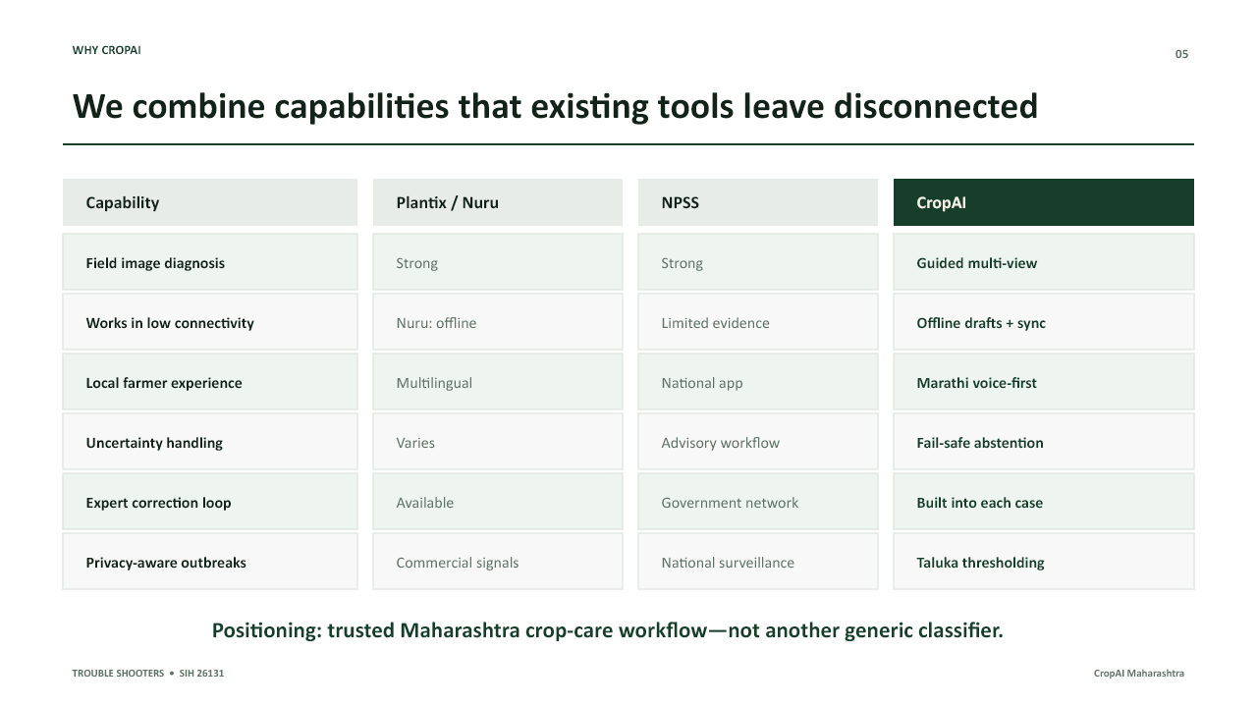
WHY CROPAI
Trouble Shooters

Slide 6
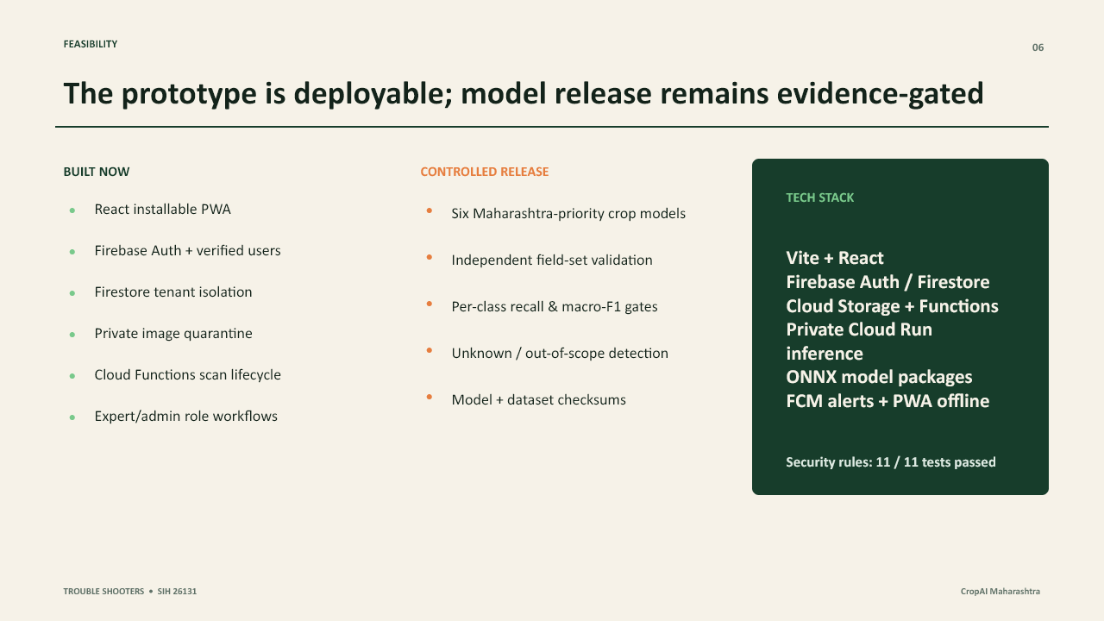
FEASIBILITY
Trouble Shooters

Slide 7
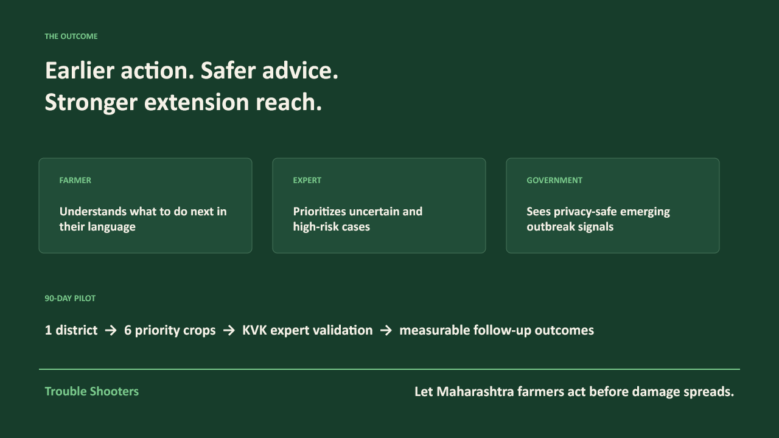
THE OUTCOME
Trouble Shooters

