Slide 1

CropAI
Detect early. Act safely.
Escalate intelligently.
Problem Statement 26131
Problem Crop disease and pest infestation early detection
Theme Agriculture / FoodTech / Rural Development
Category Software
Team Trouble Shooters

Slide 2
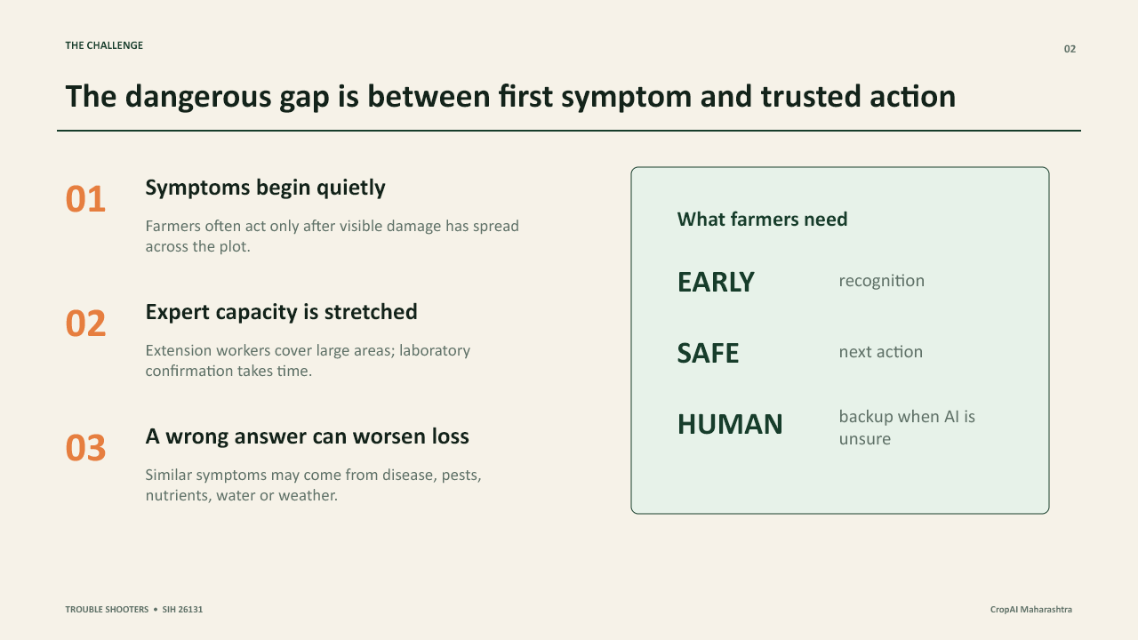
THE CHALLENGE
Trouble Shooters

Slide 3
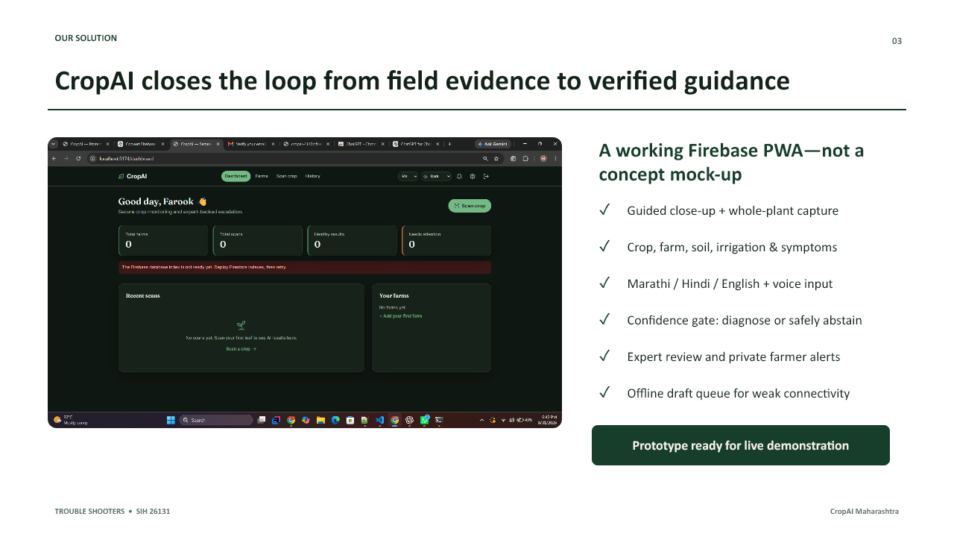
OUR SOLUTION
Trouble Shooters

Slide 4
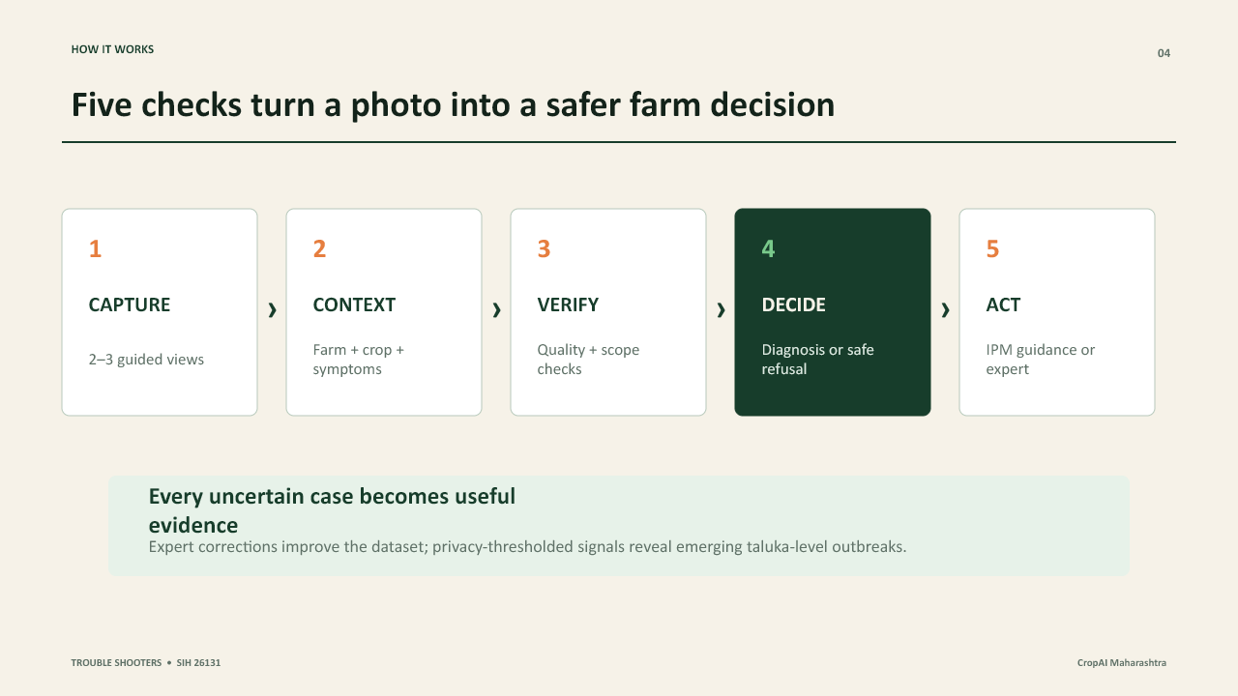
HOW IT WORKS
Trouble Shooters

Slide 5
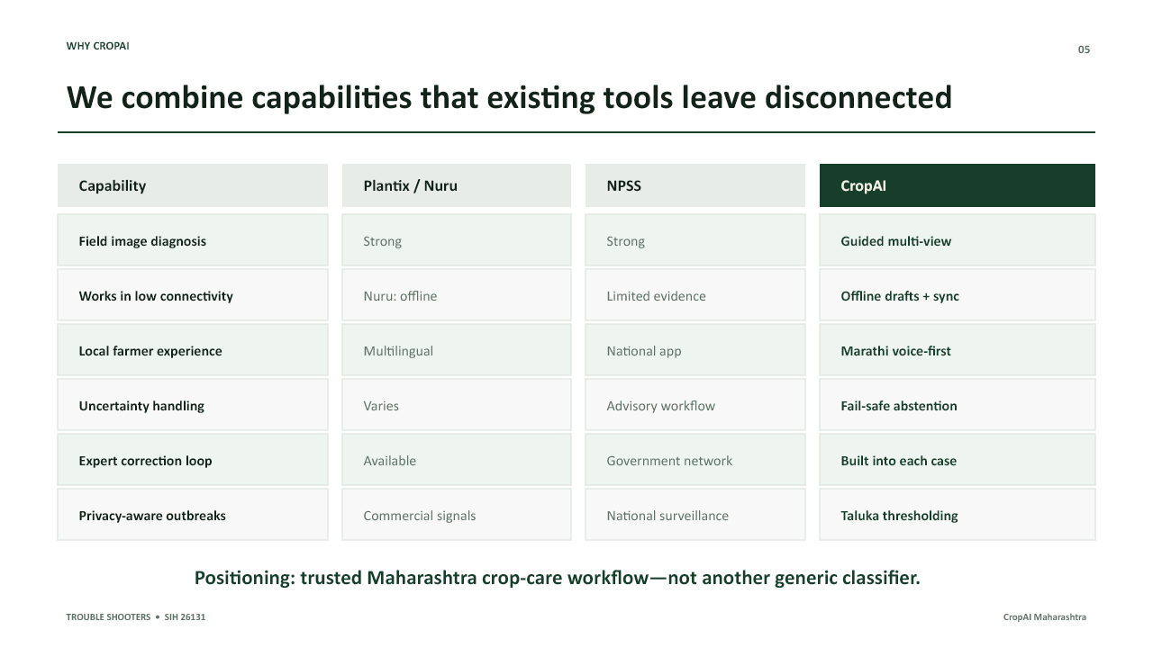
WHY CROPAI
Trouble Shooters

Slide 6
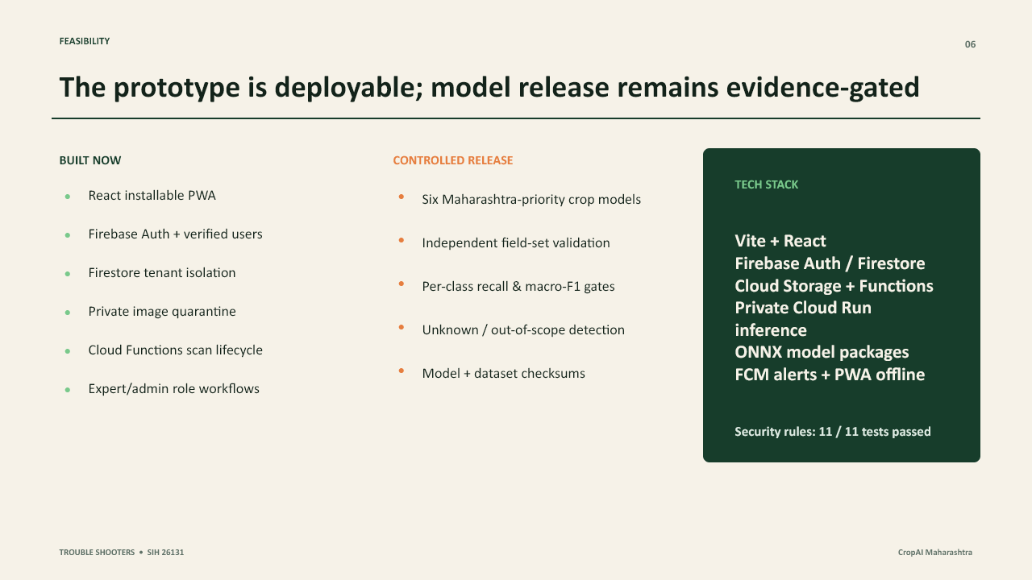
FEASIBILITY
Trouble Shooters

Slide 7
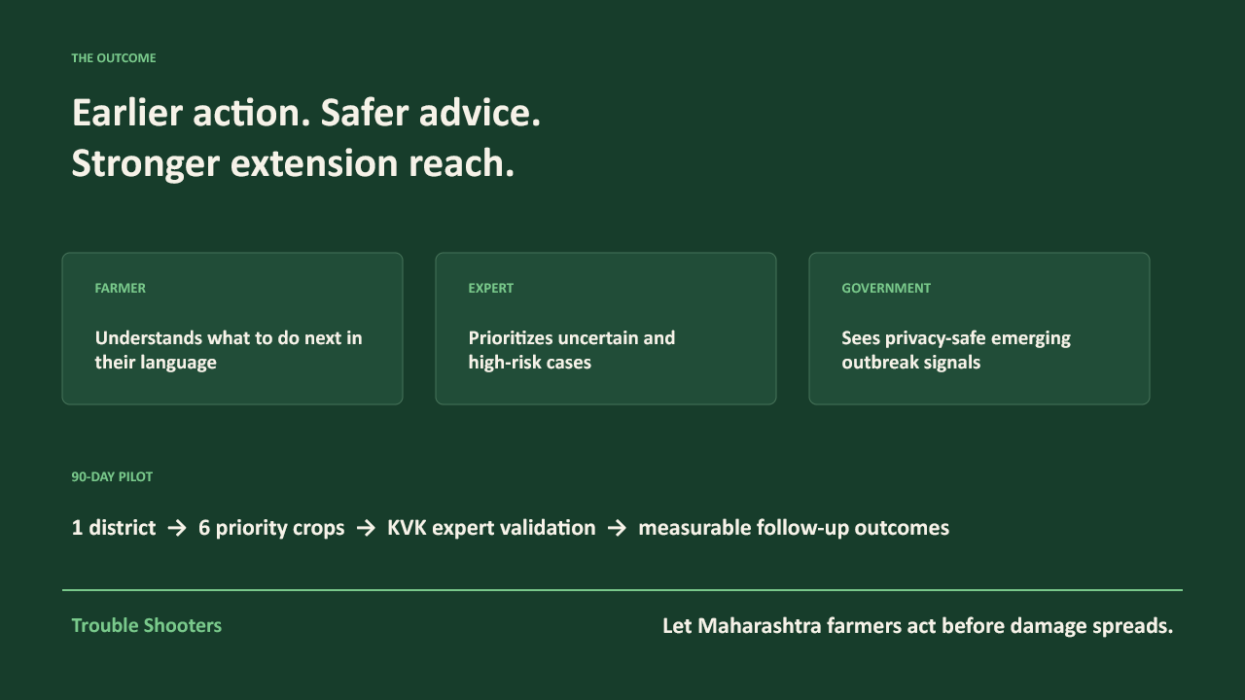
THE OUTCOME
Trouble Shooters

