Slide 1
SMART INDIA HACKATHON
CropAI
Detect earlier. Act safely.
Escalate intelligently.
Early detection and management of crop diseases and pest infestations
TROUBLE
SHOOTERS
Problem Statement 26131 | Software
Government of Maharashtra | Agriculture, FoodTech & Rural Development
Notes:
Open with the farmer outcome: earlier recognition, safer action, and expert escalation.
Do not begin with the technology stack.
[Sources]
SIH problem statement details supplied by the team.

Slide 2
THE CHALLENGE
02
The dangerous gap is between first symptom and trusted action
01
Symptoms begin quietly
Farmers often act only after visible damage has spread across the plot.
What farmers need
EARLY
recognition
02
Expert capacity is stretched
Extension workers cover large areas; laboratory confirmation takes time.
SAFE
next action
HUMAN
backup when AI is unsure
03
A wrong answer can worsen loss
Similar symptoms may come from disease, pests, nutrients, water or weather.
TROUBLE SHOOTERS • SIH 26131
CropAI Maharashtra
Notes:
Frame the problem as a decision-delay problem, not only an image-classification problem.
[Sources]
Problem description supplied by Government of Maharashtra / team brief.

Slide 3
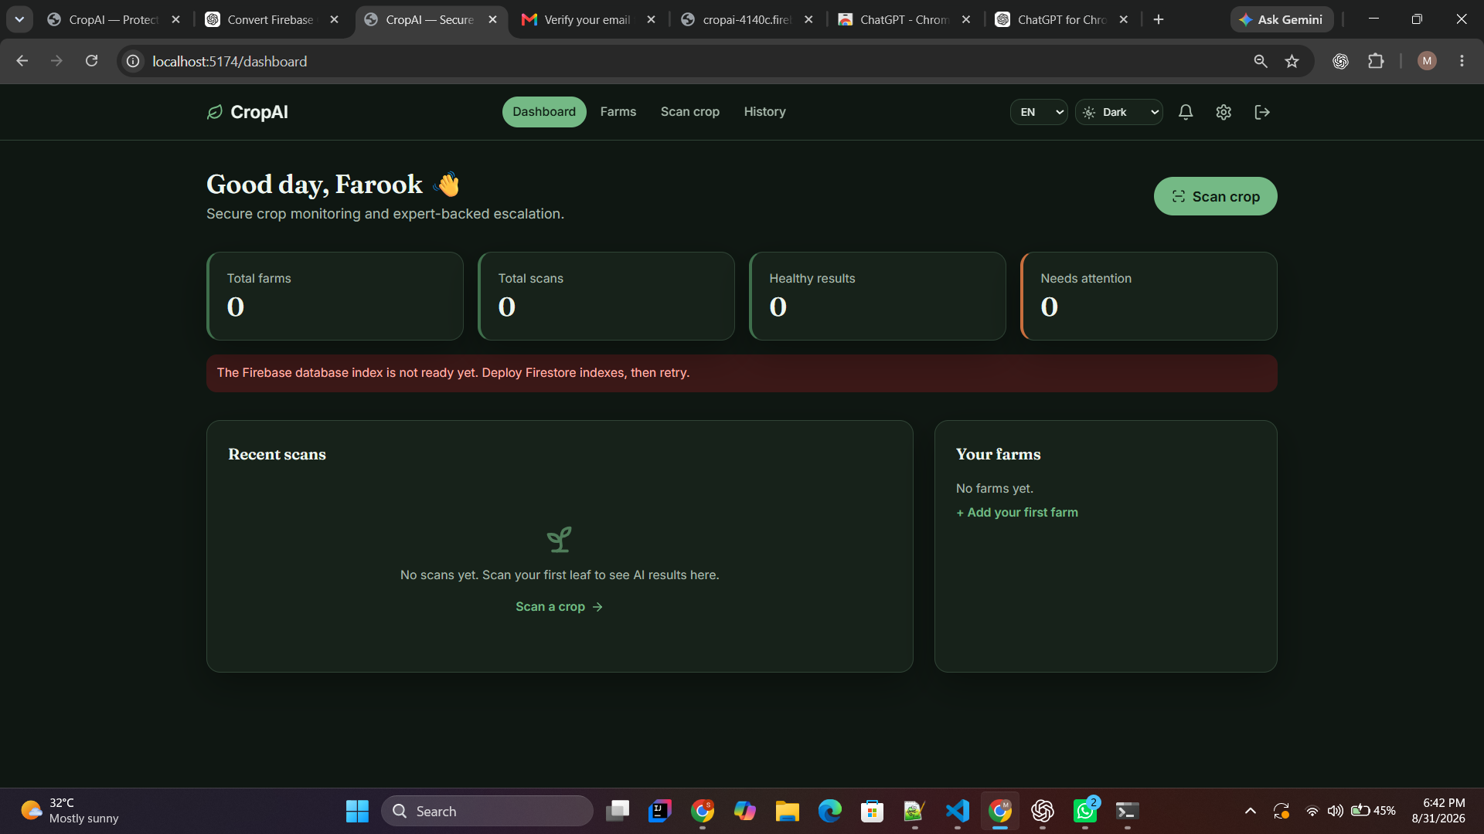
OUR SOLUTION
03
CropAI closes the loop from field evidence to verified guidance
A working Firebase PWA—not a concept mock-up
✓
Guided close-up + whole-plant capture
✓
Crop, farm, soil, irrigation & symptoms
✓
Marathi / Hindi / English + voice input
✓
Confidence gate: diagnose or safely abstain
✓
Expert review and private farmer alerts
✓
Offline draft queue for weak connectivity
Prototype ready for live demonstration
TROUBLE SHOOTERS • SIH 26131
CropAI Maharashtra
Notes:
Show the live product after this slide.
Emphasize that unvalidated model outputs fail closed; the system never invents a diagnosis.
[Sources]
Prototype screenshot: CropAI project, captured 31 Aug 2026.

Slide 4
HOW IT WORKS
04
Five checks turn a photo into a safer farm decision
1
2
3
4
5
CAPTURE
›
CONTEXT
›
VERIFY
›
DECIDE
›
ACT
2–3 guided views
Farm + crop + symptoms
Quality + scope checks
Diagnosis or safe refusal
IPM guidance or expert
Every uncertain case becomes useful evidence
Expert corrections improve the dataset; privacy-thresholded signals reveal emerging taluka-level outbreaks.
TROUBLE SHOOTERS • SIH 26131
CropAI Maharashtra
Notes:
Walk left to right. The differentiator is the confidence gate between verification and action.
Explain that expert corrections create a governed learning loop.
[Sources]
CropAI repository architecture and implemented scan workflow.

Slide 5
WHY CROPAI
05
We combine capabilities that existing tools leave disconnected
Capability
Plantix / Nuru
NPSS
CropAI
Field image diagnosis
Strong
Strong
Guided multi-view
Works in low connectivity
Nuru: offline
Limited evidence
Offline drafts + sync
Local farmer experience
Multilingual
National app
Marathi voice-first
Uncertainty handling
Varies
Advisory workflow
Fail-safe abstention
Expert correction loop
Available
Government network
Built into each case
Privacy-aware outbreaks
Commercial signals
National surveillance
Taluka thresholding
Positioning: trusted Maharashtra crop-care workflow—not another generic classifier.
TROUBLE SHOOTERS • SIH 26131
CropAI Maharashtra
Notes:
Do not attack competitors; show the integration gap CropAI addresses.
[Sources]
Plantix official features: https://plantix.net/en/download/
PlantVillage Nuru / CGIAR: https://bigdata.cgiar.org/inspire/inspire-challenge-2017/pest-and-disease-monitoring-by-using-artificial-intelligence/
NPSS, Press Information Bureau, 25 Mar 2025: https://www.pib.gov.in/PressReleaseIframePage.aspx?PRID=2114896&lang=2&reg=48

Slide 6
FEASIBILITY
06
The prototype is deployable; model release remains evidence-gated
BUILT NOW
CONTROLLED RELEASE
React installable PWA
Six Maharashtra-priority crop models
TECH STACK
●
●
Firebase Auth + verified users
Vite + React
Firebase Auth / Firestore
Cloud Storage + Functions
Private Cloud Run inference
ONNX model packages
FCM alerts + PWA offline
●
●
Independent field-set validation
●
Firestore tenant isolation
Per-class recall & macro-F1 gates
●
●
Private image quarantine
●
Unknown / out-of-scope detection
●
Cloud Functions scan lifecycle
●
Model + dataset checksums
●
Expert/admin role workflows
Security rules: 11 / 11 tests passed
TROUBLE SHOOTERS • SIH 26131
CropAI Maharashtra
Notes:
Be transparent: the platform is working, while disease models must pass field validation before release.
This honesty is a safety and feasibility strength, not a weakness.
[Sources]
CropAI repository README and verified local build/security test results.

Slide 7
THE OUTCOME
Earlier action. Safer advice.
Stronger extension reach.
FARMER
EXPERT
GOVERNMENT
Understands what to do next in their language
Prioritizes uncertain and high-risk cases
Sees privacy-safe emerging outbreak signals
90-DAY PILOT
1 district → 6 priority crops → KVK expert validation → measurable follow-up outcomes
Trouble Shooters
Let Maharashtra farmers act before damage spreads.
Notes:
Close by asking for a district pilot and access to agricultural experts/field images.
Suggested pilot metrics: image completion rate, expert turnaround, safe-refusal rate, and farmer-reported recovery.
[Sources]
SIH evaluation criteria: novelty, feasibility, practicability, sustainability, impact, UX and future progression — https://sih.gov.in/letters/Guidelines-College-SPOC.pdf

