Slide 1

Voice as Biomarkers for Disease
K.Rubasri
(E0524004)
B.Tech Computer Science and Medical Engineering(AIDA)
SRET
Under the guidance of
Dr. A.K. Jayanthy
Head Of The Department
Medical Engineering
SRET

Slide 2
CONTENT
Introduction
Literature Review
Problem Statement
Objectives
System Design
Methodology
Results & Discussions
Conclusion
Future Work

Slide 3
Introduction
Non-invasive health monitoring system
Uses voice and physiological parameters
Detects potential health risk levels
Designed using ESP32 microcontroller
Suitable for wearable and portable applications
1

Slide 4
Literature Review
S.NO | PAPER TITLE & YEAR | AUTHOR NAME & PUBLICATION | TECHNIQUE/ METHODOLOGY | PARAMETERS ACQUIRED
1. | Voice for Health: The Use of Vocal Biomarkers from Research to Clinical Practice | Guy Fagherazzi a Aurélie Fischer, et.al Digit Biomark 2021;5:78–88 | Audio signal decompostion | Acoustic, Phonation, Speech timing, Linguistic
2. | Recommendations for Successful Implementation of the Use of Vocal Biomarkers for Remote Monitoring of COVID-19 and Long COVID in Clinical Practice and Research | Aurelie Fischer et.al Interact J Med Res 2022 | vol. 11 | iss. 2 | e40655 | p. 1 | Mel Frequency Cepstral Coefficients(MFCC) | Spectral, Cepstral, Voice quality, speech pattern
3. | Voice/Speech Analysis Associated with Diseases Using Vocal Biomarkers | Sara JDS, Maor E, et.al Mayo Clinic Proceedings, 2022 | Machine learning based vocal biomarker analysis | Fundamental frequency (Pitch) Amplitude variation Jitter Shimmer Acoustic voice features
2

Slide 5
Problem Statement
Early detection of heart, respiratory, and fever-related conditions is difficult with traditional single-parameter devices.
Continuous health monitoring is not easily accessible in remote or home environments.
Voice changes related to stress or respiratory issues are often ignored in existing wearable systems.
There is a need for a compact, low-cost multi-parameter device that combines physiological signals and voice biomarkers for real-time health risk assessment.
3

Slide 6
Objectives
To develop a low-cost portable health monitoring system using ESP32 and biomedical sensors.
To analyze voice biomarkers and vital parameters for early health risk detection.
To implement a real-time risk classification system (Low, Moderate, High).
4

Slide 7
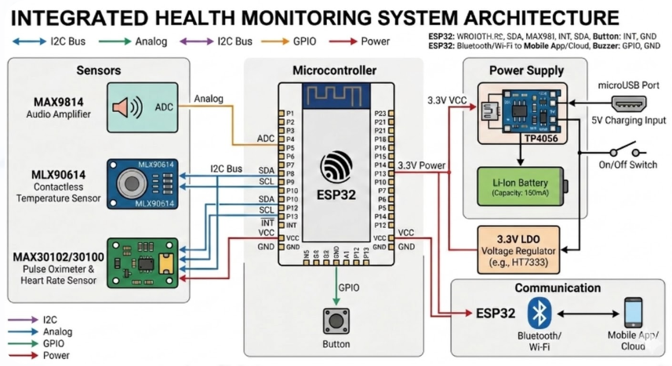
System Design
5

Slide 8
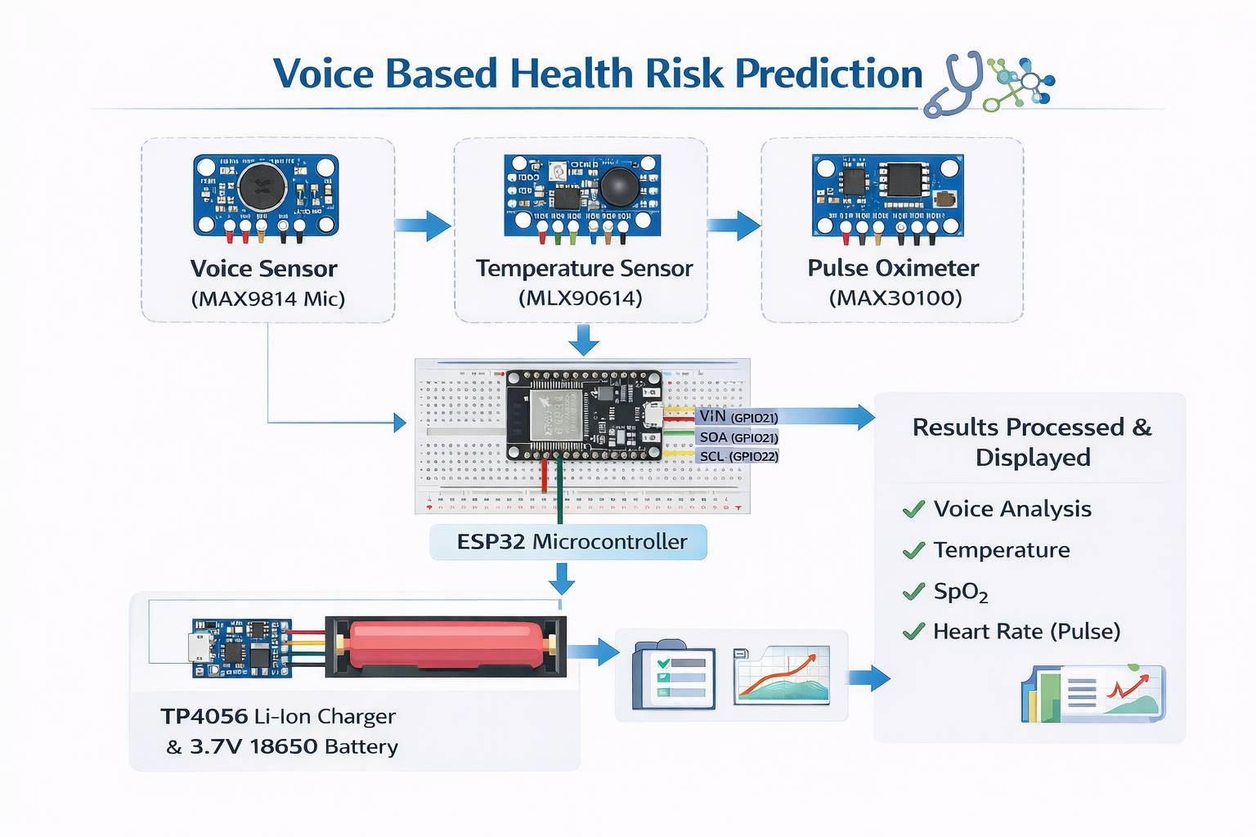
Methodology
6

Slide 9
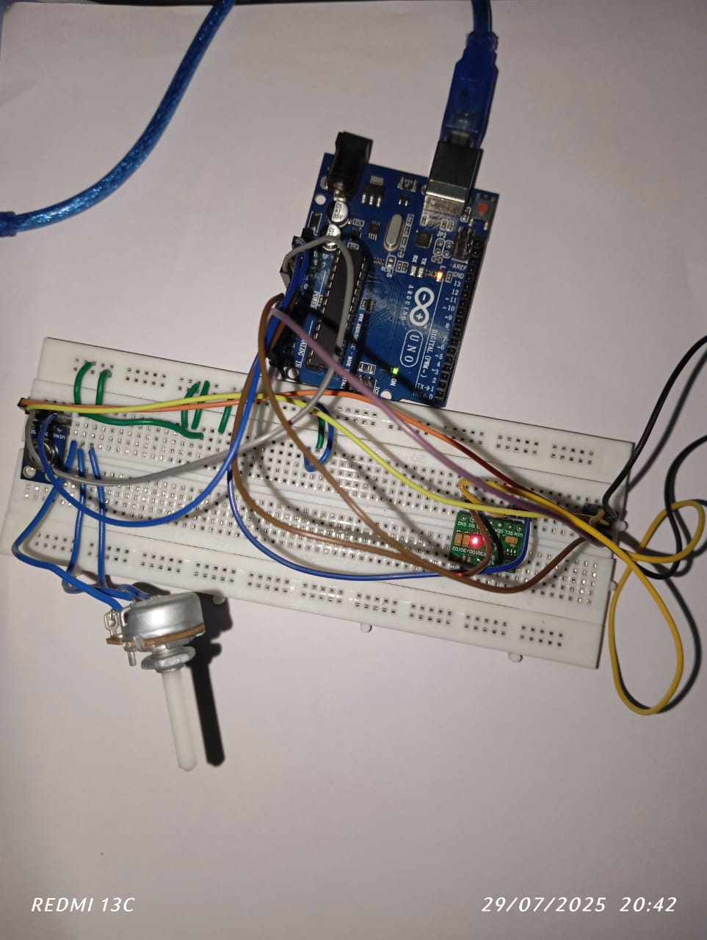
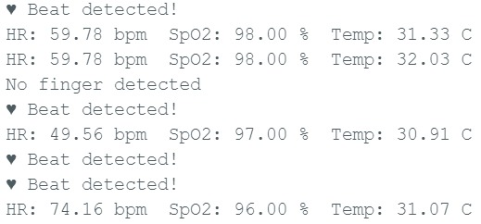
Results & Discussions
Integration of MAX30100/30102 and MLX90614 Sensor
7

Slide 10
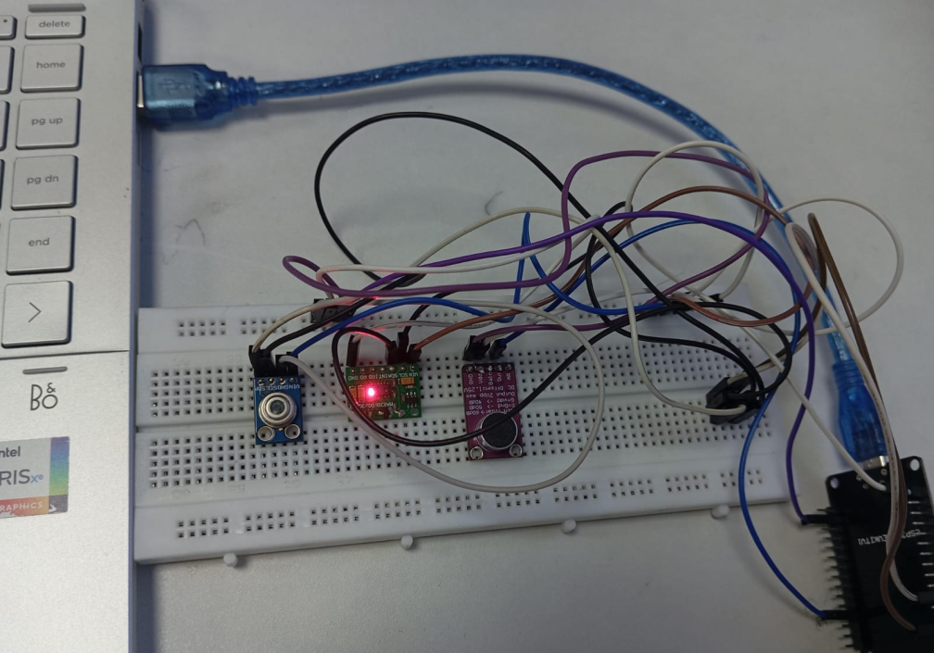
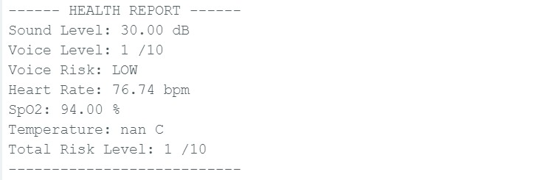
Integration of MAX30100/30102, MLX90614 and MAX9814 Sensor

Slide 11
Conclusion
In conclusion, this project proposes an AI-based system that combines voice biomarkers and physiological signals for health risk assessment. At this stage, we have completed the literature review and system design. The future work will focus on complete hardware implementation and AI model development for real-time monitoring and prediction.
8

Slide 12
Future Work
Advanced AI integration
Cloud and IOT integration
Mobile Application Development
Wearable System
Additional Sensor integration
9

Slide 13
References
Bedford J, Enria D, Giesecke J, Heymann DL, Ihekweazu C, Kobinger G, et al. COVID-19: towards controlling of a
pandemic. The Lancet 2020 Mar;395(10229):1015-1018. [doi: 10.1016/s0140-6736(20)30673-5]
Aurelie Fischer, MSc; Abir Elbeji, MSc; Gloria Aguayo, MD, PhD; Guy Fagherazzi, PhD (Interact J Med Res 2022;11(2):e40655) doi: 10.2196/40655
Jaskanwal Deep Singh Sara, MBChB, Diana Orbelo, PhD, Elad Maor, MD, PhD, Lilach O. Lerman, MD, PhD, Amir Lerman, MD: Mayo Clinic Proceedings : S0025-6196(23)00130-1
10

Slide 14
THANK YOU!

