Slide 1
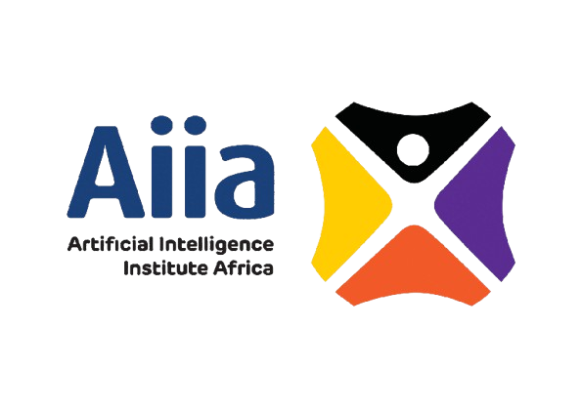
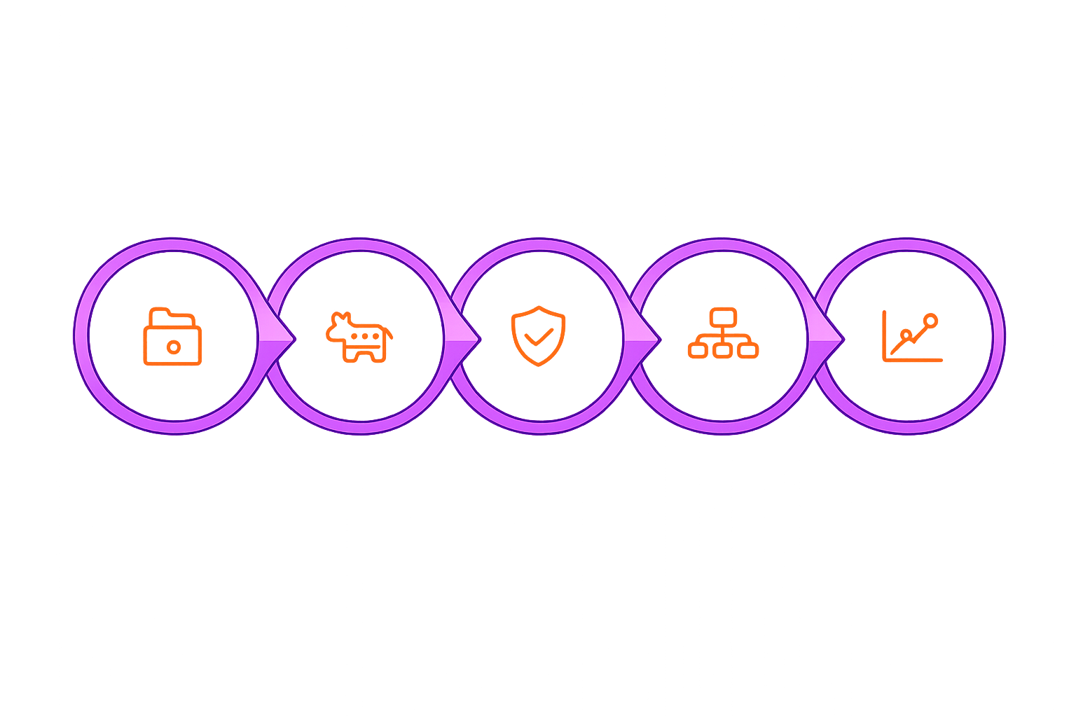
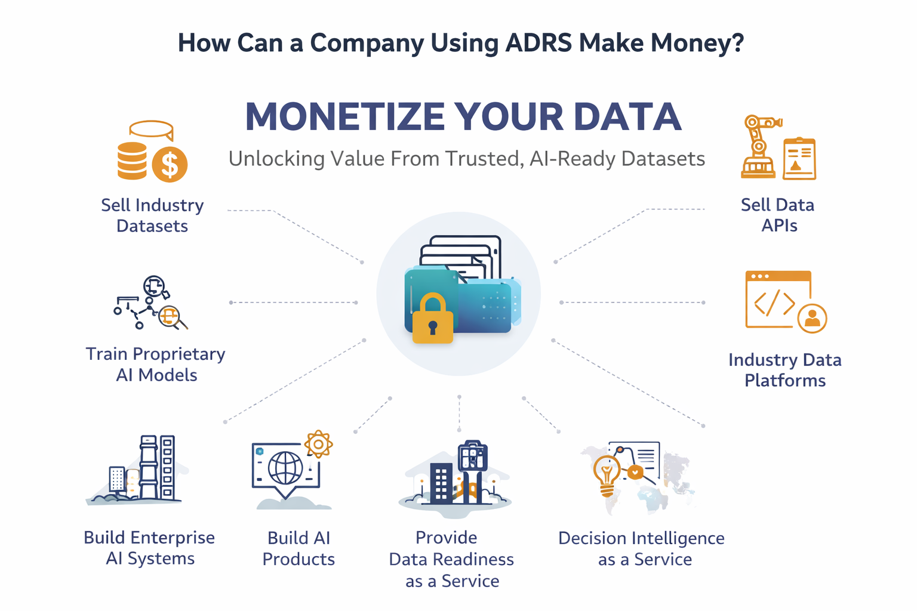
AI DATA READINESS SYSTEM
ADRS
Your Documents Hold Billions in Untapped AI Value
ADRS transforms raw documents into immutable evidence-traced, schema-versioned AI-ready datasets – a governed data factory purpose-built for enterprise AI adoption
Documents
AI Extraction
Trust Layer
Canonical
Model
Knowledge
Graph
Machine Learning
RAG / LLM Knowledge Systems
Knowledge Graph Intelligence
Unlock structured datasets from existing document archives for model training
Feed large Language Models with trusted, traceable enterprise knowledge
Build golden records and entity relationships across your entire document estate
Full audit lineage

