Slide 1

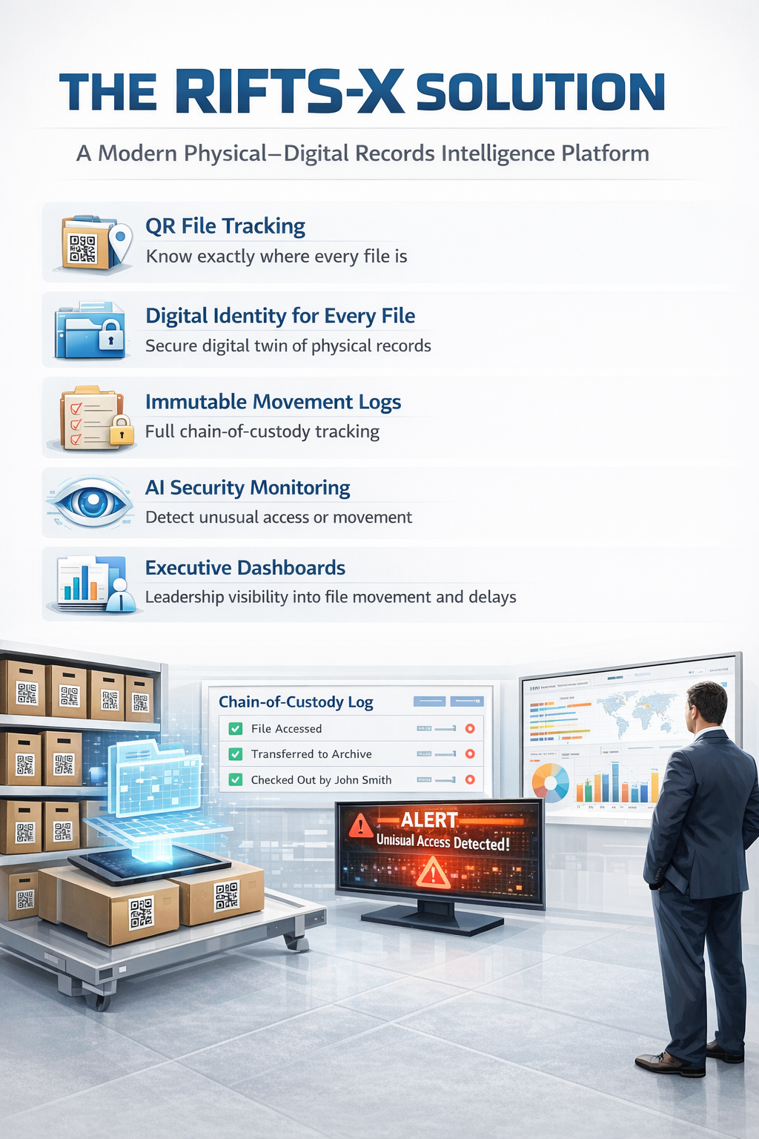
RIFTS-X - Records Intelligence & File Tracking System
Records Intelligence & File Tracking System
Transforming how government institutions manage physical and digital files
The Institutional File Problem
Government offices face daily records challenges:
• Lost or misplaced files
• No real-time visibility of file location
• Slow approvals due to manual file movement
• Paper records disconnected from digital systems
• Weak audit trails and accountability
These issues lead to delayed decisions, operational inefficiencies, and institutional risk.

