Slide 1


Mining Implicit Entity Preference from User-Item Interaction Data for Knowledge Graph Completion via Adversarial Learning
Gaole He, Junyi Li, Wayne Xin Zhao,
Peiju Liu and Ji-Rong Wen
Notes:
Hello, everyone! I’m Gaole He, from Renmin University of China.
In this talk, I’ll introduce our paper about knowledge graph completion with user-item interaction data.

Slide 2
Outline
Introduction
Background
Motivation
Related Work
Task Definition
Challenge & Solution
Experiment
Conclusion
Notes:
First, let's look at the background and motivation of this paper.

Slide 3
Background: KG & KGC
Knowledge graph (KG) : multi-relational entity graph
Knowledge Graph Completion (KGC)
Knowledge Graph
artist
Reputation
Taylor Swift
artist
genre
?
Lover
country
artist
genre
5th year
Brad
Paisley
artist
Hits Alive
Query = <Taylor Swift, genre, ?>
Notes:
Knowledge graph (KG) is typically a multi-relational entity graph containing entities as nodes and relations as edges.
Knowledge graphs are important resources for many artificial intelligence tasks but often suffer from incompleteness.
To address the problem, researchers propose a task Knowledge Graph Completion.
Knowledge Graph Completion (KGC) aims to automatically infer the missing fact information in knowledge graph (e.g. predicting a missing entity).
For example, If we don't know which genre Taylor swift belong to, we try to complete it with predict answer for the query.

Slide 4
Background: KG & UI
KGs are often utilized in application systems
Many KG entities correspond to items in application systems
Rich user-item interaction (UI) data in application systems
Application System
Knowledge Graph
artist
item 1
Reputation
Taylor Swift
artist
genre
Steph
item 2
Lover
country
item 3
artist
genre
5th year
Brad
Paisley
Bob
artist
item 4
Hits Alive
Item-entity Alignment
Notes:
KGs are often utilized in application systems.
单击
As our observation, many knowledge graph entities correspond to online items in application systems. For example, Taylor Swift's song Lover can be found in both KG and last.fm platform.
For KG entities aligned to online items, we can obtain fact triples from the KG as well as rich user-item interaction data from the application platforms.

Slide 5
Motivation
Is user-item interaction data helpful for KGC task?
User-item interaction data is likely to contain implicit evidence about entity semantics, which is potentially useful to KGC.
artist
Reputation
Taylor Swift
artist
Steph
genre
?
Lover
country
artist
genre
5th year
Brad
Paisley
Bob
artist
Hits Alive
Query = <Taylor Swift, genre, ?>
Notes:
To our motivation, user-item interaction data has explicitly reflected users’ preference at the item level, while it is likely to contain implicit evidence about entity semantics, which is potentially useful to our task.
Have a look at the example. In the figure, the users “Steph” and “Bob” like the songs from both singers “Taylor Swift” and “Brad Paisley” due to the similar style. Such co-occurrence patterns in user interaction data are helpful to infer whether the two singers share the same artist genre in KG.

Slide 6
Task Definition
Task: Given a query triple ⟨h, r, ?⟩ or ⟨?, r, t⟩, we aim to predict the missing entity given both the KG information and user-item interaction data.
artist
Reputation
Taylor Swift
artist
Steph
genre
?
Lover
country
artist
genre
5th year
Brad
Paisley
Bob
artist
Hits Alive
Query = <Taylor Swift, genre, ?>
Notes:
Our task is defined as:
Given a query triple ⟨h, r, question mark⟩ or ⟨question mark, r, t⟩, we aim to predict the missing entity given both the KG information and user-item interaction data.

Slide 7
Related Work
Existing work
path-based methods. Sun et al. RecSys 2018
regularization-based methods. Piao et al. ESWC 2018
graph neural network methods. Wang et al. KDD 2019
Drawback:
KG and UI have very different intrinsic characteristics. simple fusion strategy may hurt the representation performance
User-item interaction data is usually very noisy. It may be problematic to directly incorporate the learned information (e.g., user preference) for inferring KG facts
Notes:
Indeed, several recent efforts have attempted to leverage both KG data and user-item interaction data for jointly improving the KGC task and related recommendation tasks.
单击
Such as path-based methods proposed by Sun et al.
单击
regularization-based methods proposed by Piao et al.
单击
and graph neural network methods proposed by Wang et al.
These studies mainly focus on developing data fusion models for integrating the two kinds of data sources, e.g., learning representations in the same space or share the same information representation across different sources.
单击
However, the two kinds of data sources have very different intrinsic characteristics, and it is likely to hurt the original representation performance using simple fusion strategy.
单击
In addition, user-item interaction data is usually very noisy since user behaviors will be affected by external events or other influencing factors. It may be problematic to directly incorporate the learned information for inferring KG facts.
To solve our task, we have to consider the effect of data heterogeneity and semantic complexity on model design.

Slide 8
Interaction-Augmented Knowledge Graph
Heterogeneous graph to unify KG and UI data
Consisting of KG triples and user-item interaction triples
Nodes are organized in layers w.r.t shortest distance (minimum hop number for arriving at any user node)
Layer 0
User
Layer1
Item
Layer2
Entity
Layer3
Entity
UI
KG
Notes:
Considering the overlap between KG entities and online systems, we introduce an extended entity graph to unify the KG information and user interaction data. The extended knowledge graph consists of a union set of KG triples and user-item interaction triples.
Since our task is to leverage user interaction data for learning useful evidence to the KGC task, we organize the entity graph in a user-oriented layerwise structure
单击
Specially, user nodes are placed on the first layer,
单击
then the aligned entities (which correspond to online items) are placed on the second layer.
单击
The other nodes are organized in layers according to their distance.
We call it interaction-augmented knowledge graph.

Slide 9
Outline
Introduction
Challenge & Solution
Overview
part 1: Two-stage representation learning
part 2: Adversarial learning for KGC
Experiment
Conclusion
Notes:
Then, we will introduce the challenge in this task and how we address it.

Slide 10
Overview
Challenge:
How to learn useful KG information from user-item interaction data for improving KGC task ?
How to integrate or utilize the learned information in KGC methods?
Solution:
Two-stage representation learning
Adversarial Learning
Preference-enhanced discriminator
Query-specific generator
Notes:
The major challenge can be summarized as:
To address the first challenge, we develop a two-stage representation learning algorithm based on graph neural networks.
To address the second challenge, our idea is to develop a specific evaluation component that incorporates and learns user preference information about entities for evaluating a candidate entity given a query. Meanwhile, we keep a prediction component to produce the candidate entity without using user preference information. By mapping the two components to discriminator and generator respectively, our idea naturally fits into the successful framework of generative adversarial networks.

Slide 11
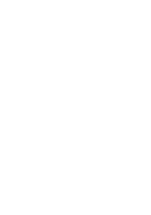



Two-stage Representation Learning
Encode useful preference evidence for enhancing KG entity representation
Learn user preference on the graph
Collect user preference on the graph
Layer 0
User
Layer1
Item
Layer2
Entity
Layer3
Entity
How to obtain preference representations for entities in KG ?
$$u_{1}$$
$$u_{2}$$
$$e$$
Notes:
Let's zoom into how two-stage representation learning work.
单击
If we want to model preference for entity e in KG,
单击
we should first find related users. And learn entity-oriented user preference for them according to graph structure.
单击
Then, we collect user preference from related users.

Slide 12
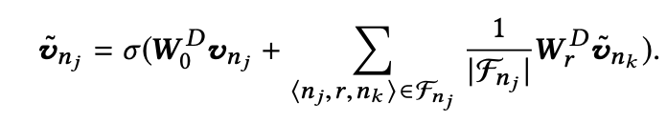

Learning Entity-oriented User Preference
Layer-wise graph convolution network
Propagate information from KG entities to users
Layer 0
User
Layer1
Item
Layer2
Entity
Layer3
Entity
Learn user preference from forward triples
$$u_{1}$$
$$u_{2}$$
$$e$$
Forward triples for entity $n_{j}$
Notes:
In the first stage, we preform the information propagation from KG entities to users. The update strategy is a combination between the original embedding and the received embeddings from forward triples.
Look, we propagate information from entities in layer 3, to layer 2, layer 1 and finally we obtain user entity-oriented preference for users in layer 0.

Slide 13
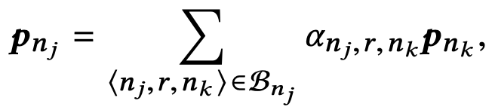

Learning Preference-enhanced Entity Representation
Layer-wise graph attention network
Collect user preference on the graph w.r.t high-order connectivity
Layer 0
User
Layer1
Item
Layer2
Entity
Layer3
Entity
$$u_{1}$$
Collect user preference from backward triples
$$u_{2}$$
$$e$$
Backward triples for entity $n_{j}$
Notes:
In the second stage, we adopt layer-wise graph attention network to collect user preference w.r.t high-order connectivity.
单击
The representations of user nodes are learned from the first stage.
单击
And we can obtain preference representations for entities in layer 1,
单击
and then target entity in layer 2.
It can be proved that the collected preference representation is indeed a linear combination of user preference representations.

Slide 14
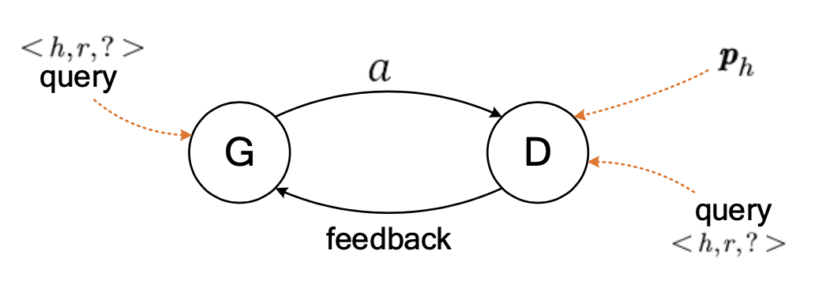
Adversarial Learning
How to integrate or utilize the learned information in KGC methods ?
Preference-enhanced
entity representation
Query-specific generator
Preference-enhanced discriminator
Notes:
Considering data heterogeneity and semantic complexity, we design an adversarial learning approach to utilizing useful information from user-item interaction data for the KGC task.
Our focus is to train a capable discriminator that is able to leverage KG information for the KGC task, and the role of the generator is to improve the discriminator and help the fusion of user interaction data. In this way, we can fully utilize useful evidence from user interaction data in the discriminator, and meanwhile avoid direct influence of user interaction data on the KG semantic space modeled by the generator.
Let’s look at the details of discriminator and generator.

Slide 15
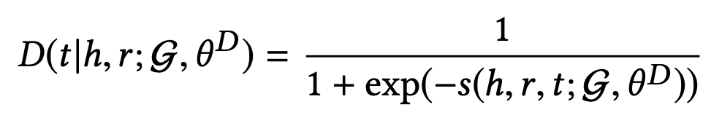
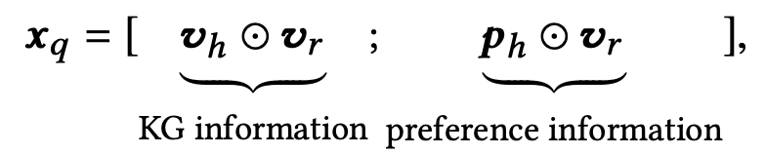
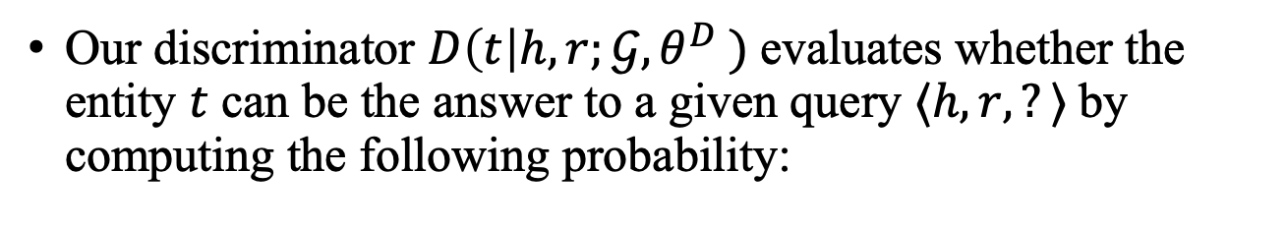
User Preference Guided Discriminator
Our discriminator $D\left(t\right|h, r;𝒢, θ^{D} )$evaluates whether the entity $t$ can be the answer to a given query $⟨h, r, ?⟩$by computing the following probability:
score
MLP-1
MLP-2
KG
KG
UI
query
answer
Notes:
Our discriminator D evaluates whether the entity $t$ can be the answer to a given query <h,r, question mark> by computing the following probability:
单击
$V_{h}$ and $V_{r}$ are learned parameters for KG entities and KG relations
单击
Besides the learned semantic representation $V_{h}$ , we enhance the entity representation using the entity-level preference of the users with high-order connectivity.

Slide 16
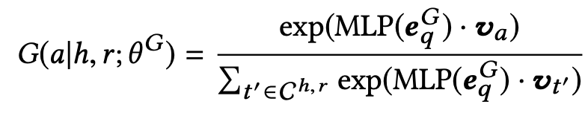





Query-specific Entity Generator
For each query $⟨h, r, ?⟩$, the probability distribution to sample a candidate entity from candidate entity set $C^{h,r}⊂E$ is defined as:
$$G(a|h,r;θ^{G})$$
softmax
MLP
candidates
query
noise
Notes:
For each query <h,r, question mark>, the probability distribution to sample a candidate entity from candidate entity set is defined as following formula
单击
We can implement query representation as any way as needed.
Here we just use the hadamard product of target entity embedding and relation embedding as query representation.
单击
After that, we concatenate the query representation with a noise z, which is drawn from Gaussian distribution with zero mean and covariance. And then use this vector to score all candidate entities and form a probability distribution with softmax.
Note that KG embeddings $v_{h}$ and $v_{r}$ are not necessarily the same as those in the discriminator.

Slide 17
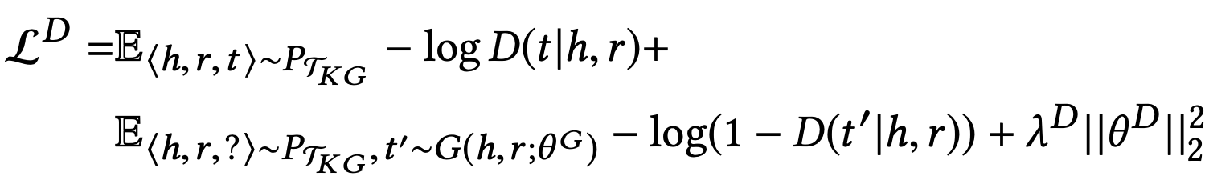
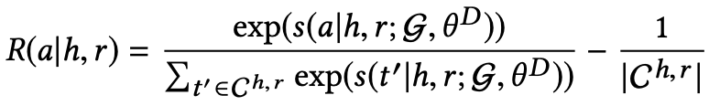
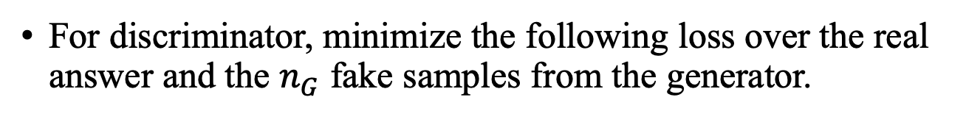
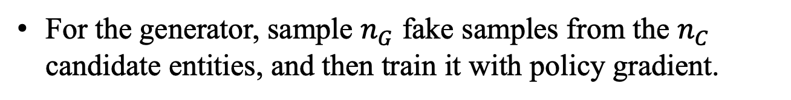
Training
For discriminator, minimize the following loss over the real answer and the $n_{G}$ fake samples from the generator.
For the generator, sample $n_{G}$ fake samples from the $n_{C}$ candidate entities, and then train it with policy gradient.
Notes:
单击
For the discriminator, we minimize the following loss over the real answer and the n_G fake samples from the generator
单击
For the generator, we first sample n_G fake samples from candidate pool and then train it with policy gradient.
For more details, please refer to our paper.

Slide 18
Outline
Introduction
Challenge & Solution
Experiment
Datasets
Setup
Results & Analysis
Case Study
Conclusion
Notes:
Then, we will move to experiment part

Slide 19
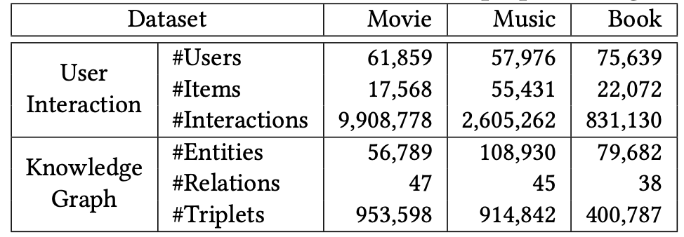
Datasets
Statistics of our datasets
Item-entity alignment from KB4Rec dataset
Three domains: movie, music and book
Training: validation: test = 8:1:1
Notes:
We obtain item-entity alignment form KB4Rec dataset, which will be introduced then.
The data cover three domains : movie, music and book.
We split knowledge graph dataset with eight:one:one ratio.
For construction details, please refer to our paper.

Slide 20
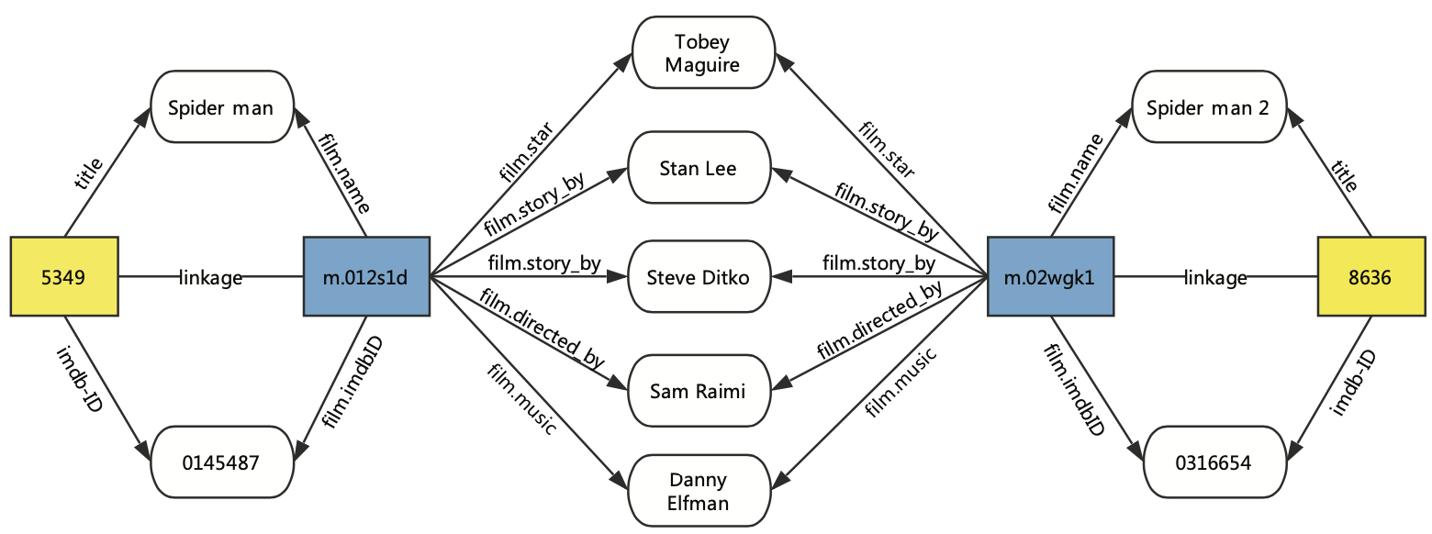
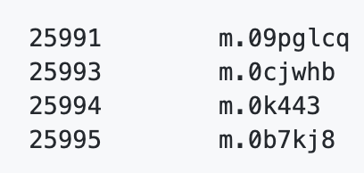
KB4Rec: A Data Set for Linking Knowledge Bases with Recommender Systems
Item-entity alignment
Linked ID pairs
Obtain rich relational facts from KB
https://github.com/RUCDM/KB4Rec
Notes:
KB4Rec is dataset for linking knowledge base with recommender systems.
单击
It organize the item-entity alignment by linked ID pairs, which consists of a recommender system item ID and a knowledge base entity ID.
单击
Here is an example about item-entity alignment from film Spider man and spider man 2 to Freebase entities. Once, we have the item-entity alignment, we can obtain rich relational facts from knowledge base with the entity id.

Slide 21
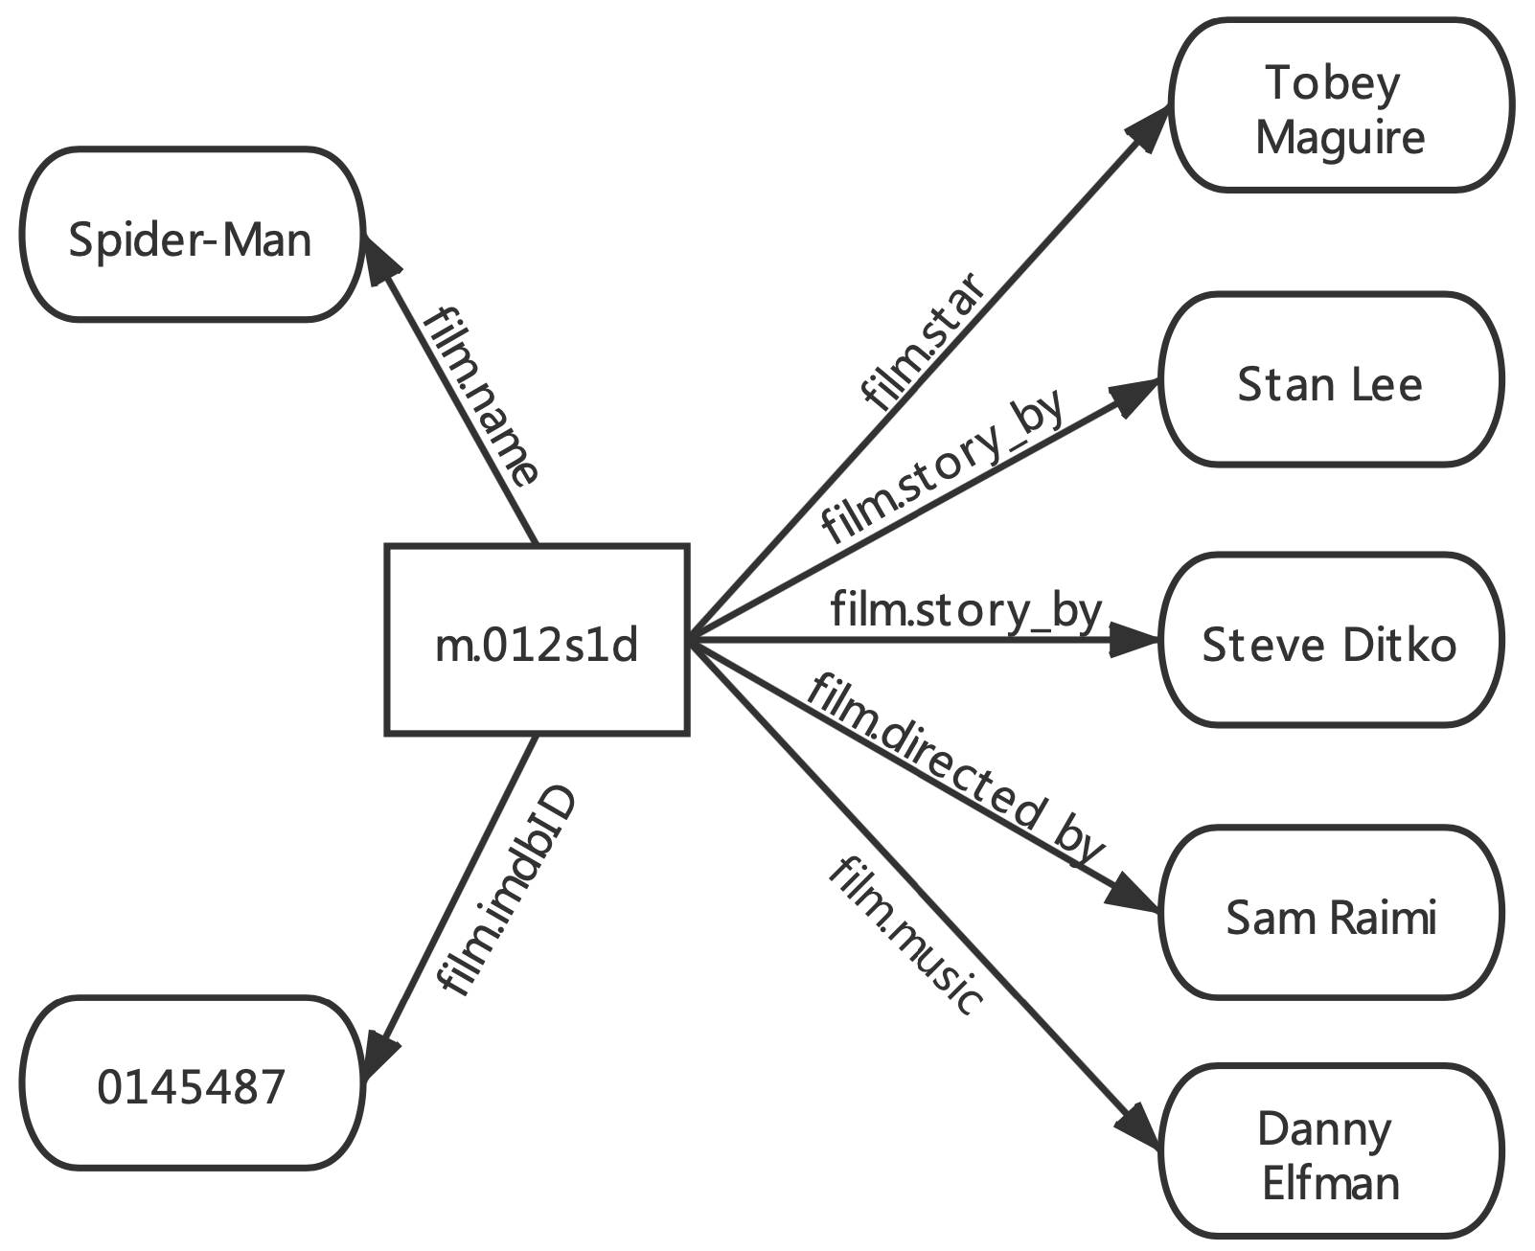
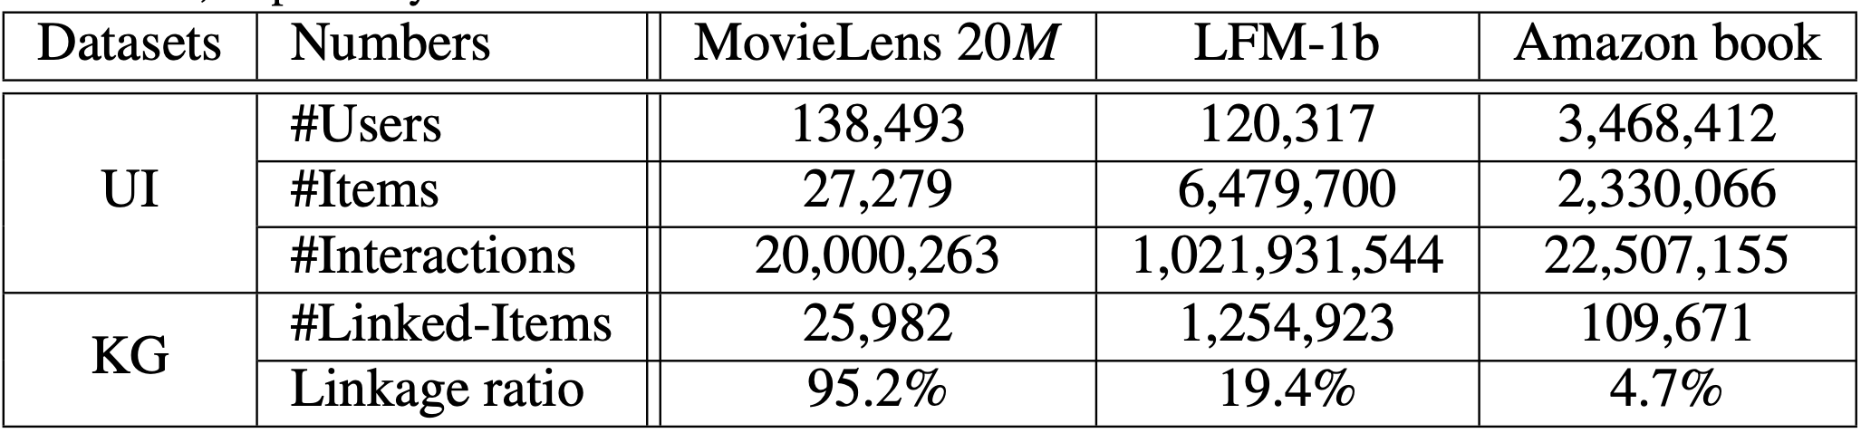
KB4Rec: A Data Set for Linking Knowledge Bases with Recommender Systems
A large amount of item-entity alignment records
1-hop Freebase sub-graph of each domain released, rich relational facts about linked items
https://github.com/RUCDM/KB4Rec
Notes:
单击
KB4Rec provide a large amount of linkage.
单击
Now, 1-hop Freebase sub-graph of each domain has been released, which provide rich relational facts about linked items. You can also follow our code to obtain subgraph of 2 and more hops.
You may have a look at this dataset, which is useful for both Knowledge graph & user-item interaction topic.

Slide 22
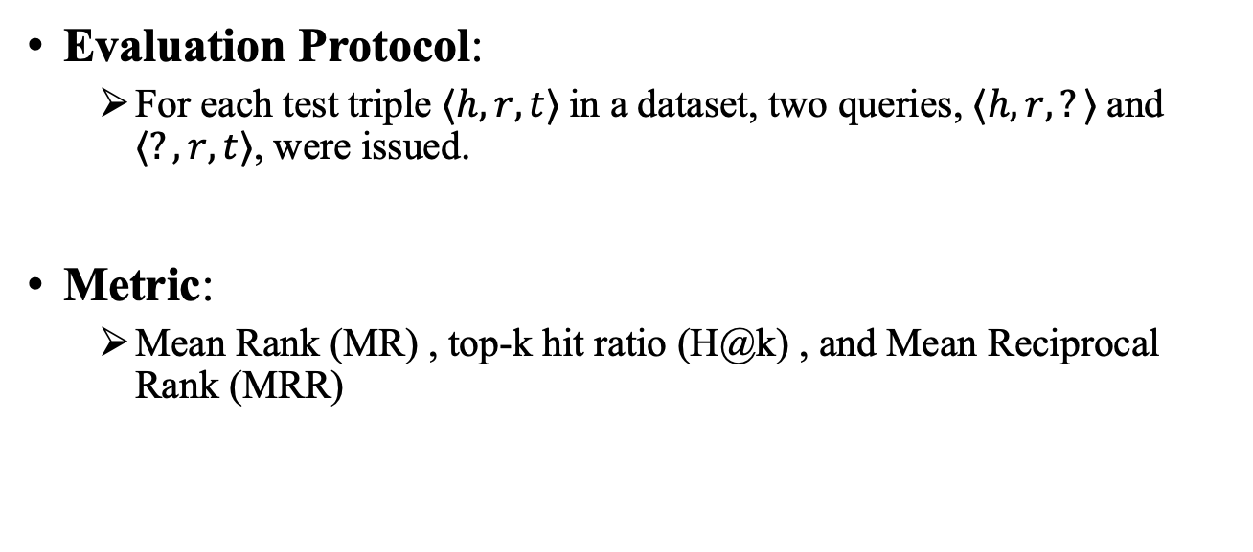
Experiment Setup
Evaluation Protocol:
For each test triple $⟨h, r, t⟩$in a dataset, two queries, $⟨h, r, ?⟩$and $⟨?, r, t⟩$, were issued.
Metric:
Mean Rank (MR) , top-k hit ratio (H@k) , and Mean Reciprocal Rank (MRR)
Notes:
For evaluation, We follow standard KGC evaluation with filter setting.
For each test triple ⟨h, r, t⟩ in a dataset, two queries, ⟨h, r, question mark⟩ and ⟨question mark, r, t⟩, were issued.
We adopt Mean rank, top-k hit ratio and MRR as our metric.

Slide 23
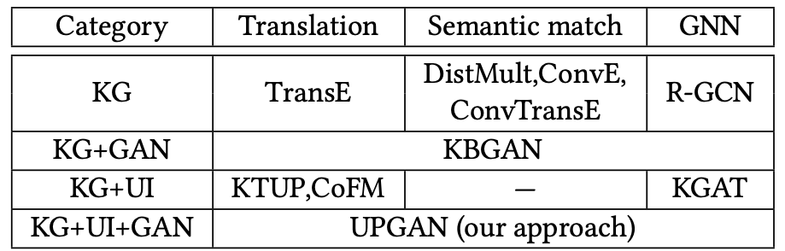
Baseline
The categorization of the comparison methods
Translation: model triples as relational translation from subject to object
Semantic match: model query and answer entity with neural networks (such as CNN), and match them in semantic space
GNN: model data source with graph neural network
GAN: model trained with GAN framework
Notes:
Our baselines have a comprehensive coverage of the related models.
To summarize, we categorize the baselines into several groups shown in this table, according to the technical approaches and utilization of user interaction data.
单击
Translation based methods model triples as relational translation from subject entity to object entity, Such as TransE, KTUP and CoFM.
单击
semantic match based methods model query and answer entity with neural networks (such as convolutional neural network), and then match them in sematic space. Such as DistMult, ConvE and ConvTransE.
单击
GNN based methods model data source with graph neural network. Such as R-GCN and KGAT
单击
GAN based methods are trained with GAN framework. Such as KBGAN.

Slide 24
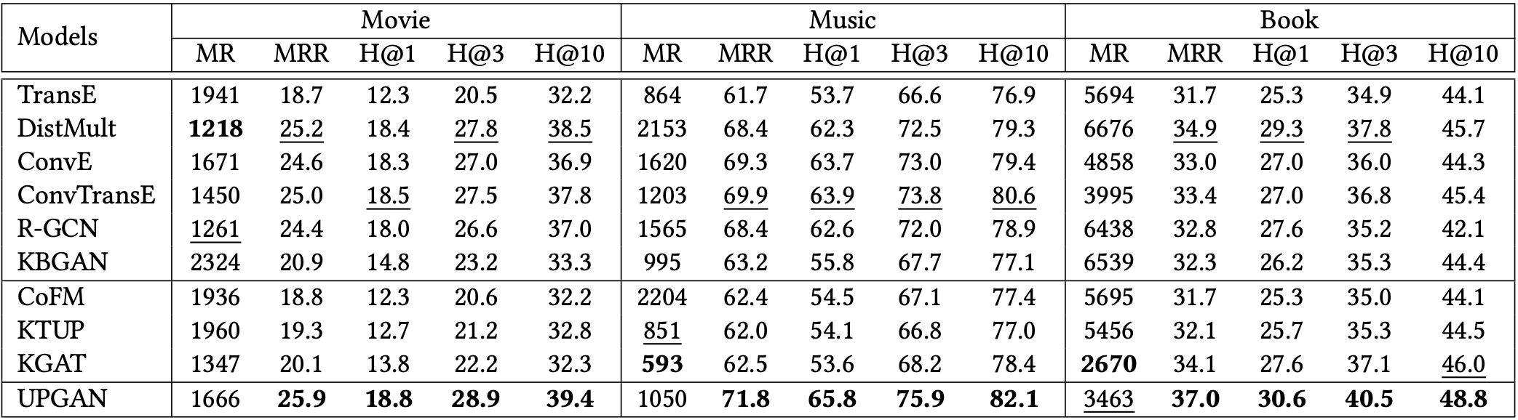
Experimental Results
Performance comparison of different methods for KGC task on three datasets
Overall, DistMult and ConvTransE are the best baseline methods.
KBGAN substantially improves over TransE on all datasets, which indicates the usefulness of adversarial learning.
UPGAN is consistently better than these baselines by a large margin.
Notes:
Main results on three datasets are shown in the table
单击
Overall, DistMult and ConvTransE are the best baseline methods.
单击
KBGAN substantially improves over TransE on all datasets, which indicates the usefulness of adversarial learning.
单击
Our approach UPGAN is consistently better than these baselines by a large margin.

Slide 25
Experimental Results
Performance comparison of different methods for KGC task on three datasets
Overall, the three methods that jointly utilize KG data and user interaction data seem to give slightly better results than TransE.
KGAT achieves a better performance on book dataset than the other two datasets.
Notes:
Let's look at other methods which incorporate user-item interaction data.
单击
Overall, the three methods that jointly utilize KG data and user-item interaction data seem to give slightly better results than TransE.
Among them, KGAT achieves a better performance on book dataset than the other two datasets.

Slide 26
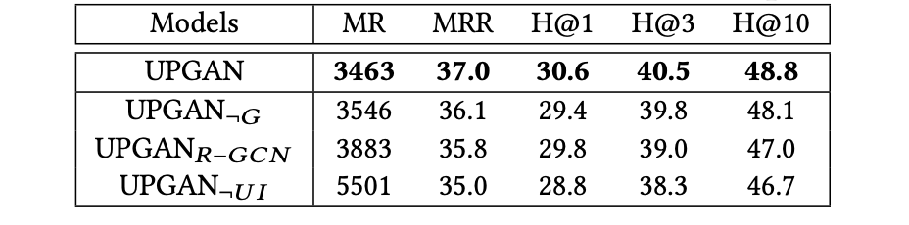
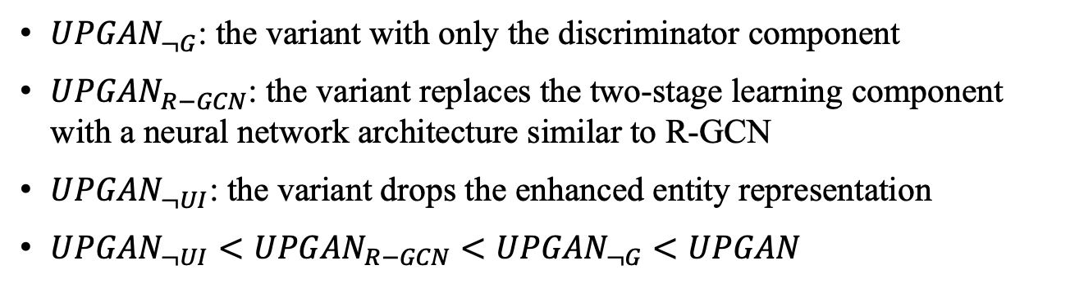
Ablation Analysis
Ablation analysis on book dataset (in percent)
${UPGAN}_{¬G}$: the variant with only the discriminator component
${UPGAN}_{R−GCN}$: the variant replaces the two-stage learning component with a neural network architecture similar to R-GCN
${UPGAN}_{¬UI}$: the variant drops the enhanced entity representation
${UPGAN}_{¬UI}<{UPGAN}_{R−GCN}<{UPGAN}_{¬G}<UPGAN$
Notes:
To effectively utilize the user interaction data, our approach has made several technical extensions. To examine how each of them affects the final performance.
We conduct ablation analysis.
There are three variants about our approach. PPT介绍
These results indicate that the proposed techniques are useful to improve the performance. Especially, user interaction data with a suitable modeling way is more important for our approach.
For the sake of time, please refer to our paper for other detail experiments.

Slide 27
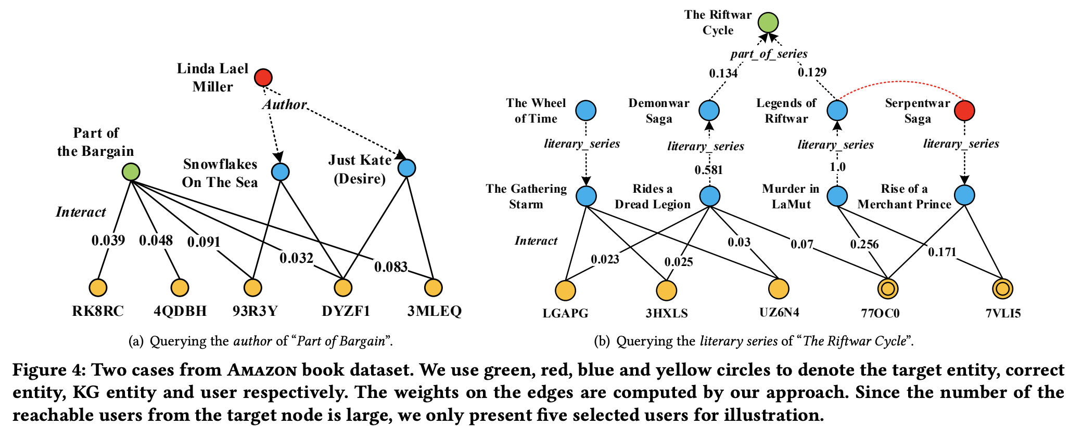
Case Study: Noisy Case
Querying the sub-series of “The Riftwar Cycle”
Target entity
33 users in common
17 users in common
UI data is likely to bring irrelevant information or even noise
Notes:
The example show we try to find the literary series of “The Riftwar Cycle”.
单击
Starting from the target entity, we can identify 128 related users in total with the breath first search extension based on the interaction-augmented KG.
单击
Given two candidate literary series “Serpentwar Saga” and “The Wheel of Time”, a straightforward method is to count the number of a literary series that has been read by the related users. However, “The Wheel of Time” is much more popular than the correct entity “Serpentwar Saga” (33 v.s. 17). It indicates that simply using the user interaction data may incorporate noise.

Slide 28
Case Study: Noisy Case
Querying the sub-series of “The Riftwar Cycle”
=“Serpentwar Saga”
Similar in user preference
Important users
Our approach identify important users to filter noise out
Notes:
As a comparison, by running our approach, we can identify more important users on the graph.
单击
As we can see, the two users with ID “77OC0” and “7VLI5” are assigned with very large attention weights by our algorithm.
单击
An interesting observation is that “Legends of the Riftwar” and “Serpentwar Saga” can be associated via the two selected users.
单击
Based on the known fact that “Legends of the Riftwar” belongs to “The Riftwar Cycle”, our approach is capable of identifying “Serpentwar Saga” as the final answer.

Slide 29
Outline
Introduction
Challenge & Solution
Experiment
Conclusion
Notes:
In conclusion,

Slide 30
Conclusions
This work
An effective approach for learning useful information from user-item interaction data to improve KGC task
Future work
Investigate into how our models perform in other domains.
Notes:
In this work, we propose an effective learning approach for learning useful information from user-item interaction data for the KGC task
In the future, we will investigate into how our models perform in other domains.

Slide 31
For Further Research
Our code is available on:
https://github.com/RUCAIBox/UPGAN
KB4Rec:
https://github.com/RUCDM/KB4Rec
Notes:
Our code is open-sourced on github.
You can also find the item-entity alignment from KB4Rec project.

Slide 32
Thanks!
Notes:
Thanks for your time and listening.

Slide 33
Reference
Recurrent knowledge graph embedding for effective recommendation. Zhu Sun, Jie Yang, Jie Zhang, Alessandro Bozzon, Long-Kai Huang, and Chi Xu. RecSys 2018.
Transfer Learning for Item Recommendations and Knowledge Graph Completion in Item Related Domains via a Co-Factorization Model. Guangyuan Piao and John G. Breslin. ESWC 2018.
KGAT: Knowledge Graph Attention Network for Recommendation. Xiang Wang, Xiangnan He, Yixin Cao, Meng Liu, and Tat-Seng Chua. KDD 2019.

Slide 34






















Evaluation
Evaluation Protocol: For each test triple ⟨h, r, t⟩ in a dataset, two queries, ⟨h, r, ?⟩ and ⟨?, r, t⟩, were issued in the following way. Each missing entity (i.e., ground truth) will be combined with the rest entities as a candidate pool (excluding other valid entities).
Candidates
Mask
Score
$$e_{1}$$
$$1$$
$$0.9$$
$$e_{2}$$
$$0$$
$$0.001$$
$$e_{3}$$
$$0$$
$$0.01$$
Query: $<h, r, ?>$
Exclude known answer $e_{1}$
$$e_{4}$$
$$0$$
$$0.1$$
Golden: $<h, r,e_{5}>$
$$Rank{(e}_{5}\left|h,r\right)=3$$
$$e_{5}$$
$$0$$
$0$.3
Other golden: $<h, r, e_{1}>$
$$e_{6}$$
$$0$$
$$0.4$$
$$e_{7}$$
$$0$$
$0$.8

Slide 35
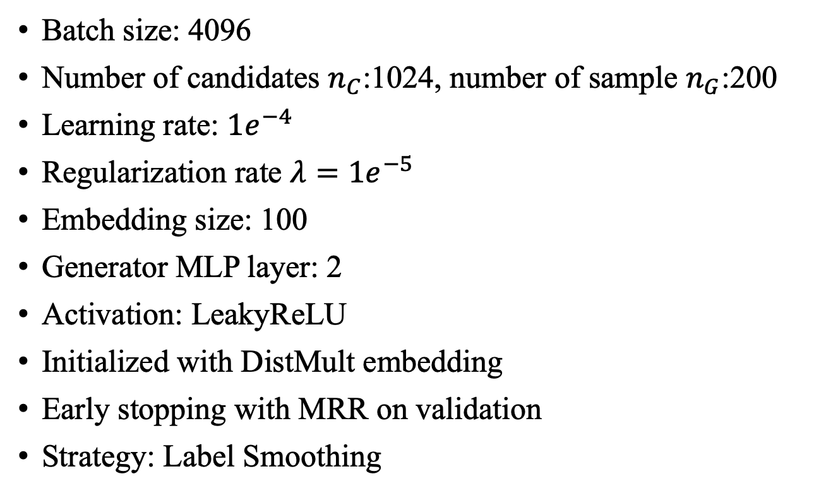
Hyperparameter
Batch size: 4096
Number of candidates $n_{C}$:1024, number of sample $n_{G}$:200
Learning rate: $1e^{−4}$
Regularization rate $λ=1e^{−5}$
Embedding size: 100
Generator MLP layer: 2
Activation: LeakyReLU
Initialized with DistMult embedding
Early stopping with MRR on validation
Strategy: Label Smoothing

Slide 36
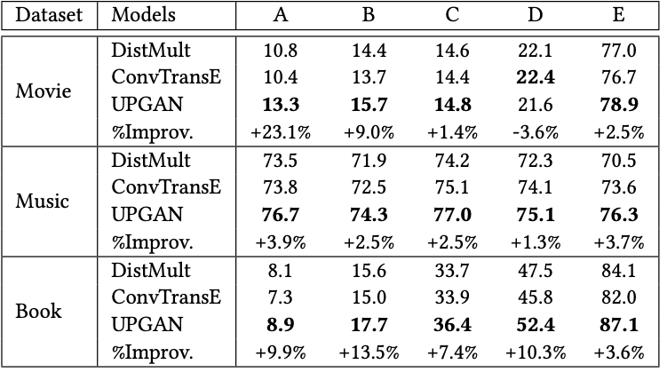
Detailed Analysis: Sparsity Level
Divide the test queries into five groups w.r.t. the frequency of the answer entity
Our approach is substantially better than baseline methods in five sparsity levels
Especially, on movie and book datasets, it yields a larger improvement in sparse groups
Notes:
For ease of further comparison, we only incorporate the results of DistMult and ConvTransE as the reference, since they perform generally well among all the baselines.
To examine how our method improves over the baseline methods, especially in the sparse case, we divide the test queries into five groups w.r.t. the frequency of the answer entity. A smaller group ID indicates that the answer entity of that case occur fewer in training set.
单击
As shown by the table, our approach is substantially better than baseline methods in five sparsity levels
单击
Especially, on movie and book datasets, it yields a larger improvement in sparse groups

Slide 37
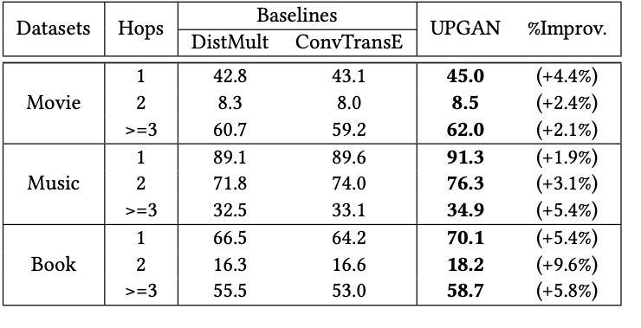
Detailed Analysis: Hop Number
Performance (H@3 in percent) comparison w.r.t. different hop numbers
Our method has yielded a substantial improvement in all three groups
The improvement is mainly related to the query difficulty instead of the hop number
Notes:
As we organize interaction-augmented knowledge graph with layers, we would like to check how the distance of a KG entity to user nodes affects the performance.
As shown by the table, we divide all test cases into 3 groups w.r.t. query entity hop number in training set.
单击
Our method has yielded a substantial improvement in all three groups.
The improvement is mainly related to the query difficulty instead of the hop number.

Slide 38
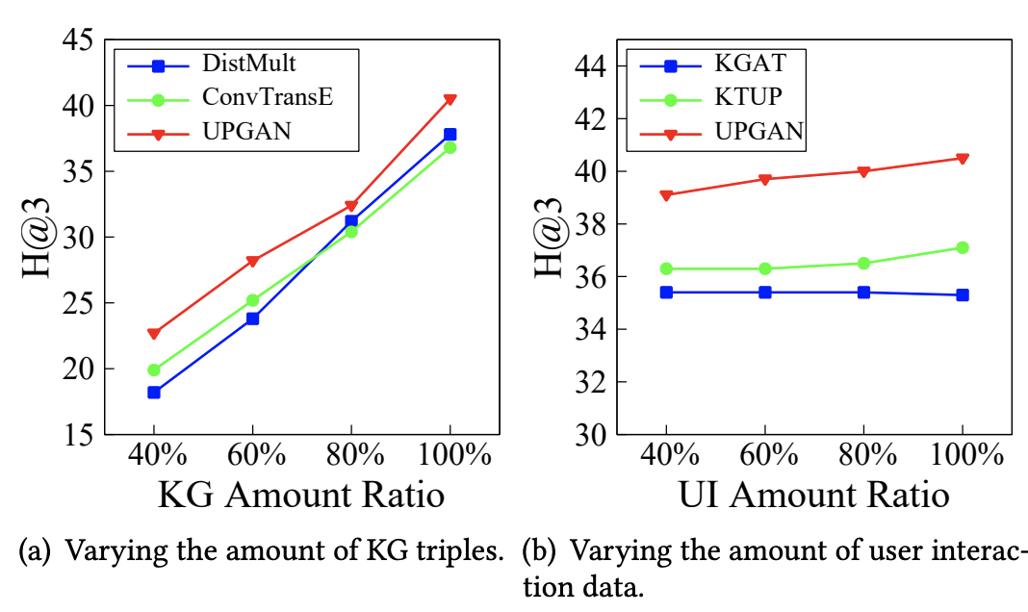
Sensitivity Analysis
Varying data sparsity on KG and UI on Amazon book dataset
Varying KG data,
Consistently better than baselines
Especially performs best with an extremely sparse
Varying UI data
Substantially better than baselines
Performance of UPGAN gradually increases and the change is relatively stable.
Notes:
We further investigate the influence of training data
单击
Varying knowledge graph data, UPGAN is consistently better than baselines with four training sets, especially performs best with an extremely sparse amount of KG triples.
This observation implies that UPGAN is able to alleviate the influence of data sparsity for KGC methods to some extent. Besides, it can yield more improvement with fewer KG triples.
单击
Varying the amount of user-item interaction data, UPGAN is substantially better than baselines for all the four ratios, which indicates the effectiveness of our approach in leveraging user interaction data.
Another observation is that the performance of UPGAN gradually increases and the change is relatively stable

Slide 39
Qualitative Analysis: Sparse Case
Querying the author of “Part of Bargain”
When KG is incomplete, it’s hard to infer relevant facts.
In this case, preference mined from user interactions can provide useful features to help infer answer.
Notes:
The example show we try to find the author of “Part of Bargain”, while there’s no known triple in KG related with the book.
From user interactions, we find users like this book, also like “Snowflakes On The Sea” and “Just Kate (Desire)”.
As they’re written by the same author Linda Lael Miller,
we may infer Linda as the answer for author of this book.

