Slide 1
Homework5

Slide 2
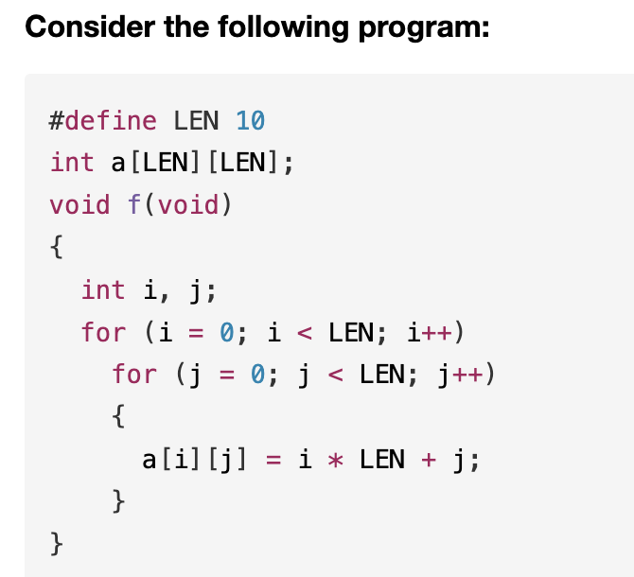
T1

Slide 3
Suppose the address of a is 0x10000000. After the function f() finished, fill the following table (if you don’t know the value, please write NONE):
%eax | 0x10000000
%ecx | 22
$0x10000004
0x10000012
0xFFFFFF8
(%eax, %ecx, 8)

Slide 4
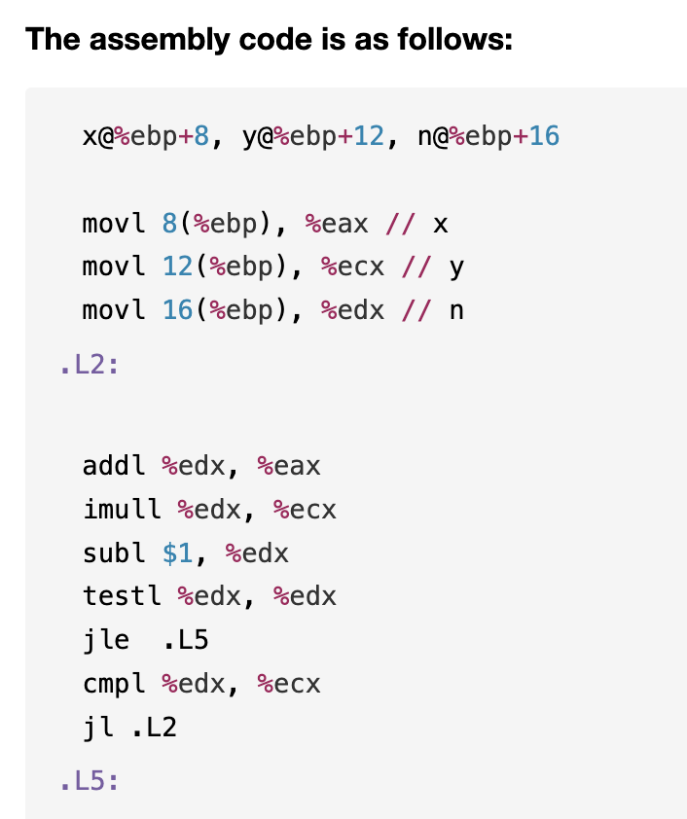
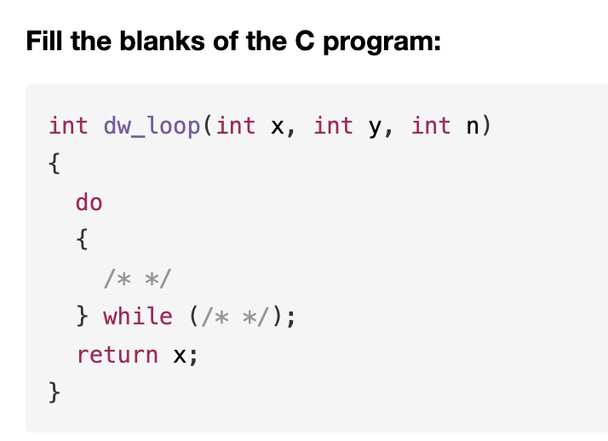
T2

Slide 5
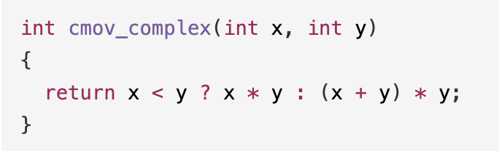
T3
After ICS class, Barathrum has written a function like below:
(1). Please write down the corresponding assembly code by using conditional move operations.
(2). When Barathrum compiles it with gcc, he finds that there’s no cmov at all in the assembly code! Please explain why gcc doesn’t use conditional move operations in this case.

Slide 6
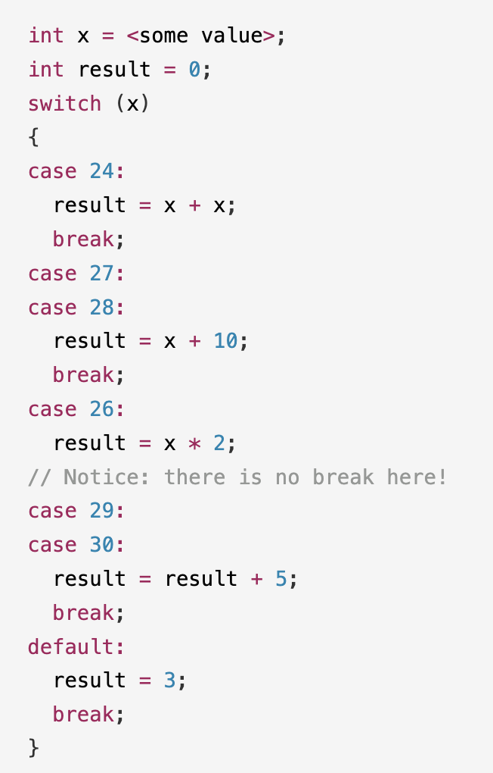
T4
Translate the following switch statements into assembly using jump table.

