Slide 1
Homework7

Slide 2
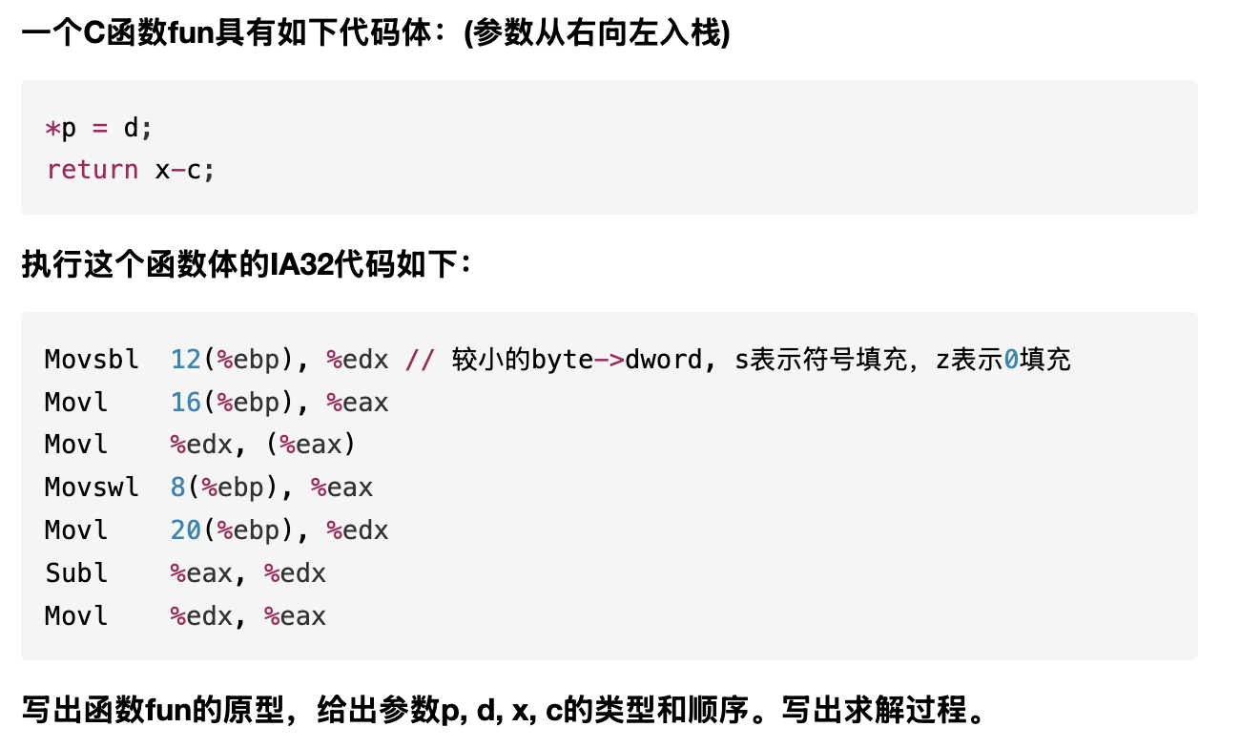
T1

Slide 3
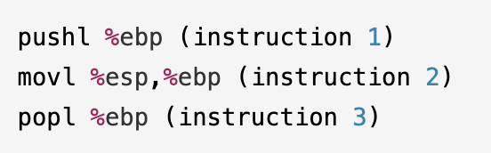
T2
Suppose the initial value of %esp is 0x7FFFFFC4, initial value of %ebp is 0x7FFFFFF4.
The value stored in address 0x7FFFFFC0 is 0x120, value stored in address 0x7FFFFFC4 is 0x200, the value stored in address 0x7FFFFFF4 is 0x2710.
We have following x86 assembly code executed sequentially:
Q: After each instruction executed, what is the value of %esp and %ebp
(1) Instruction 1: (2) Instruction 2: (3) Instruction 3:

Slide 4
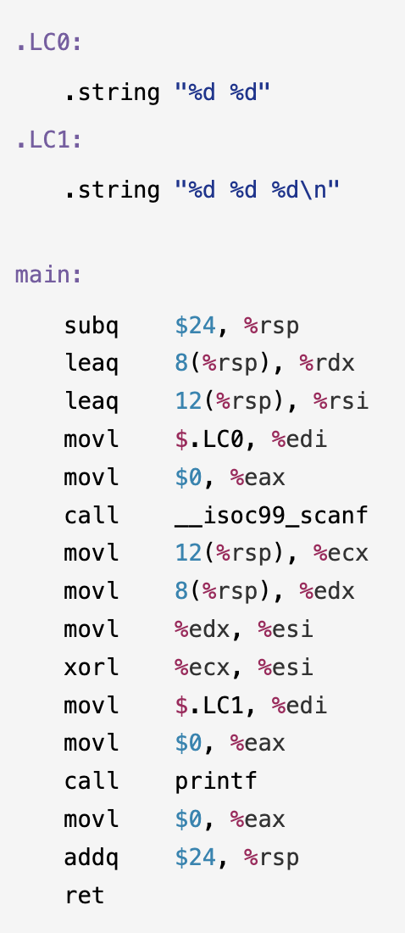
T3(1)
右边是C语言源代码文件func.c对应的汇编代码，请写出对应的C语言代码；

Slide 5
T3(2)
画出Line 24执行前栈的状态，以及此时寄存器%edi, %esi, %edx, %ecx, %rsp的值
假设进入main函数前%rsp的值为0x8000420（代码中出现的局部变量，要标记在栈图中；图中标记内存地址）

