Slide 1
Homework7

Slide 2
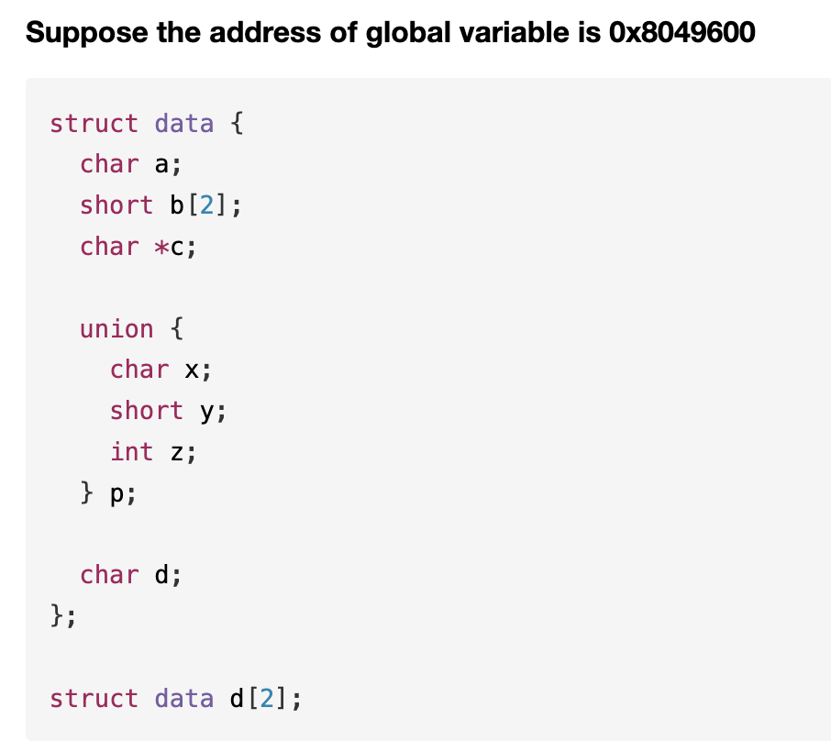
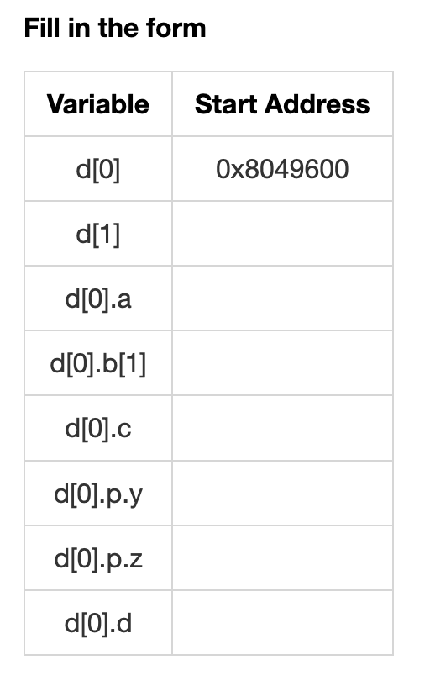
T1

Slide 3
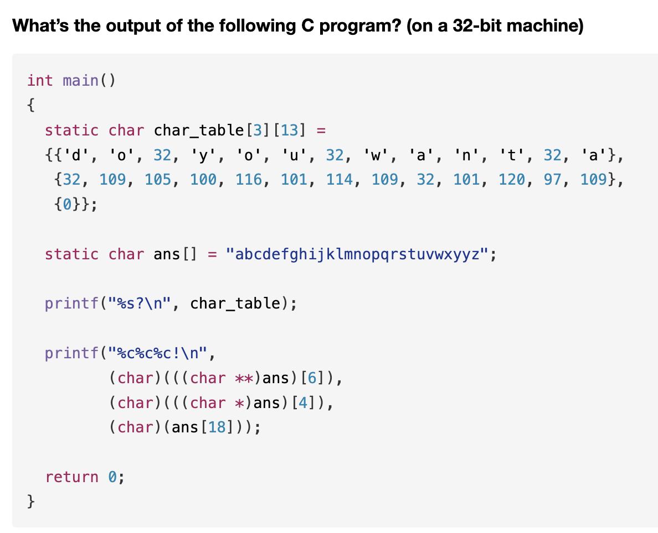
T2

Slide 4
T3
For each of the following structure declarations, determine the offset of each field, the total size of the structure, and its alignment requirement under x86-64.
A. struct P1 { int I; char c; long j; char d;};
B. struct P2 { long I; char c; char d; int j;};
C. struct P3 { short w[3]; char c*[3]};
D. struct P4 { struct P1 a[2]; struct P2 *p};
E. struct P5 { short w[3]; char c[3]}.

Slide 5
T3
Fill in the blanks:
 | Offset of each field |  |  |  | Total size | Alignment
A | i:0 | c:4
B
C
D
E

Slide 6
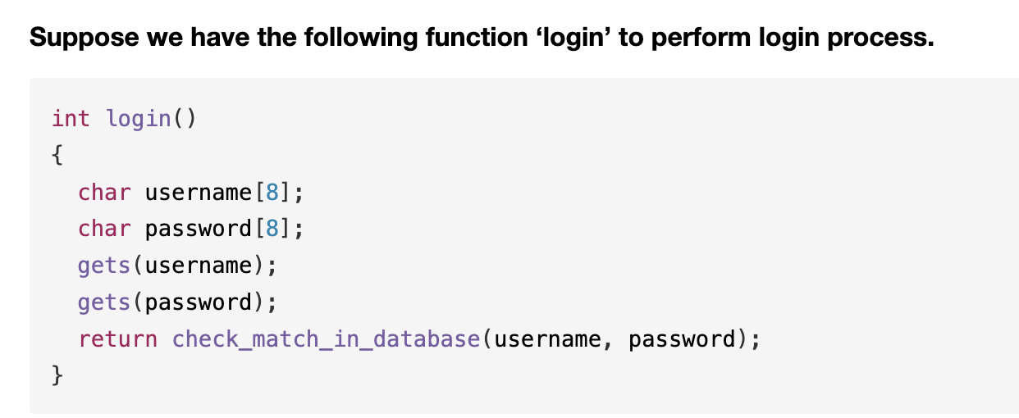
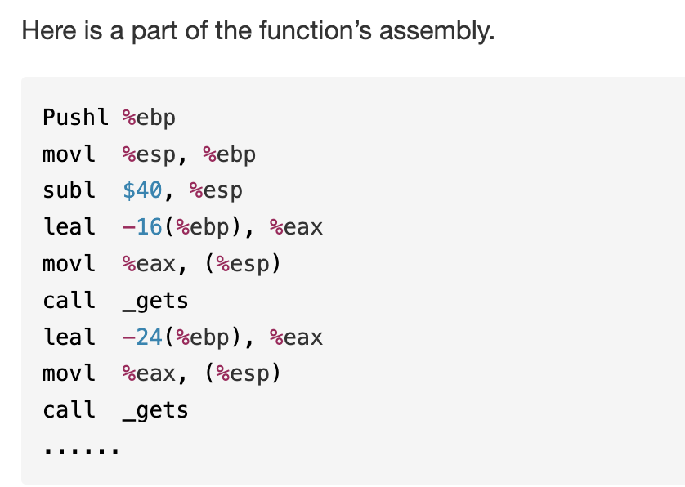
T4

Slide 7
T4
In the normal process, if the username and the password are both ok, the function ‘login_ok’ will be called to indicate login success.
We’ve already known that the address of ‘login_ok’ is 0x804013da.
Can you construct an input to make the function ‘login_ok’ be called after ‘login’ returns?
You need to specify the key bytes and their positions rather than the complete input. And give one brief explanation about your input.

