Slide 1
An Implementation of Elliptic Curve Cryptography Algorithm for Secured Data Transmission In Wireless Sensor Network
SUBMITTED BY:
Binay Pradhan (B415019)
Pritish Gupta (B415039)
Rudra Narayan Panda (B415045)
Supratik Samal (B415059)

Slide 2
INTRODUCTION
Major issue with use of public key is the size of numbers used.
ECC belongs to the category of Public-key Cryptography, performs the computations using elliptic curve arithmetic instead of integer or polynomial arithmetic.
ECC provides equally good security compared to RSA, but uses smaller key size(160-256bit VS 1024-3072bit).
Notable Advantages of ECC
Uses smaller keys, cipher texts and signatures.
ECC supports, very fast key generation.
ECC scores over RSA because of its moderately fast encryption and decryption.
ECC computations are uses less memory and CPU cycles compared to RSA, hence suited for securing Mobile Handheld devices.

Slide 3
PROPOSAL
This paper centers around the execution of the scalar point multiplication, and this is the basic task of public key Elliptic Curve Cryptography(ECC).
This cryptosystem has high security furthermore, great execution offered by ECC, compared to other options, for example RSA.
Besides, this task can be utilized in digital signature(ECDSA), establishment of key(ECDH) and various encryption/decryption(ECIES) protocols.

Slide 4
OVERVIEW
Implementation of RSA and ECC algorithm
Performance evaluation
Simulation
Packets sent
Packets received
Packets Lost

Slide 5
ECC ALGORITHM
Algorithm for Encryption
Enter a prime no p which is used to keep the points in GF (n=1)
Enter curve parameters a and b
Collect the points(y*y) which are quadratic residue of (x*x*x)+(a*x)+b
Enter e1
A random number d is generated which is private key
Find public key e2=d*e1
Enter the message P
A random number r is generated for encryption
Find c1=r*e1
Find c2=P+(r*e2)
c1 and c2 are the encrypted points
Algorithm for Decryption
Enter encrypted points c1 and c2
Enter curve parameter a and b to form the same curve as encryptor
Enter the prime no p to keep points in GF (n=1)
Enter private key d
Decrypted message (P) = c1-(d*c2)

Slide 6
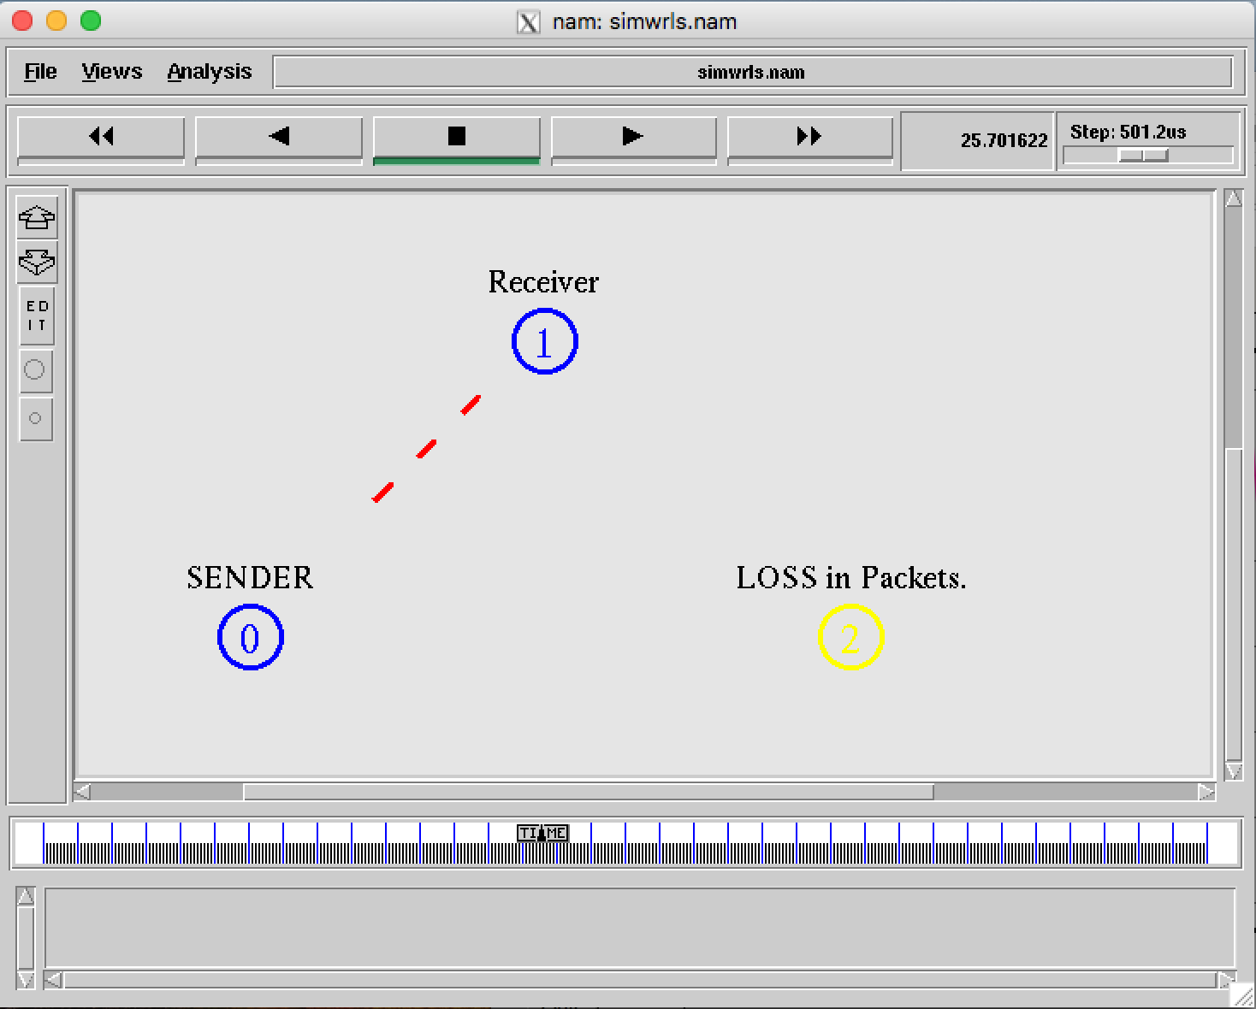
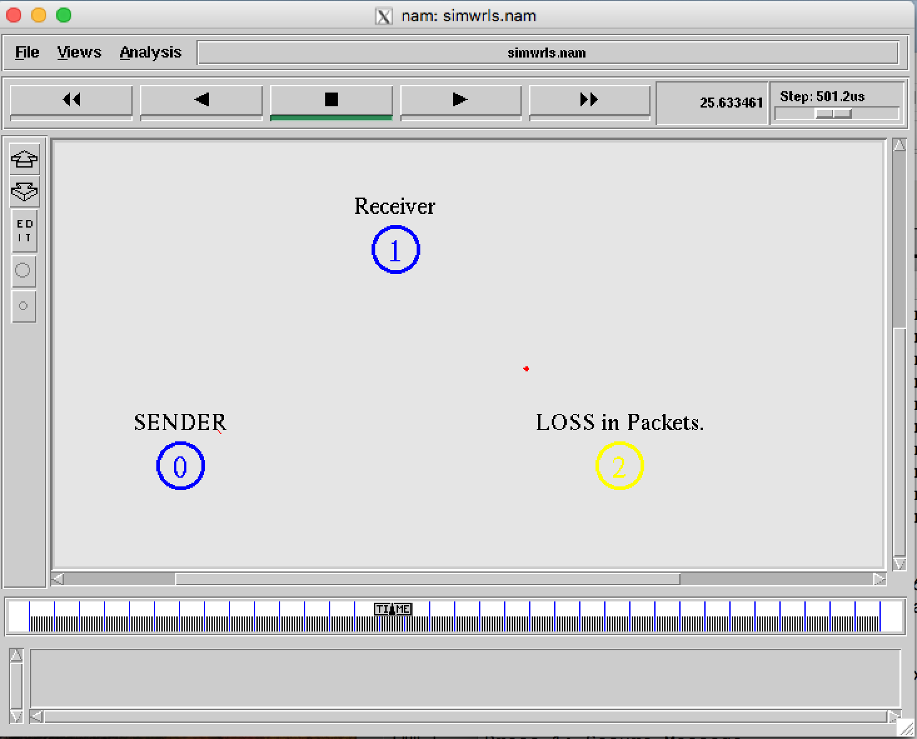
RESULTS
Packets Sent
Packet Loss

Slide 7
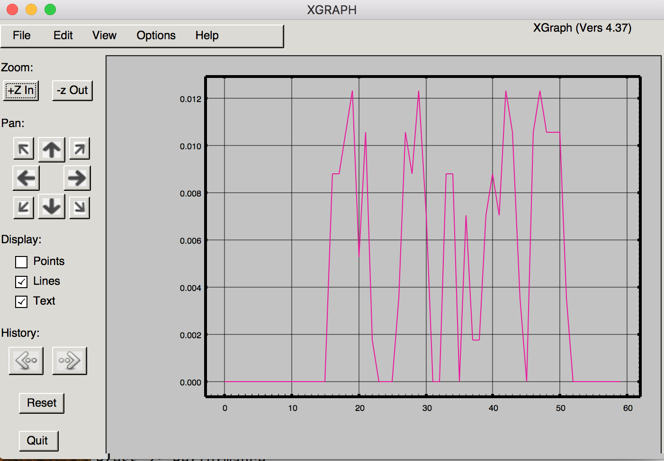
GRAPH ON PACKET TRANSFER

