Slide 1


VitalMinds
Empowering Holistic Learning

Slide 2



Challenge Overview
Offline classes focus on core subjects, limiting flexibility and personalized learning. In contrast, online courses offer more variety and convenience, allowing users to explore specific topics of interest. However, the main problem with online learning is the lack of a single platform that offers all the desired courses. Users often have to switch between multiple websites, leading to a fragmented and inconsistent learning experience.
Hacktoberfest: Section title goes here

Slide 3
Proposed Strategy
Our website offers a comprehensive range of categories, including technology, business, spirituality, health and fitness, and foundational courses. This diverse selection ensures that users can easily find and choose courses that align with their interests and needs, all in one convenient platform. By centralizing various topics, we provide a streamlined and user-friendly experience, allowing learners to access relevant content without navigating multiple websites.
Hacktoberfest: Section title goes here

Slide 4
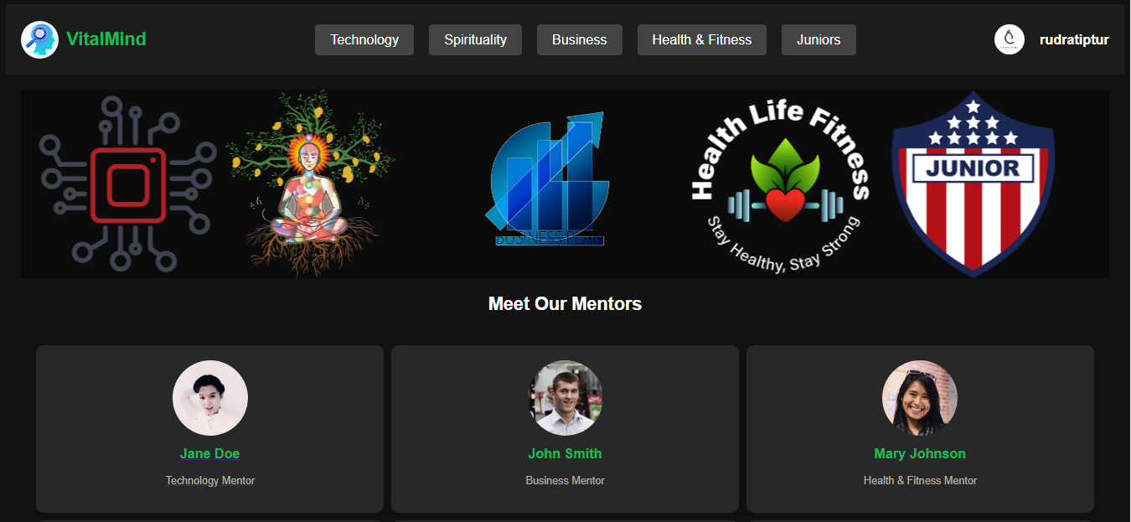
Methodology
We employed a user-friendly interface on our website to enhance navigation and minimize the time users spend searching for different courses. By organizing content into clearly defined categories, we facilitate quick access to relevant topics. Additionally, we implemented intuitive search and filter options, allowing users to efficiently find courses that meet their specific needs. This approach ensures a seamless and efficient learning experience for all users.
Hacktoberfest: Section title goes here

Slide 5

Impact & Benefits
Centralized Access: One platform, diverse courses. Enhanced Learning Experience: Efficient course discovery and enrollment. Time Efficiency: Quick course identification and learning. Cost-Effective Learning: Save money, relevant skills focus.
Hacktoberfest: Section title goes here

Slide 6

Conclusion
VitalMinds offers a centralized platform for users to access diverse courses in technology, business, spirituality, and health. This streamlined approach enhances the learning experience by saving time and effort while providing cost-effective solutions. Ultimately, VitalMinds empowers individuals to pursue their educational goals with ease and convenience.
Hacktoberfest: Section title goes here

Slide 7





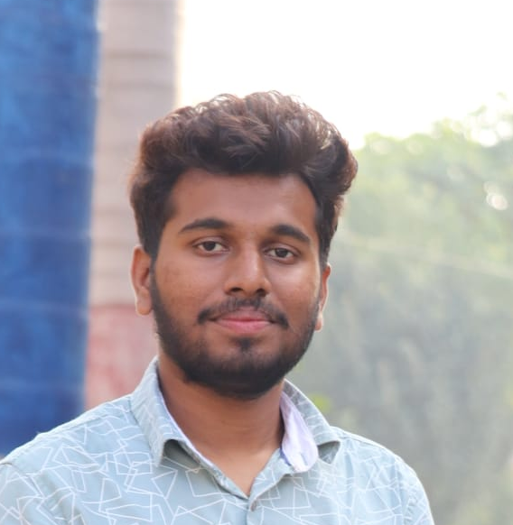

Team Amigos
Dynamic Septet
Ruchitha S S
Prathibha B R
1KI22CS097 ruchithassr@gmail.com
1KI22CS085 prathibhadevangp@gmail.com
Shivakumar S Paraddi
Rudresh M
1KI22CS102 paraddishivakumar@gmail.com
1KI22CS098 rudratiptur@gmail.com
Hacktoberfest: Section title goes here

Slide 8

Thanks for listening

