Slide 1
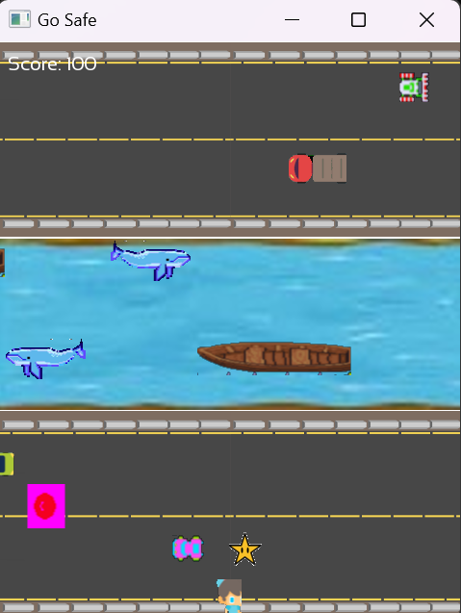
Go Safe
Hop, Dodge, Survive!
Presented by: Rudra Patel

Slide 2
Game Concept and Mechanics
Objective
Player Controls
Challenges
Cross roads and rivers to reach the finish line without losing all lives.
W/A/S/D: Movement
Dodging enemy cars and river enemies
Space: Jump (with a forward arc)
Z: Activate Safe River power-up
Timing jumps on moving logs
E & X: Toggle and submit traffic signal puzzle
Interacting with traffic signals to slow/stop vehicles
"Go Safe" challenges players to navigate a frog through hazardous roads and rivers. The primary objective is to reach the finish line without losing all available lives. Key challenges involve dodging enemy cars, timing jumps on moving logs, and interacting with traffic signals to slow or stop vehicles. The game blends classic arcade navigation with puzzle elements to create a unique and engaging experience.

Slide 3
Key Features and Interactive Puzzle
1
Dynamic Obstacles
2
Traffic Signal Puzzle
3
Safe Passage Effect
Multiple enemy car types are randomly selected from a sprite sheet. River enemies and moving logs require precise timing and strategic planning.
Signals are placed along the road, and players must press E to cycle the signal (Green → Yellow → Red) and X to submit the correct sequence.
On correct submission, vehicles slow down for a brief period, creating a safe window for the player to cross.

Slide 4



Implementation and Architecture
Scene_Frogger Class
Traffic Signal Module
Asset & Music Management
Handles player initialization, movement, and collision detection. It also contains enemy, log, and power-up spawning functions.
Created using a dedicated TrafficSignal structure. Signals cycle states using a helper function (cycleState), integrated into the update loop for interactive puzzle behavior.
Assets loaded via a configuration file. Background music from a WAV file using MusicPlayer singleton.

Slide 5



Prototype Demo and Lessons Learned
Proper Collision Detection
Tuning Physics
Safe Passage Flag
I ensured it between moving obstacles by adjusting bounding boxes and activation areas.
I tuned jump physics and boat riding mechanics to be smooth. We also integrated debug messages to verify input and state changes.
I added safe passage flag to control enemy behavior, successfully controlling enemy behavior by integrating debug messages to verify input and state changes.

Slide 6



Future Improvements and Conclusion
Improved sound and visual
2
Improve sound effects and visual effects.
More Levels
1
Add varied obstacles and puzzle sequences.
Power-Up Expansion
3
Expand power-up mechanics.

Slide 7
Key Takeaways
Classic Arcade Integration
Technical Problem Solving
Iterative Development
The game blends classic navigation with interactive puzzles, creating a new game experience.
We had to implement collision detection to ensure smooth, fun, and interactive game play that the user could easily pick up. This technical design was a critical part of the game.
We built a functional prototype that showcases the potential for a engaging game. We learned about the iterative design process.

Slide 8
Let’s Go Safe!
Thank You

