Slide 1
Go Safe
Hop, Dodge, Survive!
Presented by: Rudra Patel

Slide 2
Introduction
What is Go Safe?
Why Go Safe?
Fast-paced endless arcade game
Appeals to casual & competitive gamers
Combines reflexes, strategy, and humor
Accessible on PC

Slide 3
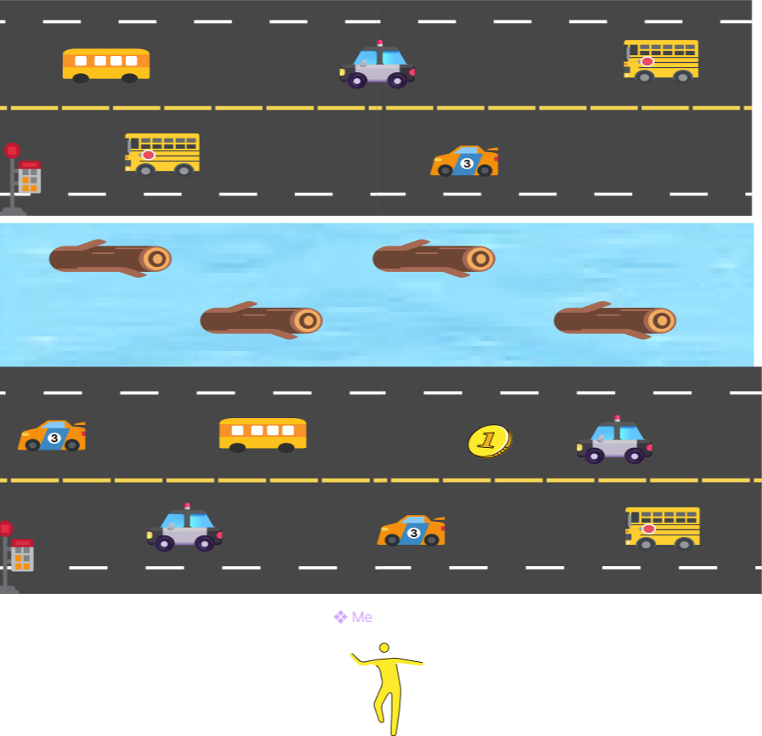

Slide 4
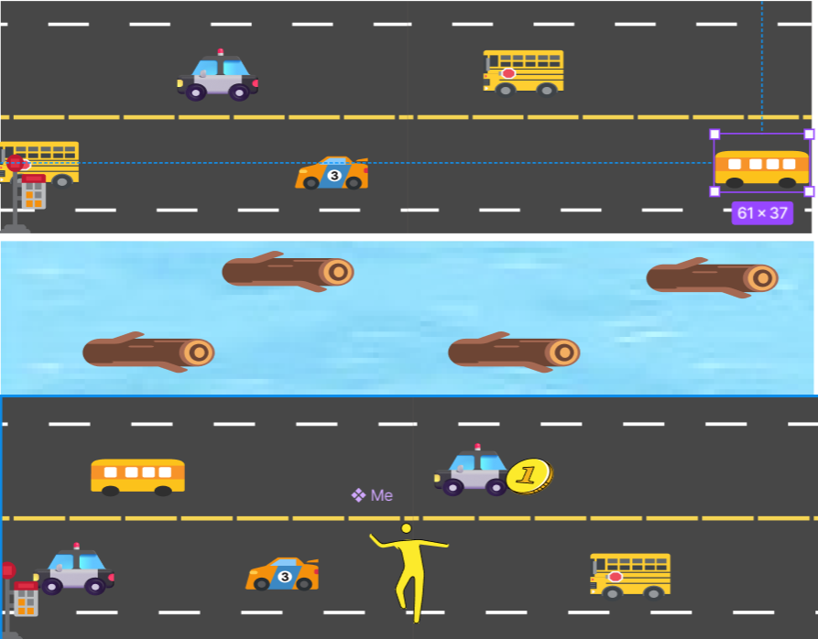

Slide 5
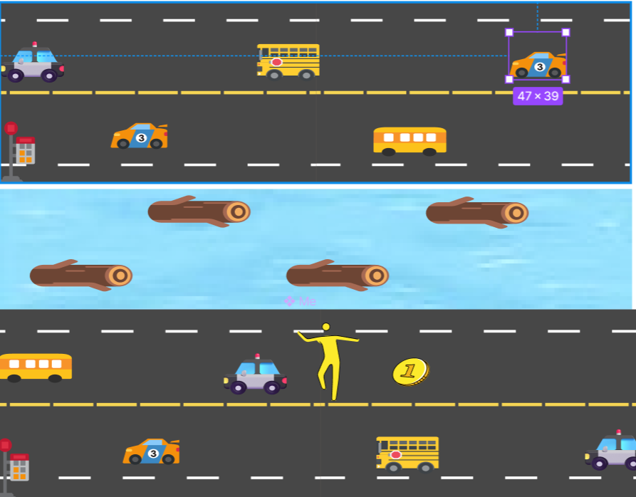

Slide 6
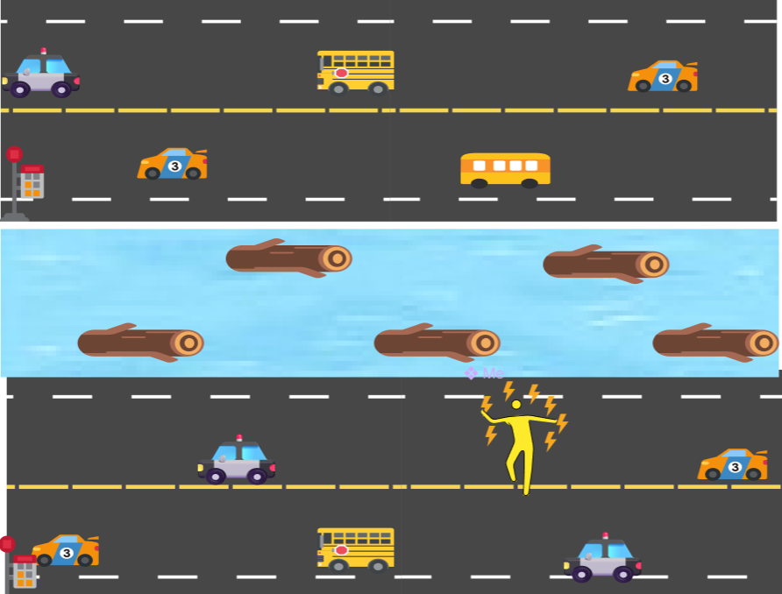

Slide 7
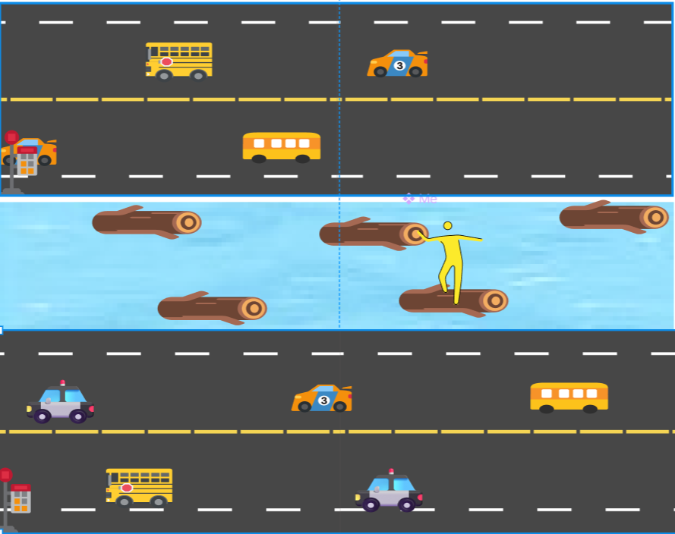

Slide 8
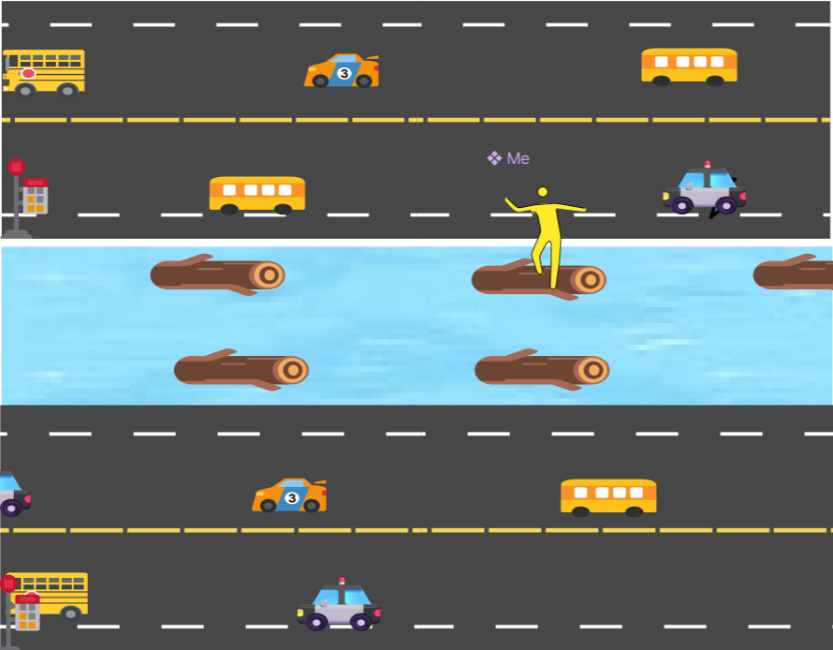

Slide 9
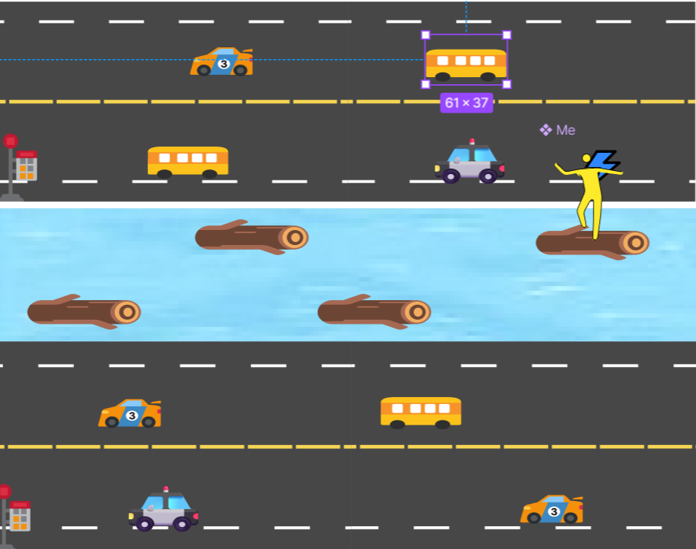

Slide 10
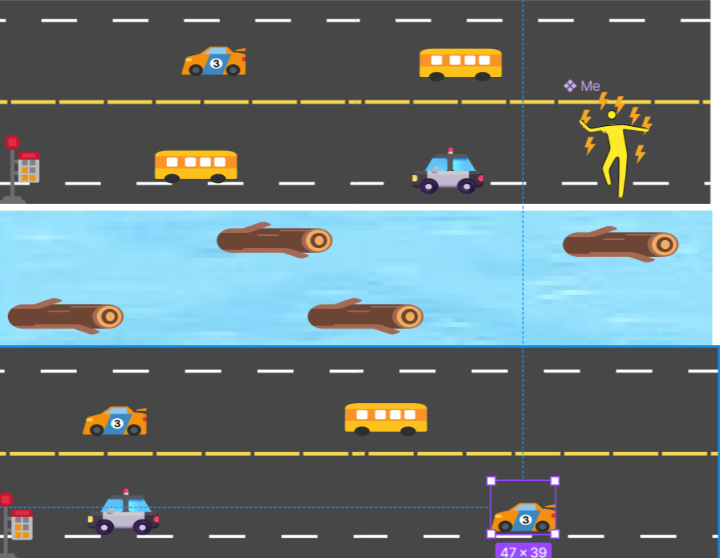

Slide 11
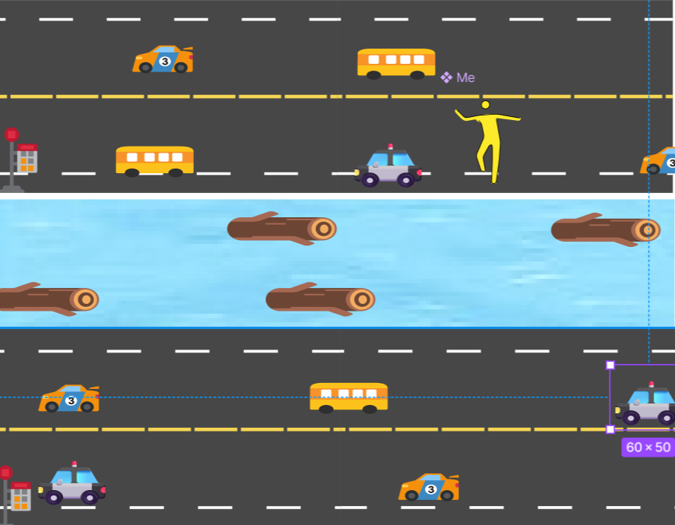

Slide 12
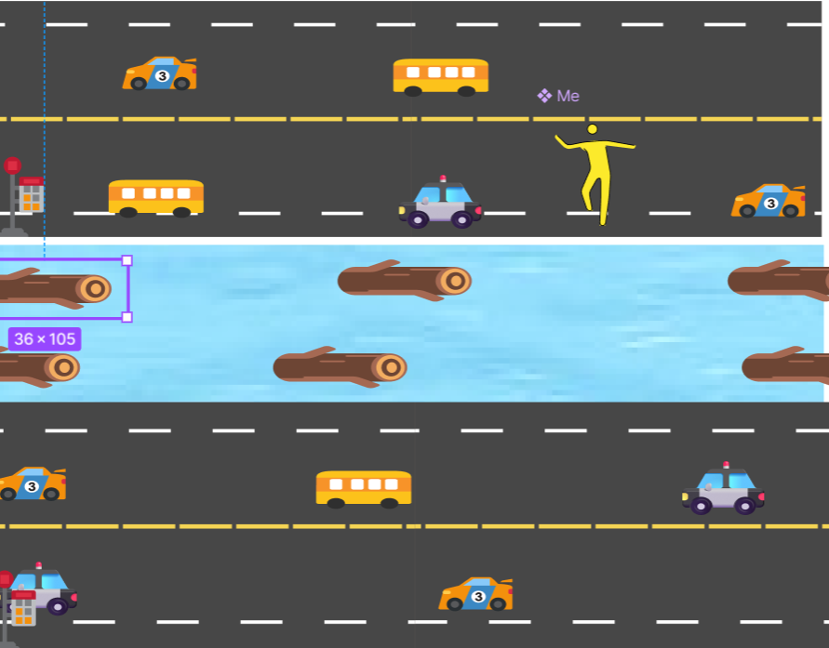

Slide 13
Key Features
Core Gameplay
Highlights
Navigate hazards (roads, rivers, vehicles)
Procedurally generated levels
Bright voxel art style
Collect rewards (coins, power-ups)
Unlockable content
Master timing with quick decisions

Slide 14
Gameplay Mechanics
Objectives
Rules
Safely guide character for highest score
Collisions with hazards end game
Collect coins & power-ups for progression
Points for lanes crossed & coins collected
Use Power-ups that can destroy obstacle, slows
down enemy and restores health

Slide 15
Game World
Environment Elements
Visual Style
Roads: multi-lane highways
Bright & cheerful voxel art
Rivers: logs, turtles
Colorful and catchy characters
Bonus zones: extra rewards & coins

Slide 16



Target Audience
Primary Audience
Platforms
Age Range
Casual gamers seeking quick sessions
PC: casual desktop gamers
Suitable for all ages
Lighthearted & non-violent nature
Fans of arcade-style games

Slide 17
Unique Selling Points
Simple Gameplay
1
Easy to learn, hard to master
Vibrant Visuals
2
Bright, blocky voxel art
Replayability
3
Procedural generation
Unlockable Content
4
Characters, themes, easter eggs
Broad Appeal
5
Perfect for short or extended play

