Slide 1


Introduction To Git & GitHub Part 1
Burcu Beygu
burcu.beygu@rug.nl
21/10/2025
Digital
Competence
Centre

Slide 2
DCC RUG Follow our training and subscribe to our newsletter to stay up-to-date
dcc@rug.nl
Digital
Competence
Centre

Slide 3
Outline
What is version control?
Git vs GitHub
What is a repository?
Local vs remote repository
Creating a local repository from scratch
Creating a remote repository from scratch
Working with existing remote repository
Configuring git
Staging & Committing
Working in a repository with git
Monitoring, tracking, comparing changes & repository
Unstage & Undo
Working with branches
Create & switch between branches
Merge branches
Creating issues
Understanding errors
Digital
Competence
Centre

Slide 4
What is version control?
Version
Contents of a file at a given point in time
Metadata
The author
Location
File type
Time at it was saved
Version Control
Group of systems and processes to manage changes made to documents, programs and directories.
Version control is useful for anything that changes over time and/or needs to be shared.
VS enables you
to track files in different states
continuous development
to combine different versions of files
identify a particular version
revert changes
Digital
Competence
Centre

Slide 5


Git vs GitHub
Git
Version control software mainly for programming
Open source
Scalable
Can be used without other hosting platforms
GitHub
Cloud-based hosting service (GitLab, BitBucket)
On-demand resources: free version, paid versions with extra features and storage
Can’t use GitHub without Git (You can but you have to edit and upload files manually)
Digital
Competence
Centre

Slide 6
Git vs GitHub
Git
Stores everything
Notifies when there is conflict
Synchronizes across different machines
GitHub
Storing projects
Keeping track of projects and files through different states
Collaboration
Several people can work on the same file
Accessed by anyone
Open Source projects
Digital
Competence
Centre

Slide 7
Git
Check your git version: Getting help:
git - -version git <command> - -help
git - -help
This particular command displays a summary of a most used Git commands.
Digital
Competence
Centre

Slide 8
Git
Configuring Git:
git config --list
Git has 3 levels of settings:
- -local : setting for one specific project
- -global : settings for all of our projects
- -system: settings for every users on `a` machine
Digital
Competence
Centre

Slide 9
Git
Configuring Git:
git config --list
Change email address to <your emailaddress>
git config --global user.email “<youremailaddress>”
Change username to <yourusername>
git config - -global user.name “<yourusername>”
Digital
Competence
Centre

Slide 10
GitHub
Have you signed up to GitHub and created an account?
Have you connected your laptop to GitHub?
Option 1: Using HTTPS
Option 2: Generate and add an SSH key to GitHub
Digital
Competence
Centre

Slide 11
Connect your laptop to GitHub
Option 1: Using HTTPS
Check if GitHub is accessible:
git ls-remote https://github.com/your-username/your-repo.git
If it prompts a password, you need a Personal Access Token (PAT)
Generate a GitHub Token:
- Go to GitHub -> Settings -> Developer settings -> Personal access tokens
- Click “Generate new token (classic)”
- Select “repo”, “workflow”, and other permissions.
- Copy the token (you won’t see it again)
Use token instead of password
- The next time Git asks for password, past the GitHub token instead
Digital
Competence
Centre

Slide 12


What is a repository?
Directory
my_project
README.md
project
setup.cfg
results
tests
Digital
Competence
Centre

Slide 13
What is a repository?
Directory
my_project
Git storage
README.md
project
.git
Repository
setup.cfg
results
tests
Digital
Competence
Centre

Slide 14
What is a repository?
Directory
my_project
Git storage
README.md
project
.git
Repository
A repo will contain all files of a project and records past versions of files
setup.cfg
results
tests
Digital
Competence
Centre

Slide 15
What is a repository?
Directory
my_project
Git storage
README.md
project
.git
Repository
setup.cfg
results
Do not edit .git !
tests
Digital
Competence
Centre

Slide 16
What is a repository?
Git stores all of its extra information in a the .git directory.
It is located in the root directory of the repository.
Git expects this information to be laid out in a very precise way, so you should never edit or delete anything in .git .
To see the .git directory:
ls -a
To see inside the .git directory:
ls .git
branches config description HEAD hooks index info logs objects packed-refs refs
.git
Digital
Competence
Centre

Slide 17

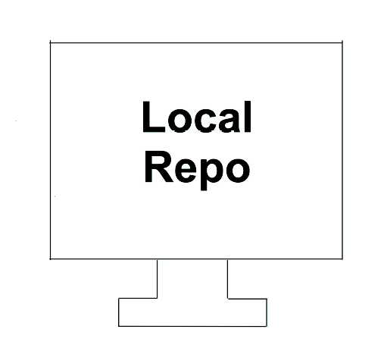
Local repository vs Remote repository
my_project
Git storage
project
.git
In your machine
README.md
setup.cfg
results
tests
Digital
Competence
Centre

Slide 18

Local repository vs Remote repository
Digital
Competence
Centre

Slide 19
Local repository vs Remote repository
GitHub
Digital
Competence
Centre

Slide 20
Local repository vs Remote repository
Digital
Competence
Centre

Slide 21
Creating a new local repository
mkdir <my_project>
cd <my_project>
git init
ls -a
You have a repo and you started to track it!
Digital
Competence
Centre

Slide 22


Git Workflow
Staging & Committing
Saving a draft
Staging area
Saving a file & update repo
Commit changes
Digital
Competence
Centre

Slide 23
Git Workflow
my_project Staging .git Directory
(Working Directory) Area (Permanent Storage)
my_project
staged
staged
committed
staged
README.md
staged
staged
staged
committed
Digital
Competence
Centre

Slide 24
Git Workflow
Modify file(s)
Save the draft / stage the file
Save the changes / Commit the updated file(s)
Repeat
Digital
Competence
Centre

Slide 25
Git Workflow
cd <my_project> : Make sure your are in the repository of your project.
touch README.md
git add README.md or git add .
git commit -m “First commit” : Always with a message.
git add <file_name> : Add files to staging area.
git commit -m “message” : Save changes to .git Directory
Digital
Competence
Centre

Slide 26
Commit Structure
Git commits have 3 parts:
1) Commit
- Contains the metadata; author, log message, commit time
2) Tree
- Tracks the names and locations of files and directories in the repo
- Maps keys to files and directories
3) Blob (Binary Large Object)
- It contains data of any kind, a compressed snapshot of a file’s content
Digital
Competence
Centre

Slide 27
Commit Structure
Commit
Tree Blob
87aa88
First Commit
README.md
#Goal of the project
Data1.csv
1925, True, -
1887, True, -
35bc56
Second Commit
README.md
1925, True, HPC
1887, True, - 1100, False, HPC
Data1.csv
analyse.py
import numpy as np
Import pandas as pd
README.md
#What does this script do?
3bac59
Third Commit
Data1.csv
1925, True, HPC
1887, True, - 1100, True, -
analyse.py
Digital
Competence
Centre

Slide 28
Monitor
Make sure you are inside your local repository, then check its status:
git status
On branch master
Nothing to commit, working tree clean
git status: displays a list of the files that have been modified (if there is any) since the last time changes were saved, as well as the status of stage and commit.

Slide 29
Compare

Slide 30
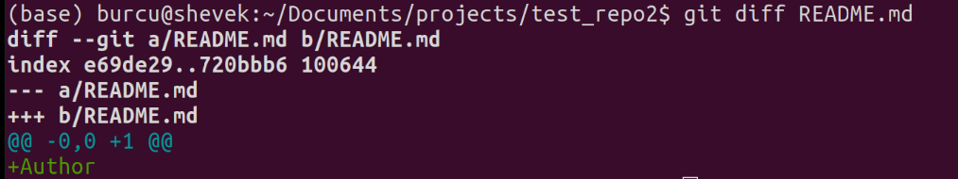
Compare
Let’s modify README.md :
nano README.md or use a text editor of your choice
DO NOT ADD your changes!
git diff README.md
git diff <file> : Compares unstaged file(s) with the last commit, shows changes between working a directory and staging area.

Slide 31
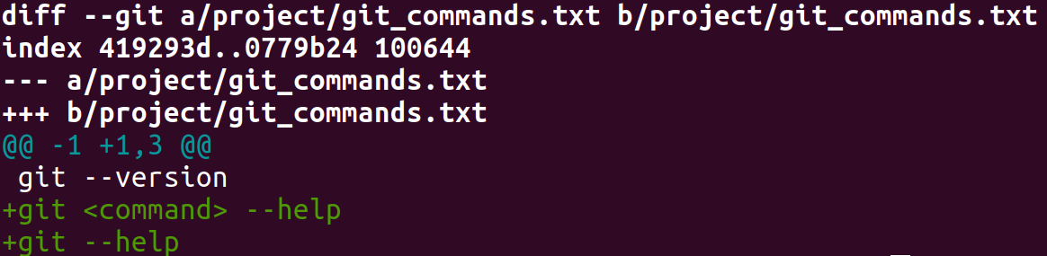
Compare

Slide 32
Compare
Input source of diff:
First line shows the files being compared.
a/project/git_commands.txt & b/project/git_commands.txt have been passed to git diff

Slide 33
Compare
Metadata:
100644: mode of file. In this specific case unexecutable
419293d & 0779b24: hashes (shortened) of preimage and postimage of the file.

Slide 34
Compare
Markers:
The old version will be represented by --- a & the new version by +++b

Slide 35
Compare
Chunk:
Shows a portion of the file that was modified. Multiple chunks can be displayed, depending on how many changes were made.

Slide 36
Compare
Header: This tells you where the changes occures:
@@ -<old start>,<old count> +<new start>,<new count> @@
-1 :The old file started at line 1.
+1: The new file also starts at line 1.
3: The new file has 3 lines in this section

Slide 37
Compare
Changes in the chunk:
2 lines are added to the second file. Green represents an addition and the red represents a deletion

Slide 38
Compare
Let’s add new file called LICENSE :
touch LICENSE or use a different method.
DO NOT ADD your changes!
git status
git diff
git add -p
git add -p : allows you to stage your commit in chunks interactively. It's especially useful if you've done too much work for one commit, you wanna break it up, you don't know how.

Slide 39
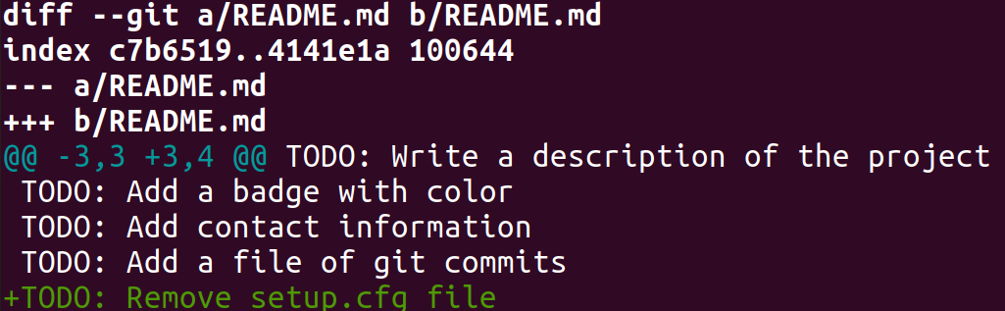
Compare
Let’s modify README.md again:
nano README.md or use a text editor of your choice
git add. : Lets stage all changes
DO NOT COMMIT!
git diff -r HEAD README.md
git diff -r HEAD <file>:Compares staged file(s) a with the last commit
or
git diff –-staged <file>

Slide 40
View specific commit
git show <hash> : Shows specific commits and changes made in this commit.
Or
git show HEAD~1 : Refers to commit made just before the most recent one
Only the first 4 -6 digits are enough
HEAD, always refers to the most recent commit.
The label HEAD~1 then refers to the commit before it, while HEAD~2 refers to the commit before that, and so on.

Slide 41
Compare commits
git diff <hash1> <hash2> : Compares changes between commits.
Or
git show HEAD~3 HEAD~4 :Compare the fourth and third most recent commits

Slide 42
Git Workflow
Best practices:
Make small changes to files
You don’t have to commit to each stage
Make frequent and small commits
Always write a (meaningful) commit message
Don’t create nested repositories
Add your username & email address to the global settings

Slide 43
Commit History

Slide 44
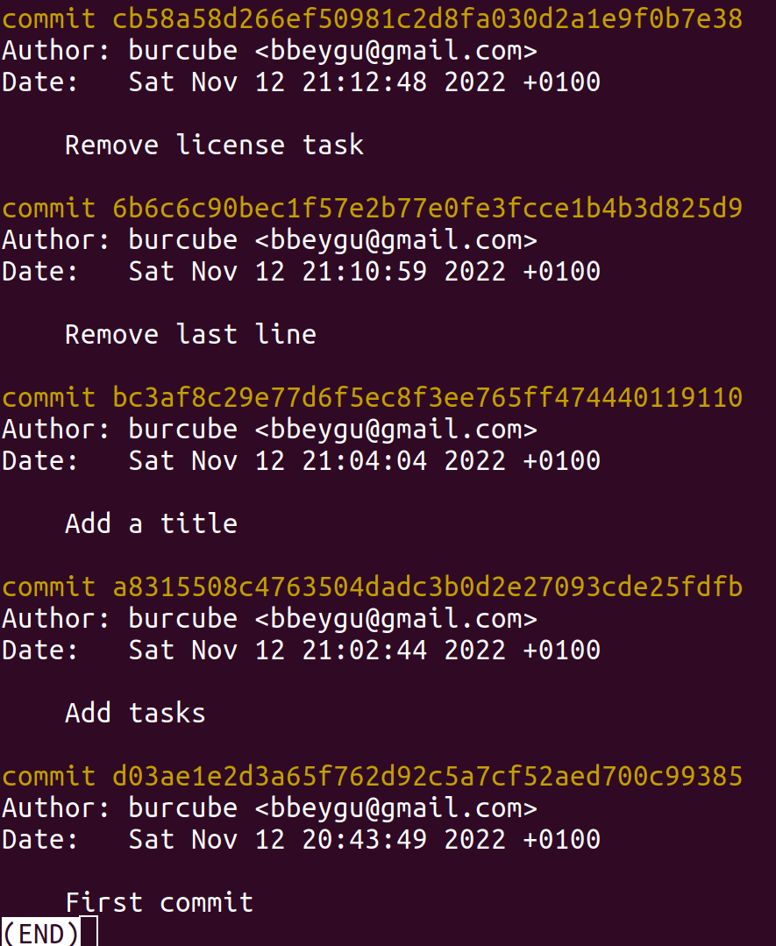
Track
git log : Shows the history of all commits in the repository
git log <file>
Log
Unique hashes that identifies each different version
Hashes allows data sharing between repos
If 2 files are the same then their hashes are the same.
Git only needs to compare hashes

Slide 45
Track
git log –oneline –graph –decorate --all : Compact commit history

Slide 46
Track
Let’s customize the log output with useful options:
git log -3 <filename> : Displays the last 3 commits of the file.
git log --since=“Nov 15 2022” :Useful for long running projects.
git log --since=“Nov 15 2022” --until=“Nov 17 2022”
git log -p :Displays the same history plus the detailed diff of the a changed files in each commit.
git log --author= “Joe” :Useful when multiple people work in the same project.
git log --stat :Displays summary of the changes in each commit

Slide 47
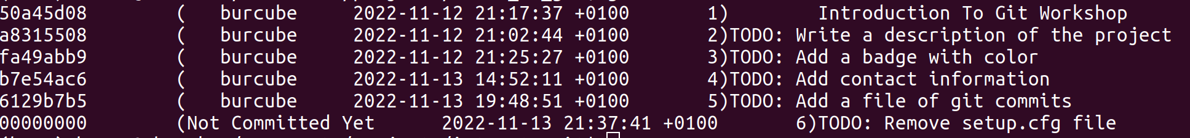
View changes per commit
git annotate <filename> : Shows changes per document

Slide 48
Unstage - Undo - Restore

Slide 49
Unstage
git restore --staged <file> : Removes file from the staging area.
git restore : Unstages all files.
Repository Staging Area Commit
README.md
README.md
README.md
LICENSE
LICENSE
LICENSE
requirements.txt
requirements.txt
setup.cgf

Slide 50
Undo changes
git restore <file> : Undo changes to an unstaged file in the working directory.
git restore . : Undo changes to all unstaged files in the current directory and a subdirectories
It only affefcts the working directory not the Git history or staging area -> No need to commit
This means losing all changes made to the unstaged file forever.

Slide 51
Restore
How to restore a file or a repository to a preferred version?
How to match a file or a repo to a preferred branch’s HEAD?
How to restore a deleted file?

Slide 52
Restore
git restore --source <hash> -- <file> : Restores a file to a specific older version without changing the commit history
Or
git restore --source HEAD~1 -- <file> : Restores a file from previous commit.
Restoring a file doesn't erase any of the repository's history. Instead, the act of restoring the file is saved as another commit, in case you later want to undo your undoing.
Then you need to stage and commit this change:
git add <file> Don’t forget to stage and commit!
git commit -m “Restore to version <hash>”

Slide 53
Restore
git restore --source <hash/or branch> -- <file>
Makes the file match a given commit or branch
git restore <file>
Discards uncommitted changes and makes the file match the HEAD of the branch you are in

Slide 54
Restore
How to restore a deleted file?
rm <file> : You accidentally deleted a file while working on a branch.
git restore <file> : Restore that deleted file to match the HEAD of your branch

Slide 55
Restore
How to remove a file from the working directory and restore it later?

Slide 56
Restore
How to remove a file from the working directory and restore it later?
git rm <file> : Removes the file from both Git and the working directory, and stages the change.
git status

Slide 57
Restore
How to remove a file from the working directory and restore it later?
git rm <file> : Removes the file from both Git and working directory, and stages the change.
git status
git restore --staged <file> :Undo git rm before committing.The `--staged` option ensurs staging.
git status
git checkout - - <file>

Slide 58
Restore
How to remove a file from the working directory (save the remove action) and restore it later?

Slide 59
Restore
How to remove a file from the working directory (save the remove action) ?
git rm <file> : Removes the file and stages the change.
git status
git commit -m “Remove <file>”

Slide 60
Restore
How to remove a file from the working directory (save the remove action) and restore it later?
git rm <file> : Removes the file and stages the change
git status
git commit -m “Remove <file>”
git checkout HEAD~1 <file>
git status
git commit -m “Restore <file> after removing it.”

Slide 61
Cleaning repository
Let’s check untracked files in our repository:
git clean -n : Lists all the untracked files in the working directory
git clean -f <file> : Deletes untracked files. It cannot be undone!
Alternatively you can tell Git not to track certain files : .gitignore file

Slide 62
Ignoring files
.gitignore : Prevents tracking temporary files (e.g., .log, .DS_Store, .pdf)
Excludes sensitive files like API keys
Create a .gitignore file in the root of your repository
nano .gitignore
Examples of content:
*.log : Git will ignore all files that end with .log
.env
__pycache__/
list : Git will ignore any file or directory called list (if a directory, anything in it)

Slide 63
Working with Branches

Slide 64
Working with branches
my_project
draft
final
final_v2
data
.git
readme.md
readme.md
readme.md
v2
my_data.csv
analysis.py
analysis_v2.py
analysis_v3.py
model.py
model_v2.md
model_v2.md

Slide 65
Working with branches
my_project
Too many subdirectory, unnecessary work!
draft
final
final_v2
data
.git
readme.md
readme.md
readme.md
v2
my_data.csv
analysis.py
analysis_v2.py
analysis_v3.py
model.py
model_v2.md
model_v2.md

Slide 66
Working with branches
Branche(s) : Allows you to have multiple versions of your work, and lets you track each version systematically.
Each branch is like a parallel universe: changes you make in one branch do not affect other branches (until you merge them back together).
In each branch:
Some files might be the same
Others might be different
Some may not exist at all
Avoids endless subdirectories
Everything is tracked
Minimizes the risk of conflicting
Branches allow us to work on different components of a project simultaneously.

Slide 67


Main branch
main
main : ground truth

Slide 68
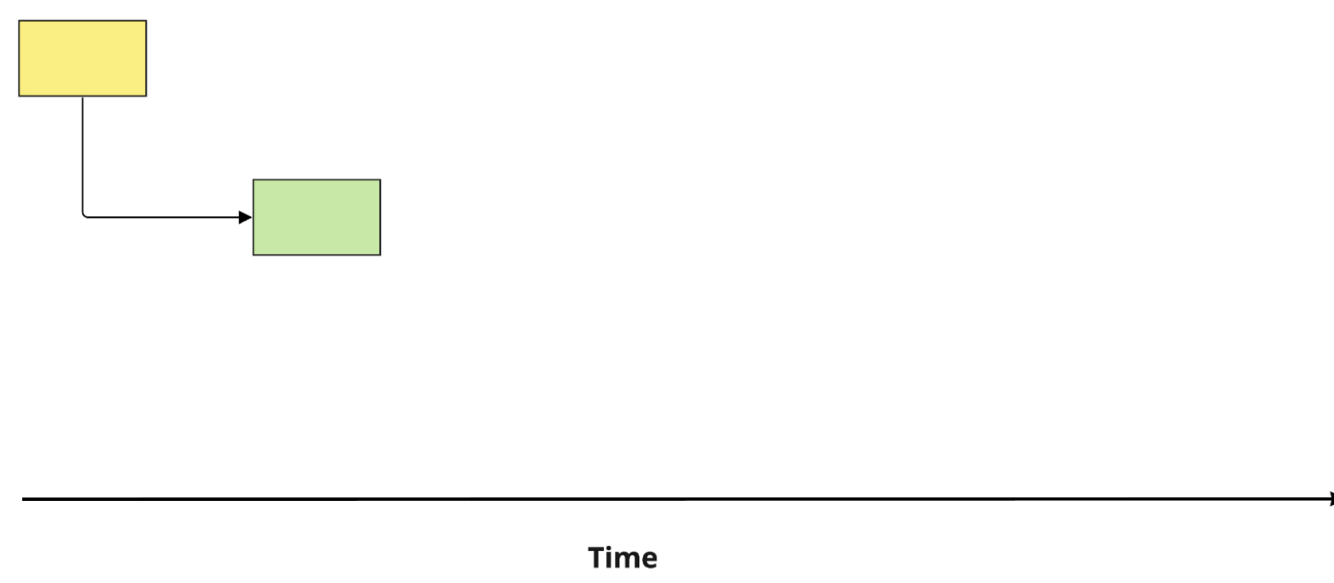
Analysis branch
main
analysis

Slide 69
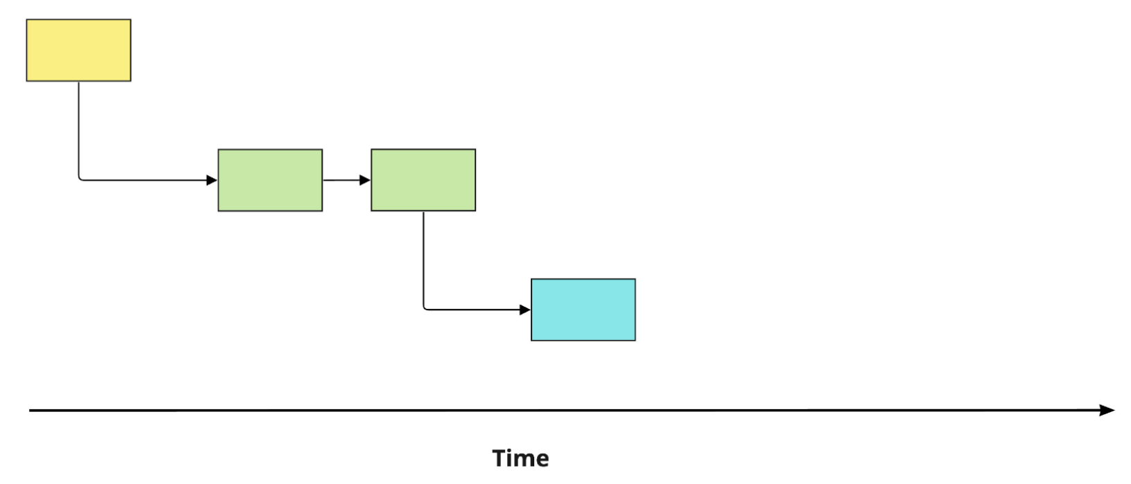
Model branch
main
analysis
model

Slide 70
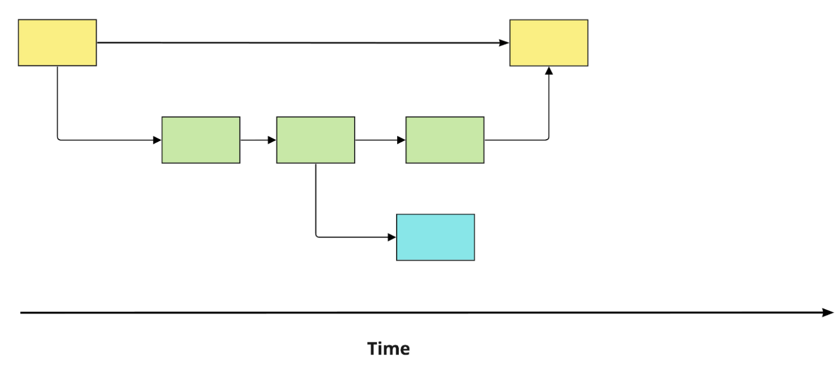
Merging Analysis to Main
main
analysis
model

Slide 71
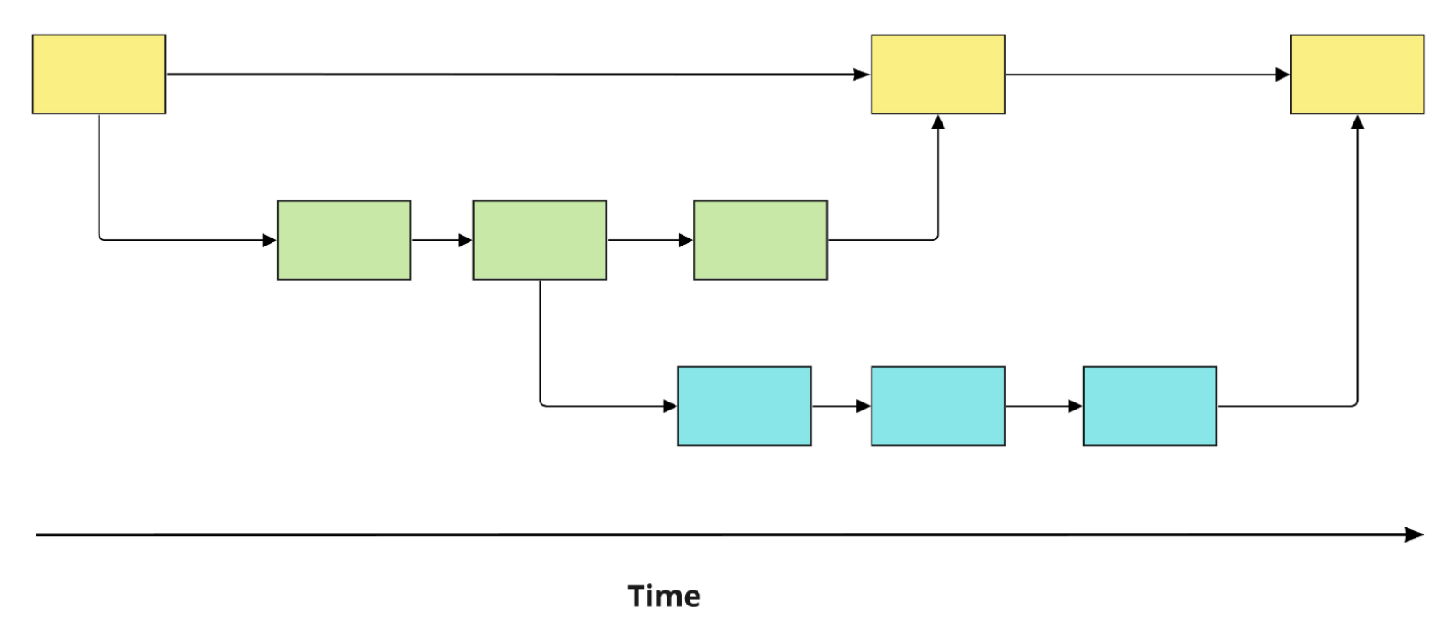
Merging Model to Main
main
analysis
model

Slide 72
Source and destination
When merging two branches:
The commits are called parent commits
source : the branch we want to merge from
destination: the branch we want to merge into
When merging analysis to main:
analysis = source
main = destination

Slide 73
Working with branches
git branch : List the existing branches
analysis
main
*model
* = current branch

Slide 74
Working with branches
git switch -c <new branch> : Creates a new branch and switches to it.
Let’s create a new branch and make some modifications, stage and commit.
Then let’s compare our branches:
git diff main analysis : Compares branches
Let’s switch branches:
git switch <branch>

Slide 75
Working with branches
Each branch should be a specific task. Don’t be overambitious!
Avoid working on the same file in two different branches at the same time
Once you complete your task, you should first switch to main.
Then merge your feature branch into main in order to keep your work up to date and accurate.
git merge source destination : Merges source to destination
git merge analysis :In order to merge, you need to be in the destination branch. a

Slide 76
Merge Types
Fast-forward merge
Before merging
Main
Feature Branch
Main
B1
B2
B3
Feature

Slide 77
Merge Types
Fast-forward merge
After merging
Main
Feature Branch
Main
Feature
B1
B2
B3
No additional commit is on main
Feature branch commits easily added to main
The main branch history remains linear
B3

Slide 78
RECAP
Daily Workflow
git branch : Make sure you are on the right branch before starting to work
git status : Make sure that you know the current status of your repo.
Work on my project : Continue working on your project if you are happy with the current status.
git add file(s) : Stage your changes often.
git commit -m “Message” : Commit your stages. Make frequent and small commits.
Happy with results : You are happy with your progress and results.
git switch main :Switch to the branch you want to merge your feature branch to .
git merge branch : Merge the branch to main to update the main branch.
git switch -c new_branch : You are ready to work on a new task in a new branch

Slide 79
Working with Remote Repositories
Digital
Competence
Centre

Slide 80
Working with an existing remote repository

Slide 81

Working with an existing remote repository: Clone
Go to a directory where you want to copy (clone) the remote repository in your local environment.
Go to the remote repository in GitHub.
Click
Select HTTPS or SSH and copy the url.
Go to your directory where you want to clone the remote.
git clone https://github.com/<username>/<remote_project>.git
After cloning don’t forget to go in that repository.
Git automatically creates a remote called origin that points to the original repository.
git remote -v :Displays the name of the remote together with the url.

Slide 82
Working with an existing remote repository: Fork
Go to a directory where you want to copy (fork) the remote repository in your local environment.
Go to the remote repository in GitHub.
Click
Select `Create a new fork`
Select an Owner and Rename the repository
Select `Copy the main branch only`
Click
In your GitHub space, a fork of the original repository will be created.

Slide 83
Clone vs Fork
Cloning
Creates a linked copy on a local computer
Requires use of Git
Push and pull updates with Git
Used for collaboration
Forking
Creates an independent copy on GitHub
Can be done within GitHub
Submit changes through pull requests (PR)
The main purpose is to experiment and make
an independent development can be used for
collaboration as well.

Slide 84
Working with a remote repository
Make sure that your local repo is up to date with the remote repo and check the status of your local repo.
git status
git pull origin main : Fetch and merge the latest changes
Make your changes to your files
git add <file>
git commit -m “Message”
git push origin main : Push changes to the remote repository
Let’s check our remote on GitHub

Slide 85
Working with a remote repository
Make sure that your local repo is sync with the remote repo and check status of your local repo.
git status
git pull origin main
Go to a <new branch> and make you changes on your files
git add <file>
git commit -m “Message”
git push origin <new branch>
On the remote repository (GitHub) create a PR
Merge the pull request. This is done by the assigned person

Slide 86
RECAP
Daily Workflow
git pull origin main : Fetch and merge the latest changes from the remote `master` (or `main`) branch into your local branch.
git checkout <feature_branch> : Switch to the local branch you want to work on.
git status : Check the current status of your repo.
Work on my project : Continue working on your project if you are happy with the current status.
git add file(s) : Stage your changes often.
git commit -m “Message” : Commit your staged changes. Make frequent and small commits.
Happy with results
git push –u origin <feature_branch> : If it is the first time that the branch is created and you want to track the remote branch, use the option `-u` . Otherwise, you can omit this option.
git push origin <feature_branch> : Push your local branch to the remote repository (not directly to `master` or `main`)
Create a Pull Request (PR ) : On GitHub/GitLab, open a pull request for code review and approval. Assign a reviewer.
Merge to master/main : Once approved, the reviewer merges the changes into the main branch.
git switch main :Switch to the master branch (or main branch).
git pull origin main : Update your local repository with the latest changes from master (or main)

Slide 87
Creating a new remote repository from existing local repo
On your machine, go to the directory where you want to create the repository
mkdir <repository-name> : This is the name of your project
cd <repository-name>
git init
touch README.md
git add README.md
git commit -m “First commit”
Digital
Competence
Centre

Slide 88
Creating a new remote repository from existing repository
git remote add origin git@github.com:<username>/<repository_name>.git
Then:
git push –u origin main
Let’s check the GitHub
Digital
Competence
Centre

Slide 89



Creating a new remote repository on GitHub
Go to your GitHub account
Select
Click New
Type your repository name (<repository-name>), select Private or Public
Click
Click
Select HTTPS or SSH and copy the url to clone it to your local environment.
Digital
Competence
Centre

