Slide 1


Introduction To Git & GitHub Part 2
Burcu Beygu
burcu.beygu@rug.nl
Digital
Competence
Centre

Slide 2
DCC RUG
dcc@rug.nl
Digital
Competence
Centre

Slide 3
Agenda
Set up a remote repository in GitHub
Add README and License
Branch protection
Public vs Private
Adding collaborator
Clone vs Fork
Recap
Working with branches
Create & switch between branches
Merging branches
Collaborative work with GitHub
Synchronizing the local repository with the remote repository
fetch, pull, push
Open a pull request
Assign
Code review
Merge pull request
Merge conflicts
Merge Types
Digital
Competence
Centre

Slide 4

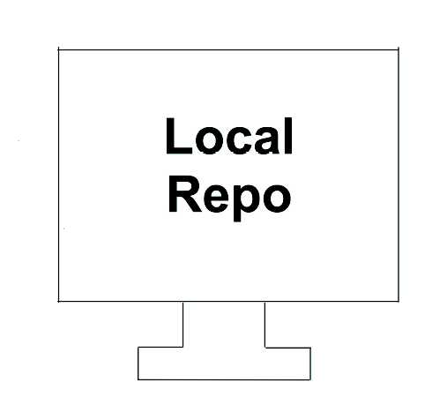
Working with Remote Repositories
Digital
Competence
Centre

Slide 5
Set up a remote repository in GitHub
But before it is good to have a plan:
Why do you need a remote repository?
Do you need a private or public repository?
Who are your collaborators?
How do you imagine collaboration and contribution to will work?
What are the rules on working branches and protecting main branch?
Which license do you need?
……
You can of course always make changes and make decisions later on, however, little pre-planing and discovery is always useful.
Digital
Competence
Centre

Slide 6
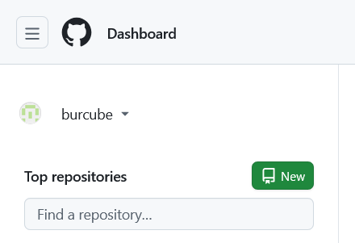
Set up a remote repository in GitHub
Click New
Digital
Competence
Centre

Slide 7
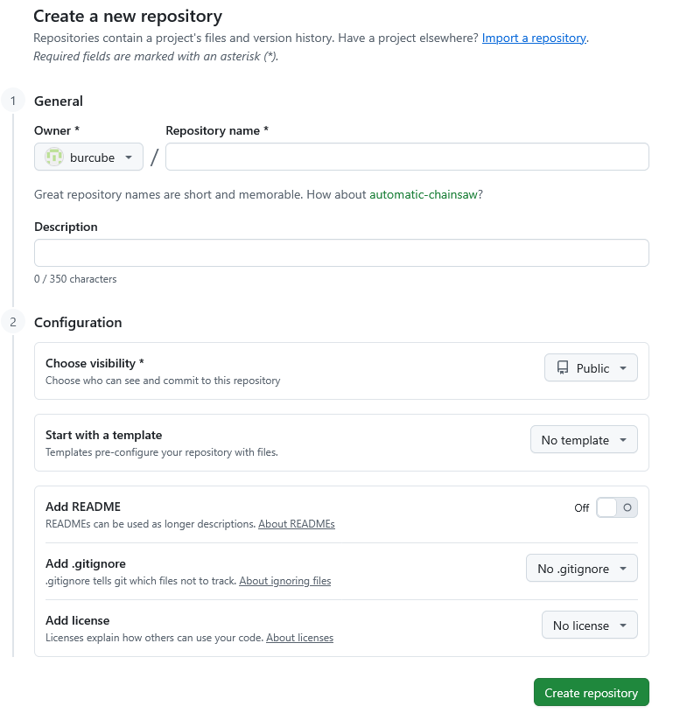
Set up a remote repository in GitHub
Digital
Competence
Centre

Slide 8
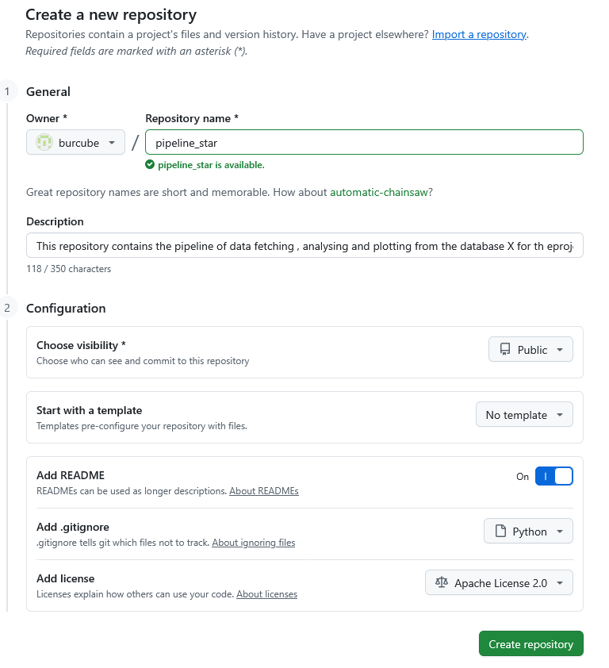
Set up a remote repository in GitHub
Digital
Competence
Centre

Slide 9
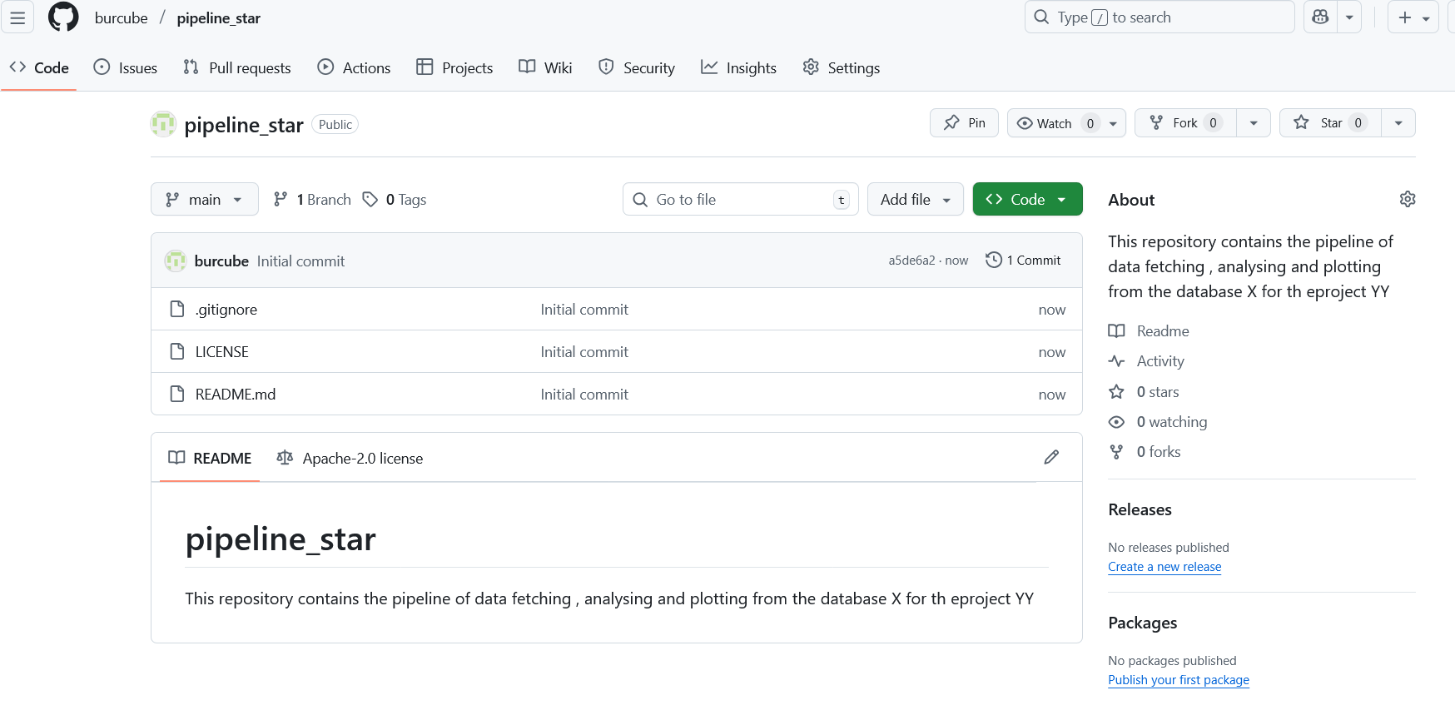
Set up a remote repository in GitHub
Everything involving that particular repository
Digital
Competence
Centre

Slide 10
Set up a remote repository in GitHub
Digital
Competence
Centre

Slide 11
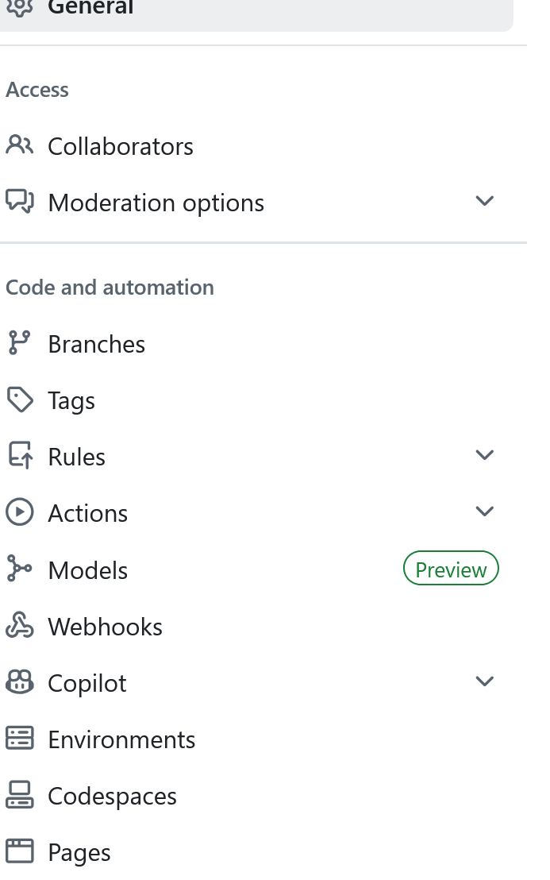
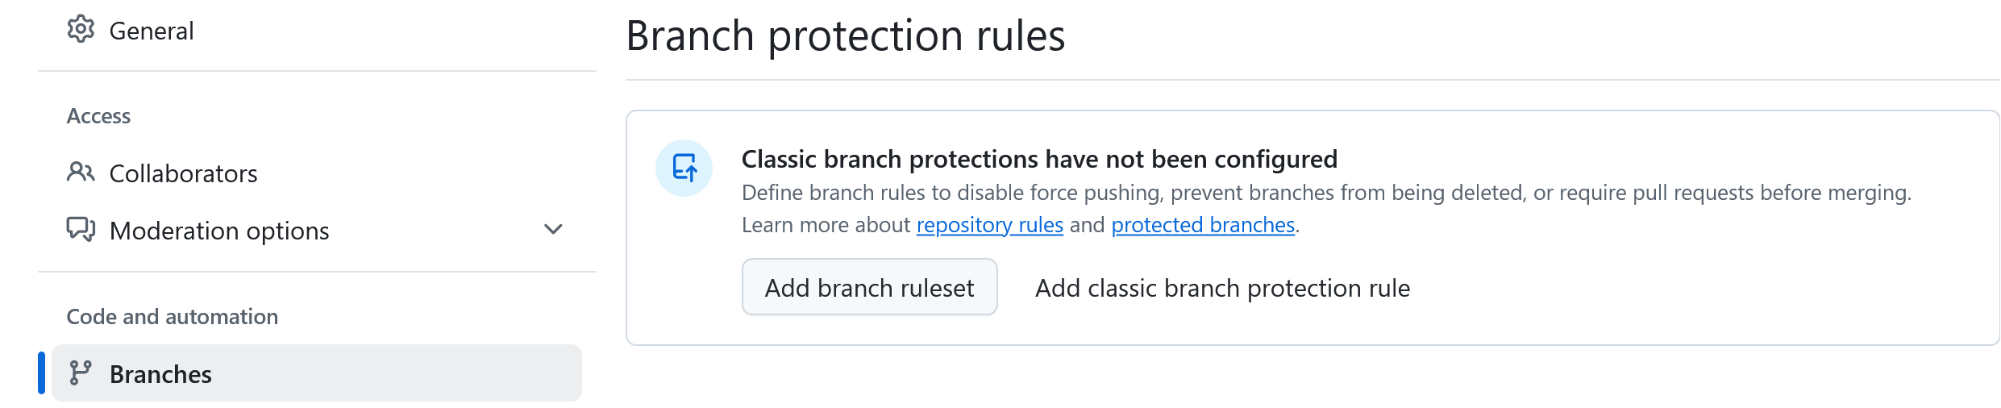
Set up a remote repository in GitHub- branch protection
Digital
Competence
Centre

Slide 12
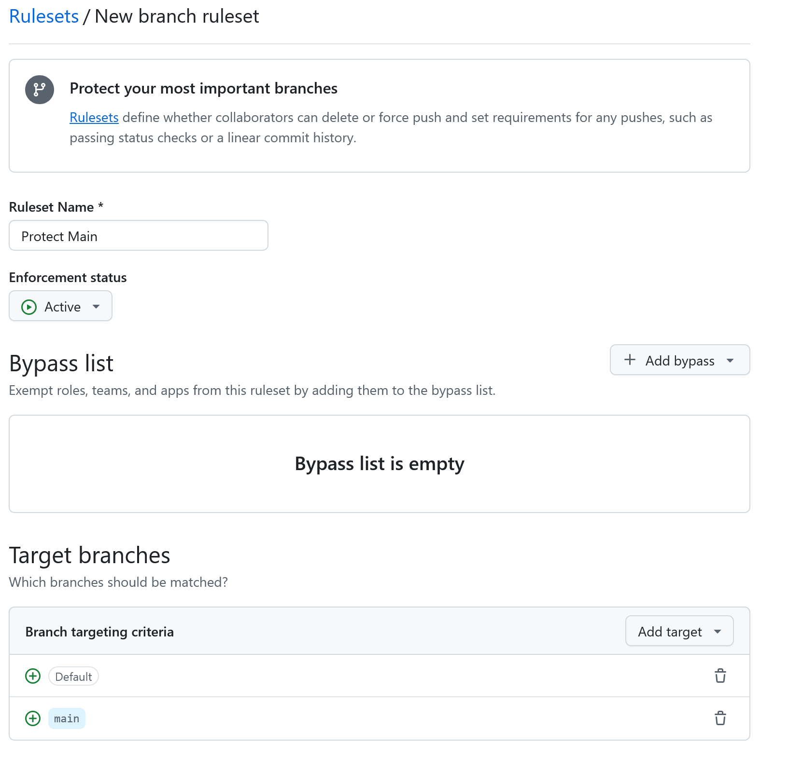
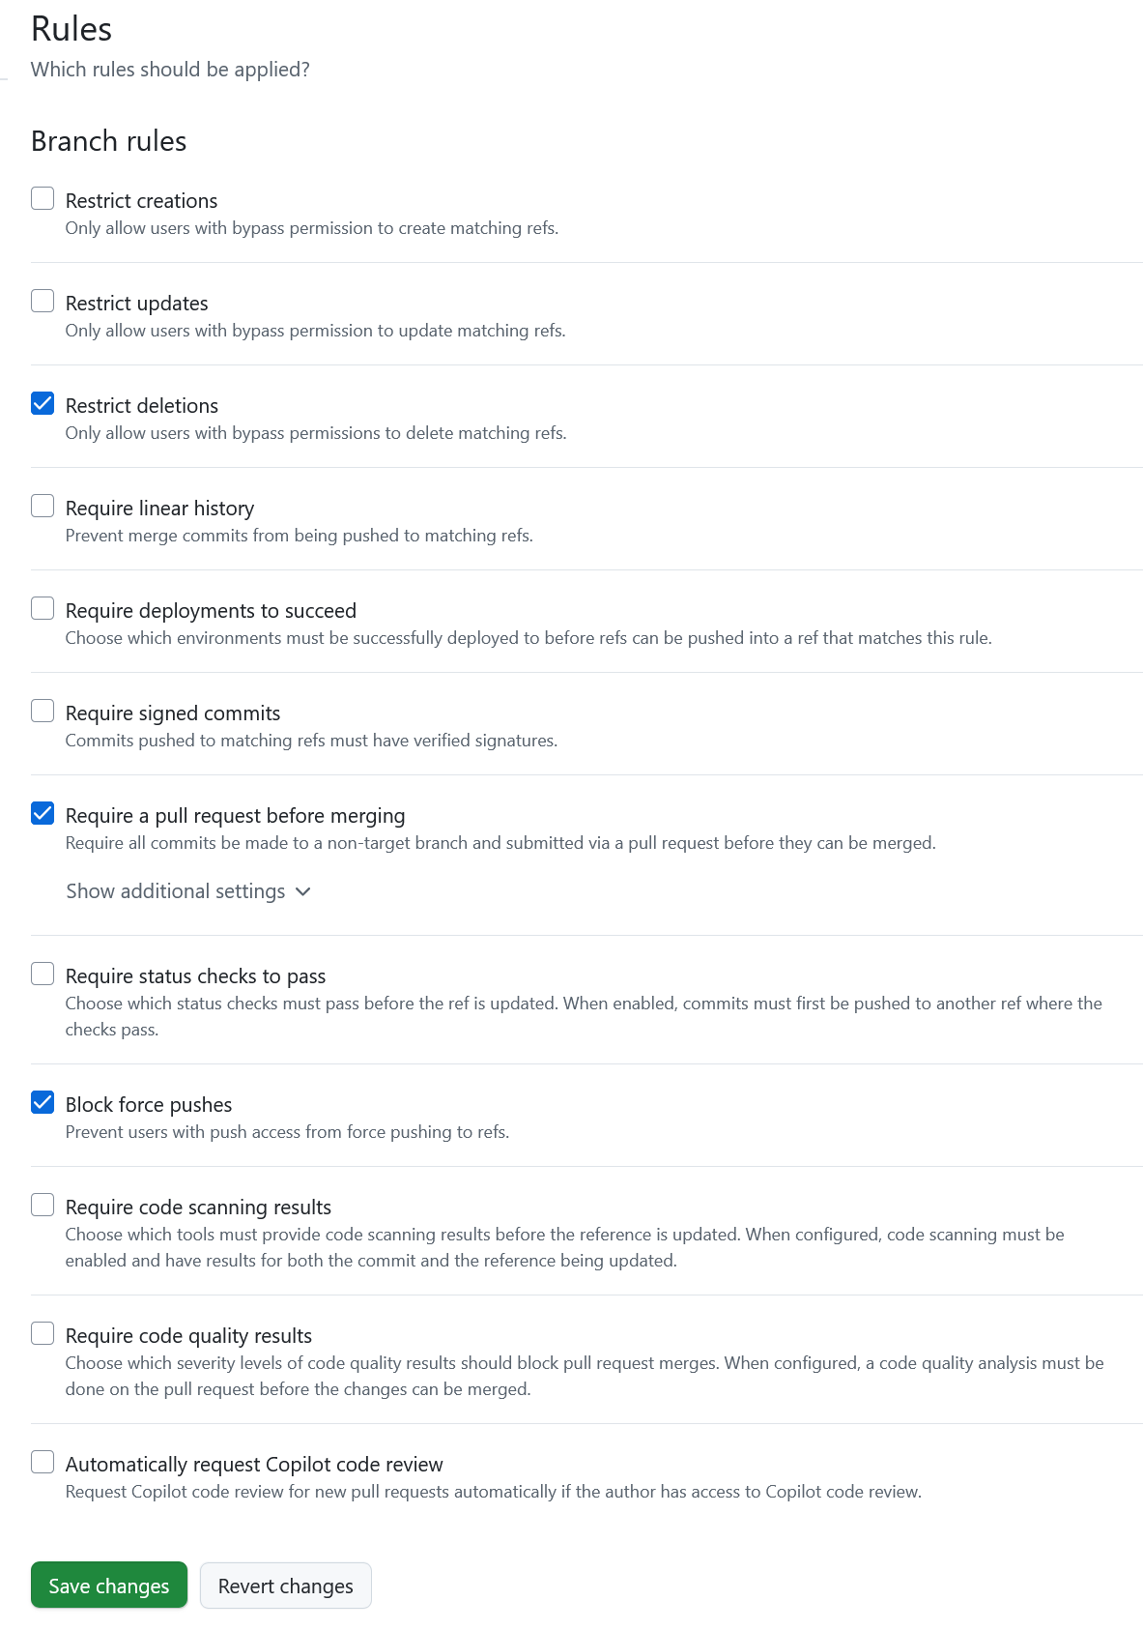
Set up a remote repository in GitHub- branch protection
First, make sure to protect the main branch and decide on the rules
Digital
Competence
Centre

Slide 13
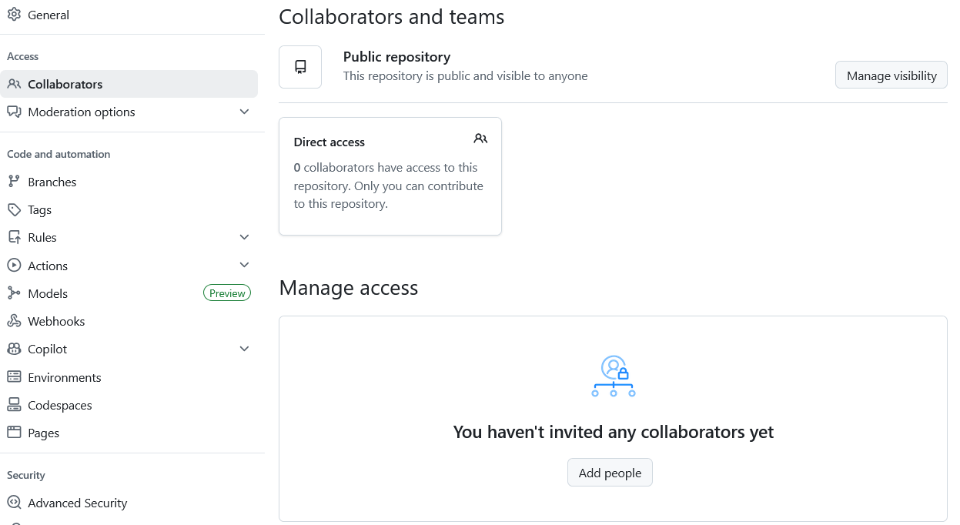
Set up a remote repository in GitHub- adding collaborators
Collaborators are the developers who contribute the code or have responsibility for code
review or managing the repository. Independent of a repository being a Public or Private
repository, you might define the collaborators.
Digital
Competence
Centre

Slide 14
Clone vs Fork
Cloning
Creates a linked copy on a local computer
Requires use of Git
Push and pull updates with Git
Used for collaboration
Forking
Creates an independent copy on GitHub
Can be done within GitHub
Submit changes through pull requests (PR)
The main purpose is to experiment and make
an independent development can be used for
collaboration as well.

Slide 15

Working with an (existing) remote repository: Clone
Go to a directory where you want to copy (clone) the remote repository in your local environment.
Go to the remote repository in GitHub.
Click
Select HTTPS or SSH and copy the url.
Go to your directory where you want to clone the remote.
git clone https://github.com/<username>/<remote_project>.git
After cloning, don’t forget to go into that repository.
Git automatically creates a remote called origin that points to the original repository.
git remote -v : Displays the name of the remote together with the url.

Slide 16
Working with an (existing) remote repository- ssh key
Generate a key on your local computer
ssh-keygen -t ed25519 -C "your_email@example.com"
2) Start the SSH agent and add your key:
eval "$(ssh-agent -s)"
ssh-add ~/.ssh/id_ed25519
3) Add your public key to GitHub
cat ~/.ssh/id_ed25519.pub
Go to GitHub -> Settings -> SSH and GPG keys -> New SSH key and paste it.
4) Test your connection
ssh –T git@github.com

Slide 17
Working with an (existing) remote repository- add remote
Don’t forget to add the remote repository:
This way, you can pull and push via the already defined ssh key.
Get information about all remotes
git remote -v
git remote set-url origin git@github.com:username/repository_name.git
Add a new remote
git remote add remote_name https://github.com/username/repository_name.git

Slide 18
Working with an (existing) remote repository: Fork
Go to a directory where you want to copy (fork) the remote repository in your local environment.
Go to the remote repository in GitHub.
Click
Select `Create a new fork`
Select an Owner and Rename the repository
Select `Copy the main branch only`
Click
In your GitHub space, a fork of the original repository will be created.

Slide 19
Recap Branches

Slide 20
Working with branches
my_project
draft
final
final_v2
data
.git
readme.md
readme.md
readme.md
v2
my_data.csv
analysis.py
analysis_v2.py
analysis_v3.py
model.py
model_v2.md
model_v2.md

Slide 21
Working with branches
my_project
Too many subdirectory, unnecessary work!
draft
final
final_v2
data
.git
readme.md
readme.md
readme.md
v2
my_data.csv
analysis.py
analysis_v2.py
analysis_v3.py
model.py
model_v2.md
model_v2.md

Slide 22
Working with branches
Branche(s) : Allows you to have multiple versions of your work, and lets you track each version systematically.
Each branch is like a parallel universe: changes you make in one branch do not affect other branches (until you merge them back together).
In each branch:
Some files might be the same
Others might be different
Some may not exist at all
Avoids endless subdirectories
Everything is tracked
Minimizes the risk of conflicting
Branches allow us to work on different components of a project simultaneously.

Slide 23


Main branch
main
main : ground truth

Slide 24
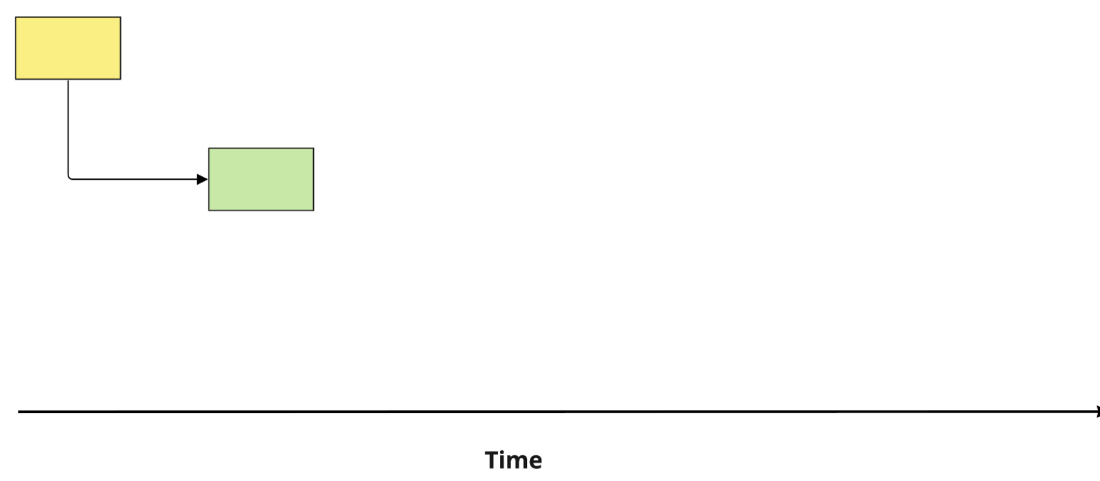
Analysis branch
main
analysis

Slide 25
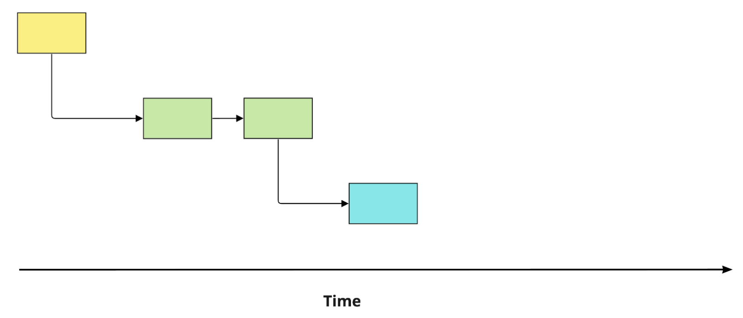
Model branch
main
analysis
model

Slide 26
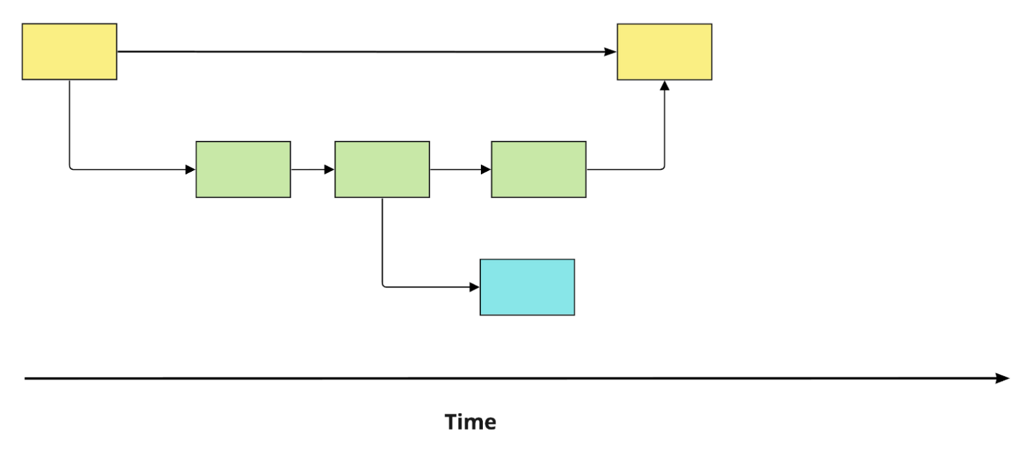
Merging Analysis to Main
main
analysis
model

Slide 27
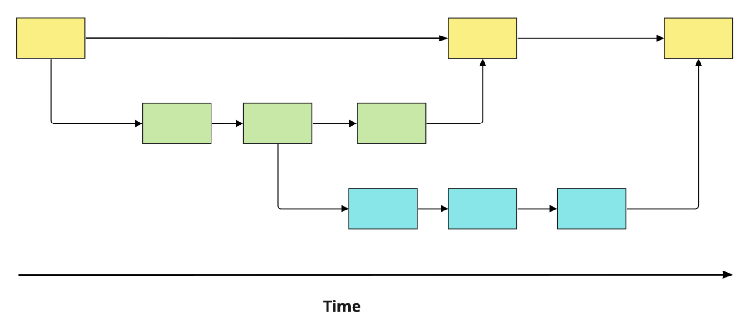
Merging Model to Main
main
analysis
model

Slide 28
Source and destination
When merging two branches:
The commits are called parent commits
source : the branch we want to merge from
destination: the branch we want to merge into
When merging analysis to main:
analysis = source
main = destination

Slide 29
Working with branches
git branch : List the existing branches
analysis
main
*model
* = current branch

Slide 30
Working with branches
git switch -c <new branch> : Creates a new branch and switches to it.
Let’s create a new branch and make some modifications, stage and commit.
Then let’s compare our branches:
git diff main analysis : Compares branches
Let’s switch branches:
git switch <branch>

Slide 31
Working with branches
Each branch should be a specific task. Don’t be overambitious!
Avoid working on the same file in two different branches at the same time
Once you complete your task, you should first switch to main.
Then merge your feature branch into main in order to keep your work up to date and accurate.
git merge source destination : Merges source to destination
git merge analysis :In order to merge, you need to be in the destination branch. a

Slide 32
RECAP
Daily Workflow
git branch : Make sure you are on the right branch before starting to work
git status : Make sure that you know the current status of your repo.
Work on my project : Continue working on your project if you are happy with the current status.
git add file(s) : Stage your changes often.
git commit -m “Message” : Commit your stages. Make frequent and small commits.
Happy with results : You are happy with your progress and results.
git switch main :Switch to the branch you want to merge your feature branch to .
git merge branch : Merge the branch to main to update the main branch.
git switch -c new_branch : You are ready to work on a new task in a new branch

Slide 33
Collaborative work with GitHub
Digital
Competence
Centre

Slide 34
Collaborative work with GitHub
COMMUNICATION
It is all about communication!
Setting up collaboration rules
Writing meaningful commit messages
Leaving clear and concise review notes and comments
…….
Digital
Competence
Centre

Slide 35
Synchronizing the local repository with the remote repository
Make sure that your local repo is synced with the remote repo and check the status of your local repo.
git status
git pull origin main : Fetch and merge the latest changes
Go to a <new branch> and make you changes on your files
git add <file>
git commit -m “Message”
git push origin <new branch> : Push the changes to the remote repository
On the remote repository (GitHub), create a PR
Merge the pull request. This is done by the assigned person

Slide 36
Synchronizing the local repository with the remote repository
git fetch
Downloads commits, branches, and tags from remote
Updates the local copy of the remote repo
It is always safe to perform.
It does not update the files!
git pull
Does fetch + merge into your current branch
Sometimes risky, as it can cause conflicts since it performs a merge.
It does updates the files!

Slide 37
Synchronizing the local repository with the remote repository
git fetch
Downloads commits, branches, and tags from remote
Updates the local copy of the remote repo
It is always safe to perform.
It does not update the files!
git pull
Does fetch + merge into your current branch
Sometimes risky, as it can cause conflicts since it performs a merge.
It does updates the files and changes the local branch immediately!

Slide 38
Synchronizing the local repository with the remote repository
Situation | Use git fetch | Use git pull
You want to see what is new before updating | + | X
You are in the middle of other work | + | X
You are ready to update your branch and integrate changes | fetch + merge manually | +
You are on a feature branch and just want to stay up to date with main | + | Maybe
You are automating | + | X

Slide 39
Collaborative work with GitHub -
Open a pull request
Pull request
The pull request shows the changes in your branch to other people and allows
people to accept, reject, or suggest additional changes to your branch.
In a side-by-side comparison, a pull request is going to keep the changes you just made on
your branch and propose applying them to the main project branch.
Digital
Competence
Centre

Slide 40
Collaborative work with GitHub -
Review pull request
Pull request review
Reviewing a pull request is an opportunity to examine another contributor’s changes and give them feedback.
Pull request reviews ensure quality and maintain the momentum of changes to your project.
It is an efficient way of improving coding skills and bringing the team to the same level.
What and How to Review?
Identify potential issues, risks, and limitations.
Suggest changes and improvements.
Share awareness of upcoming changes that the pull request doesn't account for.
Ask questions to verify shared understanding.
Highlight what the author did well and should keep doing.
Prioritize the most important feedback.
Be concise and provide meaningful detail.
Be polite!
Digital
Competence
Centre

Slide 41
Collaborative work with GitHub Code Review Workflow
Steps | Action | Who does it? | On GitHub
1 | Create PR | Author | Click “Create pull request”, assign reviewer
2 | Review code | Reviewer | Review changes -> Request changes/Approve
3 | Implement feedback | Author | Commit _ push changes, Re-request review
4 | Verify fixes | Reviewer | Approve final version
5 | Merge PR | Author/Reviewer/Maintainer | (Squash &) merge, delete branch
Digital
Competence
Centre

Slide 42
Collaborative work with GitHub Code Review Workflow – After Receiving Review Comments
Author reads review comments on PR
No
Has `main` changed since branch was created?
Yes
Stay on your feature branch, implement requested changes
Update feature branch with latest ‘main’
git switch feature branch
git fetch origin
git merge origin/main
#resolve conflicts -> git push
git switch feature branch
git fetch origin
git rebase origin/main
#resolve conflicts
git push –force-with-lease
git switch feature branch
git add .
git commit –m “Message”
git push
Reply to comments -> Resolve threads
Re-request review if needed
PR updates automatically on GitHub
Run checks
Reviewer re-checks
Approve & Merge
Digital
Competence
Centre

Slide 43
RECAP
Daily Workflow
git pull origin main : Fetch and merge the latest changes from the remote `master` (or `main`) branch into your local branch.
git checkout <feature_branch> : Switch to the local branch you want to work on.
git status : Check the current status of your repo.
git merge origin/main : Bring your branch up to date
Work on my project : Continue working on your project if you are happy with the current status.
git add file(s) : Stage your changes often.
git commit -m “Message” : Commit your staged changes. Make frequent and small commits.
Happy with results
git push –u origin <feature_branch> : If it is the first time that the branch is created and you want to track the remote branch, use the option `-u` . Otherwise, you can omit this option.
git push origin <feature_branch> : Push your local branch to the remote repository (not directly to `master` or `main`)
Create a Pull Request (PR ) : On GitHub/GitLab, open a pull request for code review and approval. Assign a reviewer.
Merge to master/main : Once approved, the reviewer merges the changes into the main branch.
git switch main :Switch to the master branch (or main branch).
git pull origin main : Update your local repository with the latest changes from master (or main)

Slide 44
Merge Conflicts
Digital
Competence
Centre

Slide 45
Merge Conflicts
What is a merge conflicts?
A merge conflict happens when Git can’t automatically combine changes from two branches because the same part of a file (or its structure) was edited differently.
Digital
Competence
Centre

Slide 46
Merge Conflicts
What is a merge conflicts?
A merge conflict happens when Git can’t automatically combine changes from two branches because the same part of a file (or its structure) was edited differently.
Digital
Competence
Centre

Slide 47
Merge Conflicts
How to solve a merge conflicts?
Scenario 1
You’ve been working on feature branch, and meanwhile, someone else changed the same file (and same lines) on main.
git switch main
git pull origin main
or
git merge feature-branch
If both branches modified the same lines or file structure → conflict
Digital
Competence
Centre

Slide 48
Merge Conflicts
How to solve a merge conflicts?
Scenario 1
Open the conflicted file in Terminal with text editor or in your VS Code:
<<<<<<<<< HEAD
Code from main branch
===========
Code from feature-branch
>>>>>>>>>> feature-branch
Conflict markers
Digital
Competence
Centre

Slide 49
Merge Conflicts
How to solve a merge conflicts?
Scenario 1
Open the conflicted file in Terminal with text editor or in your VS Code:
<<<<<<<<< HEAD
Code from main branch
===========
Code from feature-branch
>>>>>>>>>> feature-branch
You have 3 options:
Keep main (Accept current change)
Keep feature-branch (Accept incoming Change)
Accept both changes
Digital
Competence
Centre

Slide 50
Merge Conflicts
How to solve a merge conflicts?
Scenario 1
Open the conflicted file in Terminal with text editor or in your VS Code:
<<<<<<<<< HEAD
Code from main branch
===========
Code from feature-branch
>>>>>>>>>> feature-branch
Then:
Pick up the right option
Stage and commit the resolution
Continue merge or push updated branch
Digital
Competence
Centre

Slide 51
Merge Conflicts
How to solve a merge conflicts?
Scenario 2
You and a teammate changed the same file locally and both pushed to the same branch.
git pull origin main
Git can’t automatically merge→ conflict
Digital
Competence
Centre

Slide 52
Merge Conflicts
How to solve a merge conflicts?
Scenario 2
You have 3 options:
Keep main (Accept current change)
Keep feature-branch (Accept incoming Change)
Accept both changes
Then:
Pick up the right option
Stage and commit the resolution
Continue merge or push updated branch
Digital
Competence
Centre

Slide 53
Merge Conflicts
How to prevent a merge conflicts?
Pull often: Keep your branch close to main
Make small, focused commits: Fewer unrelated changes
Communicate with teammates editing the same area
Use feature branches: Don’t all work on main
Resolve conflicts early: Don’t let branches go untouched for a very long time
Digital
Competence
Centre

Slide 54
Merge Types
Digital
Competence
Centre

Slide 55
Merge Types
Fast-forward merge
Before merging
Main
Feature Branch
Main
B1
B2
B3
Feature

Slide 56
Merge Types
Fast-forward merge
After merging
Main
Feature Branch
No additional commit is on main
Feature branch commits easily added to main
The main branch history remains linear
Main
Feature
B1
B2
B3
Default fast forward git merge
git checkout main
git merge feature_branch
Force fast forward git merge
git checkout main
git merge feature_branch --ff-only
B3

Slide 57
Merge Types
Recursive merge
Before merging
Main
Feature Branch
Main
Recursive merges:
preserves historical context,
are better for more complex development
B1
B2
B4
B1
B3
B5
Feature

Slide 58
Merge Types
Recursive merge
After merging
Main
Feature Branch
Main
B1
B2
B3
B4
B5
B6
B6 is a new merge commit
B1
B3
B5
Recursive merge
git merge –no-ff feature_branch
Feature

Slide 59
Git Rebase
Git rebase:
is a method to integrate changes
is different than merge
removes merge commits for a cleaner history
Maintains a linear commit graph for clarity
Git rebase command
git checkout feature_branch
git rebase main : Rebase main branch onto feature_branch.
feature_branch commits are recreated after main’s latest commit

Slide 60
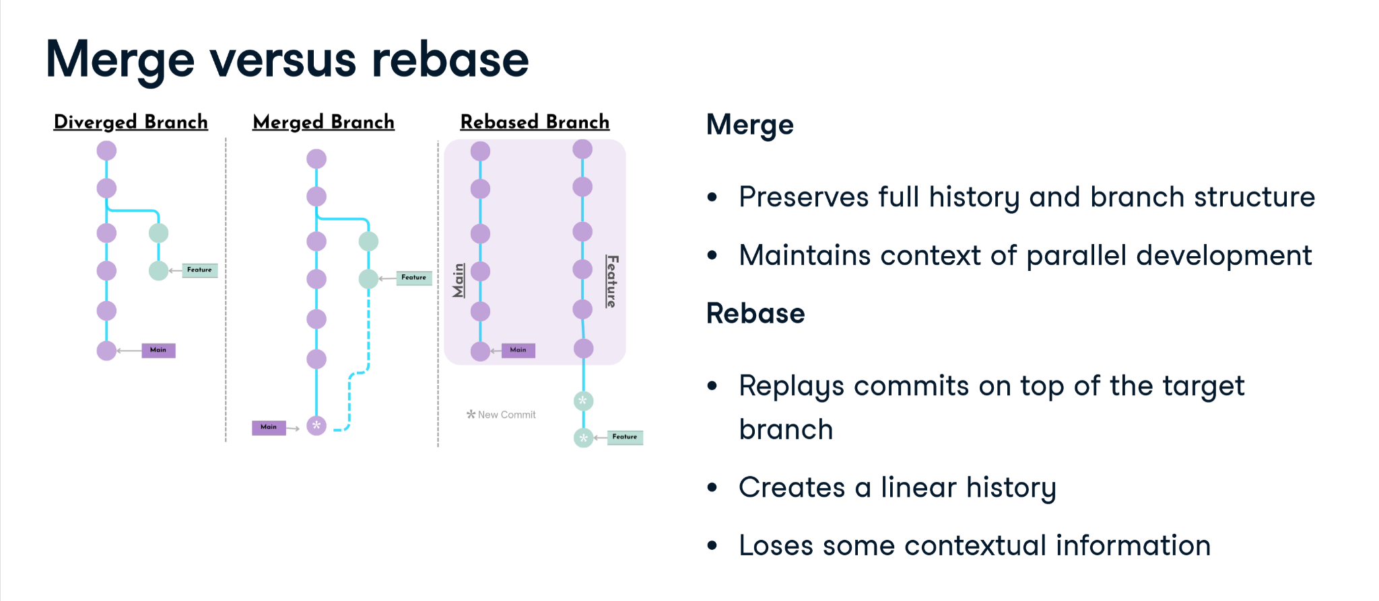
Git Rebase
*This slide is taken from Data Camp

