Slide 1
FINAL PRESENTATION STRUCTURE
D4-V2 Search and Rescue
base
Unknown Victim Location
lab
?
A rescue robot explores a known topology, inspects rooms, detects the victim, and completes rescue before time-dependent health degradation makes the mission fail.
entrance
corridor
infirmary
storage
Problem overview → classical abstraction → PDDL+ dynamics → model evolution → validation → limitations
AI2 Assignment D4-V2
1/7

Slide 2
Core modelling problem
Unknown victim location forces the model to represent information acquisition explicitly.
What the robot knows
What the robot must do
What changes with time
•
The topology is known.
•
Move through rooms.
•
Victim health degrades.
•
The victim room is not given in the exploration problem.
•
Inspect candidate rooms.
•
Long exploration can make rescue impossible.
•
Rescue only after detection.
Key modelling choice: treat sensing as explicit symbolic actions in Q1, then add time-dependent health dynamics in Q2.
AI2 Assignment D4-V2
2/7

Slide 3
Q1 — Classical PDDL approximation
Classical PDDL provides a valid abstraction, not real partial observability.
Symbolic information flow
base
move
inspect
detect
rescue
lab
victim
entrance
corridor
infirmary
rescue depends on victim-detected
direct rescue is blocked
storage
•
Rooms become inspectable symbolic states.
•
The planner does not access hidden uncertainty directly.
•
Detection changes the state, enabling the rescue action.
Presentation answer: Q1 approximates unknown location by making inspection and detection explicit in the domain model.
AI2 Assignment D4-V2
3/7

Slide 4
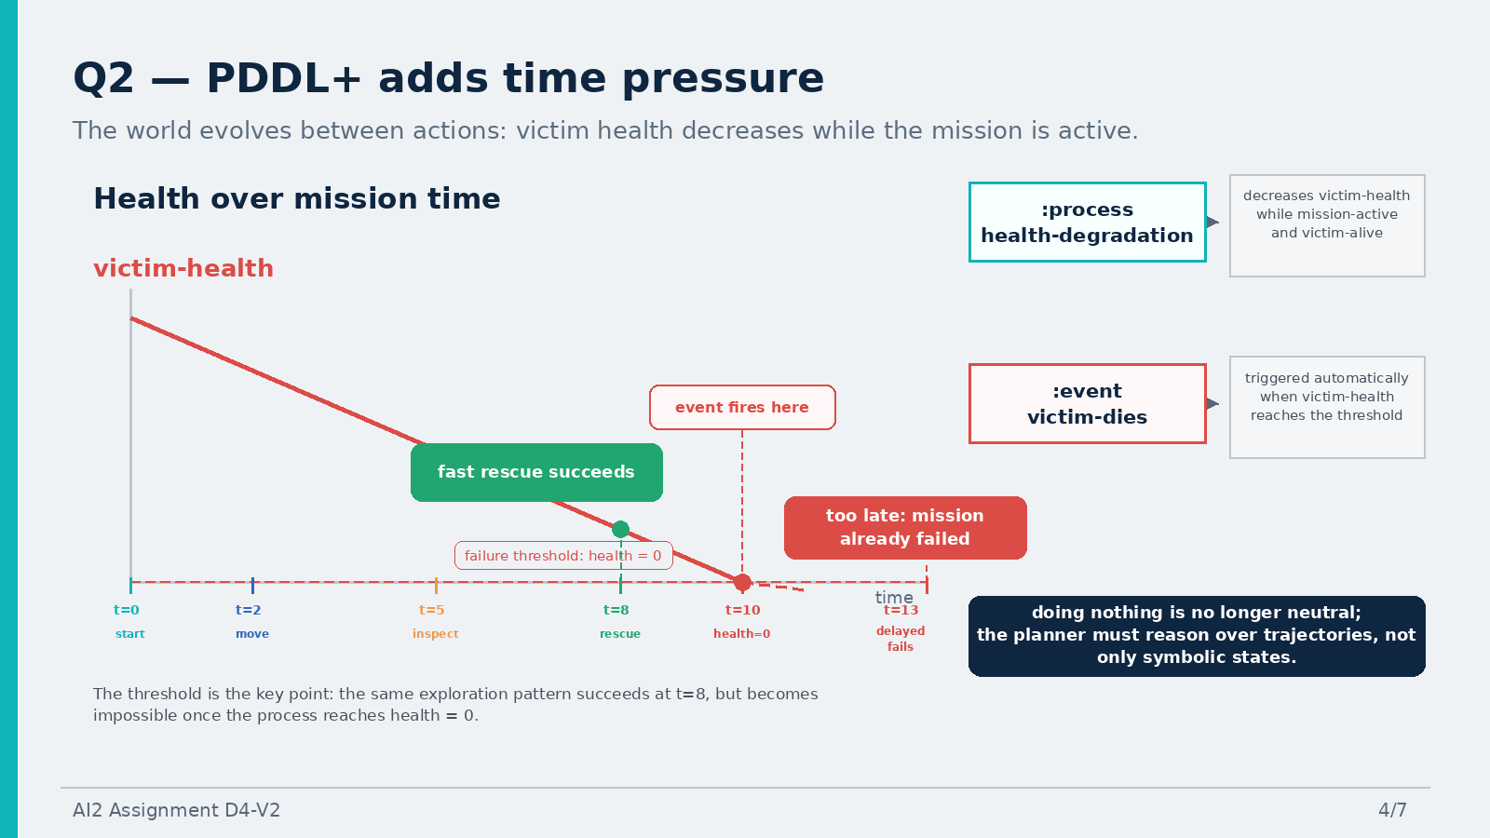

Slide 5
Evolution of the model: normal → variant → definitive
This is the central design history: each version solves a limitation of the previous one.
1 · Normal version
2 · Variant version
3 · Definitive version
victim found
→ rescue completed
find victim
→ load patient
→ move with patient
→ unload at base
health high
→ direct transport
health low
→ stabilize then transport
•
Matches the assignment core.
•
Rescue becomes transport-oriented.
too late
→ unsolvable
•
Too abstract: rescue happens in place.
•
More realistic than instant rescue.
•
Branch choice comes from victim-health thresholds.
Role in the project: baseline model for exploration and rescue logic.
Remaining issue: the model still needs a principled way to decide when stabilization is necessary.
Final message: this version adds a domain-level decision, not just extra actions.
The project moves from symbolic detection, to transport rescue, to autonomous health-based branching. This is principally due to the logical implicatons of the world “Rescue”.
AI2 Assignment D4-V2
5/7

Slide 6
Validation and demo outputs
The live demo can be replaced by saved planner outputs if the environment fails.
Direct transport
Stabilize + transport
Too-late case
Solved
Solved
Unsolvable
Plan contains transport actions and does not contain start-stabilize-patient.
Plan contains start-stabilize-patient before loading and moving the patient.
Forced delay makes the mission fail before rescue can be achieved.
Found Plan:
15.0 start-move
21.0 start-inspect
22.0 start-assess
23.0 start-load
33.0 start-unload
Found Plan:
10.0 start-assess
11.0 start-stabilize
15.0 start-load
29.0 start-unload
Problem unsolvable
Metric: -1
Dead-Ends detected
Demo path: open final domain + one problem in VS Code, run ENHSP local Docker, then compare with the saved plan file.
AI2 Assignment D4-V2
6/7

Slide 7
Reflection, limitations, and final delivery
The model is deliberately symbolic: it makes planning tractable by making its abstractions explicit.
What works
Known limits
Repository delivery
•
Q1 enforces inspect → detect → rescue.
•
No real partial observability or belief state.
Code folder:
Codes/...
Report:
Report/report.pdf
Slides:
slide/presentation.pdf
•
Q2 shows health/time interaction.
•
No noisy sensing, geometry, motion planning, or execution error.
•
Definitive validates direct, stabilization, and failure cases.
•
Some delayed PDDL+ outputs are documented as planner limitations.
The assignment demonstrates how a planning model can encode information acquisition, time pressure, and health-based branch choice while clearly exposing its abstractions.
AI2 Assignment D4-V2
7/7

