Slide 1

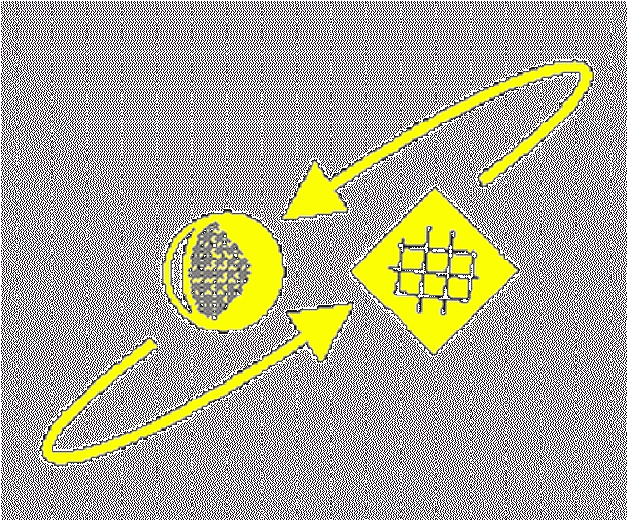
Script Recognition – 02
Human handwriting process
prof. dr. L. Schomaker
KI
RuG

Slide 2
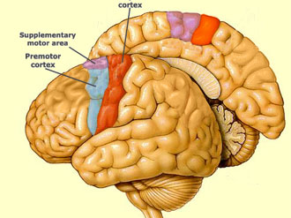
Human motor cortex
Efferent part (frontal)
© Schomaker 2001

Slide 3
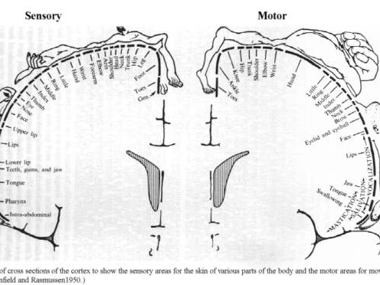
Human motor cortex
Sensory (dorsal, left) and Efferent part (frontal, right)
© Schomaker 2001

Slide 4
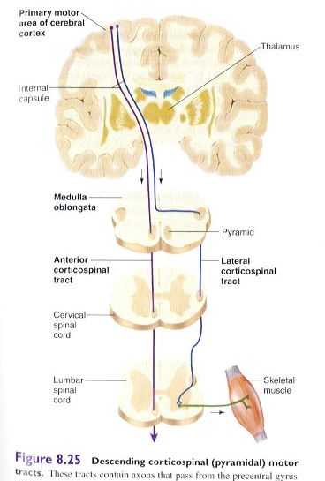
© Schomaker 2001

Slide 5

Handwriting: Human Motor Behaviour
Is an acquired skill
Children: slow tracking behaviour leads to memorisation of letter shapes
Adults: fast ballistic movements, about 100 ms per stroke
© Schomaker 2001

Slide 6
100 ms per stroke?
Cortico-muscular delay time is of the same order
Feedback corrections (eye→hand)
would be too slow.
By necessity, movement parameters must be planned in advance!
© Schomaker 2001

Slide 7
The parametrizable pattern generator
What happens when the brain decides which letter to write next?
Concept of 'Motor Program':
the parametrizable pattern generator
  apply letter placement and connection rules
  apply global parameters (size, slant)
  apply end-effector constraints
Question: what is the basic component of a Motor Program?
© Schomaker 2001

Slide 8
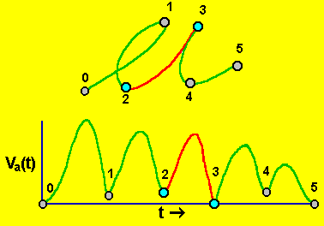
The velocity-based stroke (VBS)
The VBS is defined
by the piece of a pen
trajectory
which is
bounded by:
minima in the velocity i.e.,
maxima in the curvature
The VBS is the atomic unit of writing which is based on
cognitive control (everything of shorter duration
constitutes phenomena of biomechanics).
© Schomaker 2001

Slide 9
Curvature
running radius r(t)
of circle which is
tangential to curve.
Curvature:
C(t) = 1 / r(t)
© Schomaker 2001

Slide 10
Evidence for the special status of a VBS
When preparing for movement, the number of required strokes to write leads to a quantized amount of mental preparation time (Hulstijn en van Galen).
If a command to write 1 stroke requires
T [s] of preparation, writing n strokes will require nT [s] of preparation
→ Until about four strokes this rule holds. Beyond this amount of strokes, /\/\/\/\/\ e.g., the writer will start quickly, motor planning and execution running in parallel
© Schomaker 2001

Slide 11
The VBS also holds for other types of movements
Arm reaching
Finger tapping
Eye movements
© Schomaker 2001

Slide 12
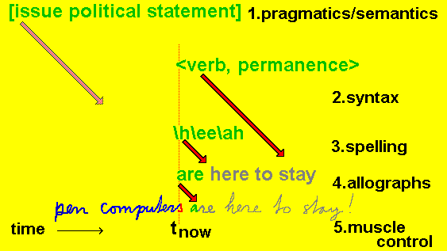
Flow of processing: from intention to twitch
© Schomaker 2001

Slide 13
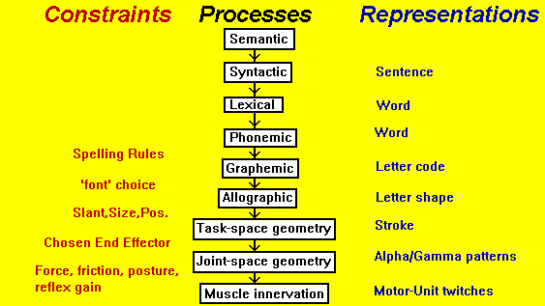
Hierarchical levels in HW motor control
© Schomaker 2001

Slide 14
Velocity-based stroke segmentation
can be used in on-line handwriting recognition
pen-tip trajectory becomes sequence of strokes
each character is defined as a sequence of strokes
(Schomaker et al, 1991): Kohonen net + transition
network for cursive on-line recognition
Web site: ~lambert → recognizer
© Schomaker 2001

Slide 15
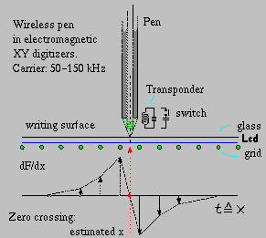
Electromagnetic position sensing in pen tablets
© Schomaker 2001

Slide 16
Conclusion
The knowledge on constraints of the writing process can be used in handwriting recognition.
Performance of on-line HWR is usually better than optical HWR.
Is this due to (coarse) order information ?
or to (fine) trajectory details in (x_{k},y_{k}) ?
© Schomaker 2001

