Slide 1
Chapter 03 Stack & Queue
第三章 栈和队列
Prof. Qing Wang

Slide 2
本章学习的线索
主要线索
重点
  栈和队列的顺序存储表示
  栈和队列的应用
难点
  栈和递归的关系
栈和队列
ADT
栈和队列顺序表示及实现
栈和队列链式表示及实现
栈和队列的应用
栈和递归
Prof. Q. Wang

Slide 3
Content
Stack and its ADT
Representation & Implementation of Stack
Application of Stack
Recursion and Stack
Queue and its ADT
Representation & Implementation of Queue
Application of Queue
Conclusion
Prof. Q. Wang

Slide 4
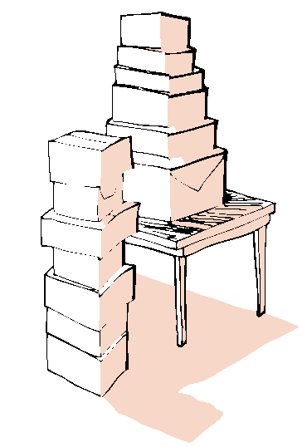

Chapter 03 Stack & Queue
栈和队列也是线性表，只不过是操作受限的线性表。但从数据类型角度看，他们是和线性表不相同的两类重要的抽象数据类型。广泛应用于各种软件系统中。
Prof. Q. Wang

Slide 5
3.1 Stack and its ADT
Definition
  A stack is a kind of special linear list.
  A stack is a data structure in which all insertions and removals of entries are made at one end, called the top of the stack.
  LIFO structure: The last entry which was inserted is the first one that will be removed.
  (LIFO: Last In First Out)
Prof. Q. Wang

Slide 6
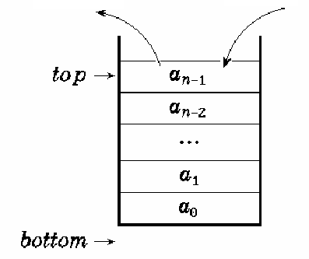
Top & Bottom
Top
  The specific end of linear list at which elements can inserted and removed.
Bottom
  Another end of the stack.
Insertion
(Push)
Removal
(Pop)
Prof. Q. Wang

Slide 7
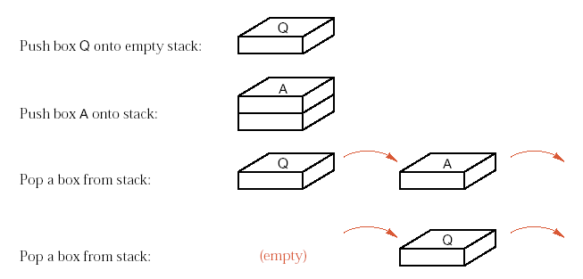

Examples of Push and Pop
Prof. Q. Wang

Slide 8
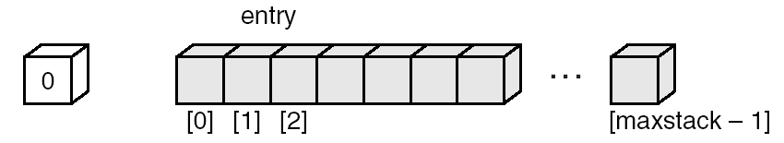
3.2 Implementation of Stack
1) Sequential form
typedef int ElemType; /* 定义栈元素的数据类型，
这里定义为整型 */
#define MAXNUM 100 /* 栈中能达到的最大容量，
这里设为100 */
typedef struct SeqStack /* 顺序栈类型定义 */
{
ElemType s[MAXNUM];
int top; /* 栈顶元素的下标 */
}SeqStack, *PSeqStack;
top
s
-1
Prof. Q. Wang
[MAXNUM-1]

Slide 9
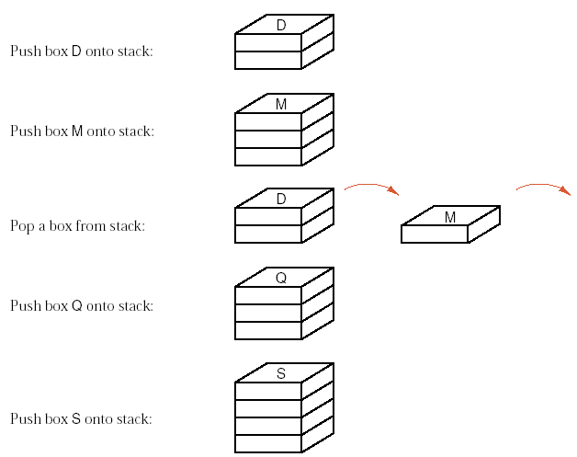
Prof. Q. Wang

Slide 10
3.1.2 Basic operations of Stack
1. Initialization；
2. Is a empty stack；
3. Push an element into the stack (Element insertion)；
4. Pop an element from the stack (Element removal)；
5. Get the value of the top element。
Prof. Q. Wang

Slide 11
Stack ADT
Create
IsEmpty
Push
Pop
getTop
a_{i}, i=0,1,2,….
< a_{i} , a_{i+1} >
Prof. Q. Wang

Slide 12
Sequential Stack
top
s
-1
[MAXNUM-1]
Create
IsEmpty
Push
Pop
GetTop
Discussions
Prof. Q. Wang

Slide 13
Algorithm 3.1 Initialization
PSeqStack createEmptyStack_seq( void )
{
PSeqStack pastack;
pastack = (PSeqStack)malloc(sizeof(SeqStack));
if (pastack==NULL)
printf("Out space!! \n");
else
pastack->top=-1;
return pastack;
}
Prof. Q. Wang

Slide 14
Algorithm 3.2 Judge a stack is empty or not
int isEmptyStack_seq ( PSeqStack pastack )
{
return ( pastack->top == -1 );
}
Prof. Q. Wang

Slide 15
Algorithm 3.3 Push an element into the stack
void push_seq ( PSeqStack pastack, DataType x )
/* 在栈中压入一元素x */
{
if ( pastack->top >= MAXNUM - 1 )
printf( "overflow! \n" );
else
{
pastack->top = pastack->top + 1;
pastack->s[pastack->top] = x;
}
}
Prof. Q. Wang

Slide 16
Algorithm 3.4 Pop the top element from the stack
ElemType pop_seq( PSeqStack pastack )
/* 出栈返回顶元素 */
{
ElemType temp;
if ( isEmptyStack_seq( pastack ) )
printf( "Underflow!\n" );
else
{
temp = pastack.s[pastack->top];
pastack->top = pastack->top - 1;
}
return temp;
}
Prof. Q. Wang

Slide 17
Algorithm 3.5 Get the value of the top element
ElemType top_seq( PSeqStack pastack )
/* 当pastack所指的栈不为空栈时，求栈顶元素的值 */
{
if (isEmptyStack_seq(pastack))
Error(“Empty Stack!”);
else
return pastack->s[pastack->top];
}
Prof. Q. Wang

Slide 18
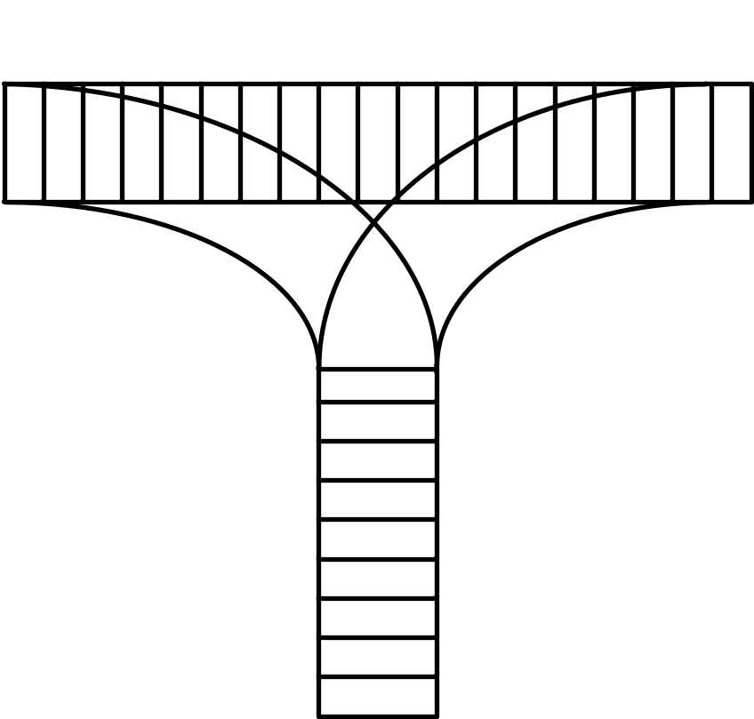
Quiz
How to arrange the carriages?
435612
123456
325641
154623
135426
Notes:
435612 154623不行

Slide 19
Quick review
Stack
  ADT
  LIFO
  Top
Sequential stack
  Overflow
Prof. Q. Wang

Slide 20

2) Linked list form
typedef int DataType ; /* 定义栈中元素类型为整型，
也可定义为其他类型 */
struct Node /* 单链表结点结构 */
{
DataType info;
struct Node *link;
};
struct LinkStack /* 链接栈类型定义 */
{
struct Node *top; /* 指向栈顶结点 */
}LinkStack, *PLinkStack;
Prof. Q. Wang

Slide 21
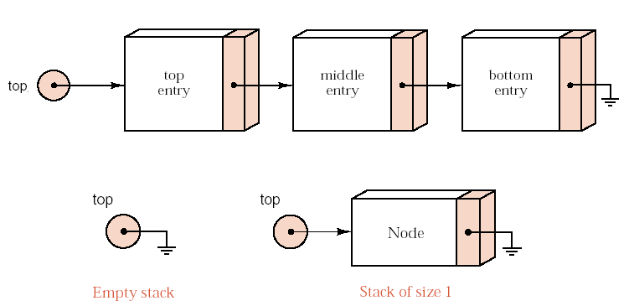
Example
Prof. Q. Wang

Slide 22
Linked stack
Create
IsEmpty
Push
Pop
GetTop
Applications
Prof. Q. Wang

Slide 23
Algorithm 3.6 Initialization
PLinkStack createEmptyStack_link( )
{
PLinkStack plstack;
plstack = (struct LinkStack *)malloc( sizeof(struct LinkStack));
if (plstack != NULL)
plstack->top = NULL;
else
printf("Out of space! \n");
return plstack;
}
Algorithm 3.7 Judge a linked stack is empty or not
int isEmptyStack_link( PLinkStack plstack )
{
return (plstack->top == NULL);
}
Prof. Q. Wang

Slide 24
Algorithm 3.8 Push an element into the linked stack
void push_link( PLinkStack plstack, DataType x )
/* 在栈中压入一元素x */
{
struct Node * p;
p = (struct Node *)malloc( sizeof( struct Node ) );
if ( p == NULL )
printf("Out of space!\n");
else
{
p->info = x;
p->link = plstack->top;
plstack->top = p;
}
}
Prof. Q. Wang

Slide 25
Algorithm 3.9 Pop the top element from the linked stack
DataType pop_link( PLinkStack plstack )
/* 出栈栈顶元素 */
{
struct Node * p;
DataType elem;
if ( isEmptyStack_link( plstack ) )
printf( "Empty stack pop.\n" );
else{
p = plstack->top;
elem = p->info;
plstack->top = plstack->top->link;
free(p);
}
return elem;
}
Prof. Q. Wang

Slide 26
Algorithm 3.10 Get the value of the top element
DataType top_link( PLinkStack plstack )
/* 对非空栈求栈顶元素 */
{
if (isEmptyStack_link(plstack))
Error(“Empty Stack!”);
else
return plstack->top->info;
}
Prof. Q. Wang

Slide 27
3.3 Applications of Stack
Bracket matching (括号匹配)
Infix expression calculator (中缀表达式计算器)
Reverse Poland calculator (逆波兰计算器)
Conversion of the arithmetic expression (表达式转换)
Impl.
Impl.
Impl.
Impl.
Prof. Q. Wang

Slide 28
Application 1: Bracket Matching
Requirement
  Develop a program to check that brackets are correctly matched in an input text file.
  The brackets are limited in {, }, (, ), [, and ].
Methods
  Read a single line of characters and ignore all input other than bracket characters.
  Our program need only loop over the input characters, until either a bracketing error is detected or the input file ends.
Prof. Q. Wang

Slide 29
例如
考虑下列括号序列：
[
(
[
]
[
(
)
]
)
]
可见，括弧匹配也遵循“后进先出”的规律。
如何表示下列“不匹配” 的情况？
到来的右括弧非是所“期待”的:
即来了一个“不速之客”，直到结束，也没有等到“期待”的匹配;
Prof. Q. Wang

Slide 30
算法的设计思想：
凡出现左括弧，则进栈；
凡出现右括弧，首先检查栈是否空？
若栈空，则表明该“右括弧”多余
否则和栈顶元素比较，
若相匹配，则“左括弧出栈”
否则表明不匹配
表达式检验结束时，
若栈空，则表明表达式中匹配正确
否则表明“左括弧”有余。
Prof. Q. Wang

Slide 31
#include <stdio.h>
#include <stdlib.h>
#include <string.h>
#define MAXNUM 100
typedef char ElemType;
// 顺序栈类型定义
typedef struct SeqStack {
ElemType s[MAXNUM];
int top; // 栈顶元素的下标
} SeqStack, *PSeqStack;
// 初始化栈
void InitStack(PSeqStack S) {
S->top = -1;
}
Prof. Q. Wang

Slide 32
// 判断栈是否为空
int StackEmpty(PSeqStack S) {
return S->top == -1;
}
// 判断栈是否已满
int StackFull(PSeqStack S) {
return S->top == MAXNUM - 1;
}
// 入栈操作
void Push(PSeqStack S, ElemType e) {
if (StackFull(S)) {
printf("栈已满，无法入栈！\n");
return;
}
S->s[++(S->top)] = e;
}
Prof. Q. Wang

Slide 33
// 出栈操作
ElemType Pop(PSeqStack S) {
if (StackEmpty(S)) {
printf("栈为空，无法出栈！\n");
return '\0';
}
return S->s[(S->top)--];
}
// 获取栈顶元素
ElemType GetTop(PSeqStack S) {
if (StackEmpty(S)) {
printf("栈为空，无栈顶元素！\n");
return '\0';
}
return S->s[S->top];
}
Prof. Q. Wang

Slide 34
// 检查符号是否匹配
int isMatchingPair(ElemType left, ElemType right)
{
if (left == '(' && right == ')') return 1;
if (left == '[' && right == ']') return 1;
if (left == '{' && right == '}') return 1;
return 0;
}
Prof. Q. Wang

Slide 35
// 检查字符串中的符号是否匹配
int isBalanced(char *expression) {
PSeqStack ps = (PSeqStack)malloc(sizeof(SeqStack));
if (ps == NULL) {
printf("内存分配失败！\n");
return 0;
}
InitStack(ps);
int len = strlen(expression);
for (int i = 0; i < len; i++) {
char c = expression[i];
if (c == '(' || c == '[' || c == '{') {
// 遇到左括号，压入栈中
Push(ps, c);
}
Prof. Q. Wang

Slide 36
else if (c == ')' || c == ']' || c == '}') {
if (StackEmpty(ps)) {// 栈为空，说明没有对应的左括号
free(ps);
return 0;
}
char top = Pop(ps);
if (!isMatchingPair(top, c)) { // 不匹配
free(ps);
return 0;
}
}
}
// 遍历完字符串后，栈应该为空
int result = StackEmpty(ps);
free(ps);
return result;
}
Prof. Q. Wang

Slide 37
int main() {
char expression[MAXNUM];
printf("请输入包含括号的表达式: ");
scanf("%s", expression);
if (isBalanced(expression)) {
printf("符号匹配成功！\n");
} else {
printf("符号匹配失败！\n");
}
return 0;
}
Prof. Q. Wang

Slide 38
Bracket Matching Program
int main() {
LinkStack openings;
char symbol;
bool is_matched = true;
while (is_matched && (symbol = cin.get()) != '\n') {
if (symbol == '{' || symbol == '(' || symbol == '[')
openings.push(symbol);
if (symbol == '}' || symbol == ')' || symbol == ']') {
if (openings.empty()) {
cout << "Unmatched closing bracket " << symbol
<< " detected." << endl;
is_matched = false;
}
Prof. Q. Wang

Slide 39
else {
char match;
match=openings.top();
openings.pop();
is_matched = (symbol == '}' && match == '{')
|| (symbol == ')' && match == '(')
|| (symbol == ']' && match == '[');
if (!is_matched)
cout << "Bad match " << match << symbol << endl;
}
}
}
if (!openings.empty())
cout << "Unmatched opening bracket(s) detected." << endl;
}
Demo
Prof. Q. Wang

Slide 40
Application 2: Infix expression calculator
限于二元运算符的表达式定义:
表达式 ::= (操作数) + (算符) + (操作数)
操作数 ::=常量|变量 | 常数
算符 ::= 运算符(分为算术运算符、关系运算符和逻辑运算符)
| 界限符(左右括号和表达式结束符等)
Exp = S1 + OP + S2
前缀表示法OP + S1 + S2
中缀表示法 S1 + OP + S2
后缀表示法 S1 + S2 + OP
Prof. Q. Wang

Slide 41
表达式标识方法
例如: Exp = a × b + (c − d / e) × f
前缀式: + × a b × − c / d e f
后缀式: a b × c d e / − f × +
+
*
*
a
b
-
f
c
/
d
e
Prof. Q. Wang

Slide 42
中缀表达式求值的算法
  采用“算符优先法”，在表达式中,优先级的顺序是:
    括号的优先级最高,对括号内的各种运算符有:先乘除、再加减，同级运算从左至右。
    先括号内，后括号外，多层括号，由内向外。
  在算符集中，在每一个运算步，相邻的算符c1 和c2之间的关系是如下三种情况（c1出现在c2之前）：
    c1<c2,c1的优先级低于c2
    c1=c2,c1的优先级等于c2
    c1>c2,c1的优先级大于c2
Prof. Q. Wang

Slide 43
算符间优先级
c₂
 | + - * / ( ) #
+ - * / ( ) # | > > < < < > > > > < < < > > > > > > < > > > > > > < > > < < < < < = > > > > > > < < < < < =
c₁
Prof. Q. Wang

Slide 44
说明：计算表达式3-(6/2)×4，‘#’是表达式的结束符。为了算法简洁，在表达式的最左边也虚设一个 ‘#’构成整个表达式的一对括号。表中的‘(’=‘)’表示当左右括号相遇时，括号内的运算已经完成。同理，‘#’=‘#’表示整个表达式求值完毕。
‘)’与‘(’、‘#’与‘)’以及‘(’与 ‘#’之间无优先关系，这是因为表达式中不允许它们相继出现，一旦遇到这种情况，则可以认为出现了语法错误。在下面的讨论中，我们暂假定所输入的表达式不会出现语法错误。
Prof. Q. Wang

Slide 45
为实现算符优先算法，在这里用了两个工作栈。一个存放算符OPTR，另一个存放数据OPND。算法思想是：
  首先置数据栈为空栈，表达式起始符“＃”为算符栈的栈底元素
  自左向右扫描表达式，读到操作数进OPND栈，读到运算符，则和OPTR栈顶元素比较（栈顶元素为c1，读到的算符为c2);
    若c1<c2,则c2进栈继续扫描后面表达式；
    若c1＝c2,则（“＝”），即括号内运算结束，将c1出栈，并且c2放弃,继续扫描后面表达式；
    若c1>c2,则将c1出栈，并在操作数栈取出两个元素a和b按c1做运算，运算结果进OPND.
    重复直到表达式求值完毕。
Prof. Q. Wang

Slide 46
表达式求值示意图：5+6×(1+2)-4
6
(
=19
1
+
2
)
-
4
读入表达式过程：
#
5
+
×
OPTR栈
OPND栈
1+2=3
6×3=18
top
5+18=23
top
top
top
23-4=19
+
top
top
top
top
top
(
2
top
top
top
top
top
top
top
top
1
×
3
top
top
top
top
top
top
top
top
top
+
18
4
top
-
6
top
top
top
top
top
#
23
19
base
base
5
Prof. Q. Wang

Slide 47
算法: 求中缀表达式值
OperandType EvaluateExpression()
{ InitStack(OPTR);Push(OPTR， ‘#’);InitStack(OPND); c=getchar()；
while(c！= ‘#’ || GetTop(OPTR)!= ‘#’)
{ if(!In(c，OP)){Push((OPND，c)；c=getchar()；} // 判定输入是否 //是操作数
else switch(Precede(GetTop(OPTR)，c)）
{ case ‘<’ ： ／／栈顶元素优先权低
Push(OPTR，c)； c=getchar()；break；
case ‘=’ ：／／脱括号并接收下一字符
Pop(OPTR，x)； c=getchar()；break；
case ‘>’ ： ／／退栈并将运算结果入栈
Pop(OPTR，theta);Pop(OPND，b);Pop(OPND，a)；
Push(OPND，Operate(a，theta，b))；break；
} ／／switch
}／／while
return GetTop(OPND)；
}／／ EvaluateExpression
Prof. Q. Wang
Notes:
In(c,op)c是操作符是返回true，否则false

Slide 48
Quick Review
Stack and applications
  Bracket match
  Infix expression
Prof. Q. Wang

Slide 49
Application 3: Reverse Polish calculator
Expression
  Infix: a+b*(c-d)-e/f
  Postfix (Reverse Polish Notation): abcd-*+ef/-
  Prefix (Polish Notation): -+a*b-cd/ef
Operands: a, b, c, d, e, f
Operators: +, -, *, /,
Delimiter: (, )
Demo
Prof. Q. Wang

Slide 50

Expression Evaluation
How to calculate the value of the expression?
  a+b*(c-d)-e/f
  abcd-*+ef/- -+a*b-cd/ef
Infix expression
Prefix expression
Postfix expression
Prof. Q. Wang
Skip

Slide 51
后缀表达式求值
先找运算符，再找操作数
例如：
a b × c d e / − f × +
a×b
d/e
c-d/e
(c-d/e)×f
Prof. Q. Wang

Slide 52
利用后缀表达式求值时，从左向右顺序地扫描表达式，并使用一个栈暂存扫描到的操作数或计算结果，例如，
a+b*(c-d)-e/f
abcd-*+ef/-
中缀表达式计算表达式的值 后缀表达式计算表达式的值
在后缀表达式的计算顺序中已经隐含了加括号的优先次序，因而括号在后缀表达式中不出现。
Prof. Q. Wang

Slide 53
后缀表达式 abcd-*+ef/- 的计算过程为：
步 扫描项 项类型 动作 栈中内容
1 置空栈
2 a 操作数 进栈 a
3 b 操作数 进栈 ab
4 c 操作数 进栈 abc
5 d 操作数 进栈 abcd
6 — 操作符 d、c退栈，计算c-d,结果r1进栈 abr1
7 ＊ 操作符 r1、b退栈，计算r2=b＊r1，r2进栈 ar2
8 ＋ 操作符 r2、a退栈，r3=a＋r2 ，r3进栈 r3
9 e 操作数 进栈 r3e
10 f 操作数 进栈 r3ef
11 / 操作符 f、e退栈，r4=e/f ，r4进栈 r3r4
12 — 操作符 r3、r4退栈 r5=r3-r4 r5进栈 r5
®

Slide 54
Elemtype EvaluateExpression_postfix( )
{ initStack(OPND); c=getchar( )；
while(c！= ‘#’ )
{
if (!In(c，OP)) { Push((OPND，c)；c=getchar( )；}
else //退栈并将运算结果入栈
{
Pop(OPND，b) ; Pop(OPND，a)；
Push(OPND，Operate(a，theta，b))；c=getchar( );
}//else
}//while
return GetTop(OPND)；
}// EvaluateExpression_postfix
Skip
Prof. Q. Wang

Slide 55
Reverse Polish calculator
// The program has executed simple arithmetic commands entered by the
// user.
// Uses: The class Stack and the functions introduction, instructions,
// do_command, and get_command.
typedef double Stack_entry;
int main()
{
Stack stored_numbers;
introduction();
instructions();
while (do_command(get_command(), stored_numbers));
}
Prof. Q. Wang

Slide 56
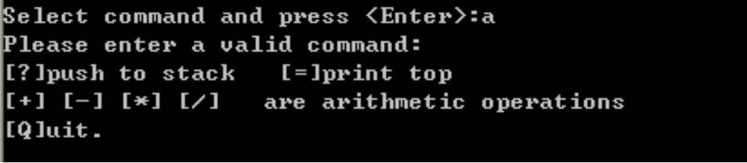
Obtaining command
The auxiliary function get_command obtains a command from the user, checking that it is valid and converting it to lower case by using the string function tolower() that is declared in the standard header file cctype.
Prof. Q. Wang

Slide 57
char get_command() {
char command;
bool waiting = true;
cout << "Select command and press <Enter>:";
while (waiting) {
cin >> command;
command = tolower(command);
if (command == '?' || command == '=' || command == '+' ||
command == '-' || command == '*' || command == '/' ||
command == 'q' ) waiting = false;
else {
cout << "Please enter a valid command:" << endl
<< "[?]push to stack [=]print top" << endl
<< "[+] [-] [*] [/] are arithmetic operations" << endl
<< "[Q]uit." << endl;
}
}
return command;
}
Prof. Q. Wang

Slide 58
bool do_command(char command, Stack &numbers)
// Pre: The first parameter specifies a valid calculator command.
// Post: The command specified by the first parameter has been applied
// to the Stack of numbers given by the second parameter.
// A result of true is returned unless command == 'q'.
// Uses: The class Stack.
{
double p, q;
switch (command) {
case '?':
cout << "Enter a real number: " << flush;
cin >> p;
if (numbers.push(p) == overflow)
cout << "Warning: Stack full, lost number" << endl;
break;
Prof. Q. Wang

Slide 59
case ‘+':
if (numbers.top(q) == underflow)
cout << "Stack empty" << endl;
else {
numbers.pop();
if (numbers.top(p) == underflow) {
cout << "Stack has just one entry" << endl;
numbers.push(q);
}
else {
numbers.pop();
if (numbers.push( p+q ) == overflow)
cout << "Warning: Stack full, lost result" << endl;
}
}
break;
top
q
p
p+q
Prof. Q. Wang

Slide 60
case '-':
if (numbers.top(q) == underflow)
cout << "Stack empty" << endl;
else {
numbers.pop();
if (numbers.top(p) == underflow) {
cout << "Stack has just one entry" << endl;
numbers.push(q);
}
else {
numbers.pop();
if (numbers.push( p-q ) == overflow)
cout << "Warning: Stack full, lost result" << endl;
}
}
break;
top
q
p
p-q
Prof. Q. Wang

Slide 61
case ‘*':
if (numbers.top(q) == underflow)
cout << "Stack empty" << endl;
else {
numbers.pop();
if (numbers.top(p) == underflow) {
cout << "Stack has just one entry" << endl;
numbers.push(q);
}
else {
numbers.pop();
if (numbers.push( p*q ) == overflow)
cout << "Warning: Stack full, lost result" << endl;
}
}
break;
top
q
p
p*q
Prof. Q. Wang

Slide 62
case ‘/':
if (numbers.top(q) == underflow)
cout << "Stack empty" << endl;
else {
numbers.pop();
if (numbers.top(p) == underflow) {
cout << "Stack has just one entry" << endl;
numbers.push(q);
}
else {
numbers.pop();
if (numbers.push( p/q ) == overflow)
cout << "Warning: Stack full, lost result" << endl;
}
}
break;
top
q
p
p/q
Prof. Q. Wang

Slide 63



Priority of operators
-- isp -- icp
 | + | - | * | / | ( | ) | #
+ | > | > | < | < | < | > | >
- | > | > | < | < | < | > | >
* | > | > | > | > | < | > | >
/ | > | > | > | > | < | > | >
( | < | < | < | < | < | =
) | > | > | > | > |  | > | >
# | < | < | < | < | < |  | =
Prof. Q. Wang

Slide 64
case 'q':
cout << "Calculation finished.\n";
return false;
}
return true;
}
Prof. Q. Wang

Slide 65
Application 4: Infix Expression to Postfix
Expression
  Infix: a+b*(c-d)-e/f
  Postfix (Reverse Polish Notation): abcd-*+ef/-
Components
  Operands: a, b, c, d, e, f
  Operators: +, -, *, /,
  Delimiter: (, ), #
Prof. Q. Wang

Slide 66
#a+b*(c-d)-e/f# abcd-*+ef/-
A specific stack OPTR is used to store temporary operators, such as +, *, and ( in above expression.
isp (in stack priority): the priority of operator at the top of OPTR stack.
icp (incoming priority): the new incoming operator priority.
If isp < icp, push the incoming operator into OPTR
If isp > icp, output and pop the top of OPTR
If isp = icp, scan next item and pop the top of OPTR
Prof. Q. Wang

Slide 67
a
b
c
d
e
/
+
×
f
-
×
#
a × ( b × ( c + d / e ) - f ) #
/
/
+
+
(
×
×
-
(
×
#
Prof. Q. Wang

Slide 68
Infix expression: a+b*(c-d)-e/f
#a+b*(c-d)-e/f#
Step | Items | Type | Activity | Optr Stack | Output
0 |  |  |  | #
1 | a | operand |  |  | a
2 | + | operator | isp(#) < icp(+) | #+ | a
3 | b | operand |  | #+ | ab
4 | * | operator | isp(+) < icp(*) | #+* | ab
5 | ( | operator | isp(*) < icp(() | #+*( | ab
6 | c | operand |  | #+*( | abc
7 | - | operator | isp(() < icp(-) | #+*(- | abc
8 | d | operand |  | #+*(- | abcd
9 | ) | operator | isp(-) > icp()) | #+*( | abcd-
 |  |  | == | #+* | abcd-
Prof. Q. Wang

Slide 69
10 | - | operator | isp(*) > icp(-) | #+ | abcd-*
 |  |  | isp(+) > icp(-) | # | abcd-*+
 |  |  | isp(#) < icp(-) | #- | abcd-*+
11 | e | operand |  | #- | abcd-*+e
12 | / | Operator | isp(-) < icp(/) | #-/ | abcd-*+e
13 | f | Operand |  | #-/ | abcd-*+ef
14 | # | Operator | isp(/) > icp(#) | #- | abcd-*+ef/
 |  |  | isp(-) > icp(#) | # | abcd-*+ef/-
 |  |  | ==, end
#a+b*(c-d)-e/f # abcd-*+ef/-
Prof. Q. Wang

Slide 70
Program
void postfix (expression e) {
Stack <char> OPTR; char ch, y;
OPTR.clear(); OPTR.push(‘#’);
while (cin.get(ch)&&ch!=‘#’){
if (isdigit(ch)) cout <<ch;
else {
y=OPTR.top();
switch(y, ch) {
case <: OPTR.push(ch); break;
case >: cout << y; OPTR.pop(); break;
case =: OPTR.pop();
}
}
}
Prof. Q. Wang

Slide 71
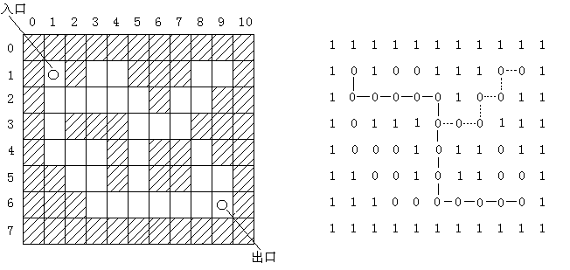
4、Maze
(a) 迷宫的图形表示 (b) 迷宫的二维数组表示
Prof. Q. Wang

Slide 72
入口
出口
Prof. Q. Wang

Slide 73
求解迷宫问题的简单方法是：从入口出发，沿某一方向进行探索，若能走通，则继续向前走；否则沿原路返回，换一方向再进行探索，直到所有可能的通路都探索到为止。
为避免走回到已经进入的点（包括已在当前路径上的点和曾经在当前路径上的点），凡是进入过的点都应做上记号。
为了记录当前位置以及在该位置上所选的方向，算法中设置了一个栈，栈中每个元素包括三项，分别记录当前位置的行坐标、列坐标以及在该位置上所选的方向（即direction数组的下标值）
Prof. Q. Wang

Slide 74
迷宫算法
do {
若当前位置可通，
则{ 将当前位置插入栈顶；
若该位置是出口位置，则结束；
否则切换当前位置的东邻块为新的当前位置；
}
否则，
若栈不空且栈顶位置尚有其它方向未经搜索，
则设定新的当前位置为沿顺时针方向旋转找到的栈顶位置的下一邻块；
若栈不空且栈顶位置的四周均不可通，
则{ 删去栈顶位置；
若栈不空，则重新测试新的栈顶位置，
直至找到一个可通的相邻块或出栈至栈空；
}
}while (栈不空)
N
W
E
S
Prof. Q. Wang

Slide 75
栈用顺序存储结构实现，栈中元素的说明如下：
struct NodeMaze
{
int x,y,d;
};
typedef struct NodeMaze DataType;
void mazePath (int *maze[],int *direction[],int x1,int y1,int x2,int y2)
/* 迷宫maze[M][N]中求从入口maze[x1][y1]到出口maze[x2][y2]
的一条路径 */
/* 其中 1<=x1,x2<=M-2 , 1<=y1,y2<=N-2 */
算法3.15 求迷宫中一条路径的算法
Prof. Q. Wang

Slide 76
{ int i,j,k,kk;
int g,h;
PSeqStack st;
DataType element;
st = createEmptyStack_seq( );
maze[x1][y1] = 2; /* 从入口开始进入,作标记 */
element.x = x1;
element.y = y1;
element.d = -1;
push_seq(st, element); /* 入口点进栈 */
while (! isEmptyStack_seq(st)) /* 走不通时,一步步回退 */
{ element = top_seq(st);
i = element.x;
j = element.y;
k = element.d + 1;
Prof. Q. Wang
Notes:
2代表已走过，方向用0，1，2，3来表示，-1时为初值无方向

Slide 77
pop_seq(st);
while (k<=3) /* 依次试探每个方向 */
{ g = i + direction[k][0];
h = j + direction[k][1];
if (g==x2 && h==y2 && maze[g][h]==0) /* 走到出口点 */
{
printf("The path is:\n"); /* 打印路径上的每一点 */
for (kk=1; kk<=st->top; kk++)
printf("the %d node is: %d %d \n",
kk, st->s[kk].x,st->s[kk].y);//栈里记录了所有步骤
printf(“the %d node is: %d %d \n”, kk, i, j);//终点的前一步
printf(“the %d node is: %d %d \n”, kk+1, g, h);//终点
return;
}
Prof. Q. Wang
Notes:
int direct[4][2]={{0,-1},{1,0},{0,1},{-1,0}};//向左、下、右、上四个方向转时，行列的增加值

Slide 78
if (maze[g][h]==0) /* 走到没走过的点 */
{ maze[g][h] = 2; /* 作标记 */
element.x = i;
element.y = j;
element.d = k;
push_seq(st,element); /* 进栈 */
i = g; /* 下一点转换成当前点 */
j = h;
k = -1;
}
k = k + 1;
}//end while inside
}//end while outside
printf("The path has not been found.\n"); /* 栈退完,未找到路径 */
}
Prof. Q. Wang
栈结束

Slide 79
3.4 Recursion and Stack
Definition of recursion
  is the name for the case when a function invokes itself or invokes a sequence of other functions, one of which eventually invokes the first function again.
  is an important problem-solving tool in computer science and mathematics. It is used in programming languages to define language syntax and in data structures to develop searching and sorting algorithms for list and tree structures
®

Slide 80
Recursion
Three typically recursions
  Recursive definition
  Recursive structures
  Recursive solutions for the specific problems
®

Slide 81
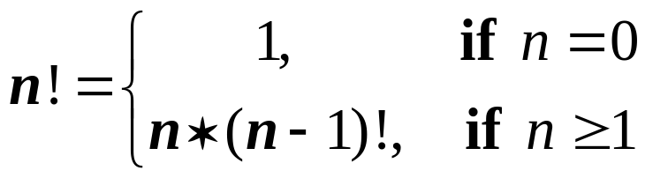
Types of recursion
Recursive definition
  Factorial function

Slide 82
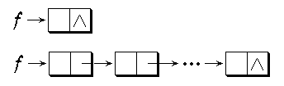
Types of recursion
Recursive structures
  Linked list
struct person{
char name[20];
struct person *next;
}
®

Slide 83
2. Recursive data structure （2）
//Declaration
typedef struct BinTreeNode
{
DataType data;
struct BinTreeNode *lchild;
struct BinTreeNode *rchild;
}BinTreeNode, *PBinTreeNode
Binary tree
bt
-
+
/
a
*
e
f
b
-
c
d
Prof. Q. Wang

Slide 84
1. 递归的概念及递归调用过程
用自身的简单情况来定义自己的方式，称为递归定义。
一个直接调用自己或者通过一系列的调用语句间接地调
用自己的函数，称为递归函数。
Factorial 阶乘
int fact (int n)
{
if (n == 0)
return 1;
else
return (n*fact(n-1));
}
Prof. Q. Wang

Slide 85
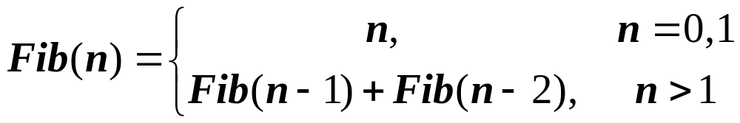
Fibonacci array(斐波纳契)数列
int fib(int n)
{
if (n == 0 || n==1)
return n;
else
return fib(n-1)+fib(n-2);
}
Prof. Q. Wang

Slide 86
Designing recursive algorithm
  Outline your algorithm.
    Combine the stopping rule and the key step, using an if statement to select between them.
if (simplest case) then
solve directly
else
make recursive call to a simpler case
®

Slide 87
Designing recursive algorithm
  Find the key step.
    Begin by asking yourself , “How can this problem be divided into parts?” or “How will the key step in the middle be done?”
  Find a stopping rule.
    This stopping rule is usually the small, special case that is trivial or easy to handle without recursion.
®

Slide 88
Designing recursive algorithm
  Check termination.
    Verify that the recursion will always terminate. Be sure that your algorithm correctly handles extreme cases.
  Draw a recursion tree.
    The height of the tree is closely related to the amount of memory that the program will require, and the total size of the tree reflects the number of times the key step will be done.
®

Slide 89
//Declaration
typedef struct Node
{
DataType data;
struct Node *link;
}Node, *PNode;
2. Recursive data structure（1）
Linked list
//Traverse linked list and print out the last node
void Find_Last ( PNode p ) {
if ( p -> link == NULL )
printf(p -> data);
else Find_Last ( p -> link );
}
Prof. Q. Wang

Slide 90
Principles of Recursion
Characteristics of recursion
  Every recursive process consists of two parts
    A smallest, base case that is processed without recursion; and
    A general method that reduces a particular case to one or more of the smaller cases, thereby making progress toward eventually reducing the problem all the way to the base case.
®

Slide 91
Designing recursive algorithm
  Check termination.
    Verify that the recursion will always terminate. Be sure that your algorithm correctly handles extreme cases.
  Draw a recursion tree.
    The height of the tree is closely related to the amount of memory that the program will require, and the total size of the tree reflects the number of times the key step will be done.
®

Slide 92
Calculating factorials
Recursive algorithm
  int factorial(int n)
  /* factorial: recursive version
  Pre: n is a nonnegative integer.
  Post: Return the value of the factorial of n.
  */
  {
  if (n == 0) return 1;
  else return n * factorial(n - 1);
  }

Slide 93
Calculating fibonacci numbers
int fibonacci(int n)
/* fibonacci: recursive version
Pre: The parameter n is a nonnegative integer.
Post: The function returns the nth Fibonacci number.
*/
{
if (n <= 0) return 0;
else if (n == 1) return 1;
else return fibonacci(n - 1) + fibonacci(n - 2);
}

Slide 94
Hanoi tower
X
Y
Z
1
2
Description
  假设有3个分别命名为X，Y，Z的塔座，在塔座X上插有n个直径大小各不相同、依小到大编号为1,2,…,n的圆盘。现要求将X轴上的n个圆盘移至塔座Z上并且仍按同样顺序叠放，圆盘移动时必须遵循下列规则：
    每次只能移动一个圆盘；
    圆盘可以插在X,Y,Z的任一塔座上；
    任何时刻都不能将一个较大的圆盘压在较小的圆盘之上。
3
Prof. Q. Wang

Slide 95
Divide & Conquer
Step1
X
Y
Z
1
2
3
n-1
n
X
Y
Z
Step2
X
Y
Z
1
2
1
3
2
3
n-1
n
n-1
n
Step3
X
Y
Z
1
2
Demo
3
n-1
n
Prof. Q. Wang

Slide 96
Recursive solution of Hanoi tower
Line void Hanoi (int n, char x, char y, char z)
1 {
2 if (n = = 1)
3 move(x, 1, z);
4 else {
5 Hanoi (n-1, x, z, y);
6 move (x, n, z);
7 Hanoi (n-1, y, x, z);
8 }
9 }
void move (char x, int n, char y)
{
printf(“Move disk %d from %c to %c”, n, x, y);
}
Hanoi (3, a, b, c)
Prof. Q. Wang
Notes:
Hanoi函数的参数含义：n数量,x源柱，y辅柱，z目标柱

Slide 97
Level
Execute lines
State of recursive stack
（Address, 盘号, x, y, z）
塔与圆盘的状态
汉诺塔问题的递归调用过程
1
1，2，4，5
a
b
c
0,3,a,b,c
1
2
2
1，2，4，5
6,2,a,c,b
3
0,3,a,b,c
6,1,a,b,c
a
b
c
3
1，2，3，9
6,2,a,c,b
0,3,a,b,c
2
3
1
a
b
c
2
6，7
6,2,a,c,b
Prof. Q. Wang
0,3,a,b,c
3
2
1

Slide 98
Level
Execute lines
State of recursive stack
（Address, 盘号, x, y, z）
塔与圆盘的状态
8,1,c,a,b
3
1，2，3，9
6,2,a,c,b
a
b
c
0,3,a,b,c
3
1
2
8，9
6,2,a,c,b
2
0,3,a,b,c
1
6，7
a
b
c
0,3,a,b,c
1
3
2
1，2，4，5
2
8,2,b,a,c
Prof. Q. Wang
0,3,a,b,c

Slide 99
Level
Execute lines
State of recursive stack
（Address, 盘号, x, y, z）
塔与圆盘的状态
6,1,b,c,a
a
b
c
3
1，2，3，9
8,2,b,a,c
0,3,a,b,c
1
2
3
a
b
c
2
6，7
8,2,b,a,c
0,3,a,b,c
2
1
3
8,1,a,b,c
a
b
c
3
1，2，3，9
8,2,b,a,c
0,3,a,b,c
1
2
3
a
b
c
2
8，9
8,2,b,a,c
Prof. Q. Wang
1
0,3,a,b,c
2
3

Slide 100
Level
Execute lines
State of recursive stack
（Address, 盘号, x, y, z）
塔与圆盘的状态
1
8，9
a
b
c
0,3,a,b,c
1
2
0
3
栈空，结束
问题：
1、Hanoi塔求解中，move语句执行多少次？
2、递归树的概念。
Prof. Q. Wang

Slide 101
Recursive calling
a
a
a
a
a
a
a
a
b
b
b
b
b
b
b
b
c
c
c
c
c
c
c
c
Hanoi (3, a, b, c)
1
1
2
2
2
2
1
3
1
3
3
3
3
3
3
2
3
1
1
1
2
2
2
1
move(a,3,c)
move(a,2,b)
move(b,2,c)
move(a,1,c)
move(c,1,b)
move(b,1,a)
move(a,1,c)
Prof. Q. Wang

Slide 102
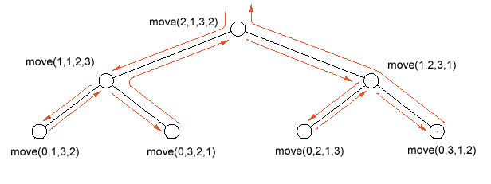
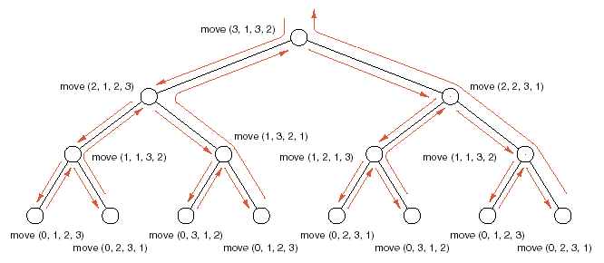
Prof. Q. Wang

Slide 103
3. Baggage Loading (背包问题)
一个背包可以放入的物品重量T，现有n件物品，重量分别为w₁,w₂,…,w_{n}，问能否从这些物品中选若干件放入背包中，使得放入的重量之和正好是T。
Prof. Q. Wang

Slide 104
(1) 分析问题，得到数学模型
1 t = 0
0 t < 0
0 t > 0, n < 1
knap(t, n-1) 或 knap(t-w_{n}, n-1); 当t>0, n>=1
Knap(t,n) =
(2) 设计算法：递归算法
(3) 程序设计：
Prof. Q. Wang

Slide 105
背包问题的递归算法
int knap (int t, int n)
{
if ( t==0)
return 1;
else if (t<0 || t>0 && n<1)
return 0;
else if (knap(t-w[n-1], n-1) == 1)
{
printf (“result:n=%d,w[%d]=%d\n”, n, n-1, w[n-1]);
return 1;
}
else
return (knap(t, n-1));
}
Prof. Q. Wang

Slide 106
Procedure of function calling
(函数调用的过程)
Before calling (调用前)：
(1) Pass the parameters and return address to the sub-function (将所有的实参、返回地址传递给被调用函数保存)
(2) Allocate memory for local variables (为被调用函数的局部变量分配存储区)
(3) Jump to the entrance of the sub-function (将控制转移到被调用函数入口)
After calling (调用后)：
(1) Save the results (保存被调用函数的计算结果)
(2) Release the allocated memory in sub-function (释放被调用函数的数据区)
(3) Return to upper level function via return address (依照被调用函数保存的返回地址将控制转移到调用函数)
Prof. Q. Wang

Slide 107
Rule: 多个函数嵌套调用时，按照“后调用先返回”的原则进行。Last calling, first return. Just like last in, first out.
int main()
{
int m,n;
...
first(m,n);
1: …
...
}
int first(int s, int t)
{
int i;
…
second(i);
2: …
...
}
int second(int d)
{
int x,y;
3: …
...
}
2
i
X
y
1
m
n
i
.
.
.
m
n
……
1
m
n
i
.
.
.
m
n
……
Prof. Q. Wang

Slide 108
Example of function calling
int main()
{
int m,n;
...
{
int i;
…
{
int x,y;
3: …
}
2: …
}
1: …
}
second
first
main
Prof. Q. Wang

Slide 109
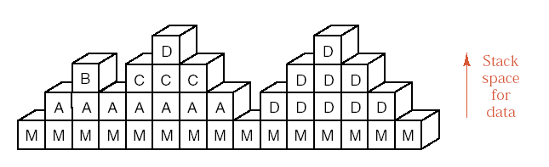
Example
void main()
{
…
…
call A(…);
…
call D(…);
…
return;
}
function A(…)
{
…
call B(…);
call C(…);
…
return;
}
function B(…)
{
…
…
…
return;
}
function C(…)
{
…
…
call D(case1);
…
return;
}
function D(…)
{
…
…
call D(…);
…
return;
}
Prof. Q. Wang

Slide 110
Stack frames for subprograms
Prof. Q. Wang

Slide 111
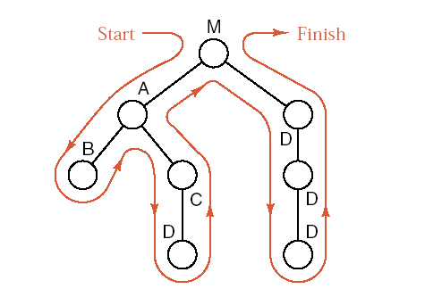
Tree of subprogram calls
Prof. Q. Wang

Slide 112
Supplementary Materials
Maze.
Eight Queen Puzzle.
Prof. Q. Wang

Slide 113
2. 递归函数到非递归函数的转换
Algorithm 3.11 Recursive program of factorial
int fact( int n )
{
if ( n == 0 )
return 1;
else
return ( n * fact( n – 1 ) );
}
Prof. Q. Wang

Slide 114
Algorithm 3.12 Non recursive program of factorial
int nfact( int n )
{ int res;
PSeqStack st; /* 使用顺序存储结构实现的栈 */
st = createEmptyStack_seq( );
while (n>0)
{ push_seq(st, n);
n = n – 1;
}
res = 1;
while (! isEmptyStack_seq(st))
{ res = res * top_seq(st);
pop_seq(st);
}
return ( res );
}
Prof. Q. Wang

Slide 115
3. 简化的背包问题*
简化的背包问题：
一个背包可以放入的物品重量T，现有n件物品，重量分别为w₁,w₂,…,w_{n}，问能否从这些物品中选若干件放入背包中，使得放入的重量之和正好是T?
(1) 分析问题，得到数学模型
1 t = 0
0 t < 0
0 t > 0 , n < 1
knap(t, n-1) 或 knap(t-w_{n}, n-1) 当t>0,n>=1
Knap(t,n)=
Prof. Q. Wang

Slide 116
(2) 设计算法：递归算法
(3) 程序设计：
int knap (int t, int n)
{
  if ( t == 0 )
  return 1;
  else if ((t<0) || ((t>0)&&(n<1)))
  return 0;
  else if ( knap(t - w[n-1], n - 1) == 1 )
  {
  printf("result: n=%d ,w[%d]=%d \n",n,n-1,w[n-1]);
  return 1;
  }
  else
  return ( knap (t, n - 1) );
}
Prof. Q. Wang

Slide 117
背包问题的非递归求解
首先我们设计一个栈st，栈中的每个结点包含以下四个字段：参数s, n,返回地址r 和结果单元k。由于knap算法中有两处要递归调用knap算法，所以返回地址一共有三种情况：
第一，计算knap( s0 , n0 )完毕，返回到调用本函数的其它函数；
第二，计算knap( s - w[n-1] , n - 1 )完毕，返回到本调用函数中继续计算；
第三，计算knap( s , n - 1 )完毕，返回到本调用函数继续计算。
为了区分三种不同的返回，r 分别用1，2，3表示，另外引入一个变量x作为进出栈的缓冲。
Prof. Q. Wang

Slide 118
栈用顺序存储结构实现，栈中元素和变量的说明如下：
struct NodeBag /* 栈中元素的定义 */
{
int s , n ;
int r ; /* r的值为1,2,3 */
int k;
};
typedef struct NodeBag DataType;
PSeqStack st;
struct NodeBag x;
Prof. Q. Wang

Slide 119
转换的做法按以下规律进行，凡调用语句
knap(s1, n1)均代换成：
(1) x.s = s1；
x.n = n1 ；
x.r = 返回地址编号；
(2) push_seq( st, x );
(3) goto 递归入口。
将调用返回统一处理成：
(1) x = top_seq( st );
(2) pop_seq( st );
(3) 根据x.r的值，进行相应处理
x.r = 1 , 返回;
x.r = 2 , 继续处理1;
x.r = 3 , 继续处理2;
Prof. Q. Wang

Slide 120
并将算法中的所有局部量都改用栈st中栈顶结点的相应字段，为了在算法中直接引入栈，并在书写上一致，算法开头增加将结点( s , n , 1 )推入栈st中的动作
算法3.14 背包问题的非递归算法
int nknap (int s,int n)
{
struct NodeBag x;
PSeqStack st;
st = createEmptyStack_seq( );
/* entry0: 初始调用入口 */
x.s = s;
x.n = n;
x.r = 1;
push_seq (st, x);
Prof. Q. Wang

Slide 121
entry1: /* 递归调用入口 */
if (top_seq(st).s == 0)
{ st->s[st->top].k = TRUE;
goto exit2;
}
else if (top_seq(st).s<0 || (top_seq(st).s>0 && top_seq(st).n<1))
{ st->s[st->top].k = FALSE;
goto exit2;
}
else
{ x.s = top_seq(st).s - w[top_seq(st).n-1];
x.n = top_seq(st).n - 1;
x.r = 2;
push_seq(st,x);
goto entry1;
}
Prof. Q. Wang

Slide 122
exit2: /* 返回处理 */
x = top_seq(st); pop_seq(st);
switch (x.r)
{ case 1: return(x.k);
case 2: goto L3;
case 3: goto L4;
}
L3: /* 继续处理1 */
if (x.k == TRUE){
st->s[st->top].k = TRUE;
printf("result n=%d , w=%d \n", top_seq(st).n,w[top_seq(st).n-1]);
goto exit2;
}
else { x.s = top_seq(st).s; x.n = top_seq(st).n - 1; x.r = 3;
push_seq(st,x);
goto entry1;
}
Prof. Q. Wang

Slide 123
L4: /* 继续处理2 */
st->s[st->top].k = x.k;
goto exit2;
}
Prof. Q. Wang

Slide 124
Quick review
Stack and applications
  ADT
  Bracket match
  Expression
Relationship between stack and function calling
  recursion
Prof. Q. Wang

Slide 125
Assignment (3)
P22
  3.4, 3.5, 3.6
P24
  3.15, 3.21, 3.28, 3.29, 3.32
附加的思考题
  两个栈的设计
  表达式转换
  循环链队列，队列溢出问题
  K阶Fibonacci数列
Prof. Q. Wang

Slide 126
Practical (2)
表达式求值
设计一个程序，演示用算符优先法对算术表达式求值的过程。(可以顺便实现中缀表达式转换为后缀表达式)
  P99 2.5
  测试数据：
  3* ( 7-2 )
  2* ( 6+2* ( 3+6* (6+6) ) )+ ( 6+6 ) *3+2
  8/ ( 9 - 9 )
Prof. Q. Wang

Slide 127
3.5 Queue and its ADT
Definition
  A queue is a special linear list.
  A queue is a list in which all addition to the list are made at one end, and all deletions from the list are made at the other end.
  FIFO structure: The first entry which is added is the first one that will be removed.
  (FIFO: First In First Out)
Prof. Q. Wang

Slide 128
Queue
“队列”也是一种特殊的线性表，对于它所有的插入都在表的一端进行，所有的删除都在表的另一端进行。进行删除的这一端叫队列的“头”，进行插入的这一端叫队列的“尾”。当队列中没有任何元素时，称为“空队列”。
Out the queue
Into the queue
a₁ a₂ a₃ … a_{n}
front
rear
Prof. Q. Wang

Slide 129
Example
Prof. Q. Wang

Slide 130
Basic operations of Queue
1. Initialization；
2. Judge a Queue is empty or not；
3. Insert a element into the Queue；
4. Remove an element from the Queue；
5. Get the value of the front element in the Queue。
Prof. Q. Wang

Slide 131
Queue ADT
Create
IsEmpty
enQueue
deQueue
getFront
a_{i}, i=0,1,2,….
< a_{i} , a_{i+1} >
Prof. Q. Wang

Slide 132
3.6 Implementation of Queue
Linked form (Linked Queue)
Sequential form
  Fixed length sequential Queue
  Variable length sequential Queue
Prof. Q. Wang

Slide 133
1) Linked Queue
typedef struct _QNode
{
DataType info;
struct _QNode *link;
}Node, *PNode;
typedef struct
{
PNode front;
PNode rear;
}LinkQueue, *PLinkQueue;
create
IsEmpty
enQueue
deQueue
GetFront
Seq. Queue
Prof. Q. Wang

Slide 134
Algorithm 3.21 Initialization
PLinkQueue createEmptyQueue_link( )
{ PLinkQueue plqu;
plqu = (LinkQueue *)malloc(sizeof(LinkQueue));
if (plqu!=NULL) {
plqu->front= plqu->rear = NULL;
}
else
printf("Out space!! \n");
return plqu;
}
Algorithm 3.22 Judge a linked queue empty or not
int isEmptyQueue_link( PLinkQueue plqu )
{
return (plqu->front== NULL);
}
Prof. Q. Wang

Slide 135
Algorithm 3.23 Insert an element at the rear of the linked queue
void enQueue_link( PLinkQueue plqu, Datatype x )
{ Node *p;
p = (Node *)malloc( sizeof(Node ) );
if ( p == NULL )
printf ("out of space!");
else{
p->info = x; p->link = NULL;
if (plqu->front == NULL) {
plqu->front = p;
plqu->rear = p;
}
else {
plqu->rear->link = p;
plqu->rear= p;
}
}
}
Prof. Q. Wang

Slide 136
Algorithm 3.24 Remove the front element from the linked queue
void deQueue_link( PLinkQueue plqu )
{
Node * p;
if( plqu->f ront== NULL )
printf( "Empty queue.\n " );
else {
p = plqu->front;
plqu->front= plqu->front->link;
free(p);
}
}
Prof. Q. Wang

Slide 137
Algorithm 3.25 Get the value of the front element of the linked queue
Datatype frontQueue_link( PLinkQueue plqu )
{
return plqu->front->info;
}
Prof. Q. Wang

Slide 138
2) Sequential queue
(1) Linear queue
Q.rear
７
J₆
６
Q.front
J₅
５
４
Q.rear
３
２
J₃
１
J₂
Q.rear
Q.front
０
Q.front
J₁
Initial state
Empty
Enqueue
Overflow
Q.rear=0
Q.front=0
Prof. Q. Wang

Slide 139
Issues in sequential forms
Overflow
  real
  fake
Strategy
  Circular queue
  Dynamic queue
    Linked form
    Variable length form
Q.rear
Q.rear
J₈
J₈
J₇
J₇
J₆
J₆
J₅
Q.front
J₅
J₄
J₃
J₂
Q.front
J₁
Prof. Q. Wang

Slide 140
(2) Circular queue
Q.front
Q.front
Q.rear
J₂
J₁
J₃
Q.rear
Initial state
Empty
enQueue
Prof. Q. Wang

Slide 141
Q.front
Q.front
Q.rear
Q.rear
J₂
J₁
J₃
J₈
J₄
J₇
J₅
J₆
Q.front
Fig1 Full
Fig2 Empty
J₂
J₁
Q.rear
J₃
J₄
J₇
J₅
J₆
Fig3 Full，if Q.rear+1 == Q.front
Prof. Q. Wang

Slide 142
#define MAXNUM 100 /* 队列中能达到的最大容量，这 里设为100 */
struct SeqQueue /* 顺序队列类型定义 */
{
DataType q[MAXNUM];
int front, rear;
};
/* 顺序队列类型的指针类型 */
typedef struct SeqQueue *PSeqQueue;
create
IsEmpty
enQueue
deQueue
GetFront
Application
Prof. Q. Wang

Slide 143
Algorithm 3.16 Initialization
PSeqQueue createEmptyQueue_seq( void )
{
PSeqQueue paqu;
paqu = (struct SeqQueue *)malloc(sizeof(struct SeqQueue));
if (paqu==NULL)
printf("Out space!! \n");
else
{
paqu->front = 0;
paqu->rear = 0;
}
return paqu;
}
Prof. Q. Wang

Slide 144
Algorithm3.17 Is Empty or not
int isEmptyQueue_seq( PSeqQueue paqu )
{
return (paqu->front == paqu->rear);
}
Prof. Q. Wang

Slide 145
Algorithm 3.18 Insert an element into the Queue
void enQueue_seq( PSeqQueue paqu, DataType x )
/* 在队列尾部插入一元素x */
{
if ( (paqu->rear + 1) % MAXNUM == paqu->front )
printf( "Full queue.\n" );
else
{
paqu->q[paqu->rear] = x;
paqu->rear = (paqu->rear + 1) % MAXNUM;
}
}
Prof. Q. Wang

Slide 146
Algorithm 3.19 Remove the front element from the Queue
void deQueue_seq( PSeqQueue paqu )
/* 删除队列头部元素 */
{
if (isEmptyQueue_seq(paqu))
printf( "Empty Queue.\n" );
else
paqu->front = (paqu->front + 1) % MAXNUM;
}
Prof. Q. Wang

Slide 147
Algorithm 3.20 Get the value of the front element in the Queue
DataType frontQueue_seq( PSeqQueue paqu )
/* 对非空队列，求队列头部元素 */
{
if (isEmptyQueue_seq(paqu))
printf( “Empty queue.\n" );
else
return paqu->q[paqu->front];
}
Prof. Q. Wang

Slide 148
Quick Review
Recursion
  Divided and Conquer
  Backtracking: Maze, 8 Queen Puzzle
Queue
  ADT
  Design Issues
    Overflow
    Flexible
Prof. Q. Wang

Slide 149
3) Variable length Sequential queue
#define MaxQueueSize 100
typedef struct _QNode
{
ElemType *base;
int front;
int rear;
}SeqQueue;
Status InitQueue(SeqQueue *q);
void DestroyQueue(SeqQueue *q);
void ClearQueue(SeqQueue *q);
BOOL IsQueueEmpty(SeqQueue q);
int QueueLength(SeqQueue q);
Status GetHead(SeqQueue q, ElemType *elem);
Status enQueue(SeqQueue *q, ElemType elem);
Status deQueue(SeqQueue *q, ElemType *elem);
Prof. Q. Wang

Slide 150
Algorithm 3.21 Initialization
Status InitQueue(SeqQueue *q)
{
q->base = (ElemType *)
malloc( sizeof(ElemType)*MaxQueueSize);
assert(q->base);
q->rear = q->front = 0;
return OK;
}
Prof. Q. Wang

Slide 151
Algorithm 3.22 Element into the Queue
Status enQueue(SeqQueue *q, ElemType elem)
{
PQNode pNode;
if (IsQueueFull(*q)) return ERROR;
q->base[q->rear] = elem;
q->rear = (q->rear+1) % MaxQueueSize;
return OK;
}
…
…
…
…
Algorithm 3.22 Element out the Queue
Status deQueue(SeqQueue *q, ElemType *elem)
{
if (IsQueueEmpty(*q)) return ERROR;
*elem = q->base[q->front];
q->front = (q->front+1) % MaxQueueSize;
return OK;
}
Prof. Q. Wang

Slide 152
3.7 Applications of Queue
Fibonacci Array
Yangvi Triangle
Others
Discrete event simulation
  Bank transactions
  Toll gate event
  Flight scheduling
Prof. Q. Wang

Slide 153
Application 1: Fibonacci Array
F_{n}=F_{n-1}+F_{n-2}, F₁=1, F₂=1
1
1
2
3
5
8
13
21
34
…
…
…
…
Front
1
1
Rear
Front
1
1
2
Rear
Prof. Q. Wang

Slide 154
Front
1
1
2
3
Rear
Front
1
1
2
3
5
Rear
Front
1
1
2
3
5
8
Front
Rear
1
1
2
3
5
8
13
Rear
Prof. Q. Wang

Slide 155
#include "queue.h"
void Fibonacci ( int n ) {
Queue q; createQueue ( &q); enQueue (&q, 1); enQueue (&q, 1);
int s,t;
getHead (&q, &s); deQueue (&q);
printf (“%d ”, s );
for ( int i=2; i<=n; i++ ) {
getHead (&q, &t); deQueue (&q);
enQueue (&q, s+t );
s = t;
printf (“%d ”, s );
}
printf (“\n”);
}
Prof. Q. Wang

Slide 156
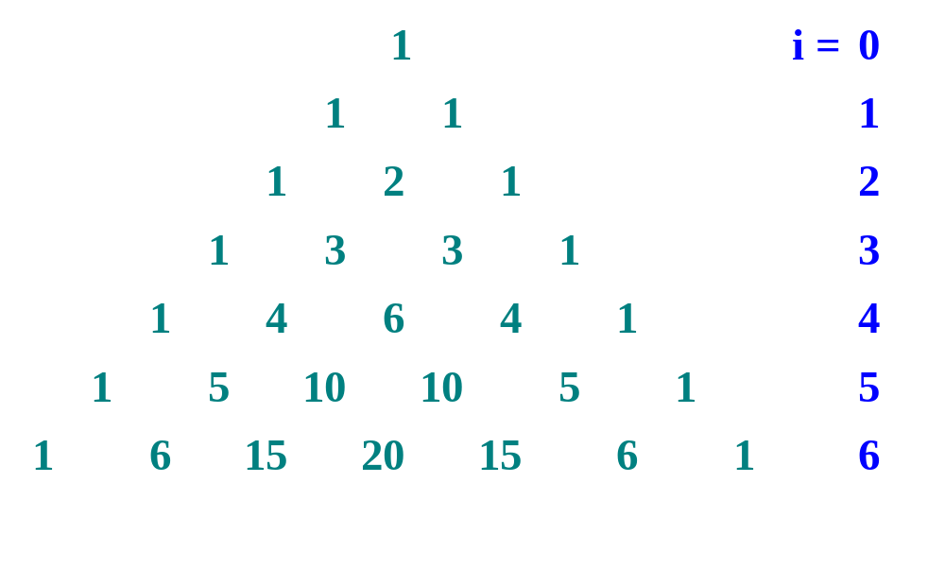
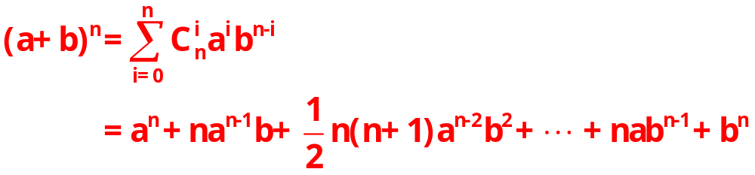
Application 2: Yangvi Triangle
Pascal’s triangle

Slide 157
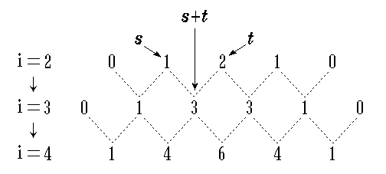
Relation between i-th row and (i+1)-th elements
®

Slide 158
Principle
0 1 1 0
0 1 2 1 0
0 1 3 3 1 0
0 1 4 6 4 1 0
0 1 5 10 10 5 1 0
0 1 6 15 20 15 6 1 0
0 1 7 21 35 35 21 7 1 0
Prof. Q. Wang

Slide 159
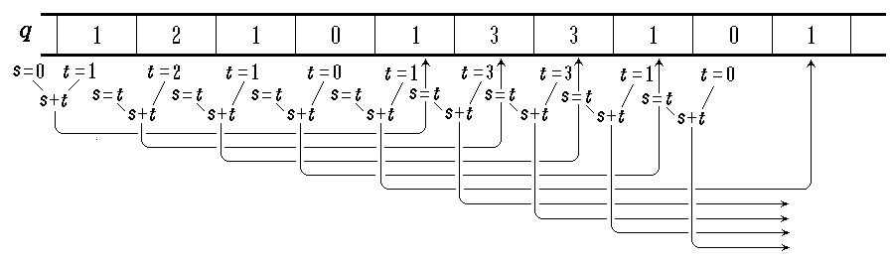
Principle
Prof. Q. Wang

Slide 160
#include "queue.h"
void YANGVI ( int n ) {
Queue q; createQueue ( &q); enQueue (&q, 1); enQueue (&q, 1);
int s = 0;
for ( int i=1; i<=n; i++ ) {
printf (“\n”);
enQueue (&q, 0); //补0用于表示一行结束
for ( int j=1; j<=i+2; j++ ) {
int t;
getHead (&q, &t); deQueue (&q);
enQueue (&q, s+t );
s = t;
if ( j != i+2 ) printf (“%d ”, s );
}
}
}
Process one row
Prof. Q. Wang

Slide 161
“划分无冲突子集问题”求解
某运动会设立n个比赛项目，每个运动员可以参加1至3个项目。试问如何安排比赛日程既可以使同一运动员参加的项目不安排在同一单位时间进行，又使总的竞赛日程最短。
若将此问题抽象成数学模型，则归属于“划分子集”问题。n个比赛项目构成一个大小为n的集合，有同一运动员参加的项目则抽象为“冲突”关系。
Prof. Q. Wang

Slide 162
例如：
某运动会设有 9 个项目:
A ={ 0, 1, 2, 3, 4, 5, 6, 7, 8 }，
7名运动员报名参加的项目分别为：
(1, 4, 8), (1, 7), (8, 3), (1, 0, 5), (3, 4), (5, 6, 2), (6, 4)
它们之间的冲突关系为: R =
{(1, 4), (4, 8), (1, 8), (1, 7), (8, 3), (1, 0), (0, 5), (1, 5), (3, 4), (5, 6), (5, 2), (6, 2), (6, 4)}
|R|=13
Prof. Q. Wang

Slide 163
“划分子集”问题即为:
将集合A划分成k个互不相交的子集
A₁，A₂，…，A_{k}（k≤n），
使同一子集中的元素均无冲突关系，并要求划分的子集数目尽可能地少。
对前述例子而言，问题即为:
同一子集的项目为可以同时进行的项目，显然希望运动会的日程尽可能短。
Prof. Q. Wang

Slide 164
求解方法
冲突关系：R = {(1, 4), (4, 8), (1, 8), (1, 7), (8, 3), (1, 0), (0, 5), (1, 5), (3, 4), (5, 6), (5, 2), (6, 2), (6, 4)}
0
7
0
7
1
1
6
6
2
2
8
8
3
3
4
5
4
5
Prof. Q. Wang

Slide 165
可利用“过筛”的方法来解决划分子集问题。从第一个元素考虑起，凡不和第一个元素发生冲突的元素都可以和它分在同一子集中，然后再“过筛”出一批互不冲突的元素为第二个子集，依次类推，直至所有元素都进入某个子集为止。
Prof. Q. Wang

Slide 166

冲突关系表
0
1
2
3
4
5
6
7
8
0 1 0 0 0 1 0 0 0
0 1 0 0 0 2 1 0 0
0 1 0 0 1 2 1 0 1
0
0 2 0 0 1 2 1 0 1
012345678
0
1
0
0
0
1
0
0
0
1
1
0
0
0
1
1
0
1
1
14568
2
0
0
0
0
0
1
1
0
0
3
0
0
0
0
1
0
0
0
1
458
4
0
1
0
1
0
0
1
0
1
8
5
1
1
1
0
0
0
1
0
0
6
0
0
1
0
1
1
0
0
0
7
0
1
0
0
0
0
0
0
0
8
0
1
0
1
1
0
0
0
0

Slide 167
为了减少重复察看 R 数组的时间，可另设一个数组clash[n] 记录和当前已入组元素发生冲突的元素的信息。
每次新开辟一组时，令clash 数组各分量的值均为“0”，当序号为“i”的元素入组时，将和该元素发生冲突的信息记入clash 数组。
Prof. Q. Wang

Slide 168
划分子集算法的基本思想:
pre (前一个出队列的元素序号) = n; 组号 = 0;
全体元素入队列;
while ( 队列不空 ) {
队头元素i出队列;
if ( i < pre ) // 开辟新的组
{ 组号++; clash 数组初始化; }
if ( i 能入组 ) {
i 入组，记下序号为 i 的元素所属组号;
修改 clash 数组;
}
else i 重新入队列;
pre = i;
}
Prof. Q. Wang

Slide 169
Application 3: Simulation of an Airport
Simulation
  Simulation is the use of one system to imitate the behavior of another system
  A computer simulation is a program to imitate the behavior of the system under study
Prof. Q. Wang

Slide 170
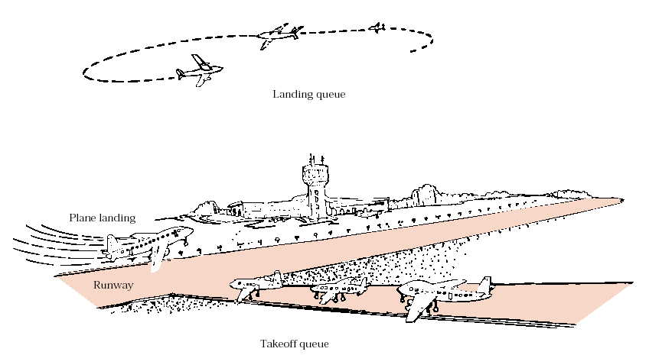
Airport simulation
机场调度
Airport
Prof. Q. Wang

Slide 171
3.8 Other list*
3.8.1 Doubled-End Queue (双端队列)
双端队列是一种特殊的线性表，对它所有的插入和删除都限制在表的两端进行。这两个端点分别记作end1和end2。它好象一个特别的书架，取书和存书限定在两边进行。
3.8.2 Double Stack (双栈)
双栈是一种增加限制的双端队列，它规定从end1插入的元素只能从end1端删除，而从end2插入的元素只能从end2端删除。它就好象两个底部相连的栈。
Prof. Q. Wang

Slide 172
3.8.3 Super Queue (超队列)
超队列是一种输出受限的双端队列，即删除限制在一端(例如end1)进行，而插入仍允许在两端进行。它好象一种特殊的队列，允许有的最新插入的元素最先被删除。
3.8.4 Super Stack (超栈)
超栈是一种输入受限的双端队列，即插入限制在一端（例如end2）进行，而删除仍允许在两端进行。它可以看成对栈溢出时的一种特殊的处理，即当栈溢出时，可将栈中保存最久（end1端）的元素删除。
Prof. Q. Wang

Slide 173
优先队列
      优先权有序表：具有特征高优先权的结点将先离开的线性结构。和到达时刻无关。
      实现方法：结点中除包含数据场外，还有本结点的优先权数。
      优先权数越小（如课本） ，优先级越高。或者：
      优先权数越大，优先级越高。
Prof. Q. Wang

Slide 174
顺序存储的优先队列
      用数组：队空：front=rear=0; 队满：rear=MaxSize-1
0
1
2
3
4
5
6
20
15
30
19
19
front
rear
a. 具有优先数为20、15、30、19的结点依次进队之后。
20
15
30
19
26
24
进队时到队尾去排队。
出队时必须进行查找，然后用最后一个结点覆盖刚刚出队的结点，代价为
O（n）。
front
rear
b. 具有优先数为26、24的结点依次进队后。
20
24
30
19
26
front
rear
c. 具有最高优先数15的结点出队。用最后一个结点覆盖它。
20
24
30
26
front
rear
d. 剩余结点中具有最高优先数为19的结点出队之后，用最后一个结点结点覆盖它之后。

Slide 175
可变长顺序栈的实现
Status InitStack(SeqStack *s)
{
s->base = (ElemType *)malloc(sizeof(ElemType) * InitSize);
assert(s->base != NULL);
s->top = s->base;
s->stackSize = InitSize;
return OK;
} /* End of InitStack() */
Status GetTop(SeqStack s, ElemType *elem)
{
if(s.top == s.base)
return ERROR;
*elem = *(s.top - 1);
return OK;
} /* End of GetTop() */
Prof. Q. Wang

Slide 176
Status Push (SeqStack *s, ElemType elem)
{
if(s->top - s->base >= s->stackSize)
{
s->base = (ElemType *)realloc(s->base, (s->stackSize +
Increment)*sizeof(ElemType));
assert(s->base != NULL);
s->top = s->base + s->stackSize;
s->stackSize += Increment;
}
*s->top++ = elem;
return OK;
} /* End of Push() */
Status Pop (SeqStack *s, ElemType *elem)
{
if(s->top == s->base)
return ERROR;
*elem = *(--s->top);
return OK;
} /* End of Pop() */
Prof. Q. Wang

Slide 177
Conclusion
Concepts of Stack and Queue
Comparison of Stack and Queue
Application of Stack
  Expression evaluation
  Expression transformation
Stack and Recursion
Application of Queue
  Discrete event simulation
Review
Prof. Q. Wang

Slide 178
Assignment (3)
P22
  3.4, 3.5, 3.6
P24
  3.15, 3.21, 3.28, 3.29, 3.32
附加的思考题
  两个栈的设计
  表达式转换
  循环链队列，队列溢出问题
  K阶Fibonacci数列
Prof. Q. Wang

Slide 179
Practical (2)
表达式求值
设计一个程序，演示用算符优先法对算术表达式求值的过程。(可以顺便实现中缀表达式转换为后缀表达式)
  P99 2.5
  测试数据：
  3* ( 7-2 )
  2* ( 6+2* ( 3+6* (6+6) ) )+ ( 6+6 ) *3+2
  8/ ( 9 - 9 )
Prof. Q. Wang

Slide 180
补充: 中缀→前缀
1) 求输入串的逆序。
2) 检查输入的下一元素。
3) 假如是操作数，把它添加到输出串中。
4) 假如是闭括号，将它压栈。
5) 假如是运算符，则
i) 假如栈空，此运算符入栈。
ii) 假如栈顶是闭括号，此运算符入栈。
iii) 假如它的优先级高于或等于栈顶运算符，此运算符入栈。
iv) 否则，栈顶运算符出栈并添加到输出串中，重复步骤5。
6) 假如是开括号，栈中运算符逐个出栈并输出，直到遇到闭括号。闭括号出栈并丢弃。
7) 假如输入还未完毕，跳转到步骤2。
8) 假如输入完毕，栈中剩余的所有操作符出栈并加到输出串中。
9) 求输出串的逆序。
Prof. Q. Wang

Slide 181
举例
假设我们要将表达式2*3/(2-1)+5*(4-1)转换成前缀形式：
  原表达式的逆序是)1-4(*5+)1-2(/3*2
Prof. Q. Wang

Slide 182
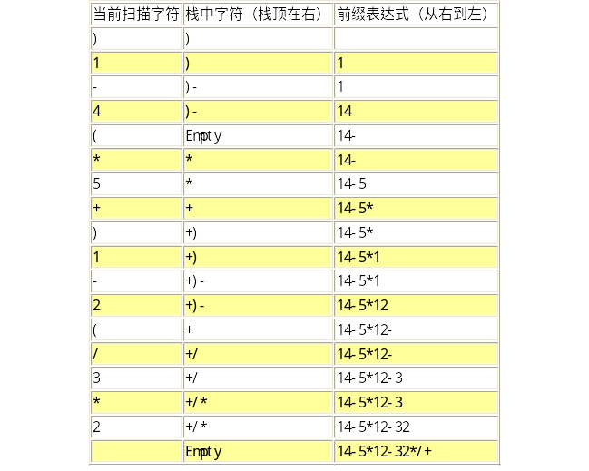
原表达式的逆序串：)1-4(*5+)1-2(/3*2
输出串的逆序为+/*23-21*5-41，所以，最终求得的前缀表达式是
+/*23-21*5-41。
Prof. Q. Wang

