Slide 1
Log File Analysis & Reporting System
Author: Shaik Rumana Anjum
Technology Used: Python, MySQL, Regex, Tabulate

Slide 2
Introduction
Log files are digital records of system and user activities generated by servers, applications, and networks.
They contain crucial information like IP addresses, user activity, errors, and requests.
Why important?
Aid in security analysis
Help troubleshoot system errors
Support performance optimization
This project automates log analysis and provides actionable insights

Slide 3
Objectives
Automate the collection and processing of large log files.
Parse data accurately and store it in a structured database for easy access.
Generate analytical reports with traffic trends, errors, and user activity details.
Support scalability for massive log data while reducing manual effort

Slide 4
Problem Statement
Manual log analysis is inefficient and prone to human error.
Difficult to visualize patterns in massive raw log files.
Large logs can impact system monitoring speed and effectiveness.
Lack of automation leads to delayed detection of system errors or attacks

Slide 5
System Architecture
Flow:
Log Source: Server/Application generates logs.
Log Parser: Uses Regex to extract fields (IP, method, status codes, etc.).
Database: Parsed data stored in MySQL for efficient querying.
Reporting Engine: Generates reports (top IPs, traffic trends, error codes).

Slide 6
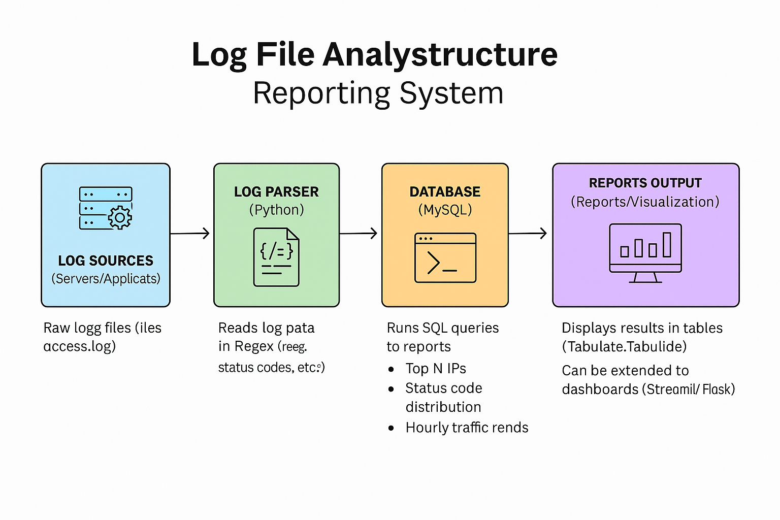

Slide 7
Technology Stack
Programming Language: Python – chosen for easy regex handling and MySQL integration.
Libraries:
mysql-connector-python – database operations
tabulate – present reports in tables
user-agents – analyze user agent strings
Database: MySQL – scalable and robust relational database.
Development: Virtual Environment (venv) for isolated dependency management.

Slide 8
Database Design
Tables:
user_agents – stores user-agent details (OS, browser, device type).
log_entries – contains parsed logs with fields like IP, method, timestamp, status code.
Relationship: Each log entry references a user agent (foreign key).
Show ER diagram with table fields and relations

Slide 9
Log Parsing
Log format: Apache/Nginx combined log format.
Regex pattern identifies required fields.
Example extracted fields:
IP Address
Timestamp
Request (method, path, protocol)
Status code & bytes sent
Referrer and user agent
Invalid or malformed lines are skipped automatically with warnings

Slide 10
Core Features
Batch log processing – handles millions of records without memory overload.
Duplicate detection via MySQL UNIQUE constraints.
Comprehensive reporting capabilities:
Top N IPs (most active users/attackers)
Status Code Distribution (error vs. success trends)
Hourly Traffic Trends (identify peak load times)
Flexible design to extend with more report types.

Slide 11
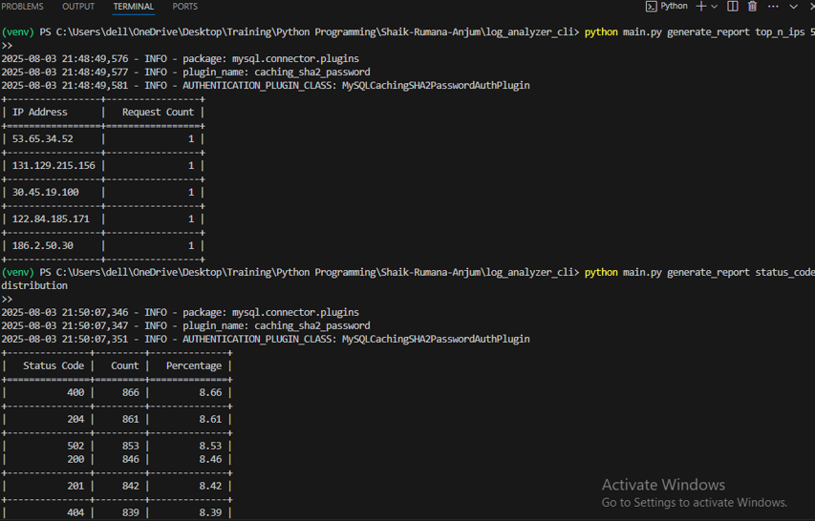
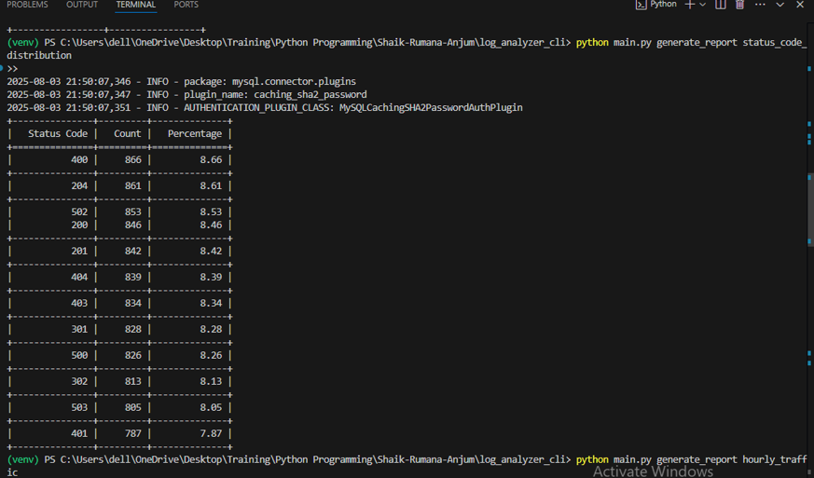
Sample Reports

Slide 12
Challenges & Solutions
Large Data Volume:
Solution: Batch insertion & optimized SQL queries.
Malformed Log Entries:
Solution: Regex validation with warning logs for skipped entries.
Duplicate Entries:
Solution: Database constraints ensure data integrity.
Scalability:
Solution: Modular design with separate parser, database handler, and reporting module.

Slide 13
Conclusion & Future Scope
The system provides a reliable way to parse, store, and analyze logs.
Helps identify security threats, system errors, and usage trends faster.
Future Enhancements:
Add a Streamlit/Flask Web Dashboard for real-time visualization.
Set up automatic alerts for error spikes or unusual traffic.
Integrate with cloud services (AWS, GCP) for large-scale log storage and analysis.

