Slide 1

BAYESIAN MODELLING FOR REGRESSION
Alexis Boukouvalas, based on slides by C.M.Bishop

Slide 2
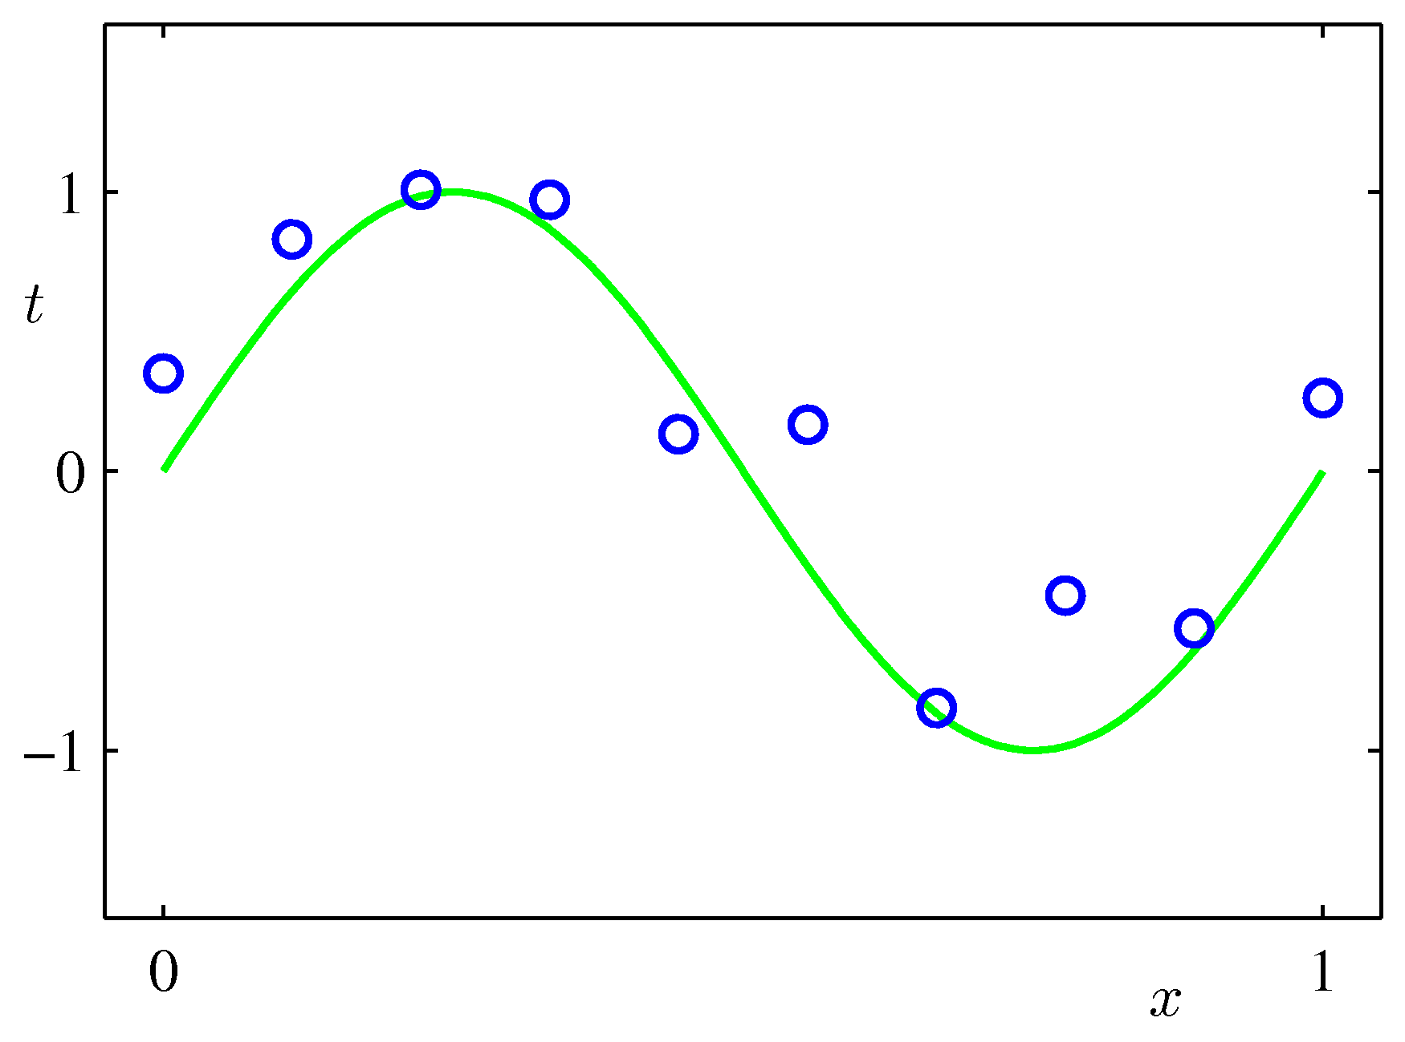
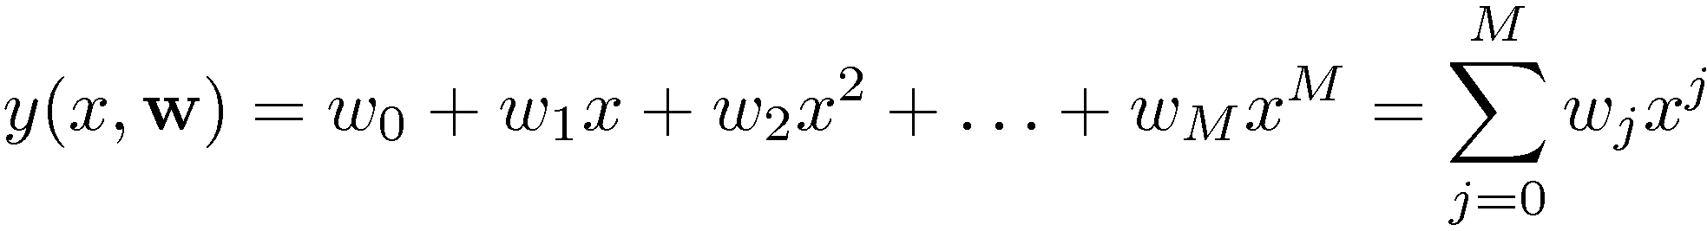
Reminder: Linear Basis Function Models
Example: Polynomial Curve Fitting

Slide 3

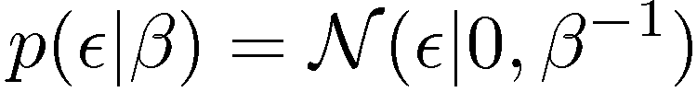

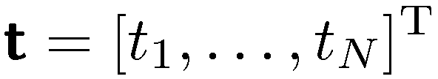
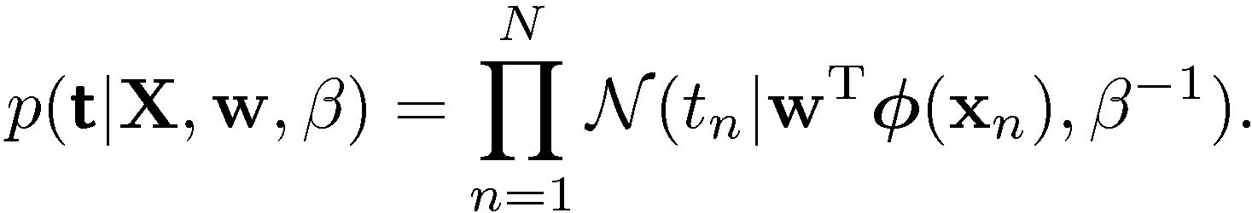
Reminder Maximum Likelihood (1)
Assume observations from a deterministic function with added Gaussian noise:
which is the same as saying,
Given observed inputs, , and targets,
, we obtain the likelihood function
where

Slide 4
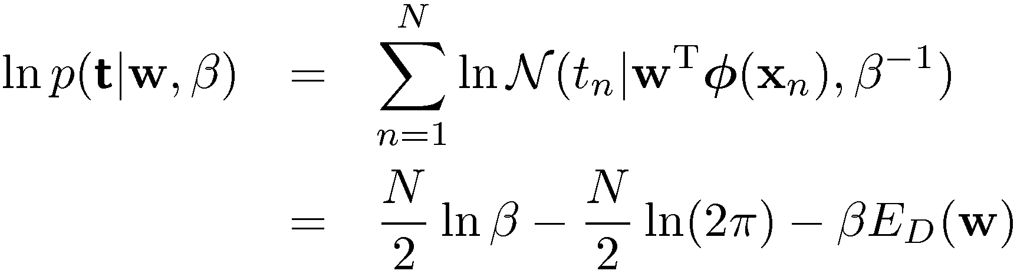
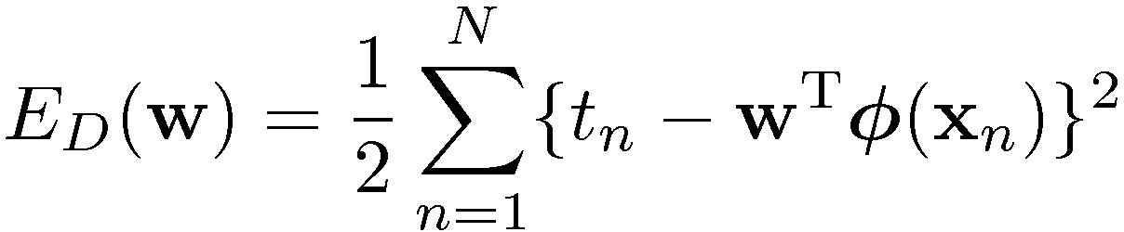
Reminder: Maximum Likelihood (2)
Taking the logarithm, we get
where
is the sum-of-squares error.

Slide 5
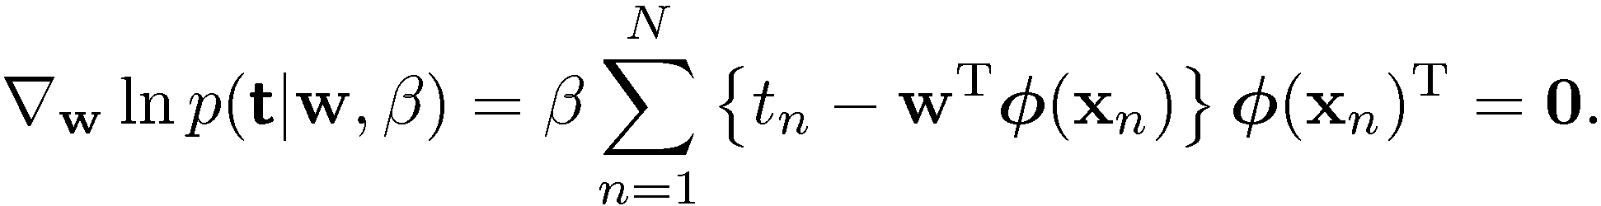


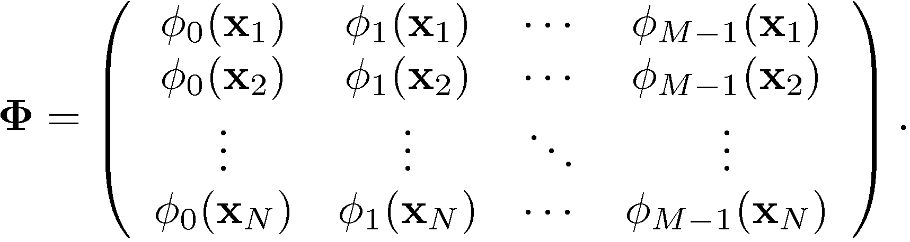
Reminder: Maximum Likelihood
Computing the gradient and setting it to zero yields
Solving for w, we get
where
The Moore-Penrose pseudo-inverse, .

Slide 6
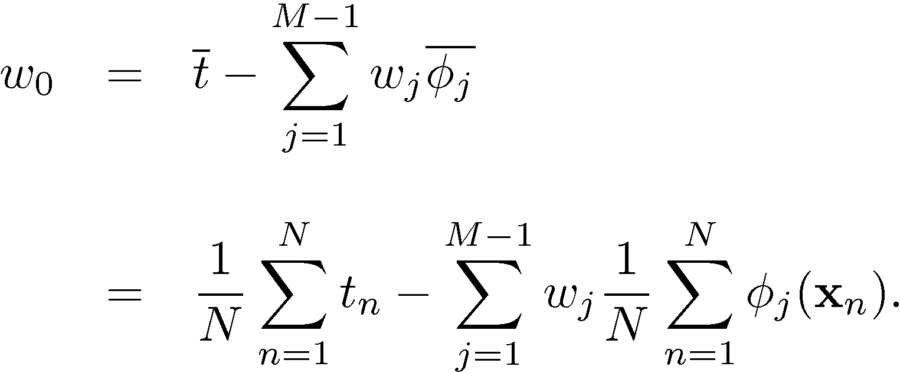
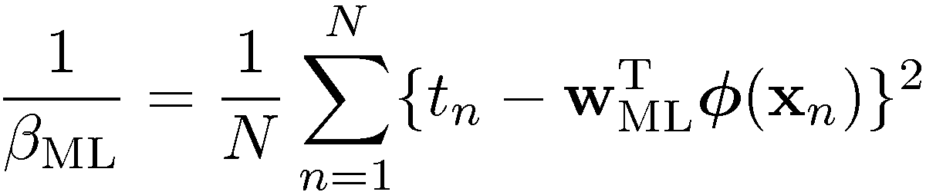
Maximum Likelihood and Least Squares (4)
Maximizing with respect to the bias, w₀, alone, we see that
We can also maximize with respect to the noise, giving

Slide 7

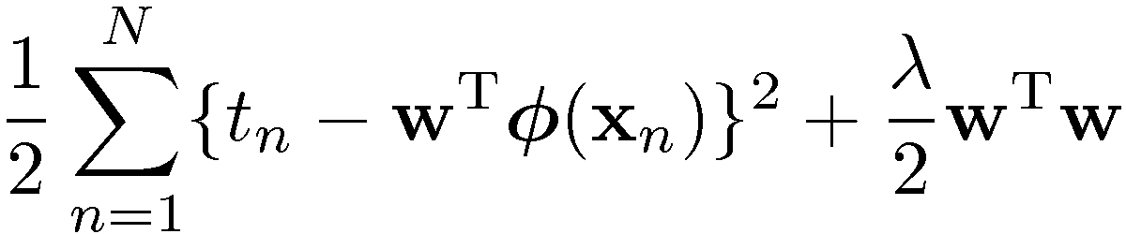
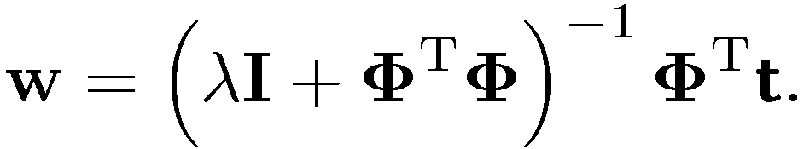
Regularized Least Squares (1)
Consider the error function:
With the sum-of-squares error function and a quadratic regularizer, we get
which is minimized by
Data term + Regularization term
Lambda is called the regularization coefficient.

Slide 8


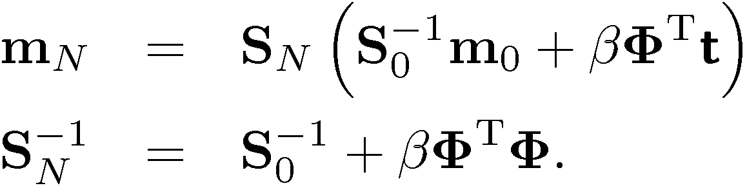
Bayesian Linear Regression (1)
Define a conjugate prior over w
Combining this with the likelihood function and using results for marginal and conditional Gaussian distributions, gives the posterior
where

Slide 9
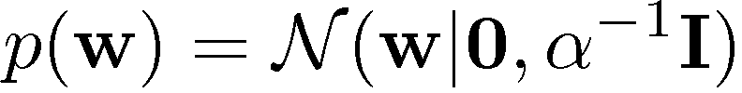
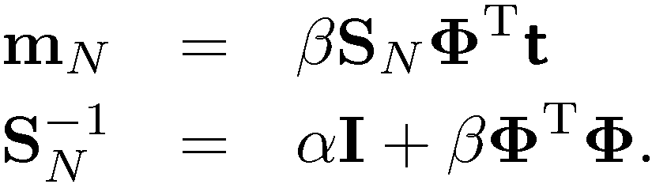
Bayesian Linear Regression (2)
A common choice for the prior is
for which
Next we consider an example …

Slide 10
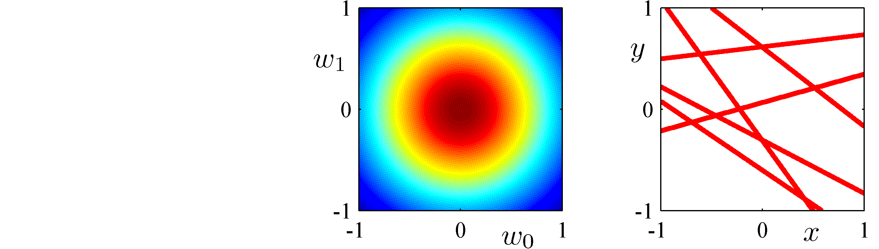
Bayesian Linear Regression (3)
0 data points observed
Prior
Data Space

Slide 11
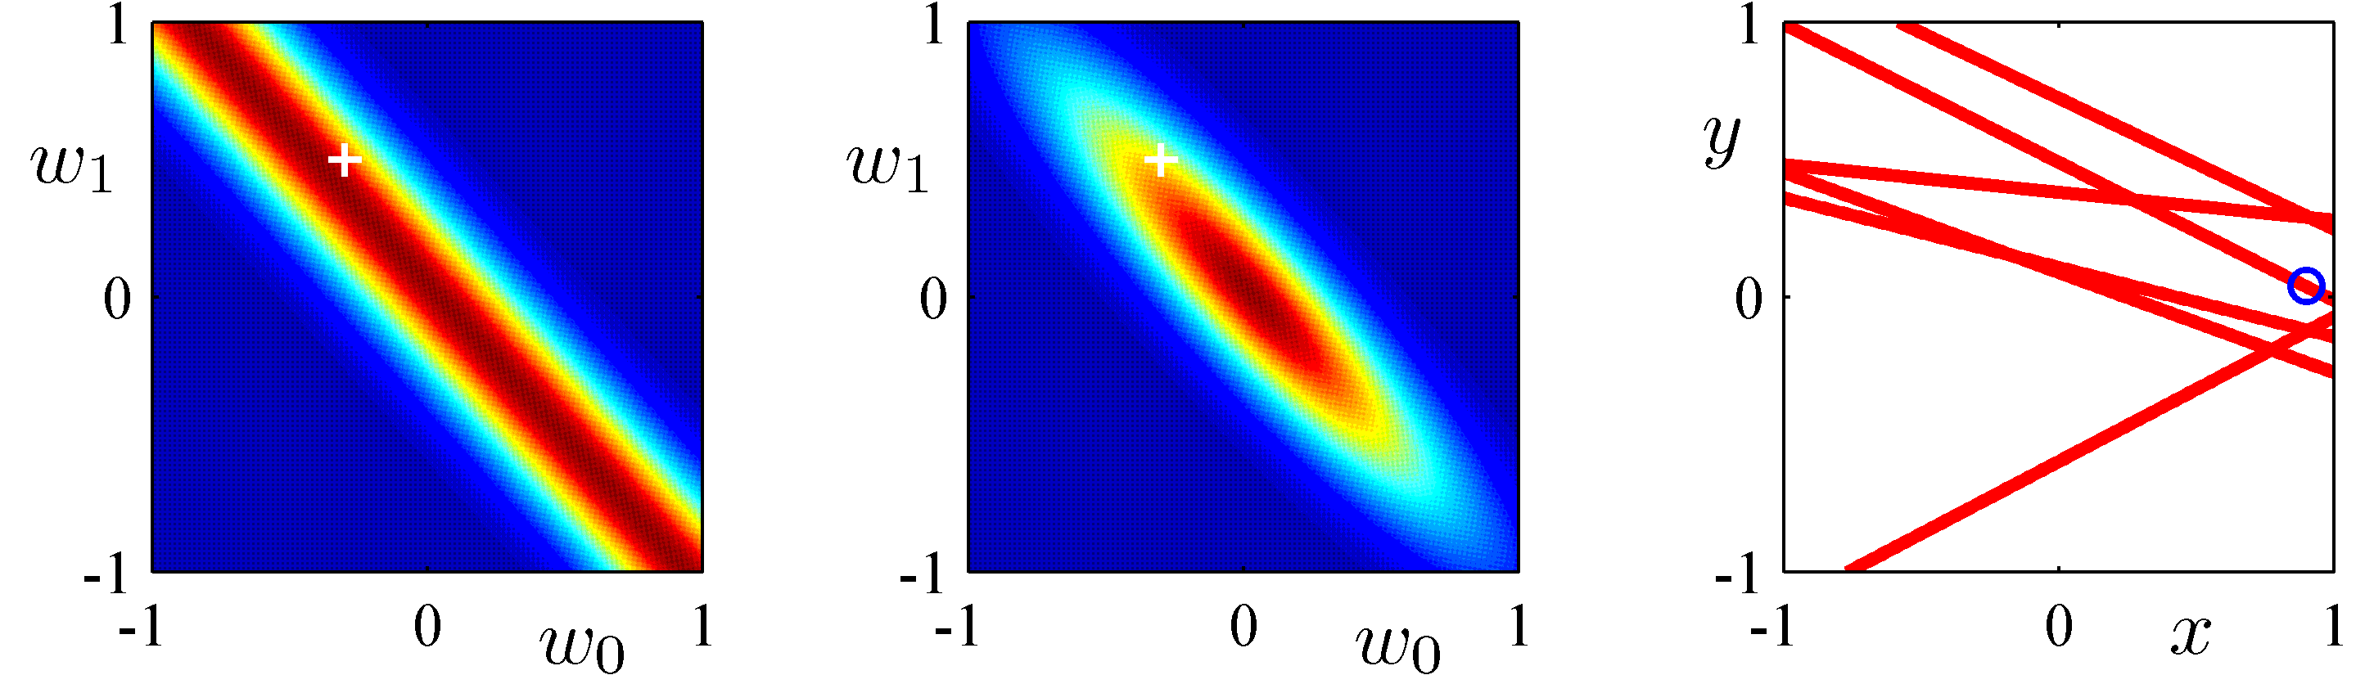
Bayesian Linear Regression (4)
1 data point observed
Likelihood
Posterior
Data Space

Slide 12
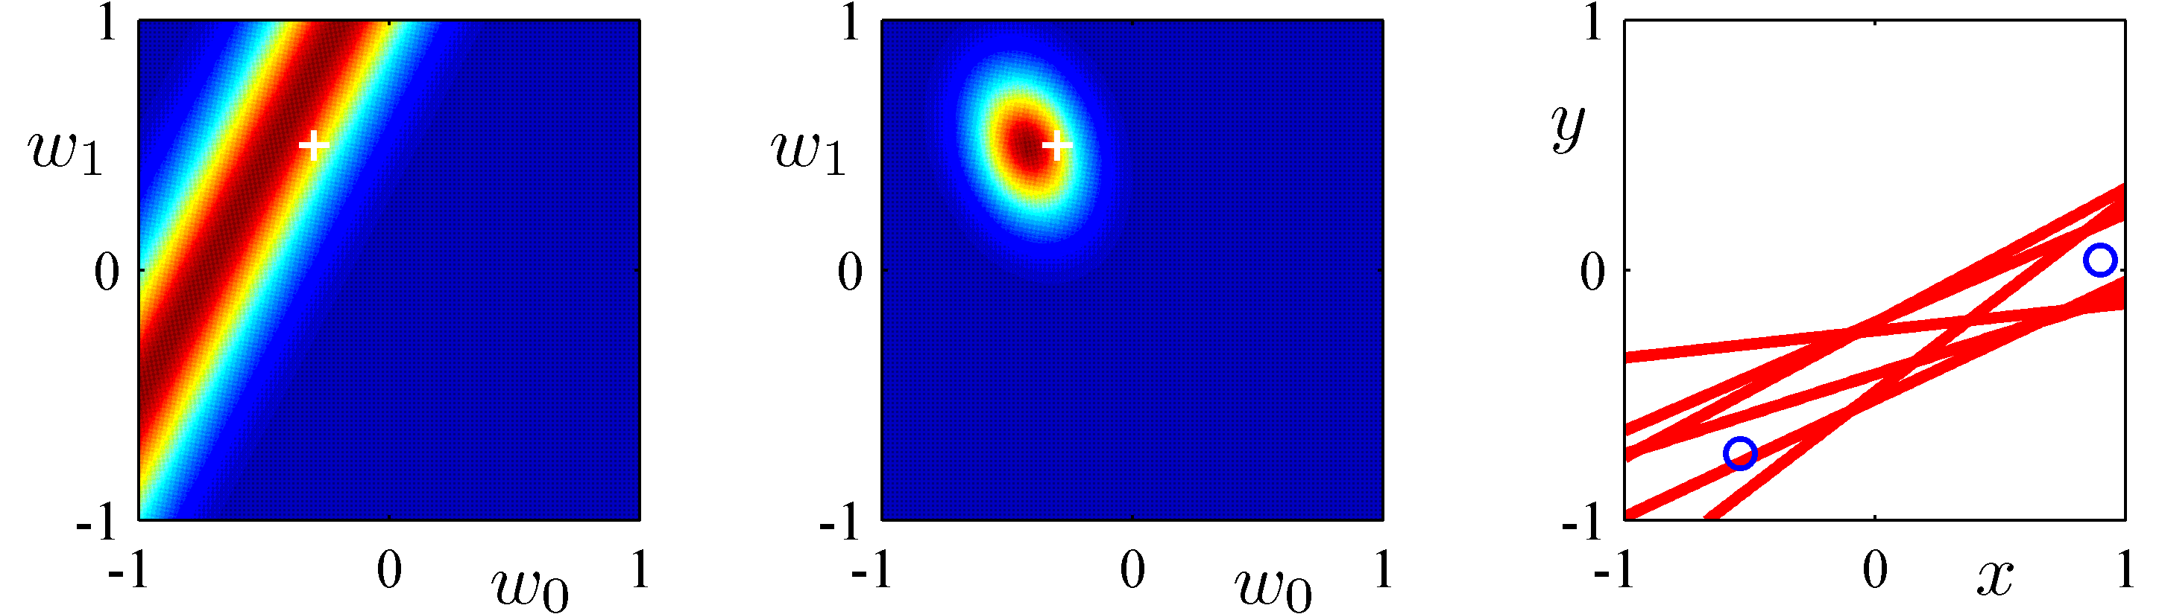
Bayesian Linear Regression (5)
2 data points observed
Likelihood
Posterior
Data Space

Slide 13
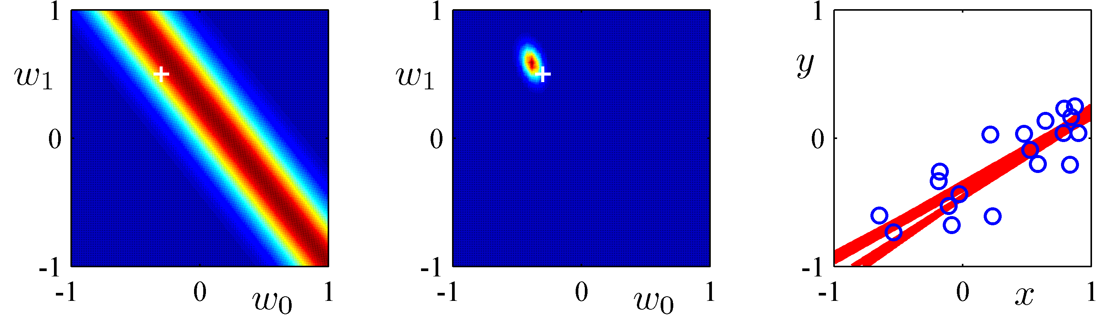
Bayesian Linear Regression (6)
20 data points observed
Likelihood
Posterior
Data Space

Slide 14
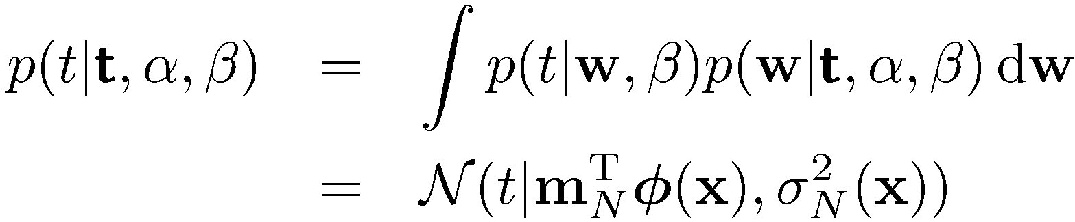
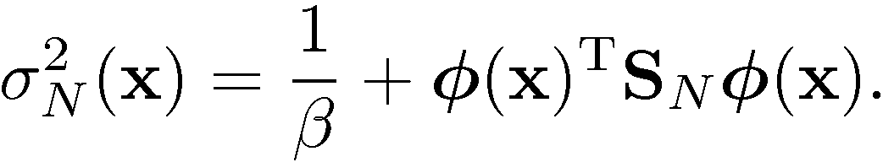
Predictive Distribution (1)
Predict t for new values of x by integrating over w:
where

Slide 15
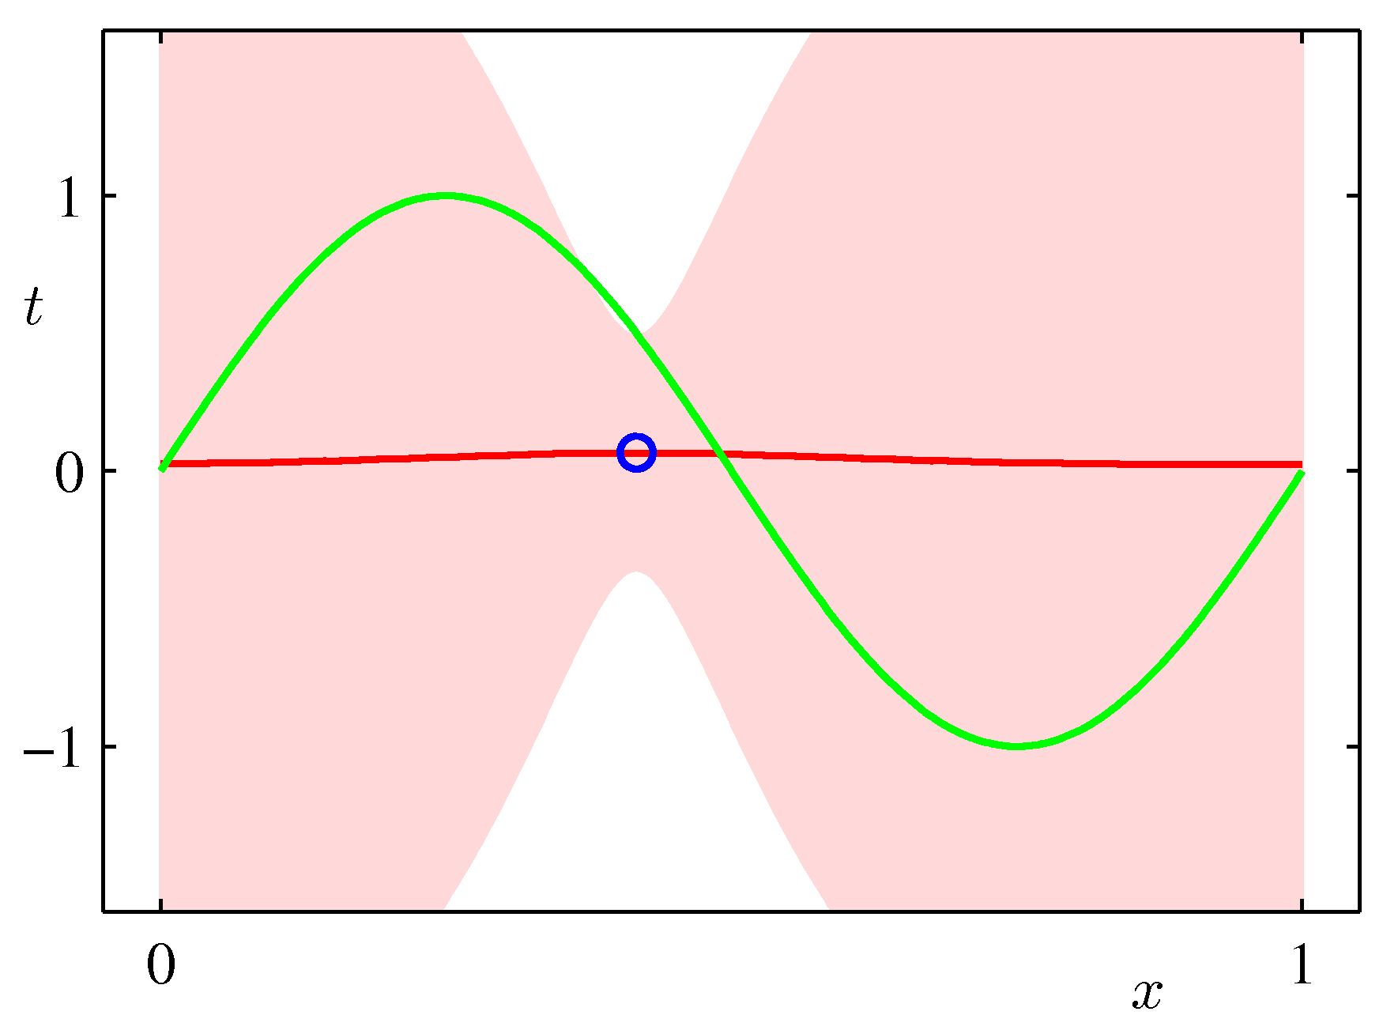
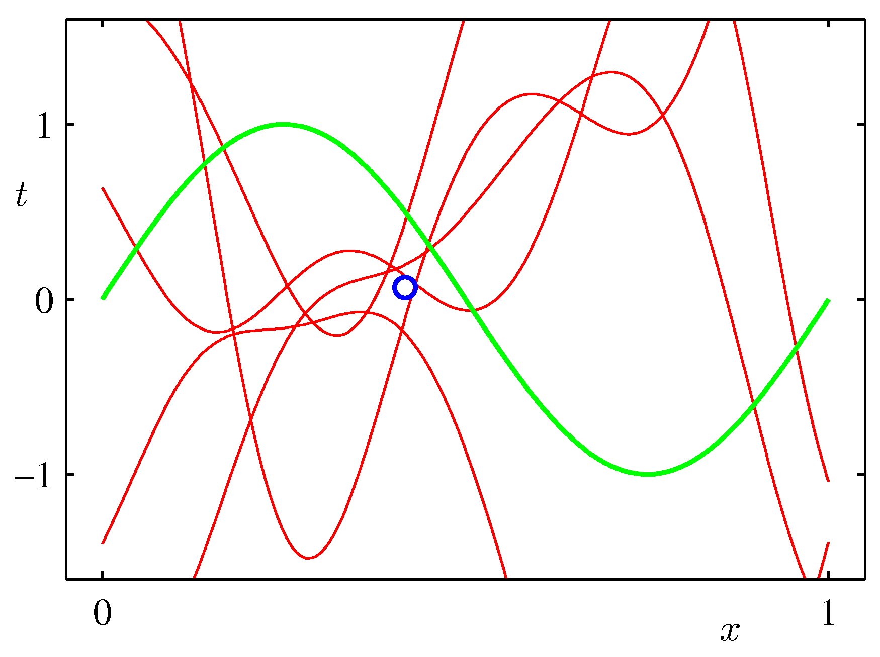
Predictive Distribution (2)
Example: Sinusoidal data, 9 Gaussian basis functions, 1 data point

Slide 16
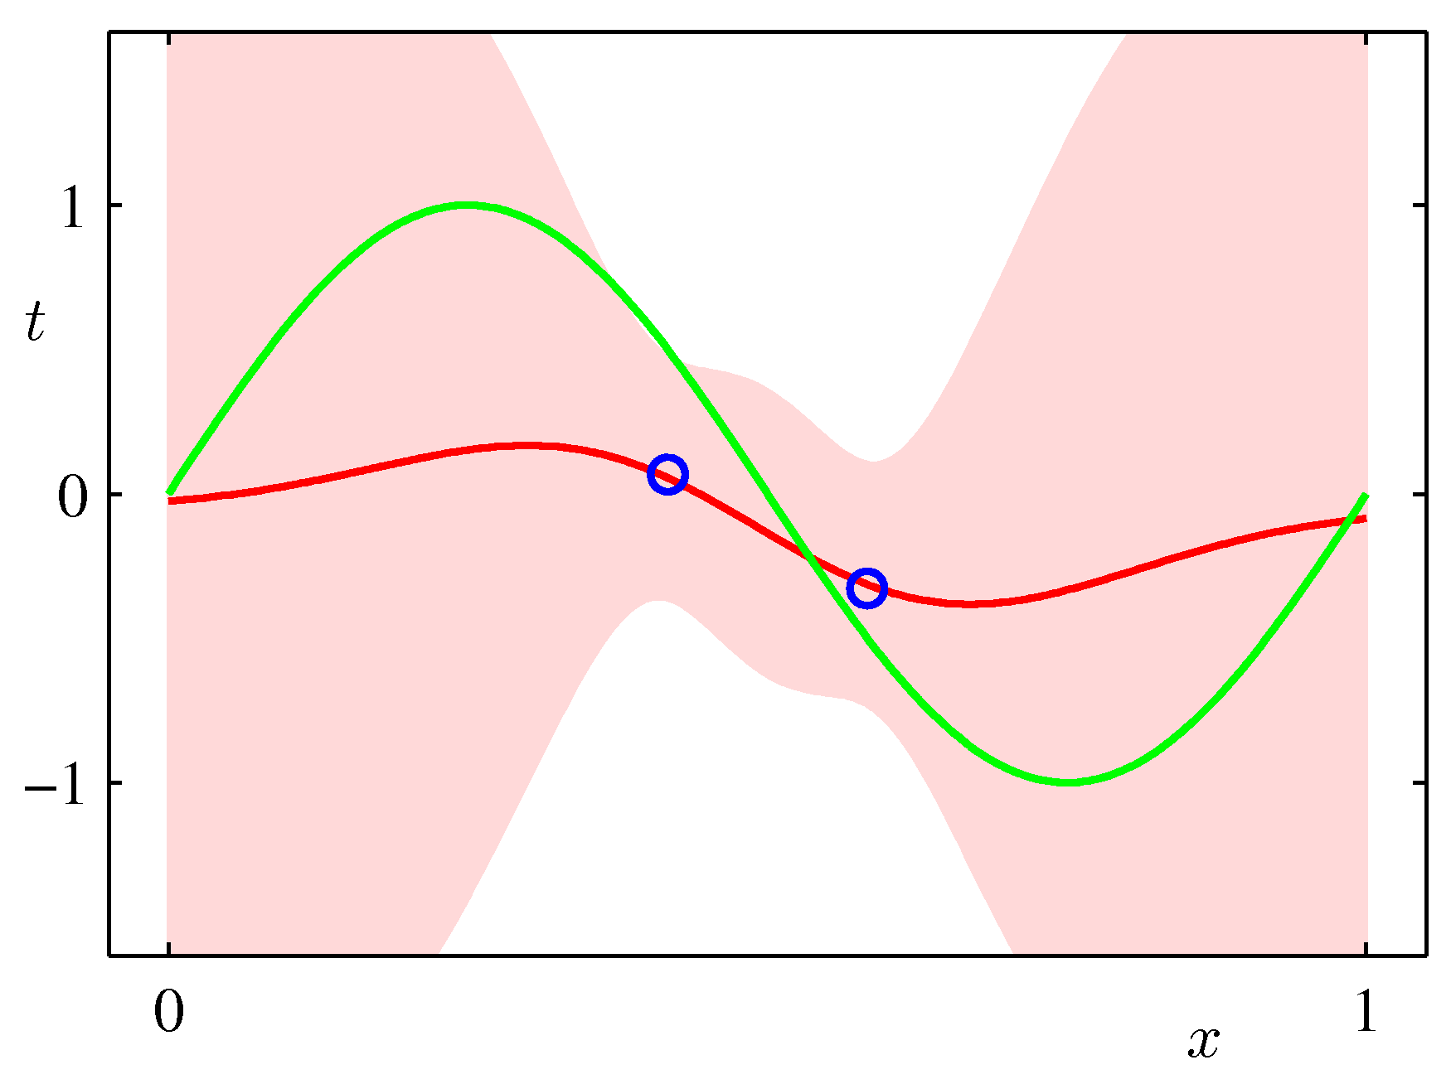
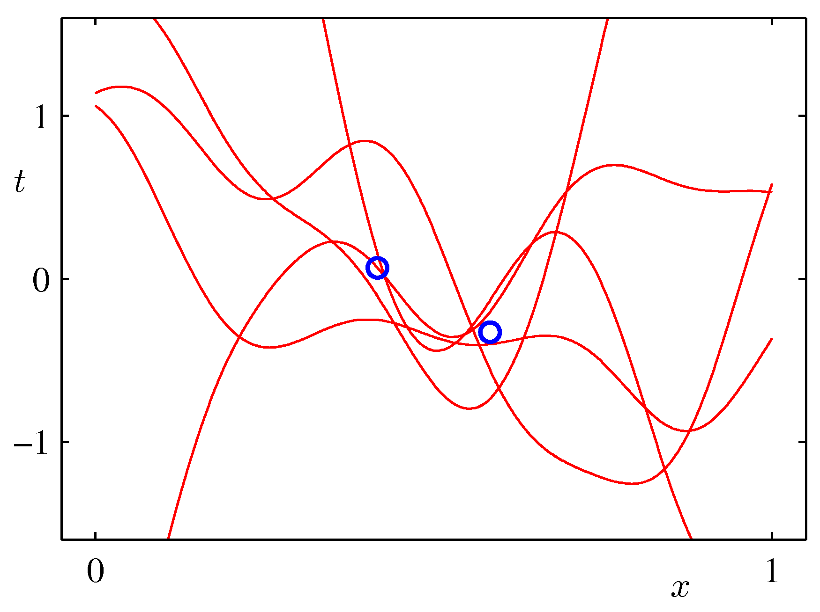
Predictive Distribution (3)
Example: Sinusoidal data, 9 Gaussian basis functions, 2 data points

Slide 17
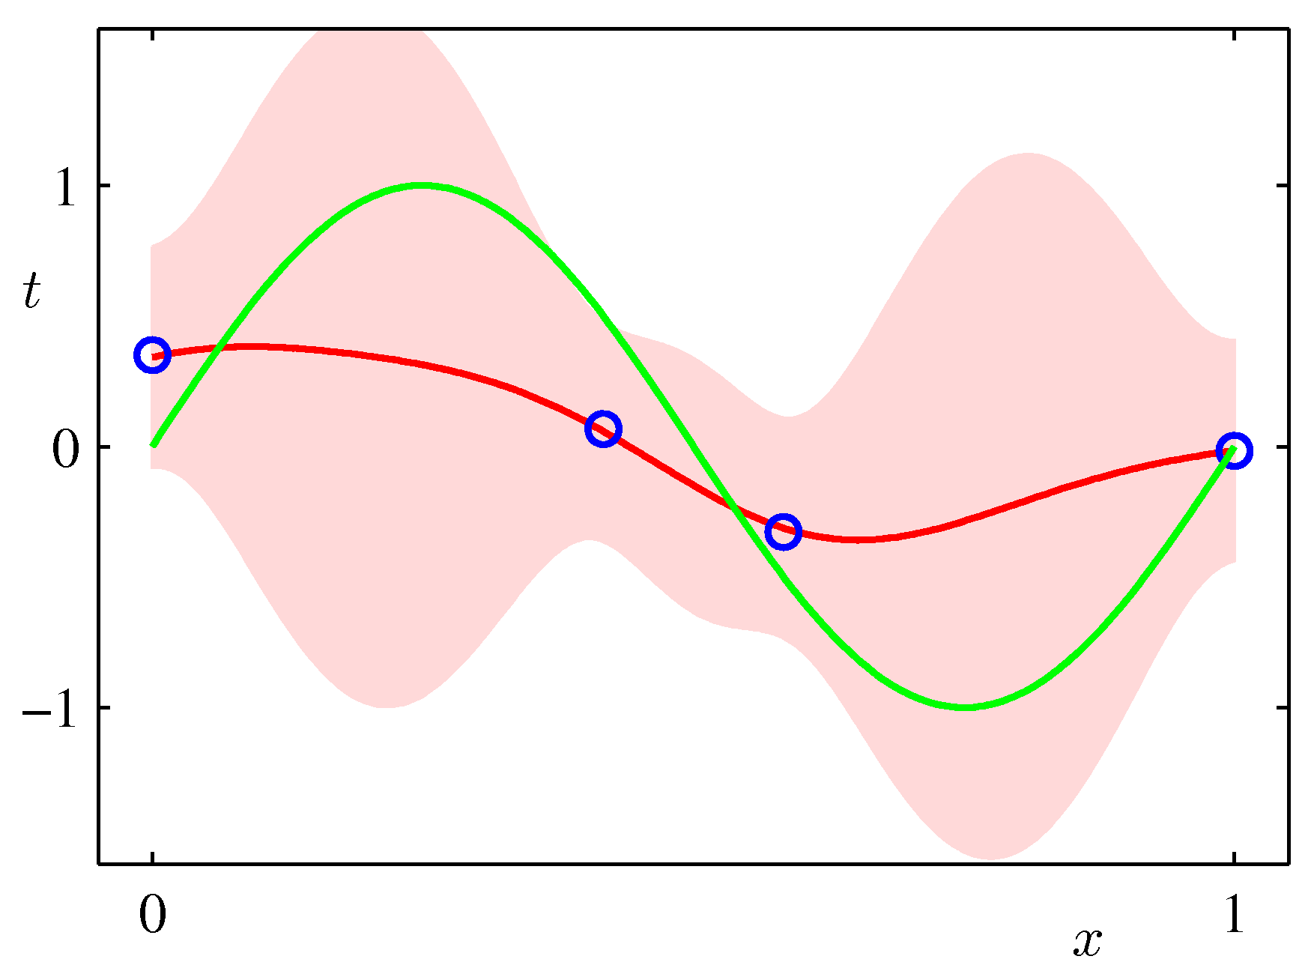
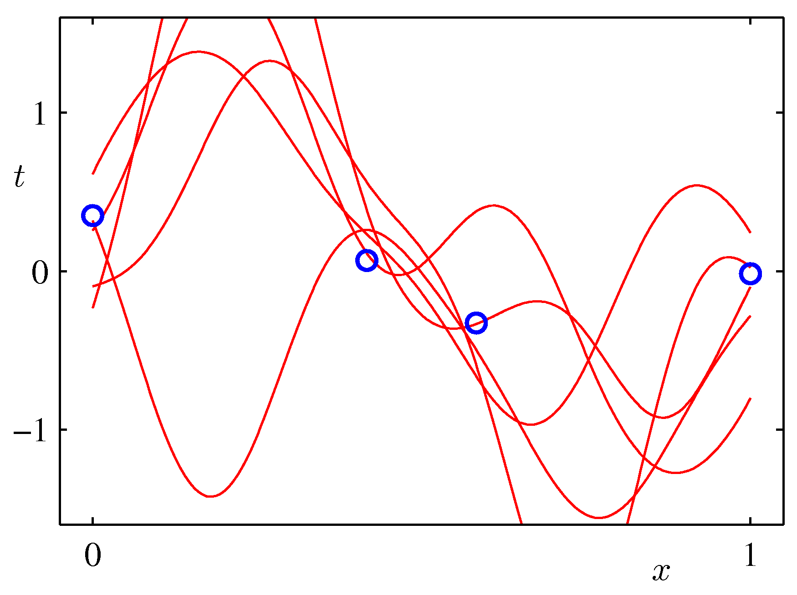
Predictive Distribution (4)
Example: Sinusoidal data, 9 Gaussian basis functions, 4 data points

Slide 18
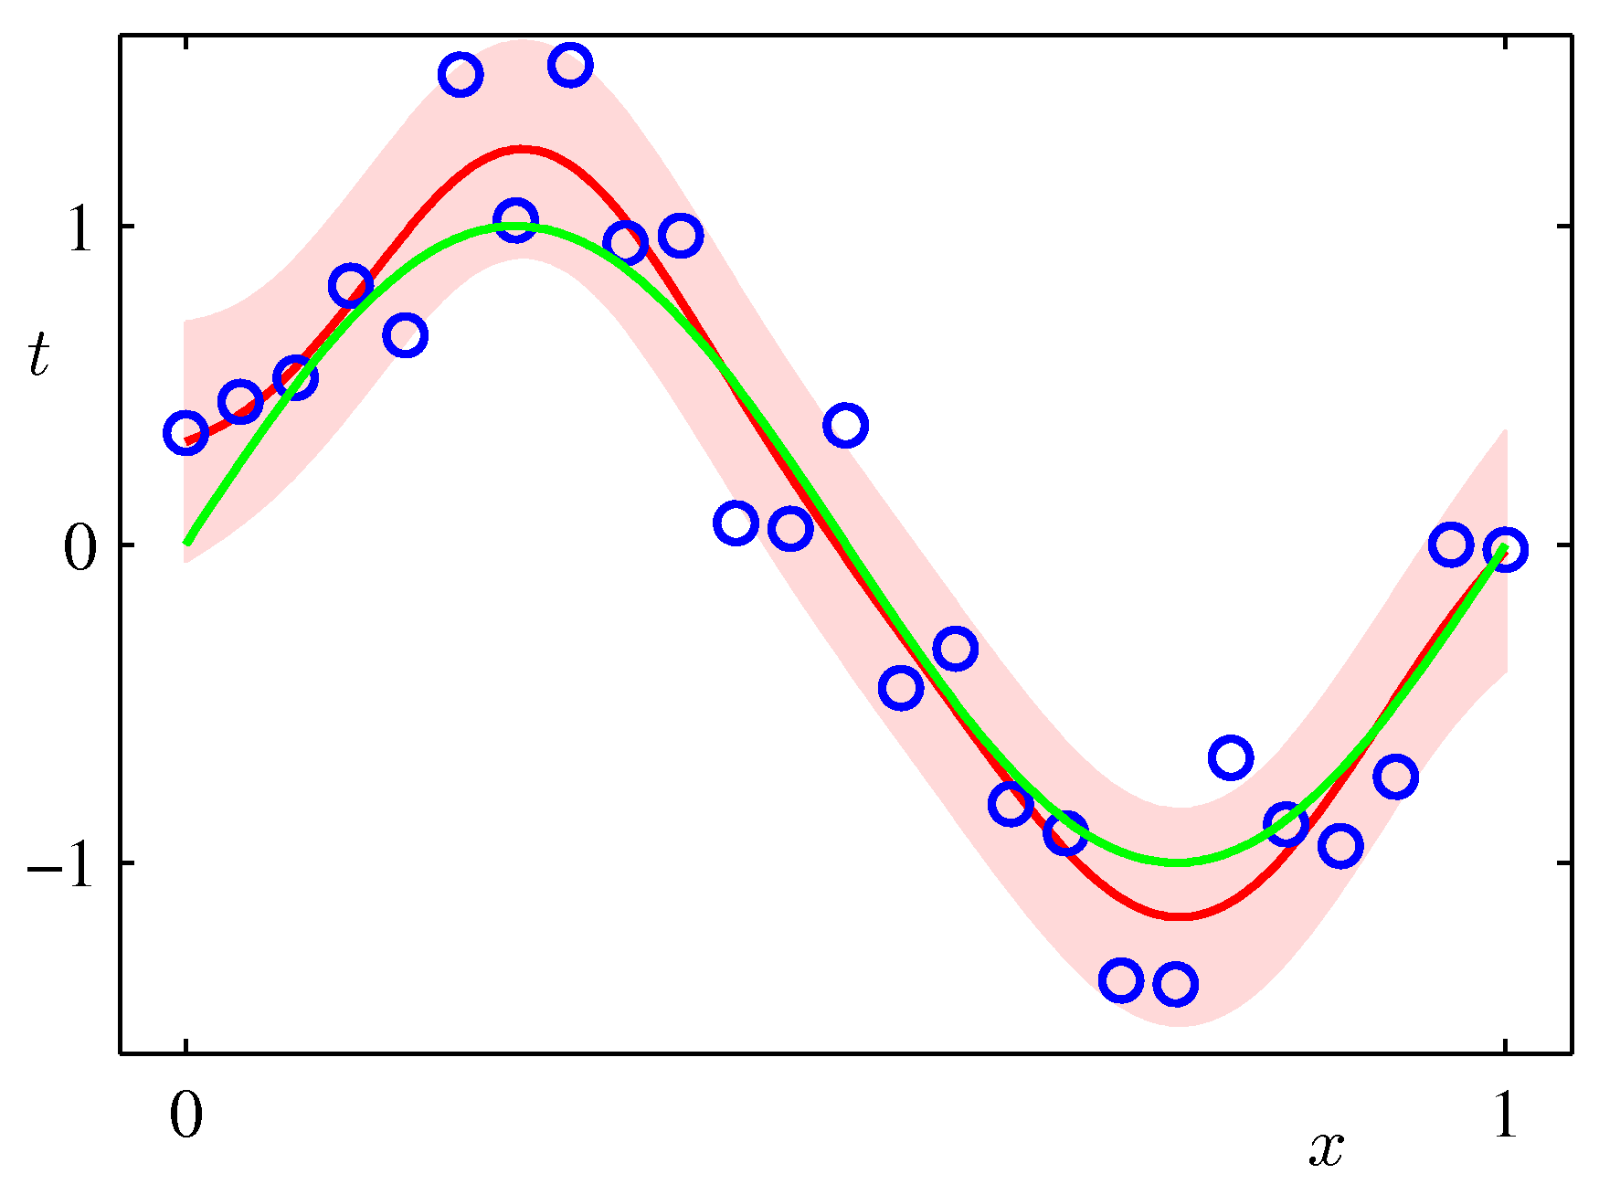
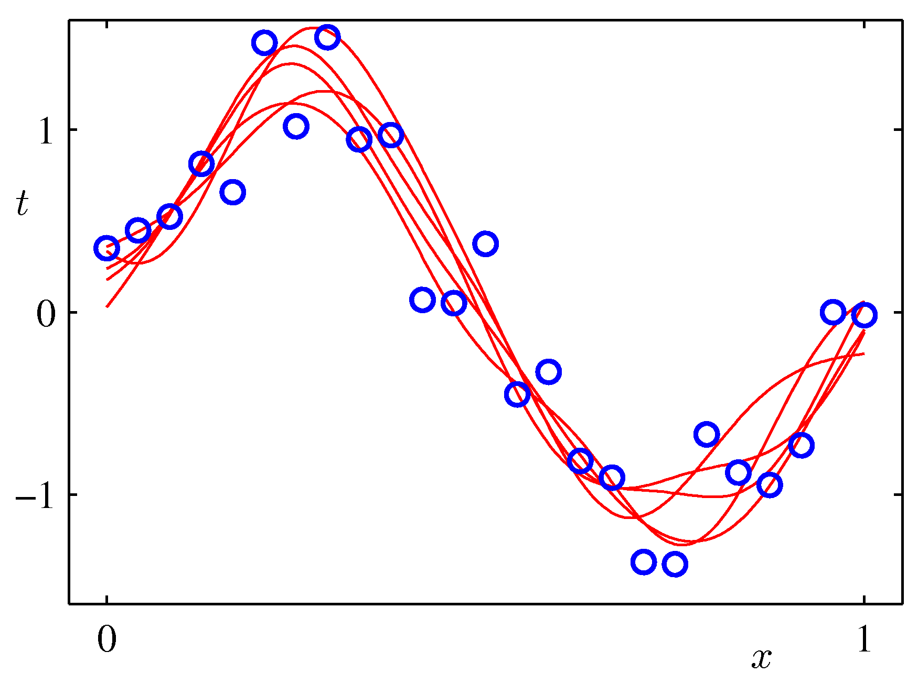
Predictive Distribution (5)
Example: Sinusoidal data, 9 Gaussian basis functions, 25 data points

Slide 19
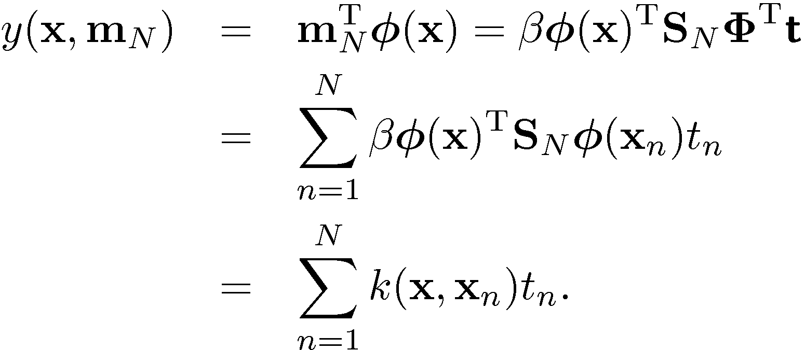
Equivalent Kernel (1)
The predictive mean can be written
This is a weighted sum of the training data target values, t_{n}.
Equivalent kernel or smoother matrix.

Slide 20
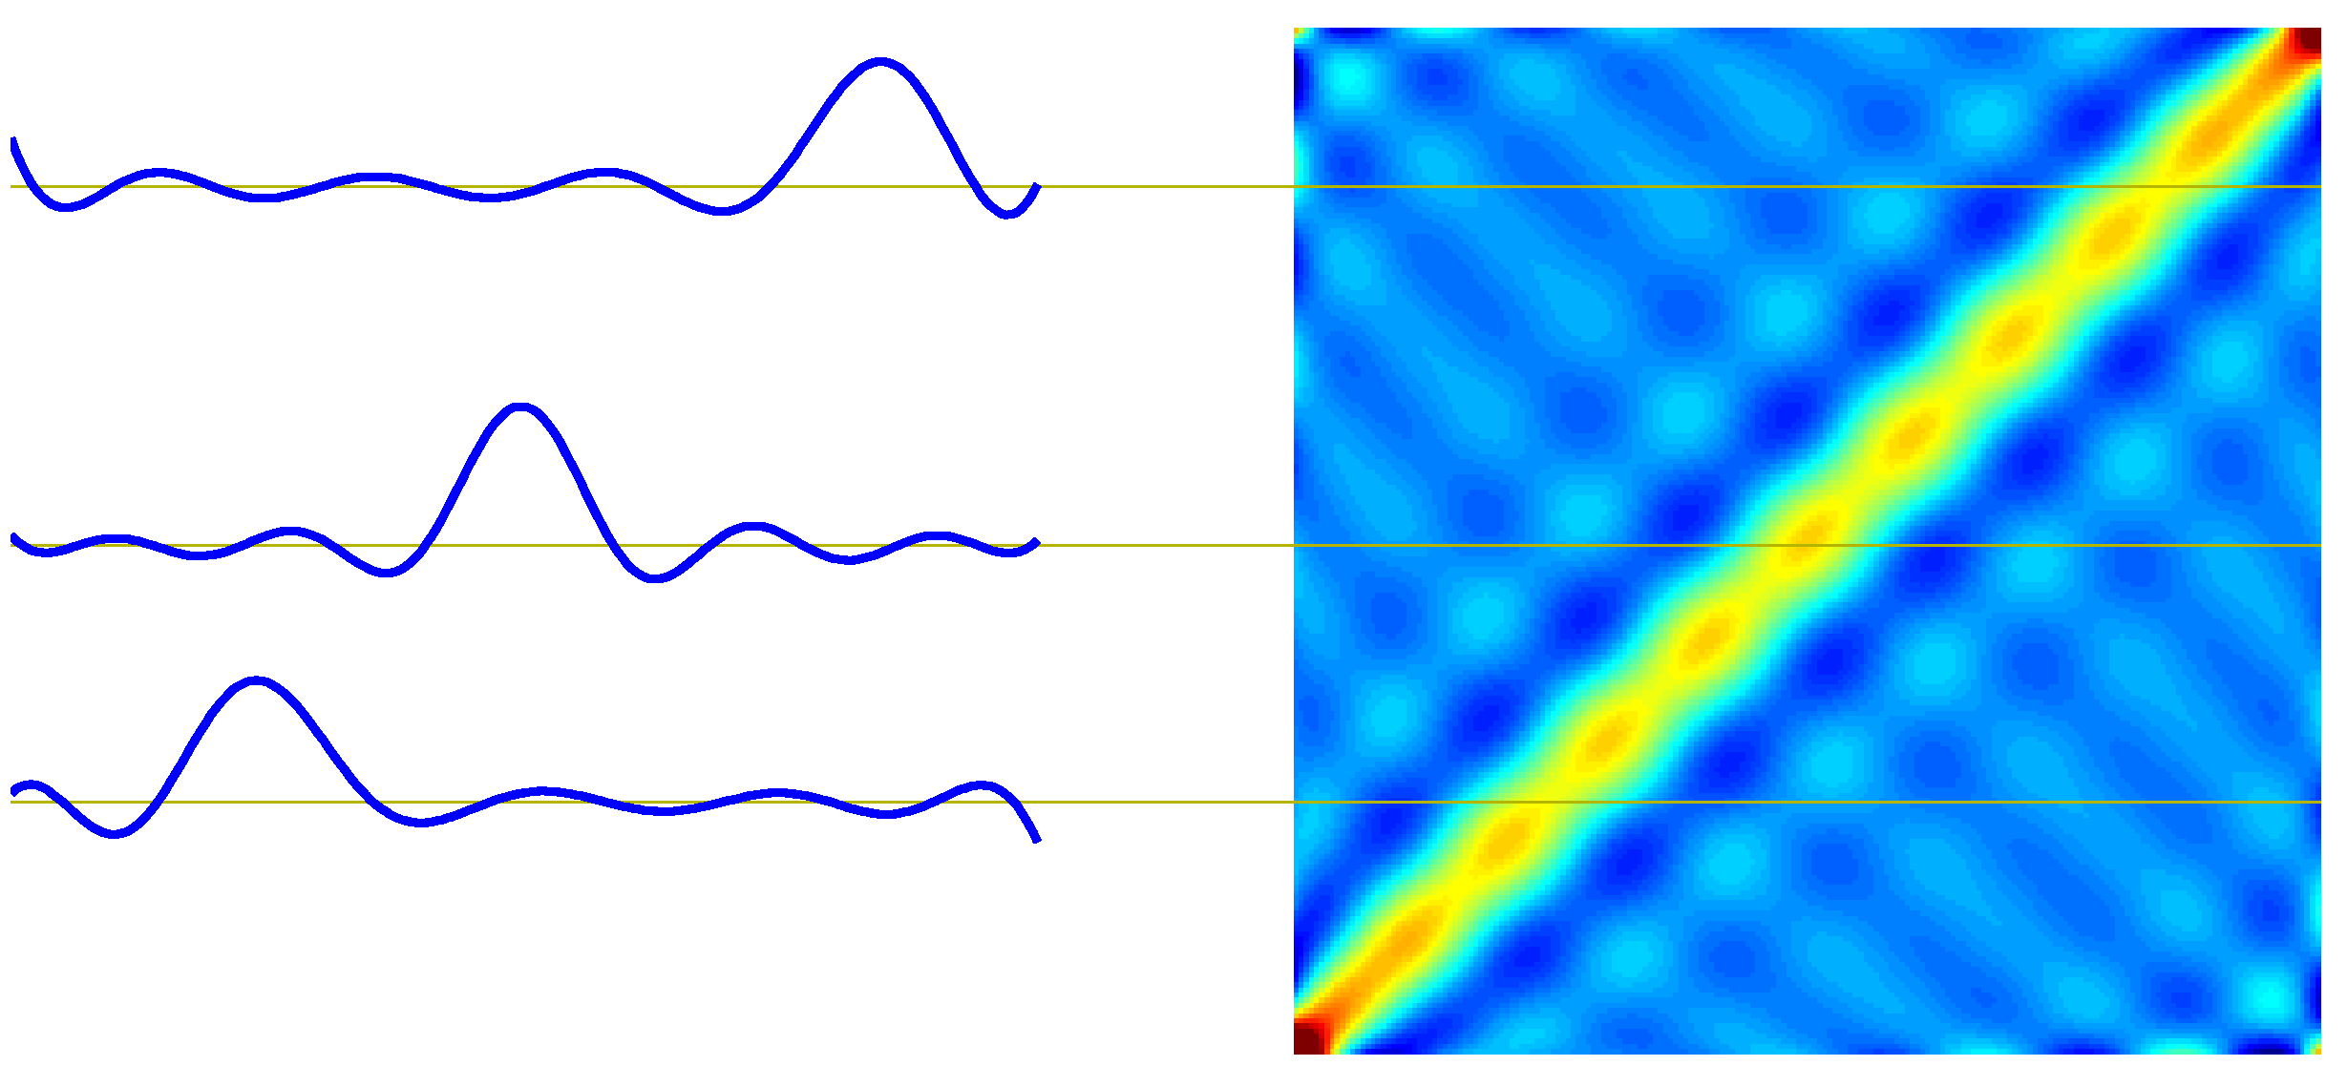






Equivalent Kernel (2)
Weight of t_{n} depends on distance between x and x_{n}; nearby x_{n} carry more weight.

Slide 21
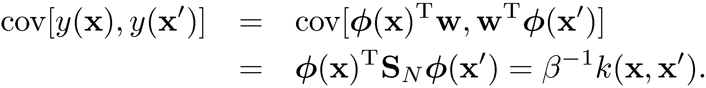
Equivalent Kernel (3)
The kernel as a covariance function: consider
We can avoid the use of basis functions and define the kernel function directly, leading to Gaussian Processes (Chapter 6).

Slide 22
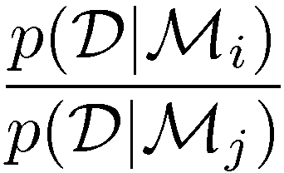
Bayesian Model Comparison (1)
How do we choose the ‘right’ model?
Assume we want to compare models M_{i}, i=1, …,L, using data D; this requires computing
Bayes Factor: ratio of evidence for two models
Posterior
Prior
Model evidence or marginal likelihood

Slide 23
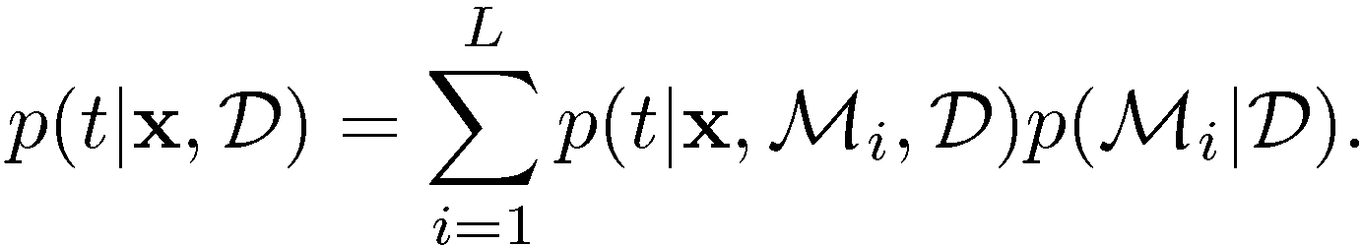
Bayesian Model Comparison (2)
Having computed p(M_{i}jD), we can compute the predictive (mixture) distribution
A simpler approximation, known as model selection, is to use the model with the highest evidence.

Slide 24
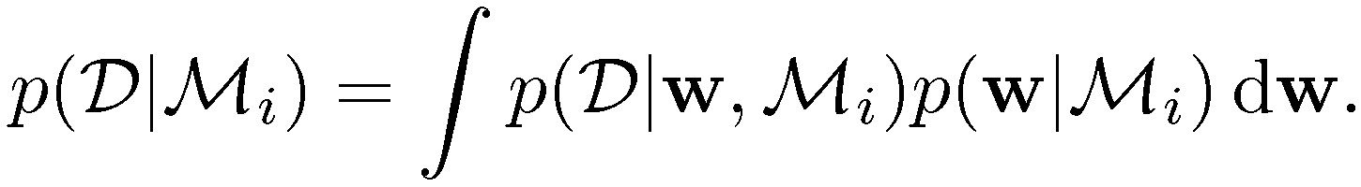
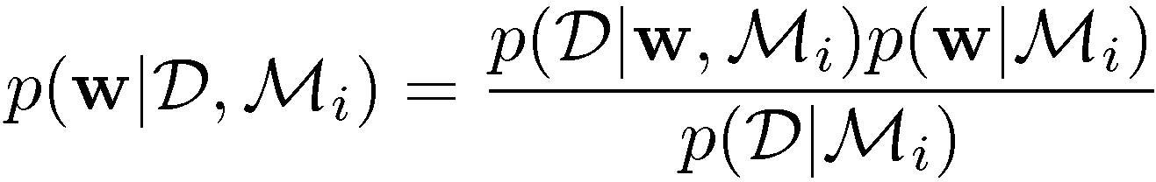
Bayesian Model Comparison (3)
For a model with parameters w, we get the model evidence by marginalizing over w
Note that

Slide 25
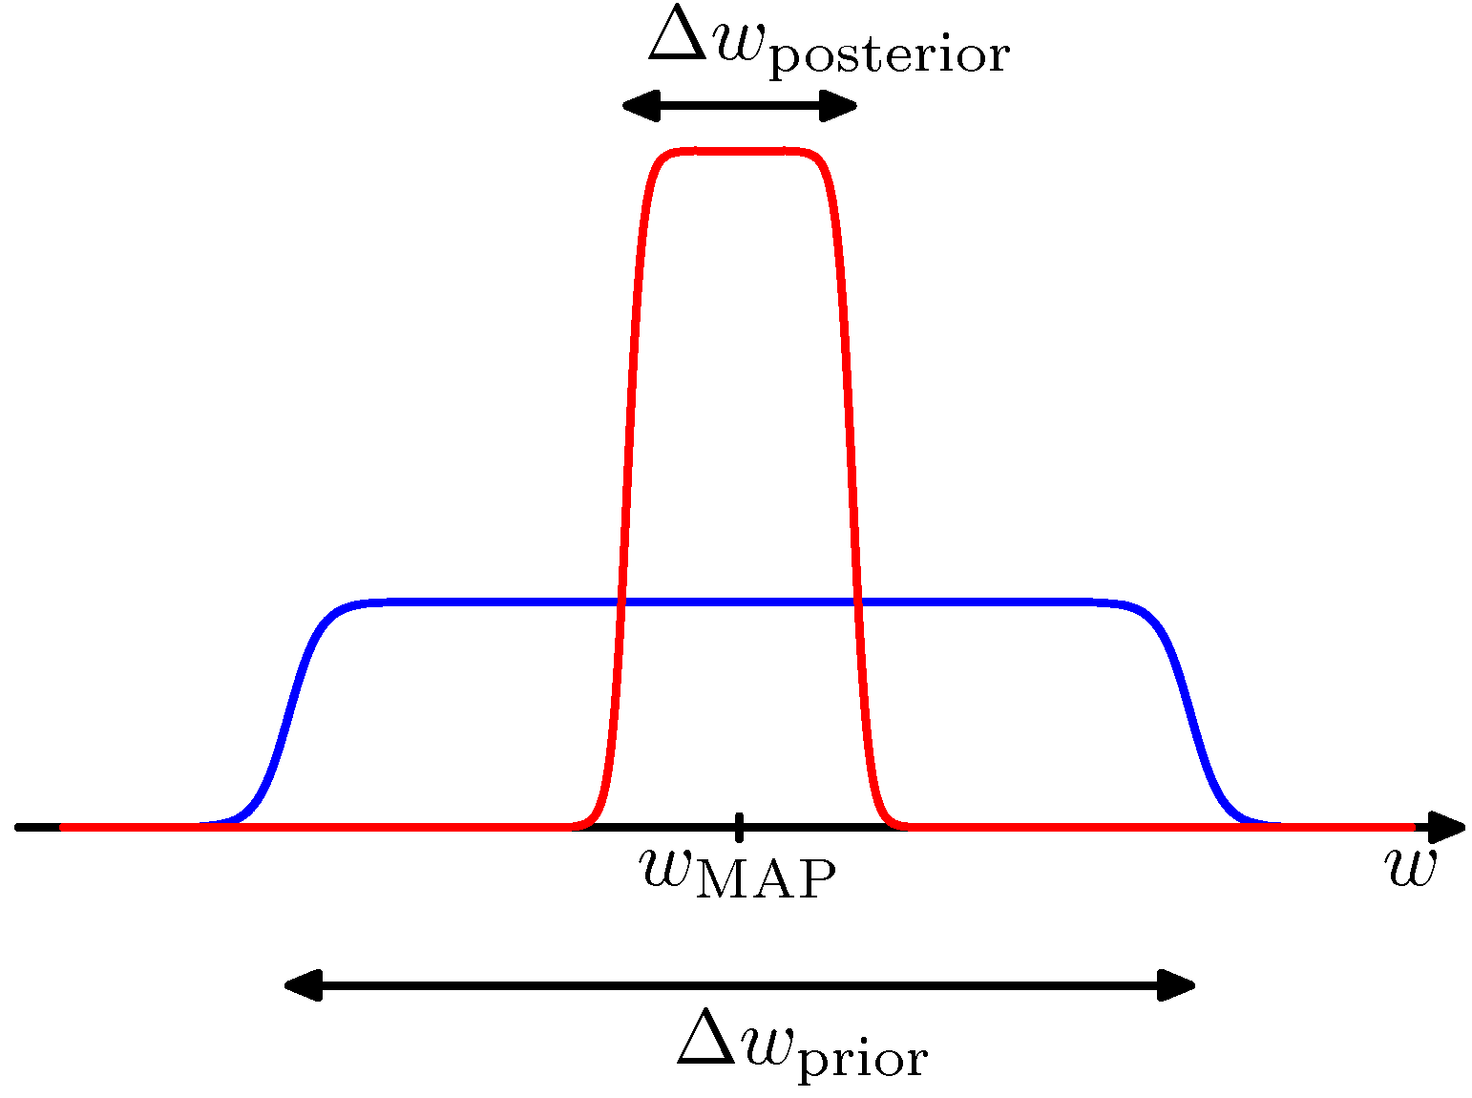
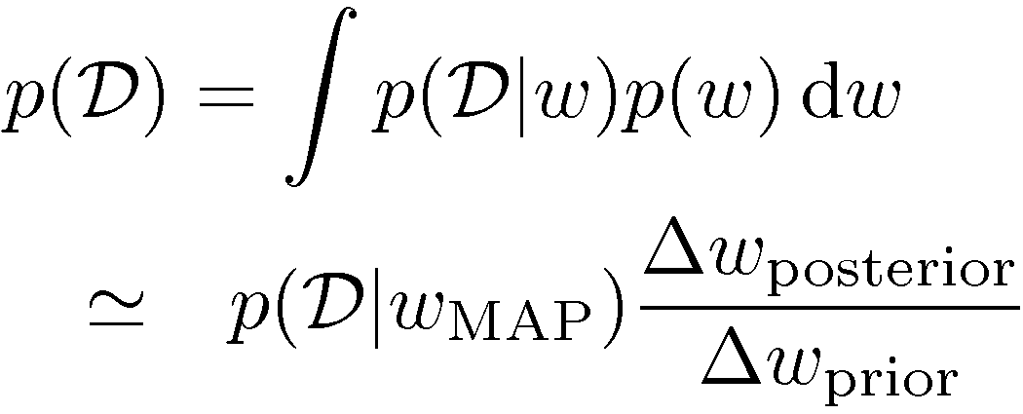
Bayesian Model Comparison (4)
For a given model with a single parameter, w, con-sider the approximation
where the posterior is assumed to be sharply peaked.

Slide 26
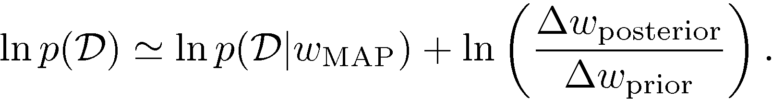

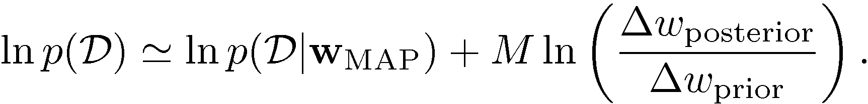
Bayesian Model Comparison (5)
Taking logarithms, we obtain
With M parameters, all assumed to have the same ratio , we get
Negative
Negative and linear in M.

Slide 27
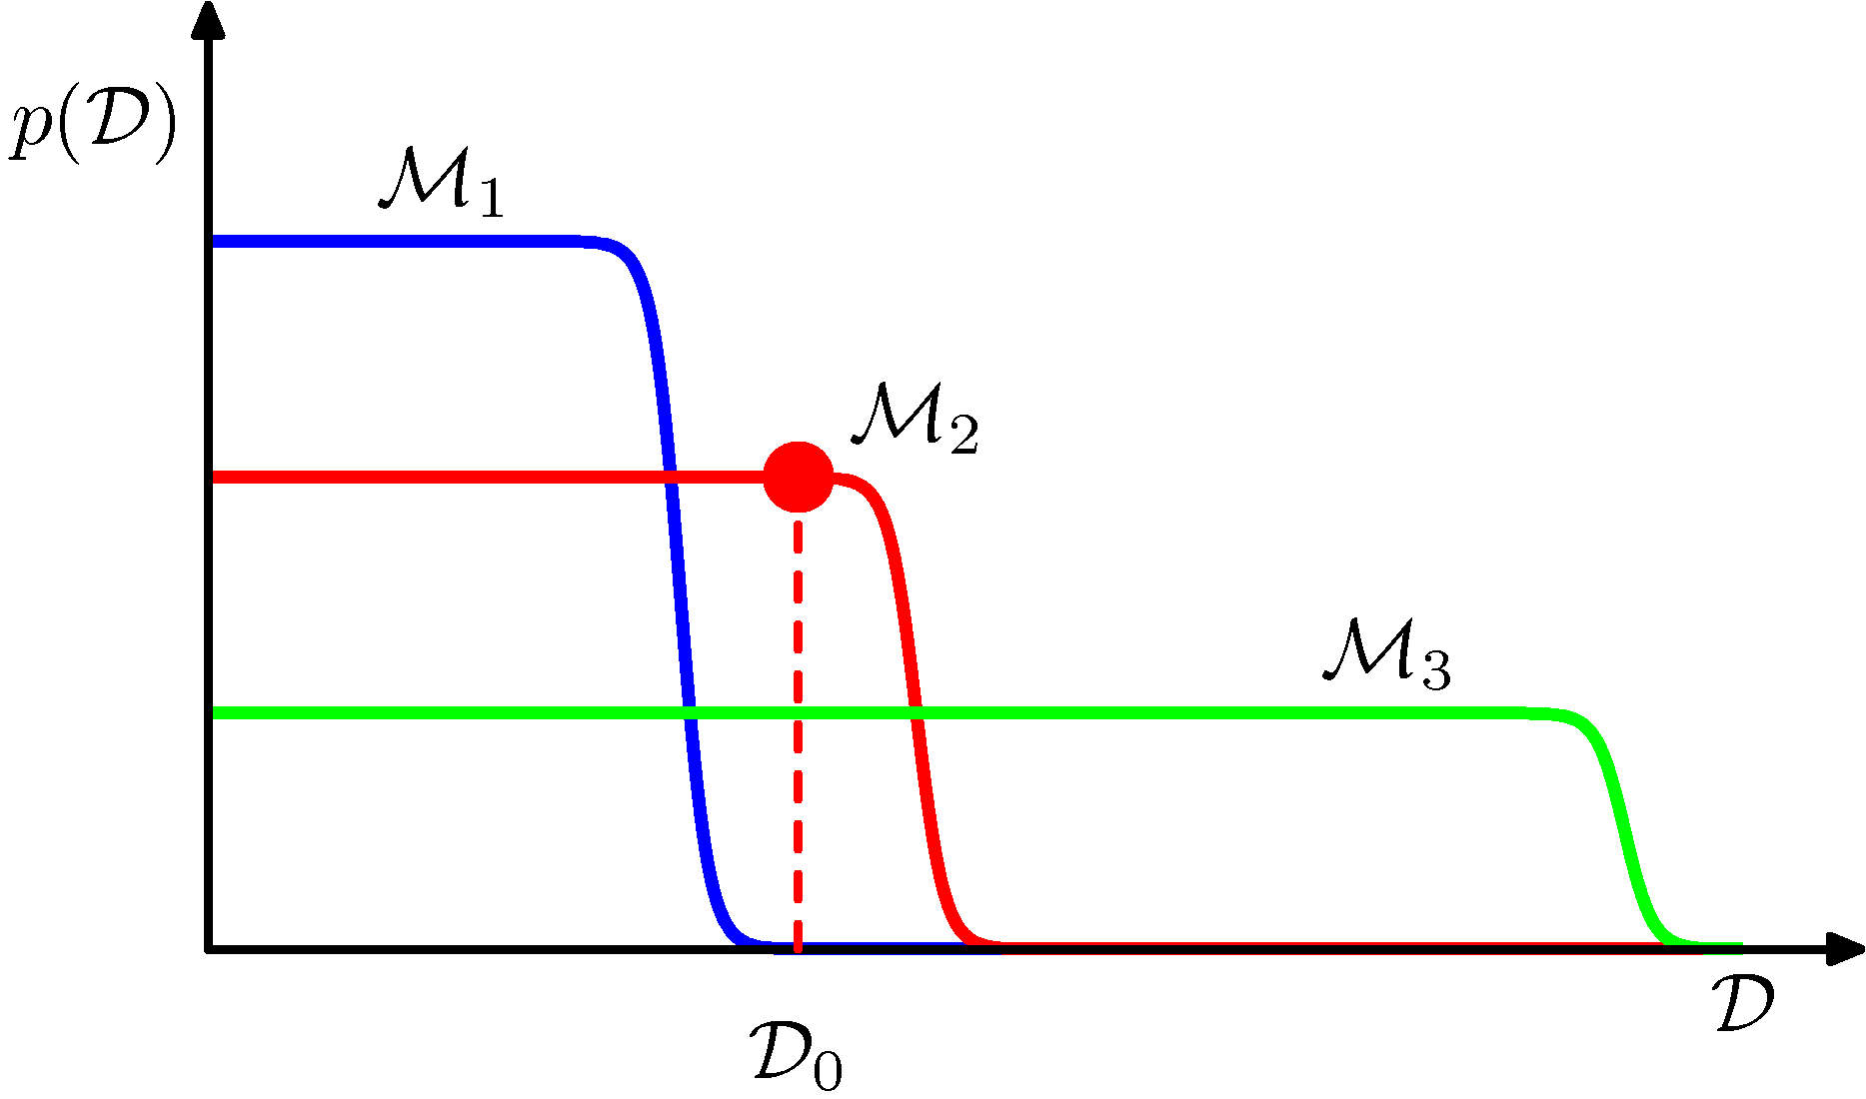
Bayesian Model Comparison (6)
Matching data and model complexity

Slide 28
Limitations of Fixed Basis Functions
M basis function along each dimension of a D-dimensional input space requires M^{D} basis functions: the curse of dimensionality.
Can get away with fewer basis functions, by choosing these using the training data or using infinite models such as Gaussian Processes.

