Slide 1

Hospital Patient Care Operations Analytics
A DATABASE Using MYSQL
Presented By :
SANNAPUREDDY RUPADEVI

Slide 2
About Me
S.RUPADEVI, B.Tech – CSE
Why Data Science?
Data science gives you the ultimate power to predict trends and guide massive choices using everyday data. It has many open roles, high demand, good pay, job flexibility etc..
Work Experience : Fresher
LinkedIn :https://www.linkedin.com/in/rupa-devi-767b1b28a/
GitHub :https://github.com/RUPAREDDY045

Slide 3
Agenda
Objective of the Project
Database Structure
ER Diagram
Key Analysis Questions
Experience/Challenges
Conclusion

Slide 4
Objective of the Project :
The objective of this project is to design and implement an Hospital Patient Care Operations Analytics that efficiently stores and manages hospital-related data within an organization.
The system needs to track various aspects of patients information, including patient demand, appointment behaviour, treatment performance, doctor and room utilization, and operational problems.
The system should ensure the integrity and consistency of data by using relational tables with appropriate foreign keys and cascading actions.
The system should allow for easy management and querying of patient data, providing insights such as hospital operations, patient appointments, medical services, treatment encounters, doctors, and room resources.
The goal is to streamline Hospital operations, ensuring that all relevant patient data is accessible and accurately updated across different modules.

Slide 5
Database Structure :
This project contains 5 interrelated tables:
Doctors
Patients
Rooms
Appointments
Treatments
These tables are connected using Primary Keys and Foreign Keys to maintain relational database integrity.

Slide 6
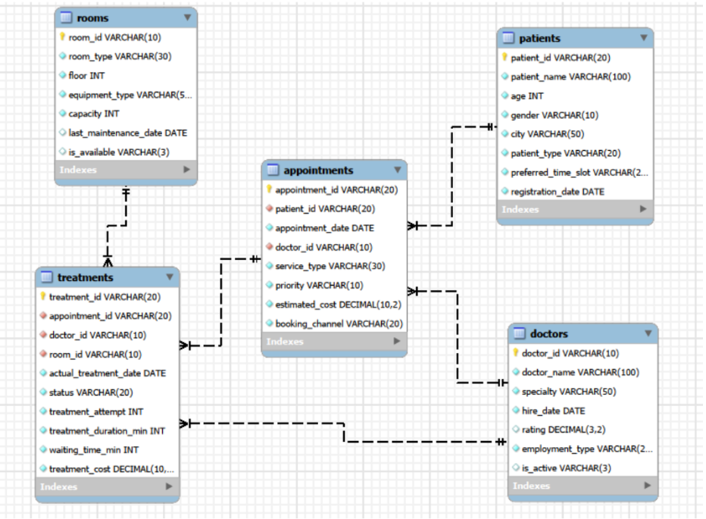
ER Diagram

Slide 7

Key Analysis Questions Patient Insights
What is the total number of patients?
Query :
Output :
The Hospital Patient Care Operations currently contains 400 patients.
The COUNT(distinct patient_id) query successfully retrieves the total number of patients from the PATIENTS table.

Slide 8

What is the total number of appointments?
Query :
Output :
The total number of appointments were identified from the appointments data.
The total number of appointments helps understand the total appointments the hospital have.

Slide 9

What is the total number of treatment records?
Query :
Output :
The query calculates the total number of treatments records of the patients who are appointed in the hospital.

Slide 10

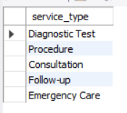
What are the different medical service types?
Query :
Output :
The query identifies the different medical service types, helping recognize the available medical services in the hospital.

Slide 11

How many doctors are currently active?
Query :
Output :
The query calculates the doctors who are currently active, providing an overview of the active doctors.

Slide 12

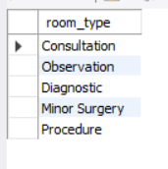
What are the different room types?
Query :
Output :
The query identifies the different types of rooms available, helping understand the different types of rooms different patients.

Slide 13


What is the total estimated appointment value?
Query :
Output :
The query calculates the estimated treatment cost, helping to know the total estimated cost for the treatments in the hospital.

Slide 14


What is the average treatment duration?
Query :
Output :
The query identifies the treatment duration, helping to know the average treatment time the doctors take to treat the patients.

Slide 15
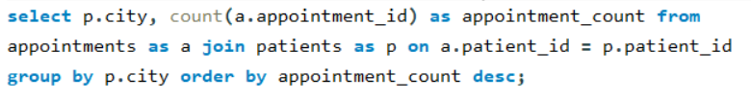
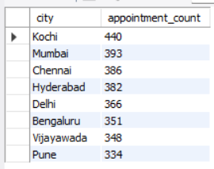
Compare appointment volume across cities.
Query :
Output :
The query calculates the total appointments from each city, helping identify the city with most and least appointments.

Slide 16
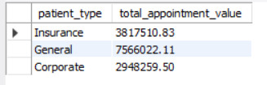
Compare estimated appointment value across patient types.
Query:
Output:
The query calculates the cost of appointments by the type of payment methods the patient is using to pay the bill.

Slide 17
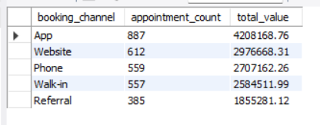
Examine booking channels and their contribution to demand.
Query :
Output :
The query identifies the number of appointments booking from different booking channels and estimated treatment cost, helping understand the number of appointments have book booked from different booking channels and total estimated treatment cost from each booking channel.

Slide 18
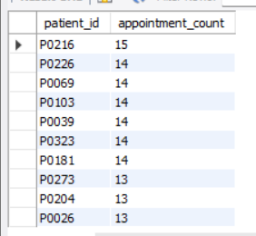
Compare patients by number of appointments.
Query :
Output :
The query compares the patients with their number of appointments booked, helping to understand which patient booked how many appointments.

Slide 19

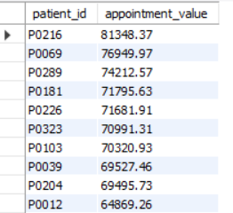
Identify patients with higher cumulative estimated appointment value.
Query :
Output :
The query identifies the patients with most estimated appointment cost, helping to compare patients with most and least estimated appointment costs.

Slide 20
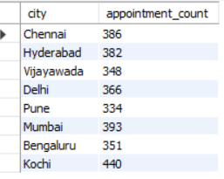
Compare patient activity across cities.
Query :
Output :
The query compares the cities with highest appointments, helping to understand the cities with most and least appointment counts.

Slide 21
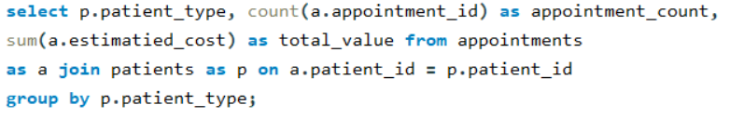
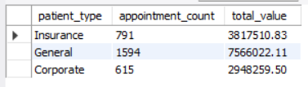
Compare General, Corporate, and Insurance patients.
Query :
Output :
The query identifies patients taking appointments by different methods like insurance, general and corporate, helping to estimate the treatment cost from each type of appointment.

Slide 22


Examine treatment duration and waiting time.
Query :
Output :
The query identifies the average treatment duration and waiting time, helping to understand the time taken for treatment and waiting time.

Slide 23
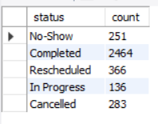
Compare Completed, Cancelled, No-Show, Rescheduled, and In Progress outcomes.
Query :
Output :
The query counts the treatments which are no-show means not shown to take treatment, treatment completed, rescheduled, in progress, and cancelled treatments, helping compare the treatment status and its counts.

Slide 24
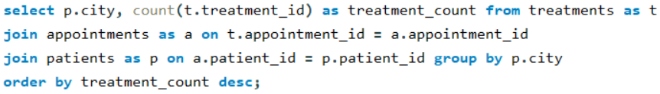
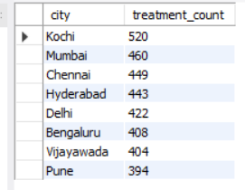
Identify areas with higher treatment activity or proper outcomes.
Query :
Output :
The query identifies the cities with higher treatment appointments, helping to find out the city with highest appointments.

Slide 25

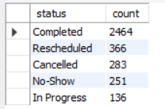
Find common problem statuses and patterns.
Query :
Output :
The query finds the total counts treatments which are completed, rescheduled, cancelled, no-show, and in-progress statuses, providing information that most of the treatments are completed.

Slide 26
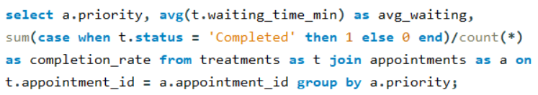
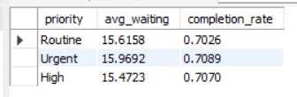
Investigate whether priority level is associated with waiting time or treatment outcomes.
Query :
Output :
The query compares the priority of treatments with waiting time and completion rate.

Slide 27
Challenges / Experiences:
Learned real-time database design.
Worked with multiple related tables.
Practiced SQL joins and aggregate queries.
Creating correct foreign key relationships.
Maintaining data consistency.
Writing complex JOIN queries.
These challenges were solved using Primary Keys, Foreign Keys, JOIN operations, GROUP BY, SUM(), AVG(), and COUNT() functions.

Slide 28
Conclusion :
Successfully designed and implemented an Hospital Patient Care Operations Analytics using MySQL.
Managed five interrelated tables for doctors, patients, rooms, appointments, treatments.
Used SQL queries, joins, and aggregate functions to generate meaningful patients and appointments insights.
Improved understanding of relational database design, foreign keys, data integrity, and SQL-based analysis.
“This project helped me understand how SQL can be used to manage real-world hospital data and generate meaningful business insights. Thank you.”

Slide 29

THANK YOU

