Slide 1
MACHINE LEARNING CAPSTONE PROJECT
Bank Loan Approval Prediction
A Machine Learning pipeline that predicts whether a bank loan application will be approved or rejected
Rupjit Das • BCA 3rd Year • Banking & Financial Services

Slide 2
THE CHALLENGE
The Problem & The Data Behind It
PROBLEM
614
13
Predict whether a loan application will be Approved or Rejected, using applicant demographic, financial, and credit data.
Applications
Features
OBJECTIVE
422 / 192
0
Give banks a faster, more consistent, data-driven way to support loan-approval decisions.
Approved / Rejected
Duplicates
KEY FEATURE GROUPS
Demographic: Gender, Married, Dependents, Education
Binary classification • Mixed feature types • Missing data in 7 columns
Financial: Income, Loan Amount, Loan Term
Credit & Location: Credit History, Property Area
Bank Loan Approval Prediction — Capstone Project
2

Slide 3
OUR APPROACH
From Raw Data to Model-Ready Features
1
2
3
4
5
→
→
→
→
Clean
Missing Data
Explore
(EDA)
Encode
Categories
Split &
Scale
Train 3
Models
KEY INSIGHT FROM EDA
69% of applications were approved historically — a moderately imbalanced target.
WHY THIS MATTERS
Because approvals dominate the data, accuracy alone can mislead. Precision, Recall & F1 were used to judge models fairly.
Demographics (gender, education, employment) barely move approval rates — the decision is driven by financial & credit factors, not applicant profile.
Bank Loan Approval Prediction — Capstone Project
3

Slide 4
MODELING
Three Models Trained & Compared
BEST MODEL
Logistic Regression
Accuracy
78.86%
Precision
75.96%
Recall
98.75%
F1-Score
85.87%
Tied with Random Forest on accuracy — chosen for higher recall and easier explainability in a lending context.
Bank Loan Approval Prediction — Capstone Project
4

Slide 5
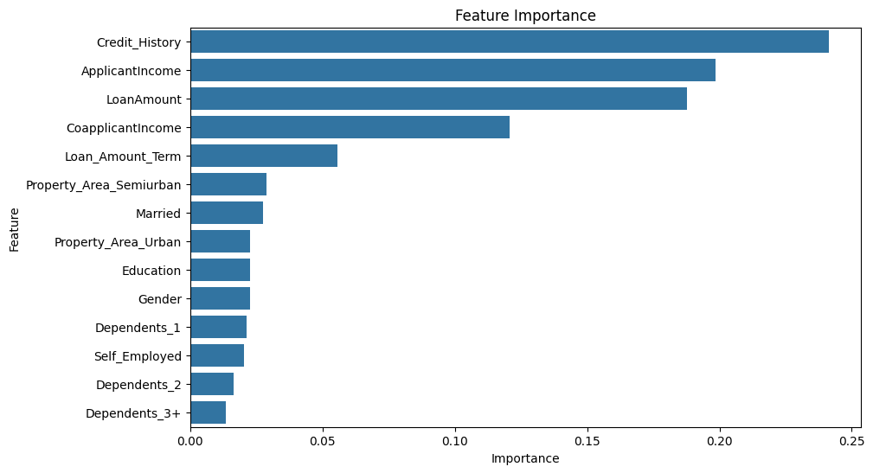
WHAT DRIVES APPROVAL
Credit History Is the #1 Predictor
TOP 3 FEATURES
Credit_History
24.1%
ApplicantIncome
19.9%
LoanAmount
18.8%
INSIGHT
Credit history alone accounts for the largest share of predictive power — followed by income and loan size. Demographics rank lowest, confirming the decision is financially driven.
Bank Loan Approval Prediction — Capstone Project
5

Slide 6
IMPACT & NEXT STEPS
What This Means & Where It Goes Next
BUSINESS IMPACT
SUGGESTED NEXT STEPS
1
Train the already-imported XGBoost model
⚡
Faster, data-driven second opinion alongside manual review
2
Hyperparameter tuning (GridSearchCV)
3
Handle class imbalance (weighting / SMOTE)
🎯
Focuses reviewer effort on borderline / risky applications
4
Engineer features (e.g. Total Income)
5
Deploy behind a simple API / web form
🔍
Explainable — officers can see which factors drove a prediction
Best used today as a decision-support tool alongside human underwriters — not a fully automated approval system.
Bank Loan Approval Prediction — Capstone Project
6

Slide 7
CONCLUSION
A Complete, Working ML Pipeline for Loan Approval
From raw, messy applicant data to a saved, compared set of trained models — every stage was implemented and validated.
78.86%
98.75%
3
Credit
History
Best Accuracy
Best Recall
Models Compared
Top Predictor
Thank you
Rupjit Das • BCA 3rd Year • Bank Loan Approval Prediction Capstone

