Slide 1
Customer Shopping Behavior Analysis
An end-to-end data analytics project using Python, PostgreSQL and Power BI
October 2026
Notes:
Welcome. This project analyzes the shopping behavior of 3,900 customers to find what drives spending and how the business can grow.

Slide 2
Project Overview
Goal: understand who our customers are, what they buy and what drives their spending, then turn it into clear business actions.
Python
PostgreSQL
SQL
Power BI
→
→
→
Clean and prepare data
Store the data
Answer 10 business questions
Build the dashboard
3,900 customers | 18 data columns | 25 products in 4 categories | 50 US states
Notes:
The data was cleaned in Python, stored in PostgreSQL, analyzed with SQL, and presented in Power BI. The dataset has one row per customer.

Slide 3
Data Cleaning and Preparation
1
Checked the data: structure, data types and missing values
2
Fixed 37 missing ratings: filled with the median rating of each category
3
Renamed columns: snake_case names to make SQL easier
4
Created new columns: age_group and purchase_frequency_days
5
Removed a duplicate column: promo_code_used was identical to discount_applied, then loaded the data into PostgreSQL
Notes:
Only Review Rating had missing values, 37 rows or under 1 percent. The age groups are quartiles: 18-31, 32-44, 45-57 and 58-70.

Slide 4
The Business at a Glance
$233K
3,900
$59.76
3.75 / 5
Total revenue
Customers
Average purchase
Average rating
Clothing and Accessories bring 76% of revenue
Outerwear is the smallest category at 8%
Average purchase is about $60 in every category
Notes:
Revenue is $233,081 in total. Clothing is $104K and Accessories $74K. Customers spend a very similar amount whichever category they buy from.

Slide 5
What the SQL Analysis Showed
Gender
Subscribers
Discounts
$60.25 vs $59.54
27% subscribe
43% of purchases
Women vs. men average spend. Men bring more revenue only because there are more male customers.
Subscribers do not spend more ($59.49 vs. $59.87 for non-subscribers).
Discounted purchases are not bigger ($59.28 vs. $60.13). Hats and Sneakers are discounted most.
Customer segments
Shipping
Age groups
80% are Loyal
$60.48 vs $58.46
Ages 18-31 lead
Only 2% of customers are new, so growth relies on the existing loyal base.
Express vs. Standard average purchase. A small gap of about $2.
Young Adults bring the most revenue ($62K), but all age groups are close.
Notes:
These are the headline answers from the 10 SQL queries. The main message: subscriptions and discounts are not increasing how much customers spend.

Slide 6
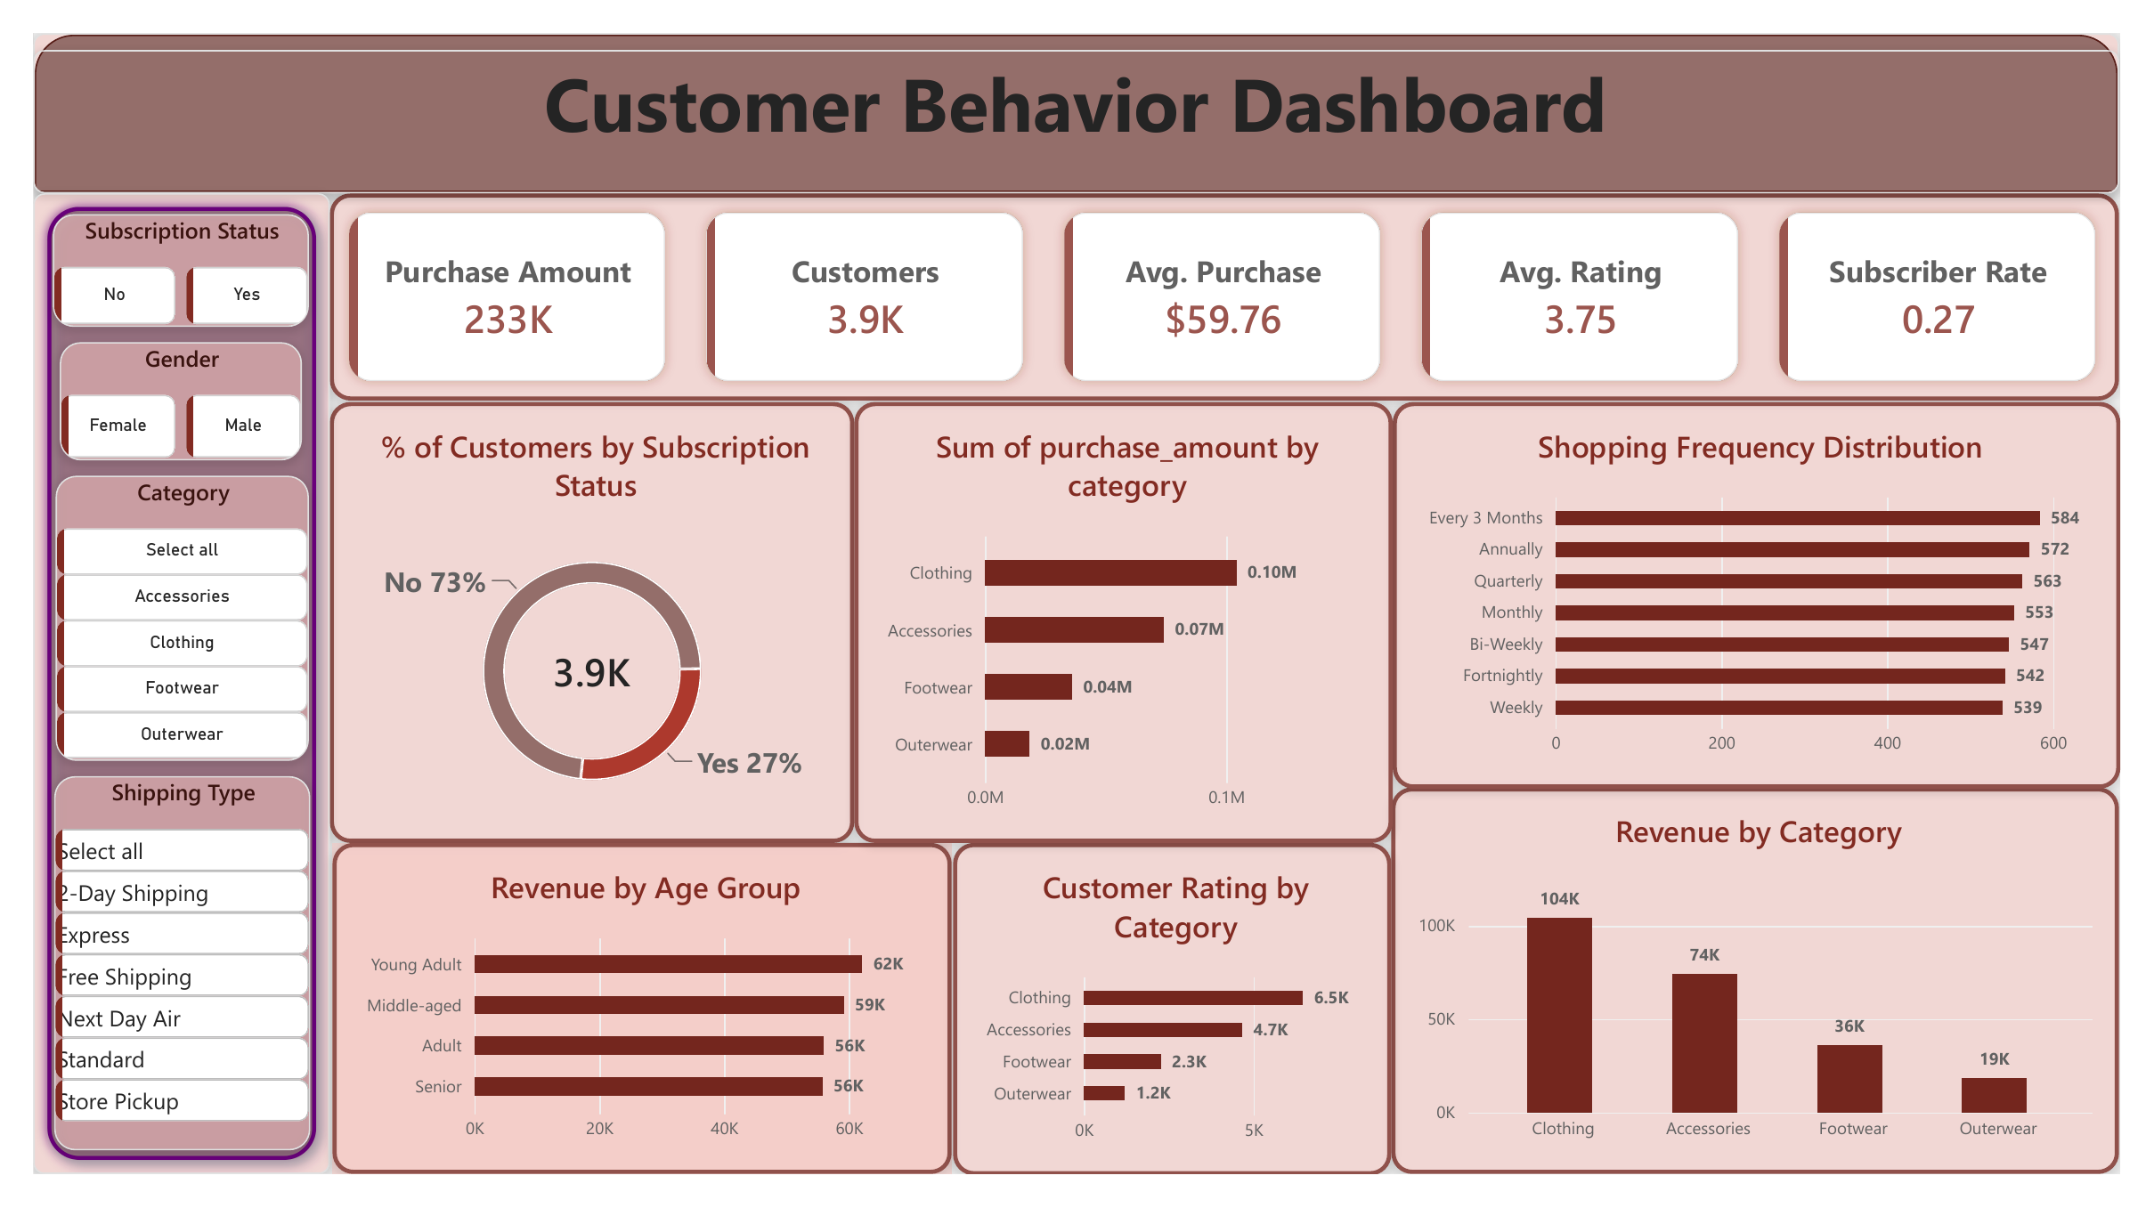
Power BI Dashboard
Notes:
The dashboard has filters for subscription, gender, category and shipping type, five KPI cards, and charts for subscription split, revenue by category, shopping frequency, revenue by age group and rating.

Slide 7
Recommendations and Conclusion
1
Improve subscriptions: add real benefits and offer free trials to repeat buyers
Conclusion
2
Cut unnecessary discounts: test fewer discounts on Hats, Sneakers and Coats
Our customers are loyal and evenly spread across ages and regions. Subscriptions and discounts are not raising spend, so the biggest chances are smarter offers, more new customers and stronger Outerwear sales.
3
Win new customers: only 2% are new, so run first-purchase offers
4
Attract more women: same spend as men, but only 32% of customers
5
Boost Outerwear: just 8% of revenue, so bundle it with Clothing
Notes:
Many differences between groups are small, so they should be tested for statistical significance before big decisions. Next steps: add date and cost data for trend and profit analysis.

