Slide 1

Smart Home System
Group 12

Slide 2

Smart Audio System
Alexa Integration
Access Amazon Alexa anywhere in your home
Expand Capabilities with Alexa Functions
Indoor User Positioning System
Automatically plays audio closest to the user
As user moves from one location(in home) to another,system tracks location and “moves” with the user.

Slide 3

Smart Scheduling System
Dynamic Alarm
Sets Wake-Up Time Based on Commute Condition
Notifies User Best Time to Leave
Day Scheduler
Sends Notification of Events

Slide 4
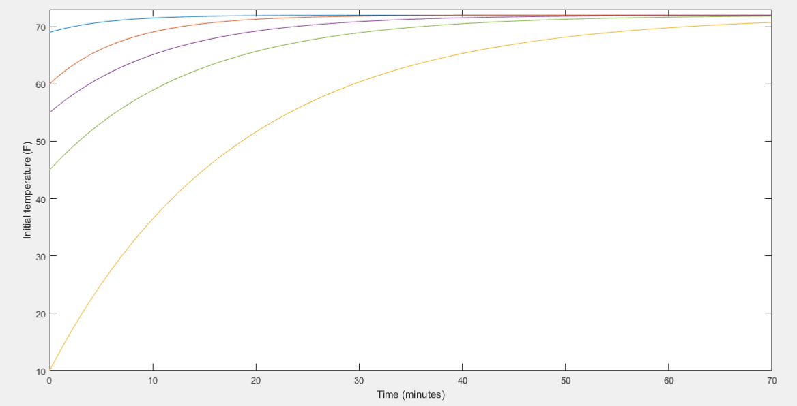
Smart Energy System
Regulate Temperature
Newton’s Law of Cooling
Time to Temperature

Slide 5
Plan moving forward...

Slide 6
Image References
http://www.iene.eu/1/announcements-c38.html
https://transportation-forms.stanford.edu/cost/
http://www.clker.com/clipart-play-audio.html

