Slide 1

Smart Home System
Group 12

Slide 2

Smart Home System

Slide 3
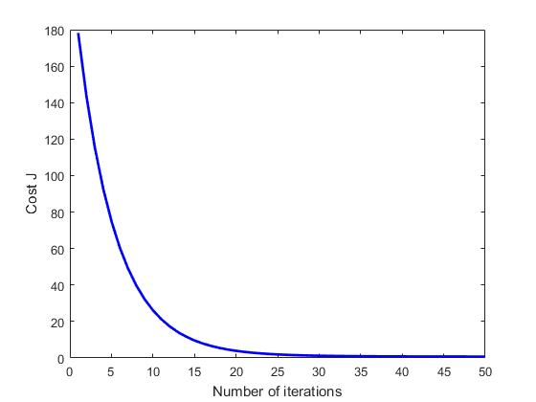
Linear Regression Parameter Learning

Slide 4
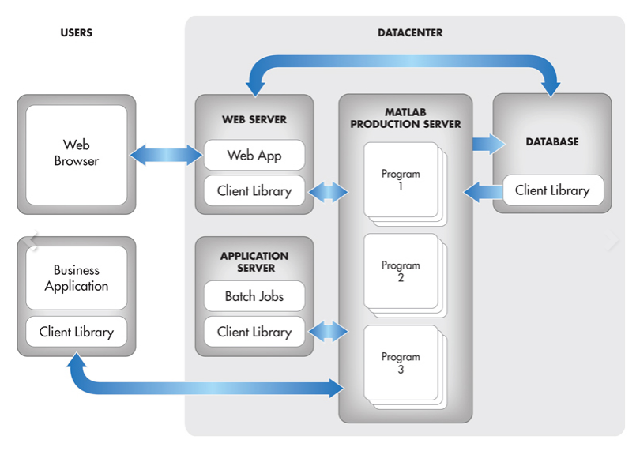

Slide 5

Smart Scheduling System
Dynamic Alarm
Sets Wake-Up Time Based on Commute Condition
Notifies User Best Time to Leave
Day Scheduler
Sends Notification of Events

Slide 6

Smart Audio System
Alexa Integration
Access Amazon Alexa anywhere in your home
Change the settings of your smart home with the custom Alexa skill
Indoor User Positioning System
Automatically plays audio closest to the user
As user moves from one location(in home) to another,system tracks location and “moves” with the user.

