Slide 1
School of Computer Science & Engineering
AI Application Development
Smart Timetable management and teacher replacement system

Slide 2
Team members & roles
Team members | Role
Praveen D N | Team Lead
Mounish M | Customer Contact Lead
Praveen D N | Development Lead
K Rushikesh | Test Lead
Manik Prabhu | Developer
K Sai Kiran, Sathishkumar V, Bille Arun Kumar | DevOps / GitHub / Product Build / Documents
Notes:
Talk about how they are managing their documents, how google docs does automatic versioning
As them what they know about Android and IoS versions

Slide 3
Smart Timetable Management and Teacher Replacement System
In most educational institutions, timetable creation is done manually, which takes significant time and effort.
Managing teacher availability and handling last-minute absences is difficult, often leading to confusion and class disruptions.
There is no proper system to assign substitute teachers based on subject expertise and availability.
We interacted with lecturers to understand real challenges faced in timetable management and teacher substitution.
Substitute teachers may not match the subject expertise.
Notes:
Talk about how they are managing their documents, how google docs does automatic versioning
As them what they know about Android and IoS versions

Slide 4
User/ Customer Understanding
1: How do you currently create the timetable?
Timetable is created manually using Excel or paper, which takes a lot of time and effort.
2: What challenges do you face during timetable creation?
It is difficult to manage multiple subjects, teachers, and constraints, which often leads to conflicts.
3: What happens when a teacher is absent?
We manually try to find a substitute teacher, which takes time and may not always be effective.
4: How do you assign substitute teachers?
Usually based on availability at that moment, not necessarily based on subject expertise.
5: What problems occur during teacher replacement?
Replacement teachers may not match the subject, causing quality issues and confusion.
6: What kind of solution would you prefer?
An automated system that can generate timetables and assign substitute teachers efficiently.
Notes:
Talk about how they are managing their documents, how google docs does automatic versioning
As them what they know about Android and IoS versions

Slide 5
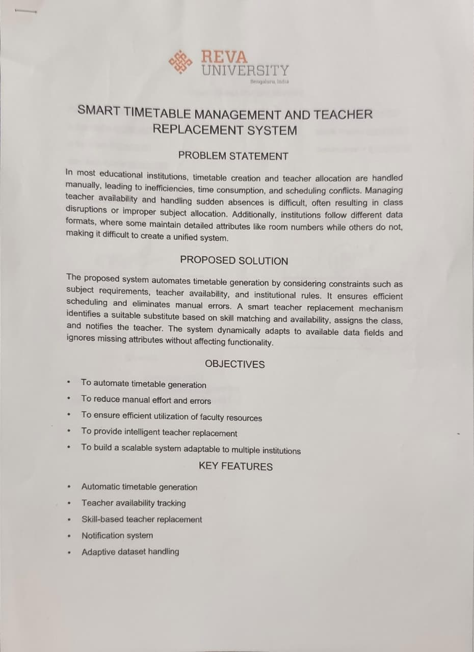
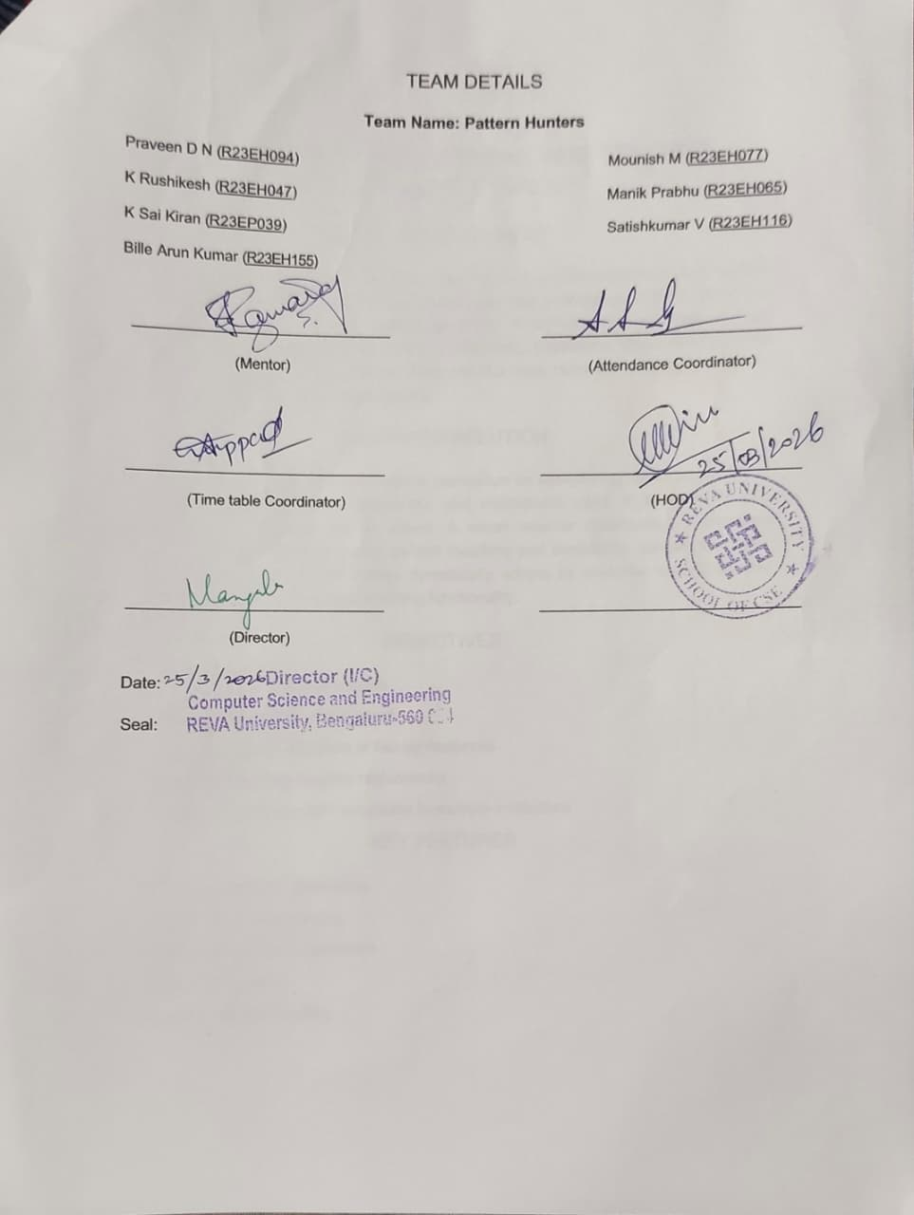
User/ Customer Understanding

Slide 6
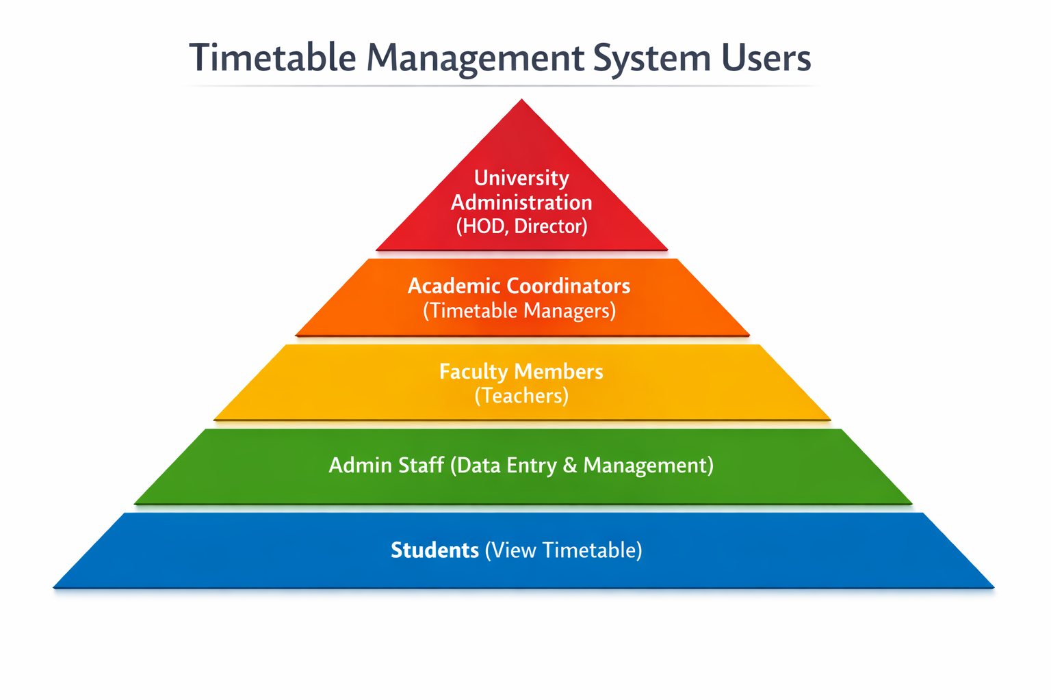
Ideal Customer Profile (ICP)
Demographics
Educational Institutions (Schools, Colleges, Universities)
Admin Staff / Timetable Coordinators
Faculty Members (Teachers, Professors)
Medium to Large Institutions (multiple departments)
Institutions using digital systems (basic or advanced)
Psychographics
Prefer automation over manual work
Face frequent timetable conflicts and scheduling issues
Need quick solutions for teacher absence
Want efficient resource (faculty) management
Open to adopting smart/digital systems
Notes:
Only stress on the 1st sentence – the definition
Come back to the 2nd sentence in the end as part of revision

Slide 7
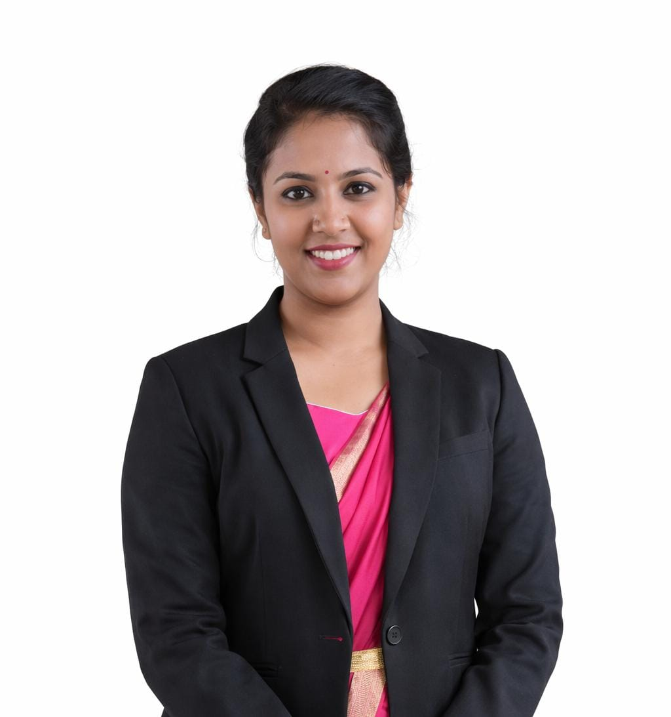
Customer Persona (CP)
Name : Mrs. Deekshitha Gowda
Age : 28 years
Education : M.Tech
Locality : Urban / Semi Urban
Hobbies & Interests : Reading, Administration work
Lifestyle : Busy, Responsible, Time-bound
Device habits : Uses laptop/desktop more
What influences the person : Efficiency, accuracy, time-saving solutions
Notes:
Only stress on the 1st sentence – the definition
Come back to the 2nd sentence in the end as part of revision

Slide 8
Product USP
• Fully automates timetable generation and teacher replacement, reducing manual effort and errors.
• Intelligently assigns substitute teachers based on subject expertise and availability.
• Adapts to different institutional data formats, making it flexible and scalable.
• Handles real-time changes and provides instant notifications, ensuring smooth academic operations.
• Integrated notification system for instant communication and faster response.
• Centralized platform for managing scheduling and substitutions across departments.
• Handles real-time changes like sudden teacher absence without disrupting academic flow.
Notes:
Only stress on the 1st sentence – the definition
Come back to the 2nd sentence in the end as part of revision

Slide 9
Use Cases & High level Requirements
Use Case 1: Timetable Generation
Input: Subjects, teacher data, availability, constraints.
Output: Automatically generated conflict-free timetable.
Use Case 2: Teacher Replacement
Input: Teacher marked absent.
Output: Substitute teacher assigned based on subject and availability.
Use Case 3: Late Arrival Handling
Input: Teacher marked late.
Output: Temporary replacement assigned for that
period.
Notes:
Only stress on the 1st sentence – the definition
Come back to the 2nd sentence in the end as part of revision

Slide 10
Use Cases & High level Requirements
Use Case 4: Room Allocation Handling
Input: Room unavailable (placement/training usage).
Output: Updated classroom assignment with notification.
Use Case 5: Workload Management
Input: Weekly teaching hours and faculty data.
Output: Balanced workload distribution among teachers.

Slide 11
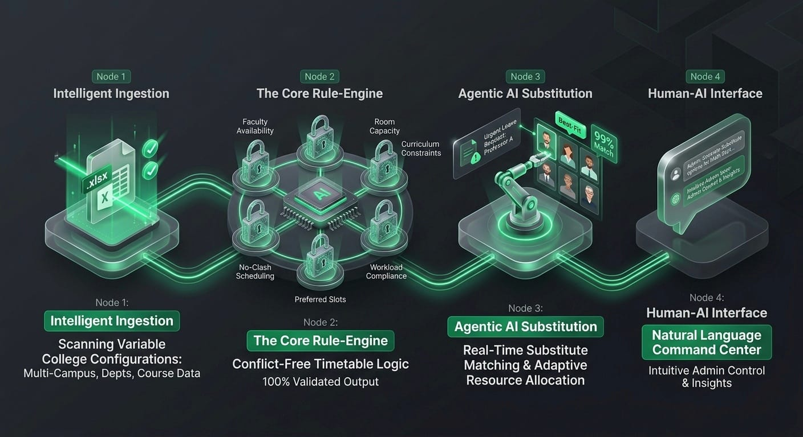
Proof of Concept (PoC) / Prototype Demo
Notes:
Only stress on the 1st sentence – the definition
Come back to the 2nd sentence in the end as part of revision

Slide 12
Thank you

