Slide 1

BACHELOR OF TECHNOLOGY
IN
Artificial Intelligence and Machine Learning
(MR20-1CS0132)- Machine Learning Explore
III Year - I Semester
Project Guide: Proff. Sameera Sulthana
Department of AIML, School of Engineering
Malla Reddy University Hyderabad.
Batch Number: ST09
Roll Numbers and Names :
2111cs020412-Rushi Eshwar Reddy Neelam 2111cs020413-D.Rushika 2111cs020414-K.Rushindra 2111cs020415-P.Rushitha 2111cs020416-Ch.Sadwik 2111cs020417-B.Sahithi

Slide 2
INTRODUCTION
Project Title
Prediction of chronic kidney disease using machine learning perspective.
Abstract:
In the modern world, chronic kidney disease has become one of the most hazardous diseases. CKD is a condition in which the kidney cannot perform the proper filtering of the blood or it stooped working completely which causes the left toxic into the blood, which leads the patient to death. It is likely impossible to detect CKD in the early stages, and it is very difficult to save patient’s lives in the last stage of CKD. A patient's life can be saved by renal transplant or the early detection the CKD. Machine Learning algorithm techniques have played a very important role in CKD prediction. Past medical test, reports can also be used as a tool for the early detection of renal disease. Machine Learning (ML) Techniques like RandomForestClassifier is used in this review. We have to find out that Decision Tree has shown the best result of 97.5% of accuracy. Generally, the majority of the algorithms are based on supervised learning and classification problem solving. We have explained some important attributes, which play a major role in early CKD Prediction and Detection. Every attribute has its specific effect on CKD. The previous researchers have done many experiments to get the best attribute and best ml technique for the prediction. in this paper, we have studied all related ML techniques, and important Attributes and discussed the measurement factor for CKD prediction.

Slide 3
Data Set Description
The dataset here we use is the publically available CKD dataset. Out of 25 attributes,11 are numeric and 14 are nominal attributes. The data set contains number of missing values. Here the information of dataset uses the patients data like age, blood pressure, specific gravity, albumin, sugar, red blood cells etc. The data set contains number of missing values. We use the following representation to collect the dataset:
age - age
bp - blood pressure
sg - specific gravity
al - albumin
su – sugar
rbc - red blood cells
pc - pus cell
pcc - pus cell clumps
ba - bacteria
bgr - blood glucose random
bu - blood urea
sc - serum creatinine
sod - sodium
pot – potassium
hemo - hemoglobin
pcv - packed cell volume
wc - white blood cell count
rc - red blood cell count
htn - hypertension
dm - diabetes mellitus
cad - coronary artery disease
appet - appetite
pe - pedal edema
ane – anemia
class - class

Slide 4
Data Pre Processing Techniques
Cleaning Noisy Data: Removing outlier and smoothening noisy data is an important part of preprocessing. Outliers are values that lies away from the range of the rest of the values. In clinical data, outliers may arise from the natural variance of data. The potential outliers are the data points that fall above Q3 + 1.5(IQR) and below Q1 − 1.5 (IQR), where Q1 is the first quartile, Q3 is the third quartile, and IQR = Q3 − Q1 .
Handling Missing Values: Data is not always available (or missed) due to equipment malfunction, inconsistent with other recorded data and thus deleted, not entered into the database due to misunderstanding, some data may not be considered important at the time of entry.
Handling Categorical Data: In this step, data has been transformed into the required format. The nominal data converted into numerical data of the form 0 and 1. For instance, ‘Gender’ has the nominal value that can be labeled as 0-for female and 1-for male. After preprocessing the data then the resultant CSV file comprises all the integer and float values for different CKD related features.

Slide 5
Model Selection-Model Development
Random Forest Regression:
Random forest algorithm constructs multiple decision trees to act as an ensemble of classification and regression process.
A number of decision trees are constructed using a random subsets of the training data sets.
A large collection of decision trees provide higher accuracy of results.
The runtime of the algorithm is comparatively fast and also accommodates missing data.
Random forest randomizes the algorithm and not the training data set. The decision class is the mode of classes generated by decision trees.

Slide 6
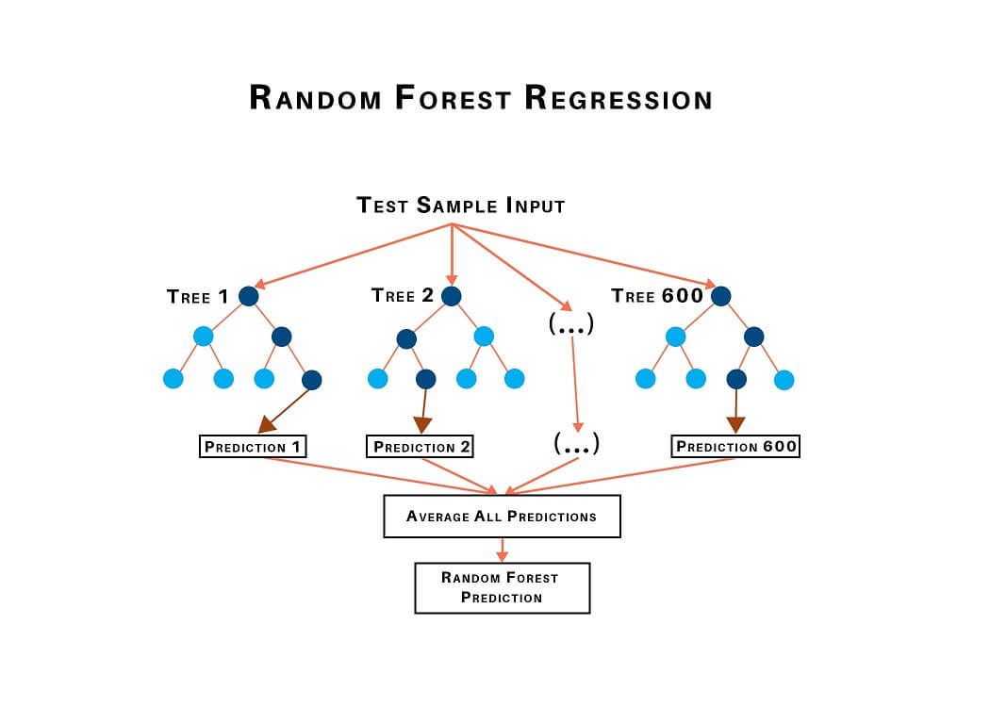
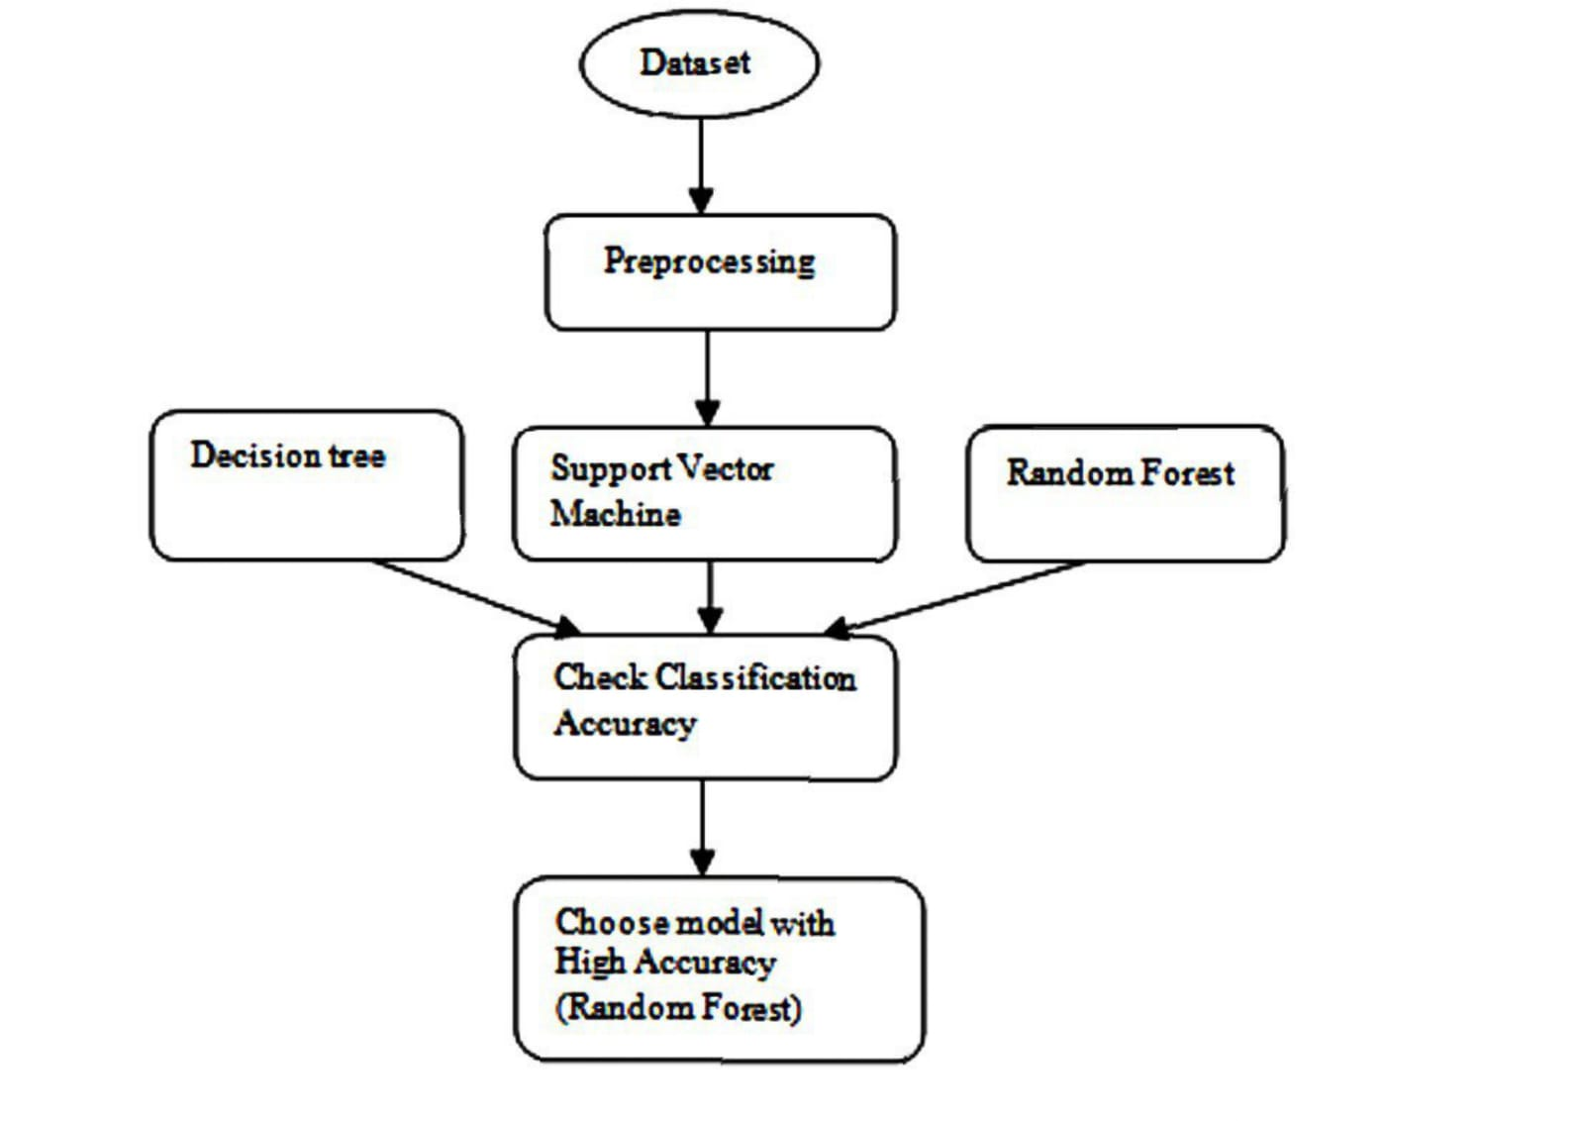
Fig: CKD prediction using machine learning models

Slide 7
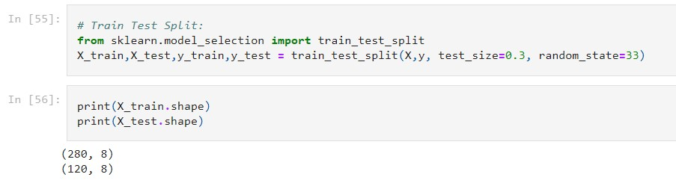
Model Training and Testing
In machine learning projects, we generally divide the original dataset into training data and test data.
We train our model over a subset of the original dataset, i.e., the training dataset, and then evaluate whether it can generalize well to the new or unseen dataset or test set.
Training data makes up for seventy percent of the whole data used, and the rest for test data.
Fig:Representation of Train-Test split using Random Forest

Slide 8
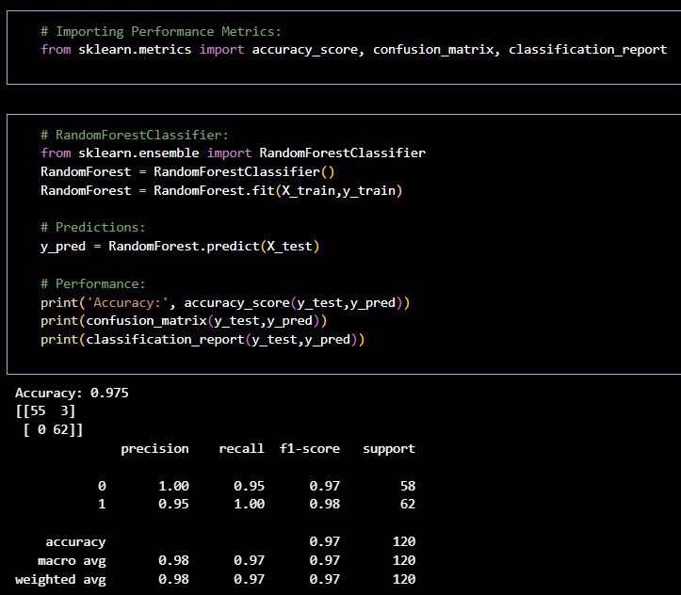
Model Evaluation Metrics
Model evaluation is the process that uses some metrics which help us to analyze the performance of the model. The evaluation also helps to analyze a model’s key weaknesses.There are many metrics like Accuracy,Precision,Confusion Matrix and Mean Square Error.
Under Random Forest Algorithm,we obtain an accuracy of 97.5%.
Model evaluation is the process that uses some metrics which help us to analyze the perf
Model evaluation is the process that uses some metrics which help us to analyze the performance of the model.

Slide 9
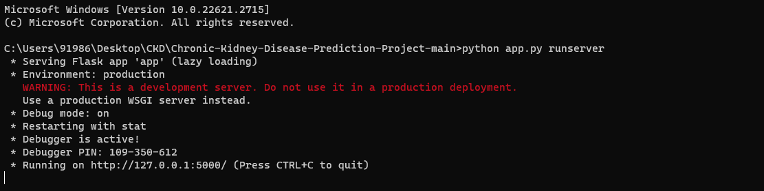
Application Integration & Model Deployment

Slide 10
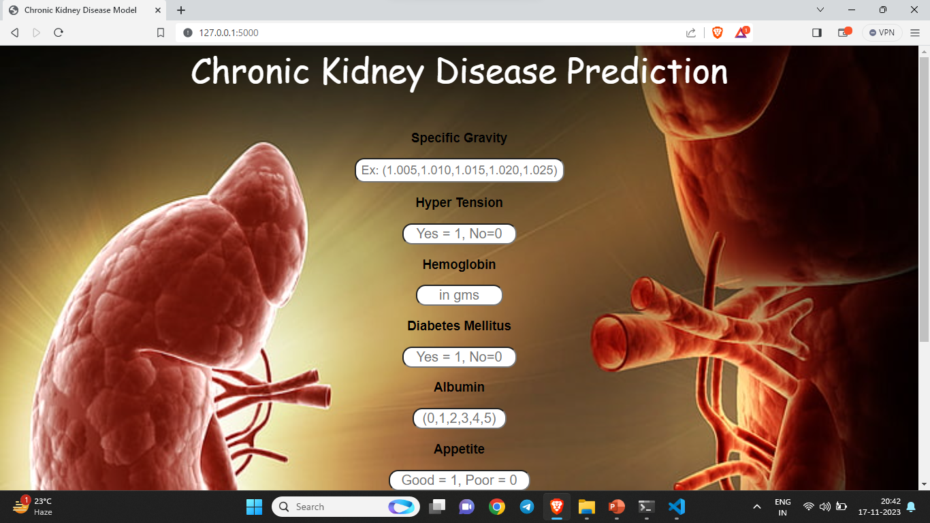

Slide 11
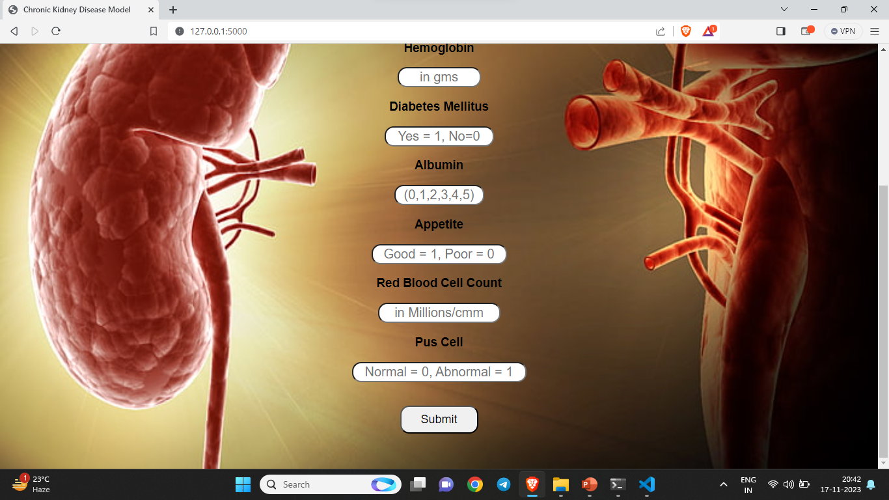

Slide 12


Slide 13


Slide 14
THANK YOU

