Slide 1
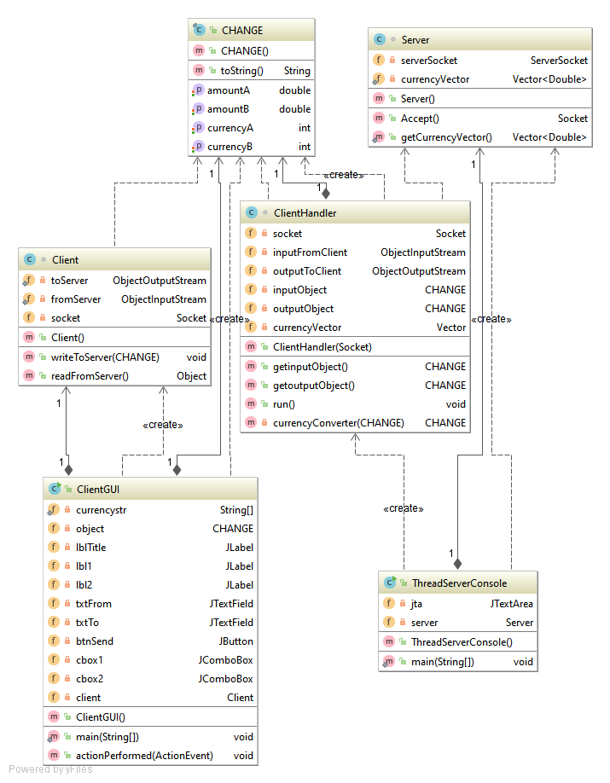
ConvertWeight
ConvertWeight()
weightConvertVector
indexA
getWeightConvertVector() Vector <Double>
indexB
ConvertWeight()
weightConvertVector
ConvertWeight()
(ConvertWeight)
ConvertWeight
ConvertWeight
weightConverter(ConvertWeight) ConvertWeight
switchString
object
lTitle
ConvertWeight()
jTextArea
btnSubmit
cmbFrom
cmbTo

