Slide 1
calculator
Name : Rutuja Gawas
Organization Name: NextHikes IT Solutions
Project Name: Calculator

Slide 2
IMPORTANCE OF PROJECT
I have successfully created the basic calculator as explained during the sessions. This project has helped me better understand the concepts and I am excited about the skills I'm developing in this new role.
My calculator is a simple electronic device that performs basic arithmetic operations including addition, subtraction, multiplication, and division, that functions are created
Also My calculator will also have a clear (C) button that allows you to reset.

Slide 3
LIBRARY
I wanted to share my recent experiences with Tkinter for GUI development. As the name suggests, it's quite intuitive and user-friendly, making it an interesting choice for my project.
1. **User-Friendly**: Tkinter is easy to learn for beginners who are just starting with GUI programming in Python.
2. **Cross-Platform Compatibility**: Applications built with Tkinter can run on different platforms, including Windows, macOS, and Linux, without requiring major changes.
4. **Built-in Features**: It comes with a range of pre-built widgets like buttons, menus, text boxes, and labels, which can help speed up development.
5. **Extensive Documentation**: Tkinter has comprehensive documentation and a supportive community, which makes it easier to find help and resources

Slide 4
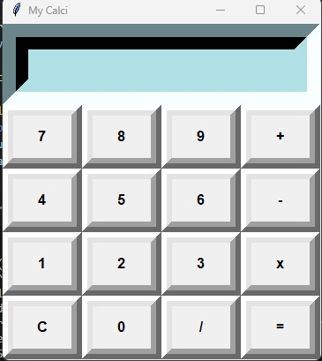
REFERENCE USED
Reference used
My calci
https://youtu.be/tdqUPsDbLLc?si=95yFfMjSDV0Rmms_
https://youtu.be/F5PfbC5ld-Q?si=YBkOhperjwv8H01x
https://youtu.be/KfpkudKkGzY?si=iPdatbNqaDUG7f6G

Slide 5
CHALLENGES
In today’s world with AI its quite easy to do accomplish the task. Though I gone through many videos and got the idea how to accomplish this project. I consider this project as "positive challenge "aiming to learn, grow, and improve. Definitely this projects will encourage individuals to step outside their comfort zones and develop new skills or expand their knowledge.

Slide 6
