Slide 1
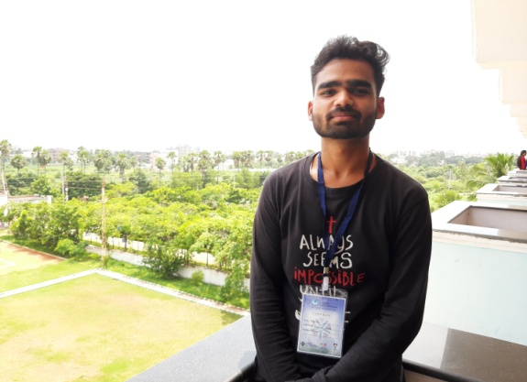
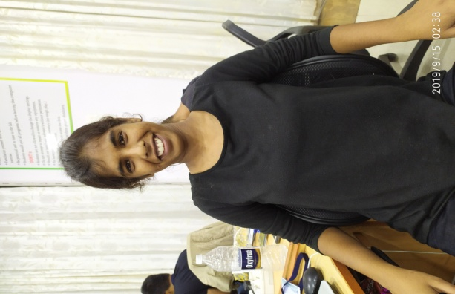

ELECTABUZZ
Rutuja Lahoti Ankit Dongre Tanishq More
TE-IT TE-EEP TE-IT

Slide 2
PROBLEMS (1/2)
“There is going to be a lot of rising demand of power from regions like Asia,Latin,America and parts of Africa”.
Depletion of natural resources.
Increase in pollution rate.
30k-40k Tons of kinetic energy is wasted per highway per day.
WALK FOR GENERATION

Slide 3
PROBLEMS (2/2)
Rate of performance of the older power plants is low as compared to new ones.
Financial crisis of private power generators.
All these things leaves us with the problem, HOW DO WE ENSURE THAT THEN LIGHTS STAY ON??
WALK FOR GENERATION

Slide 4
APPROACH
The world’s scientists agree that we are on a path towards disaster that can only be stopped by weaning ourselves off our fossil fuel habit.
Keeping all the listed problems in our mind for designing our solution ,we came up with an idea of “WALK FOR GENERATION”.
WALK FOR GENERATION

Slide 5
IDEA/INTRODUCTION
This is our step to try to improve the energy crisis in our country.
Our solution is very unique and simple way to solve the problem.
Our solution is to collect and convert wasted kinetic energy from vehicles & mechanical force by footsteps into electrical energy and store it.
WALK FOR GENERATION

Slide 6
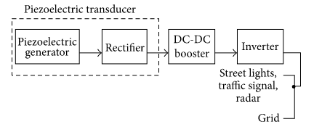
DIAGRAM
WALK FOR GENERATION

Slide 7
FLOWCHART/ WORKING
RUNNING VEHICLE/ FOOTSTEPS OF HUMANS
CREATING PRESSURE ON A PEIZOELECTRIC PLATE
RESULT: GENERATION OF VIBRATIONS ON QUARTZ
VOLTAGE IS INDUCED BY TRANSDUCER
STORING ENERGY IN A RECHARGEABLE BATTERY
POWER CONVERT INTO AC IF REQUIRED
LIGHTING OF BULBS
WALK FOR GENERATION

Slide 8
TOOLS AND TECHNOLOGY USED IN OUR MODEL
NODEMCU (ESP8266)
BREADBOARD
CAPACITOR(47* 10^{(-6)F})
BRIDGE RECTIFIER
PIEZOELECTRIC TRANSDUCER
STORAGE BATTERY
LED’S
ZERO BOARD
JUMPERS
BUSSTRIPS
WALK FOR GENERATION

Slide 9
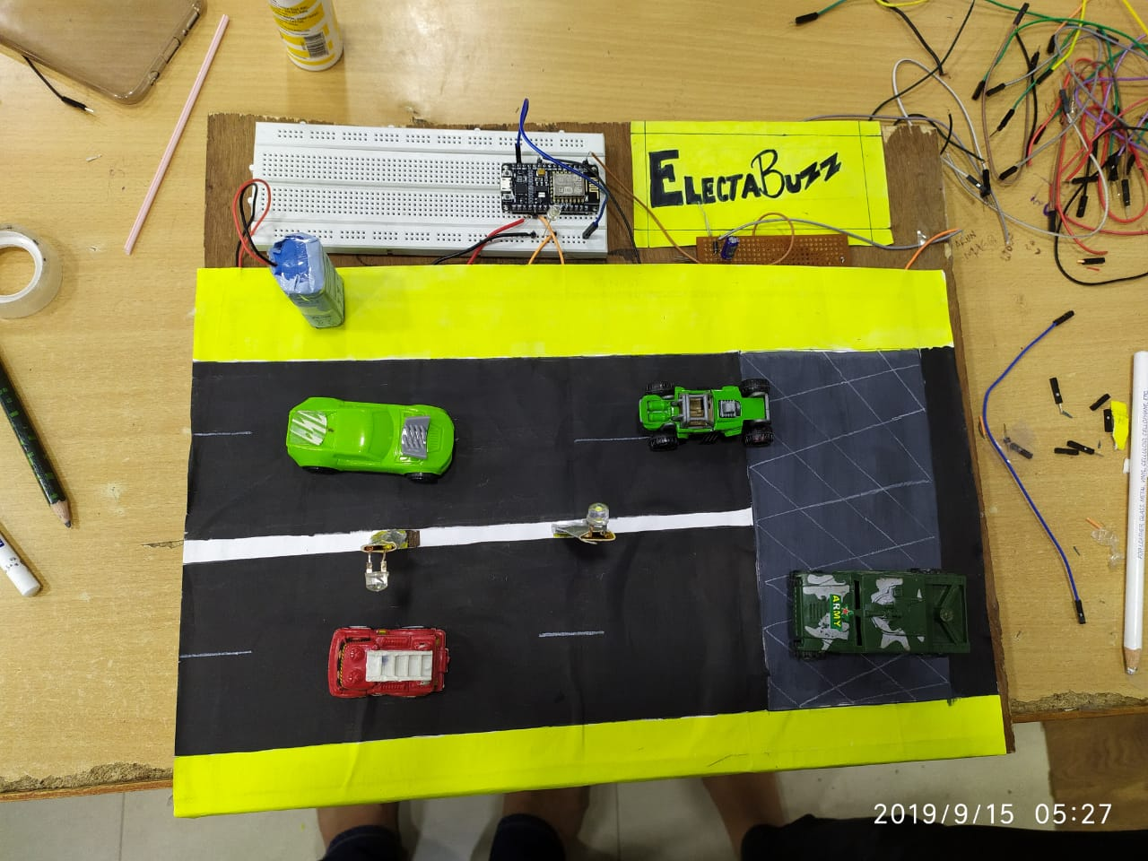
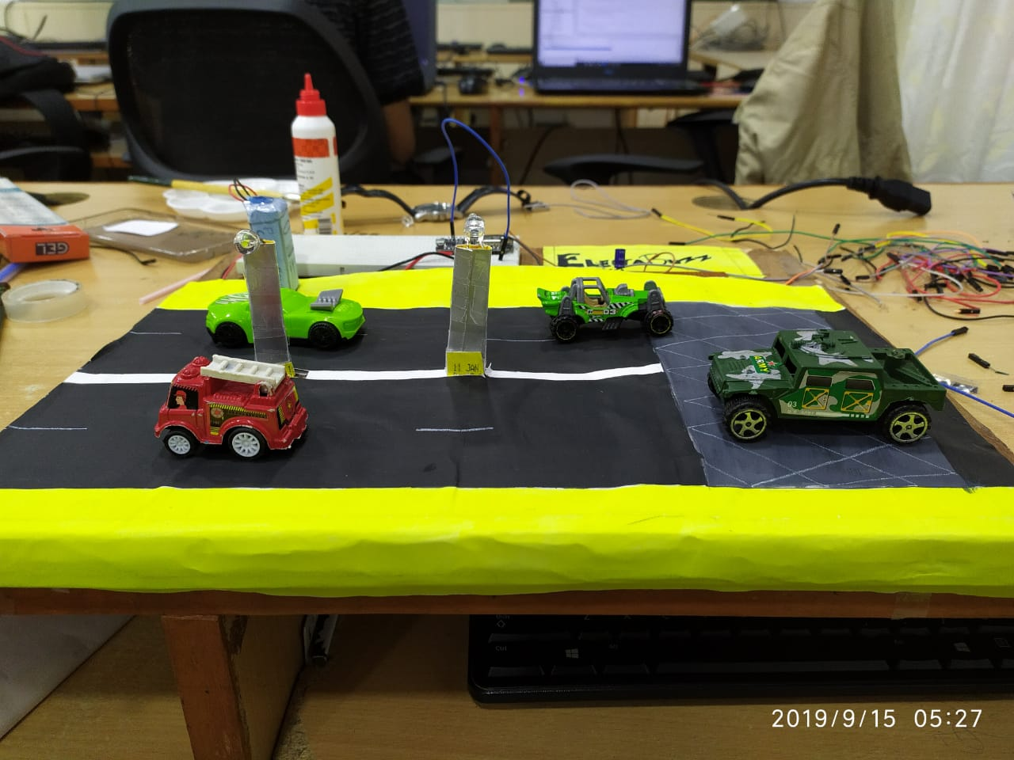
MODEL
WEBSITE:
https://electabuzz.netlify.com
WALK FOR GENERATION

Slide 10
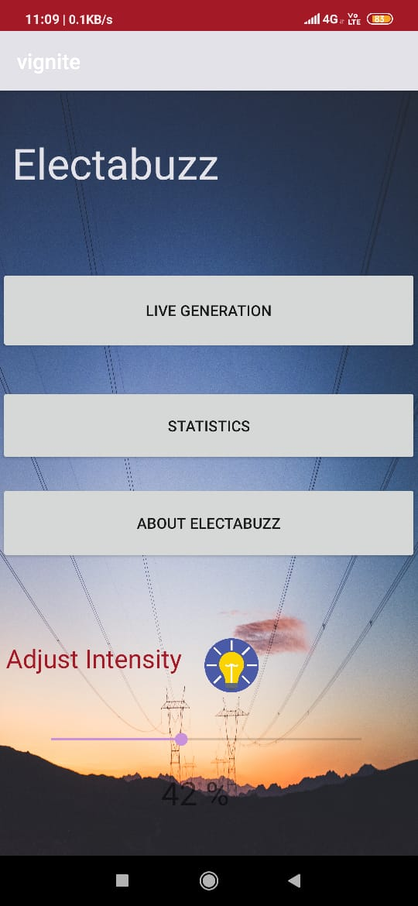
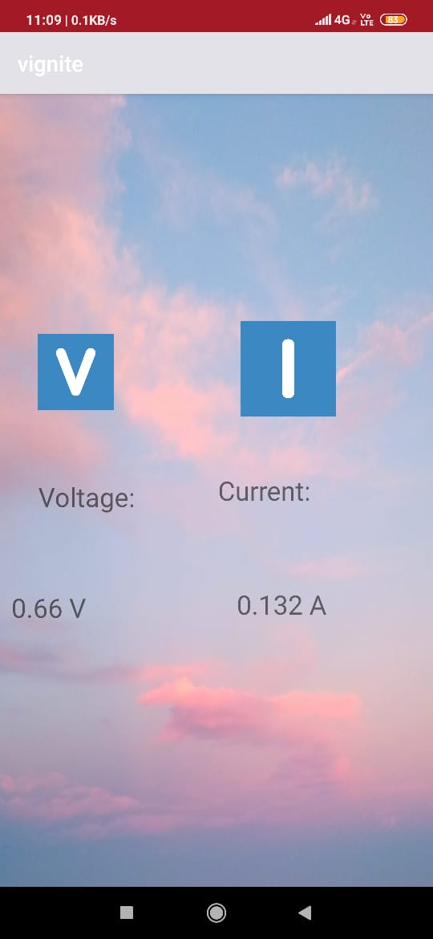
ANDRIOD APP
INTENSITY CONTROL
VOLTAGE & CURRENT DISPLAY
WALK FOR GENERATION

Slide 11

DEMO
WALK FOR GENERATION

Slide 12
FEATURES OF OUR MODEL
Generation of voltage
Lightning of LEDs
Regulating intensity of LEDs
Intensity-distance mechanism
WALK FOR GENERATION

Slide 13
STATISTICS (PART 1/2)
Factors affecting electricity generation:
Dimensions of road
Traffic Road
Speed of Vehicles
Assumptions
500 vehicles passing per hour
Speed of each vehicle 60kmph
WALK FOR GENERATION

Slide 14
STATISTICS (PART 2/2)
Power estimation for 1km stretch road:
No. of Piezoelectric Generator | 3280
Traffic rate per hour | 500
Speed (kmph) | 100
Load traffic rate | 444.44
Total Power/peizo/km/hr | 57.083
Total power(Wmin) | 3120.556
Total power(KWhr) | 187.233
WALK FOR GENERATION

Slide 15
Implementation (1/2)
Lets take a real life example:
Mumbai-Pune Express Highway
Facts:
Length of highway: 94.5 km
6 Lane road
Amount required by Govt. to generate 1KWHr= Rs.5
Road Costings:
Budget of Highway= Rs. 1146cr
Total Cost of Peizoelectric generator for 94.5km= Rs. 62Cr
Total Cost of the road generator for 94.5km= Rs. 1210Cr
The new cost is just 1.05 times the orignal cost
WALK FOR GENERATION

Slide 16
Implementation (2/2)
Power Generated:
Total power generated in 1km in a day=187.23KWHr
Power generated in a year by the entire road= 3,87,48,185 KWHr
Price of this power for govt. = Rs9.2 Cr
The amount invested on this road return in just less than 4yrs.
The avg. Life of the complete setup is 30yrs.
Thus in the remaining 26yrs, govt. would profit Rs.520Cr.
WALK FOR GENERATION

Slide 17
FUTURE DEVELOPMENT
The stored energy from peizoelectric transducer is transffered to the street lights around,and its intensity is controlled by an app.
As the coming generation is of electric cars the rate of carbon emission will be decreased.
We can store energy from peizoelectric transducer to a power station which are used to charge electric cars.
This will be a clean source of income which will be benifitial to both society and the goverment.
WALK FOR GENERATION

Slide 18
APPLICATION
You can use this system at the crowded places.
For eg: Staircases on railway stations, schools, hospitals , lifts , etc.
Roads where frequently traffic jams occur with heavy traffic.
On highways
WALK FOR GENERATION

Slide 19
THANK YOU
WALK FOR GENERATION

