Slide 1
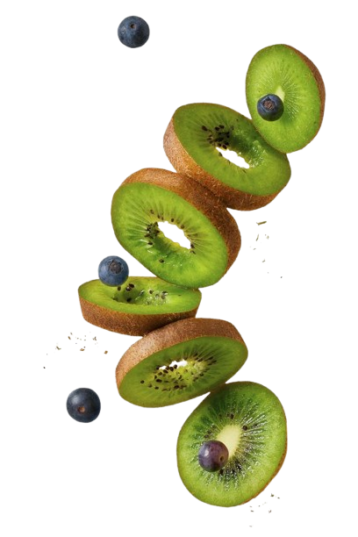
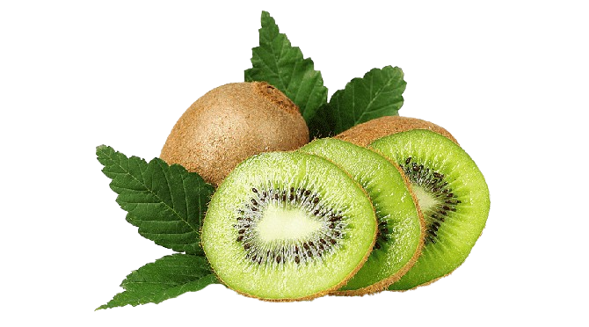
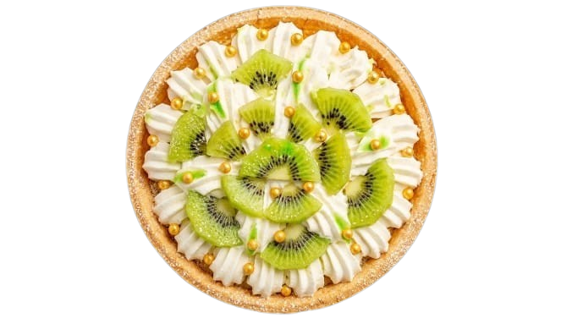
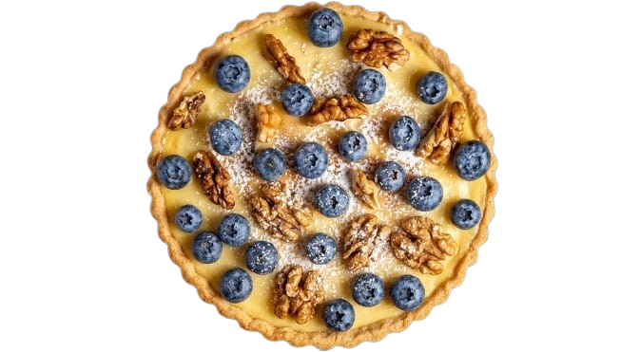
KIWI
.Kiwifruit has a thin, fuzzy, fibrous, light brown skin that is tart but edible, and light green or golden flesh that contains rows of tiny black edible seeds. The fruit has a soft texture with a sweet, sour and unique flavour.
KIWI BLUEBERRY STRAWBERRY ORANGE

Slide 2
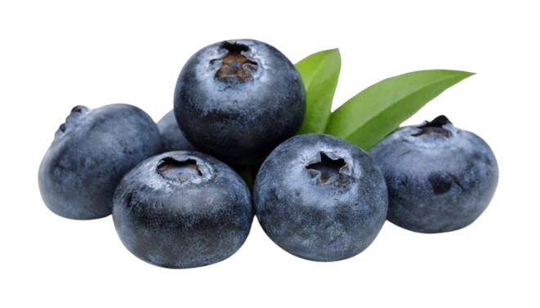
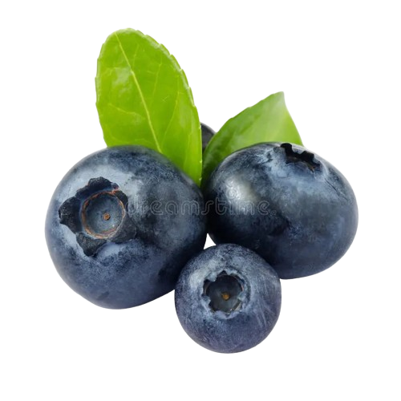
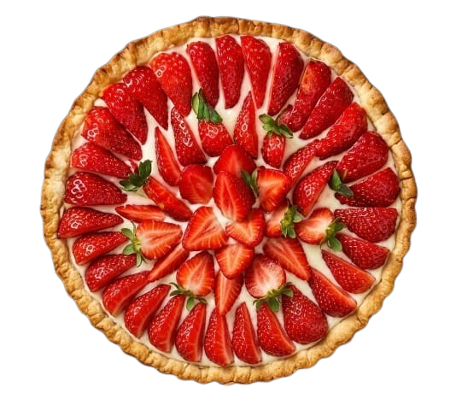
BLUEBERRY
  Blueberries are a widely distributed and widespread group of flowering plants with blue or purple berries. They are classified in the all native to North America. The highbush varieties were introduced into Europe during the 1930s
KIWI BLUEBERRY STRAWBERRY ORANGE

Slide 3
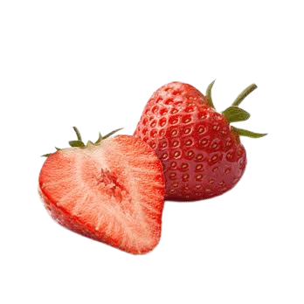
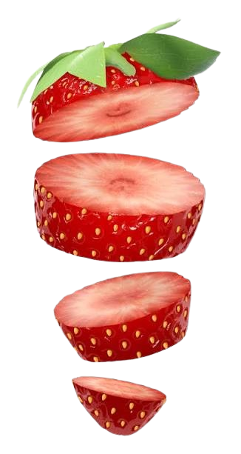
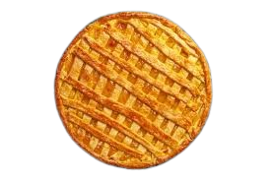
STRAWBERRY
  The name comes from the Old English "streoberie," potentially referring to the straw-like runners or the scattered appearance of the achenes
KIWI BLUEBERRY STRAWBERRY ORANGE

Slide 4
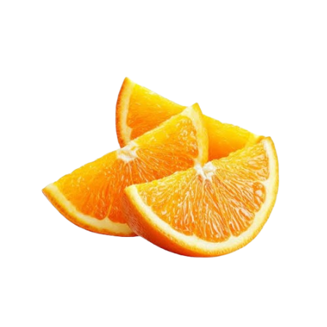
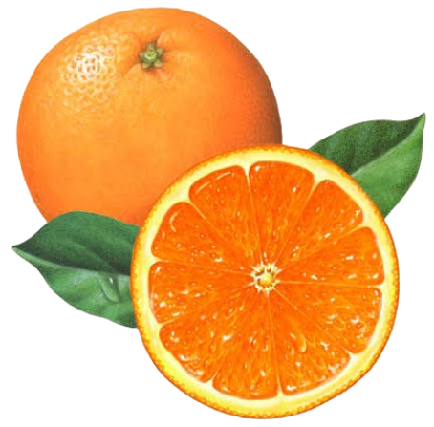
ORANGE
  The orange is a hybrid citrus fruit (Citrus × sinensis) born from a cross between the pomelo and the mandarin orange
KIWI BLUEBERRY STRAWBERRY ORANGE

