Slide 1

-
LISTENING
Part 3 and Part 4

Slide 2
FLOWCHART

Slide 3
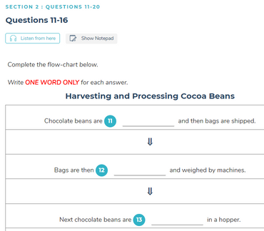
Flowchart TIPS
NEVER LOSE ATTENTION
Apply the knowledge from Matching
Quickly Scan each sentences carefully
Quickly Recall words/phrases when a certain synonym of the sentence is heard.

Slide 4
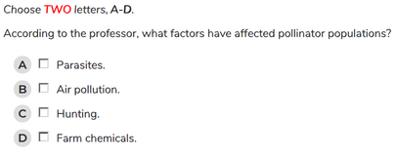
MCQ
MCQ TIPS
Always UNDERSTAND the question
Skim the choices
Try to understand the dialogue, don't choose too quickly
Try to remember/recall certain keywords you heard in the dialogue
Last resort -> Make educated guesses

Slide 5
TABLE COMPLETION

Slide 6
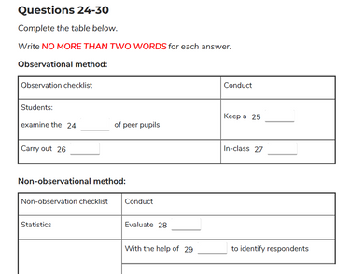
Table completion TIPS
Apply the knowledge from Form completion
Read all the given context given in the table
Skim based on the flow of the table
(Mostly from left to right)

Slide 7
DIAGRAM LABELLING

Slide 8
DIAGRAM LABELLING TIPS
Quickly Scan the Diagram
Try to understand/figure out what is in the diagram
Have an idea of the relationship between the figures in the diagram
EX:
item 1 is across from item 2
item 3 is in between item 1 and item 2...
Stay focus, Never Lose track of where you are

Slide 9
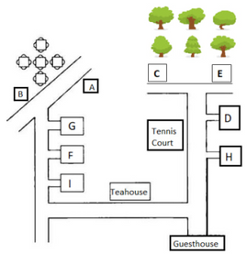
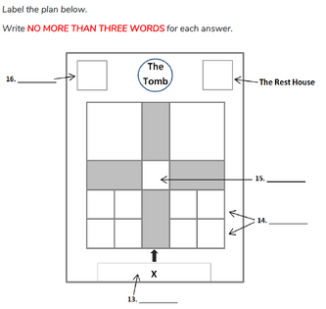

Slide 10
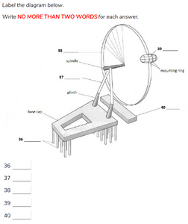

Slide 11
-
Q & A
For Full Practice Tests: ieltsonlinetests.com

