Slide 1

-
LISTENING
A General Overview of the Test

Slide 2
OVERVIEW
The Listening Test is a test made to test students on their ability to listen to English conversations on various topics.
This test takes 30mn max, with 10mn for you to transfer answers to an answer sheet.
The test has a total of 40 Questions
The Test audio will only play ONCE
The test consists of 3 parts:
Part 1: usually a conversation about everyday social context.
Part 2: speech about a Social Context.
Part 3: a discussion/university lecture (may involve different accents)

Slide 3
BAND SCORE
Correct Answer | Band Score
39-40 | 9
37-38 | 8.5
35-36 | 8
32-34 | 7.5
30-31 | 7
26-29 | 6.5
23-25 | 6
18-22 | 5.5
16-17 | 5
13-15 | 4.5
11-12 | 4

Slide 4
QUESTION TYPES
1. Form Completion
3. Matching
5. Sentence Completion
2. Multiple Choice Questions
4. Diagram Labeling
6. Short-Answer Question

Slide 5
GENERAL TIPS
Read, Read, Read!
Read the instructions
Always obey the INSTRUCTIONS
Read the given text/options
SKIM
UNDERSTAND/ANTICIPATE/PREDICT THE ANSWERS
Read your writing
Double checking your SPELLING is a must!
Stay Focus, Never Look Back, Move on

Slide 6
GENERAL TIPS
INSTRUCTIONS Examples:
One word And/Or A Number: Sugar, 012345, 20 Dollars, Ielts Test,
SKIM:
Stay Focus, Calm Your MIND
Quickly Move your eyes, remember keywords
UNDERSTAND/ANTICIPATE/PREDICT
What is this Conversation About?
This answer should be? (FOOD, Number, Person...)
Remember the context, Guess the answer

Slide 7
FORM COMPLETION

Slide 8
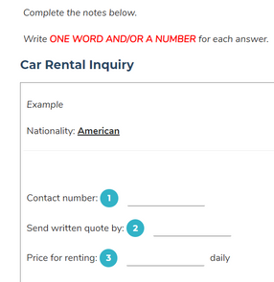
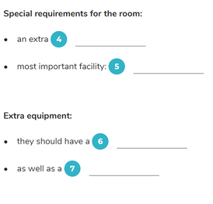

Slide 9
MCQ

Slide 10
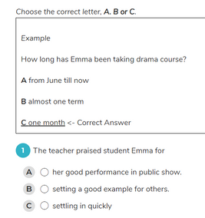
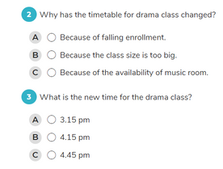

Slide 11
MATCHING

Slide 12
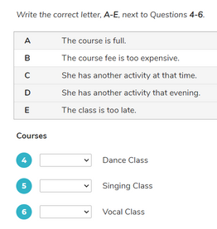

Slide 13
-
Q & A
For Full Practice Tests: ieltsonlinetests.com

