Slide 1


-
KHOUN SOVANSUNCHHAY
OVERALL SCORE - 8.0
Telegram: t.me/SunchhayKhoun
Facebook: Sunchhay Khoun
Educational Background:
Sophomore at CADT majoring in Computer Science
Freshmen at BIU majoring in International Business

Slide 2
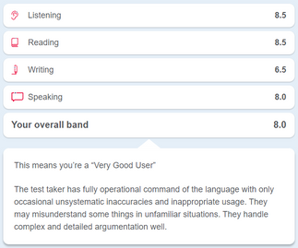
-

Slide 3
MOTIVATION
BAND SCORE | REWARDS
5.0 - 6.0 | 4 Years Scholarship at BIU
6.5-7.0 | 4 Years Scholarship at BIU and 220 dollars money back
7.5+ | Full Scholarship to Study Abroad Or 4 Years Scholarship at BIU with a 600 dollars annual Salary

Slide 4
BAND SCORE
Average Band Score
Country | Band Score
Australia | 6.5
Canada | 6.0
UK | 6.5
Singapore | 6 - 6.5

Slide 5
CONTENT
TABLE OF CONTENT:
Introduction to IELTS Listening
Tips for the test - Practice & Review
Mock Test x2
Preparation Before Test Day
Website Demo

Slide 6
ABOUT IELTS
The 2 types of IELTS
ACADEMIC
GENERAL
Test for people who wants to enroll into university abroad
Reading:
3 long paragraphs from books, newspaper...
Writing:
Task 1: describe about a given chart or diagram
Test for people who wants to live or work abroad
Reading:
Paragraphs from advertisements, magazines...
Writing:
Task 1: write a letter (informal/formal)
WE ARE TAKING THE ACADEMIC TEST

