Slide 1

BMS INSTITUTE OF TECHNOLOGY & MANAGEMENT,
YELAHANKA, BANGALORE.
Department of Computer Science & Engineering
AutomaTIC TEXT SUMMARISATION
Vighnesh Raut 1by15cs100
r s varun 1by15cs067
tushar sahay 1by15cs095
umesh daftari 1by15cs097
Under the guidance of:
Jagadish p
Assistant professor, CSE
BMSIT&m

Slide 2
ABSTRACT
In this information era, Huge amount of data is present. Humans are inefficient to summarize this size of data. So we need text summarizer to do this for us.
Text summarization is the process of identifying the most important meaningful information in a document or set of related documents and compressing them into a shorter version preserving its overall meanings.

Slide 3
Introduction
A summary is a text that is produced from one or more texts, that conveys important information in the original text, and it is of a shorter form.
The goal of automatic text summarization is presenting the source text into a shorter version with semantics.
The most important advantage of using a summary is, it reduces the reading time.

Slide 4
Problem statement
There are existing tools and softwares which attempt to summarize the huge chunk of data, but they are not at par of what we really expect them to do.
Their main approach to summarize the text is an algorithm that finds big words that have a somewhat deep meaning. But using this approach leads to skipping of sentences that have simple words but convey important information.

Slide 5
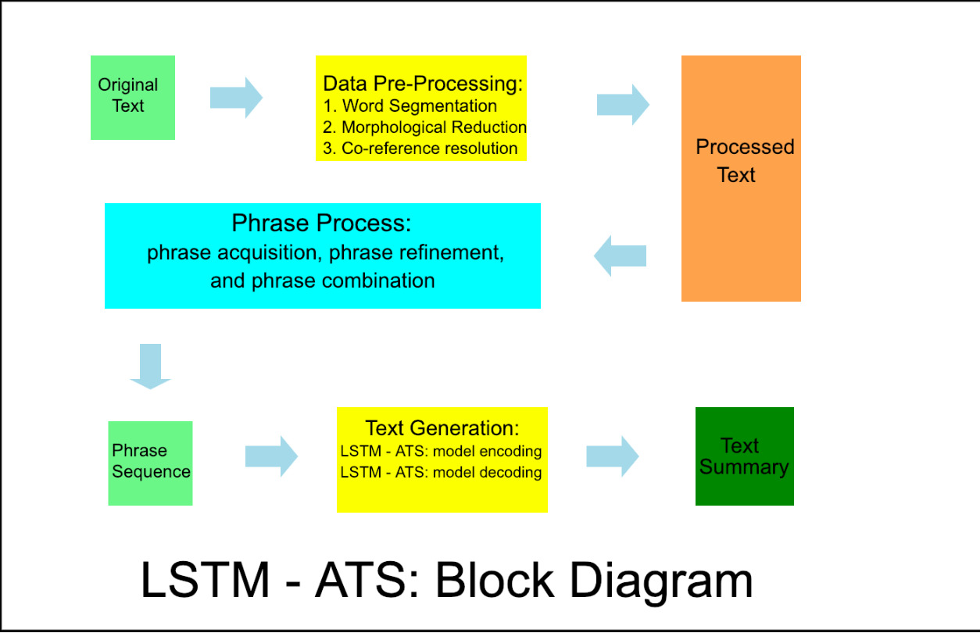
DESIGN SPECIFICATON ANALYSIS

Slide 6
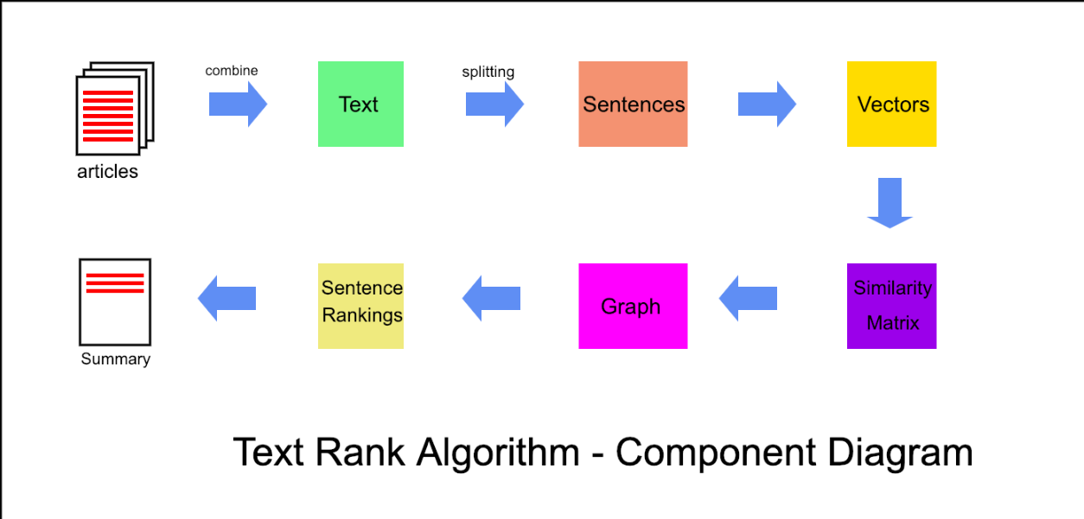
COMPONENT DIAGRAM

Slide 7
Experimentation & Optimization

Slide 8
Work in Progress

Slide 9
REFERENCES
Amjad Abu-Jbara and DragomirRadev. 2011. Coherent citation-based summarization of scientific papers. In Proceedings of the 49th Annual Meeting of the Association for Computational Linguistics: Human Language Technologies-Volume 1. Association for Computational Linguistics, 500–509.
Nemhauser, George L., Laurence A. Wolsey, and Marshall L. Fisher. "An analysis of approximations for maximizing submodular set functions—I." Mathematical Programming 14.1 (1978): 265-294.
Abigail See, Peter J. Liu, Christopher D. Manning,” Get To The Point: Summarization with Pointer-Generator Networks”, (Submitted on 14 Apr 2017 (v1), last revised 25 Apr 2017 (this version, v2))
Ramesh Nallapati, Bowen Zhou, Cicero Nogueira dos santos, Caglar Gulcehre, Bing Xiang,” Abstractive Text Summarization Using Sequence-to-Sequence RNNs and Beyond”,( Submitted on 19 Feb 2016 (v1), last revised 26 Aug 2016 (this version, v5))
Alexander M. Rush, Sumit Chopra, Jason Weston,” A Neural Attention Model for Abstractive Sentence Summarization”, 3 Sep 2015
Mehdi Allahyari, Seyedamin Pouriyeh, Mehdi Assefi, Saeid Safaei, Elizabeth D. Trippe, Juan B. Gutierrez, Krys Kochut, “Text Summarization Techniques: A Brief Survey”, (Submitted on 7 Jul 2017 (v1), last revised 28 Jul 2017 (this version, v3))

