Slide 1

BMS INSTITUTE OF TECHNOLOGY & MANAGEMENT,
YELAHANKA, BANGALORE.
Department of Computer Science & Engineering
AutomaTIC TEXT SUMMARISATION
Vighnesh Raut 1by15cs100
umesh daftari 1by15cs097
r s varun 1by15cs067
tushar sahay 1by15cs095
Under the guidance of:
Jagadish p
Assistant professor, CSE
BMSIT&m

Slide 2
ABSTRACT
Processing large amount of data in short time is very time-consuming and also nearly impossible for humans as the data is increasing exponentially every passing day.
Here comes the need for a Text Summariser that would convey the message of the large document in short form so that we don’t have to read the entire doc to understand it.
In this paper, we try to combine the power of different algorithms into one to improve the quality of the summary and its relevance.

Slide 3
Introduction
A summary is a text that is produced from a text document, that conveys important information of it, in a shorter length.
The goal of automatic text summarization is to present the source text into a shorter version with semantics.
The most important advantage of using a summary is, it reduces the reading time.

Slide 4
PROBLEM STATEMENT
There are existing summarisers act directly on the entire sentences even if it is not required. We address the same by using sentence compression techniques and then feeding it to the algorithm.
Existing applications either use Sentence-Feature Extraction techniques or use Semantic Analysis method. Combining them would improvise the performance of the summariser.

Slide 5
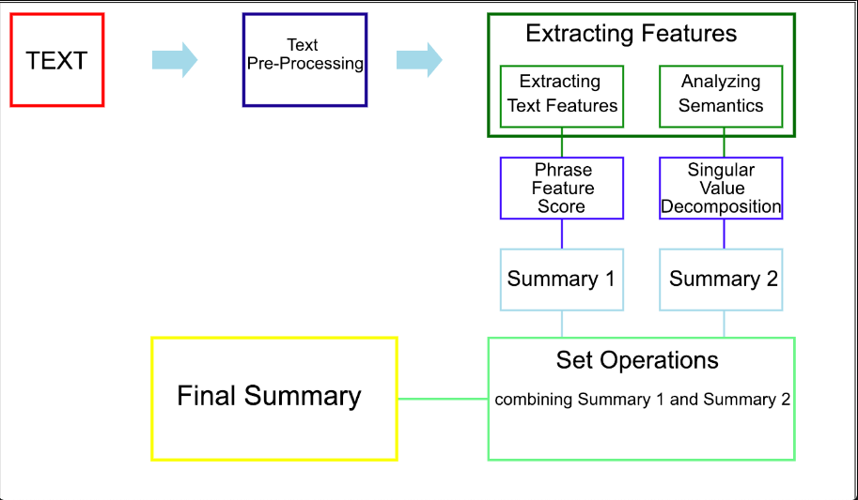
BLOCK DIAGRAM

Slide 6
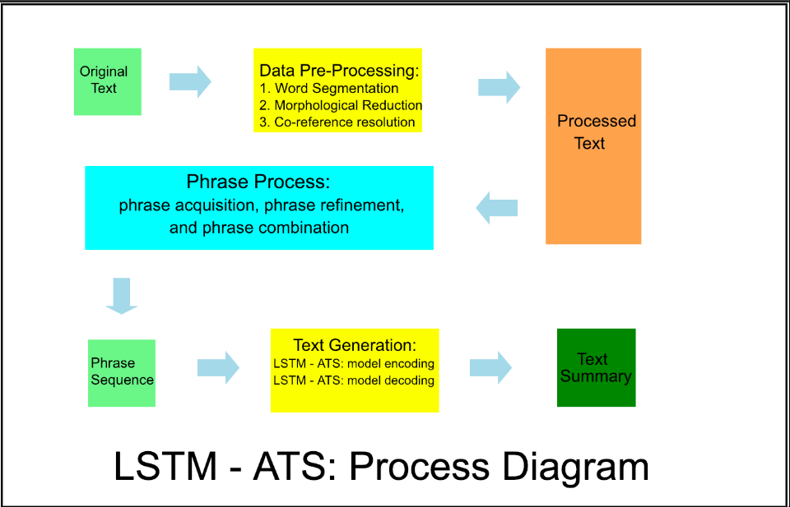
DESIGN SPECIFICATION ANALYSIS

Slide 7
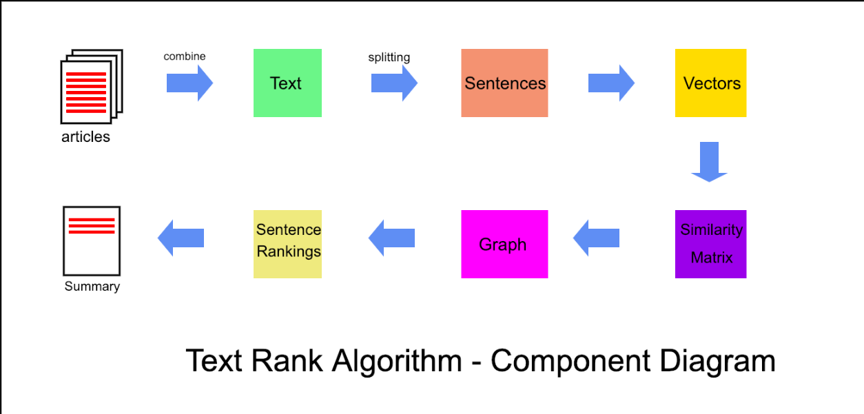
COMPONENT DIAGRAM

Slide 8
TEXT RANK ALGORITHM

Slide 9
LSTM ( Long Short-term Memory )

Slide 10
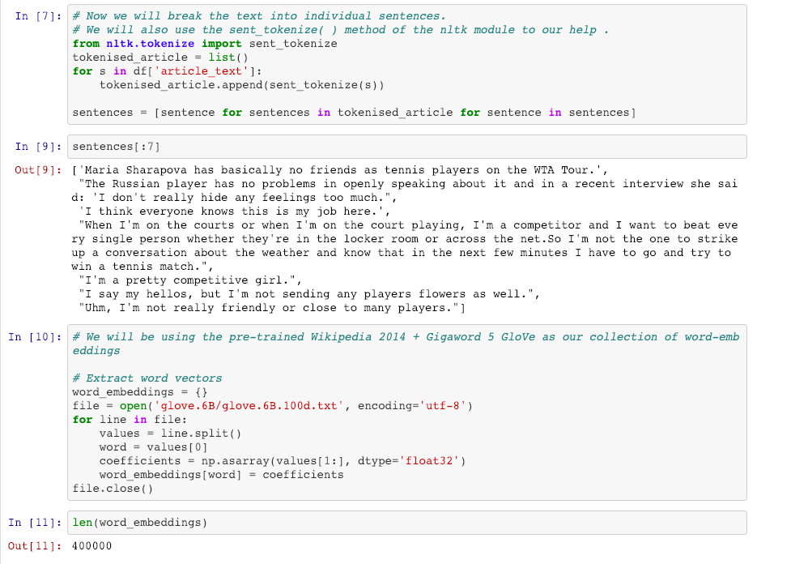
Experimentation

Slide 11
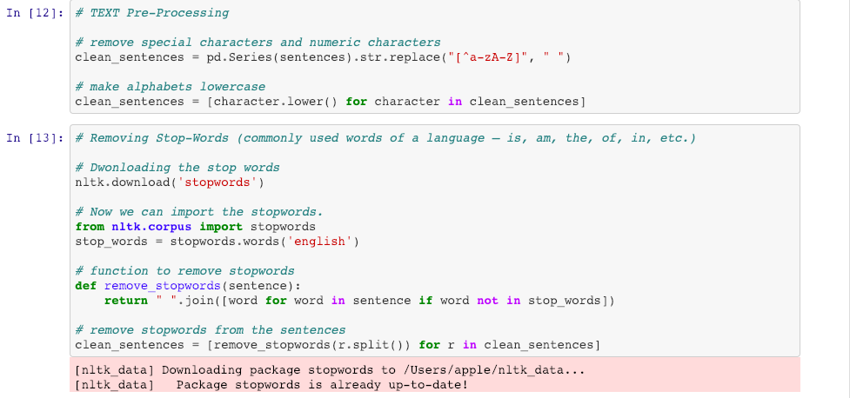
Partial Implementation

Slide 12
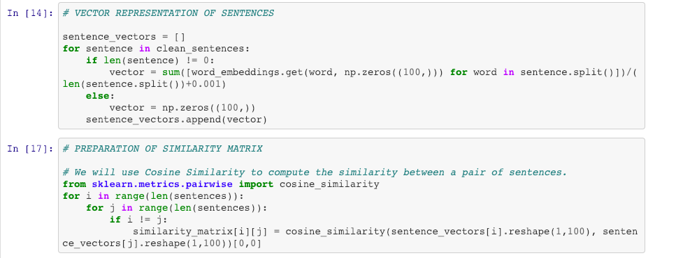
Partial Implementation (Continued)

Slide 13
REFERENCES
[1] M. Esther Hannah, Dr. Saswati Mukherjee, K. Ganesh Kumar. “An Extractive Text Summarization Based on Multivariate Approach”, 2010 3rd International Conference on Advanced Computer Theory and Engineering (ICACTE)
[2] Mahsa Afsharizadeh, Hossein Ebrahimpour-Komleh, Ayoub Bagheri. “Query-oriented Text Summarization using Sentence Extraction Technique”, 2018 4th International Conference on Web Research (ICWR)
[3] Siya Sadashiv Naik, Manisha Naik Gaonkar. “Extractive Text Summarization By Feature-Based Sentence Extraction Using Rule-Based Concept”, 2017 2nd IEEE International Conference On Recent Trends in Electronics Information & Communication Technology (RTEICT)
[4] Aditya Jain, Divij Bhatia, Manish K Thakur. “Extractive Text Summarization using Word Vector Embedding”, 2017 International Conference on Machine Learning and Data Science

