Slide 1

BMS INSTITUTE OF TECHNOLOGY & MANAGEMENT,
YELAHANKA, BANGALORE.
Department of Computer Science & Engineering
AutomaTIC TEXT SUMMARISATION
Vighnesh Raut 1by15cs100
r s varun 1by15cs067
tushar sahay 1by15cs095
umesh daftari 1by15cs097
Under the guidance of:
Jagadish p
Assistant professor, CSE
BMSIT&m

Slide 2
ABSTRACT
Text summarization is the process of identifying the most important meaningful information in a document or set of related documents and compressing them into a shorter version preserving its overall meanings.
The goal of automatic text summarization is to present the source text into a shorter version with semantics.

Slide 3
Problem statement
There are existing tools and softwares which attempt to summarize the huge chunk of data, but they are not at par of what we really expect them to do.
Their main approach to summarize the text is an algorithm that finds big words that have a somewhat deep meaning. But using this approach leads to skipping of sentences that have simple words but convey important information.

Slide 4
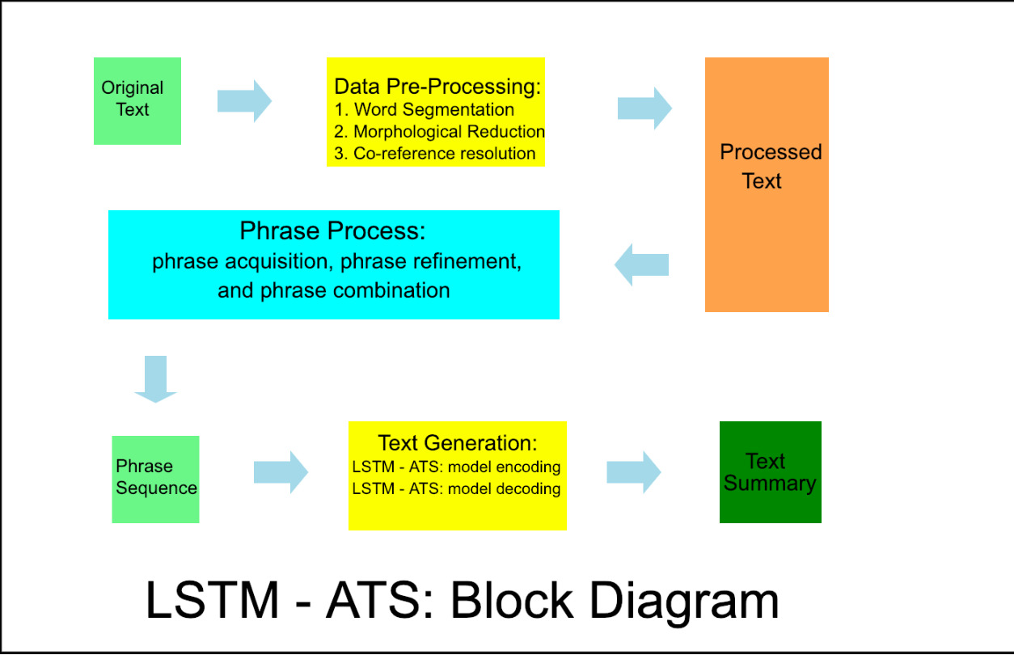
DESIGN SPECIFICATON ANALYSIS

Slide 5
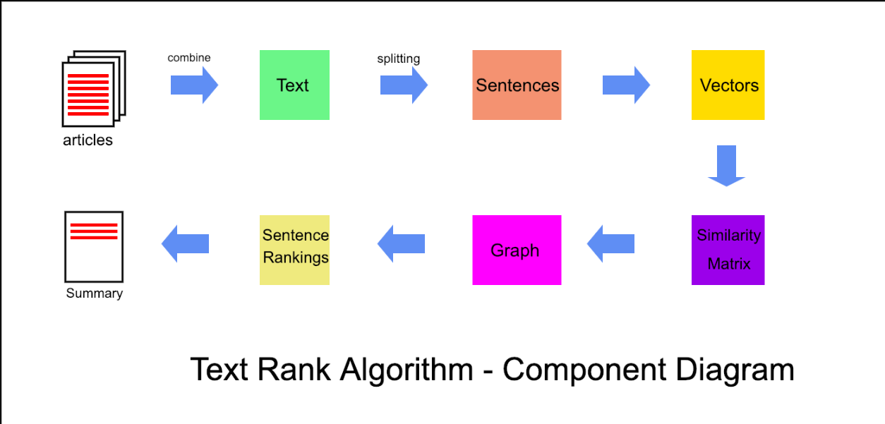
COMPONENT DIAGRAM

Slide 6
Experimentation & Optimization

Slide 7
Work in Progress

Slide 8
REFERENCES
Extractive Text Summarization Using Word Vector Embedding, Aditya Jain, Divij Bhatia, Manish K Thakur, 2017 International Conference on Machine learning and Data Science
Extractive Text Summarization By Feature-Based Sentence Extraction Using Rule-Based Concept , Siya Sadashiv Naik, Manisha Naik Gaonkar 2017 2nd IEEE International Conference On Recent Trends in Electronics Information & Communication Technology (RTEICT), May 19-20, 2017, India
Query-oriented Text Summarization using Sentence Extraction Techniques Mahsa Afsharizadeh, Hossein Ebrahimpour-Komleh, Ayoub Bagheri 2018 4th International Conference on Web Research (ICWR)
An Extractive Text Summarization Based On Multivariate Approach M. Esther Hannah, Dr Saswati Mukherjee, K. Ganesh Kumar 2010 3rd International Conference on Advanced Computer Theory and Engineering (ICAC)

