Slide 1
Portable Rydberg System
Haroldo T. Hattori
01 October 2026

Slide 2
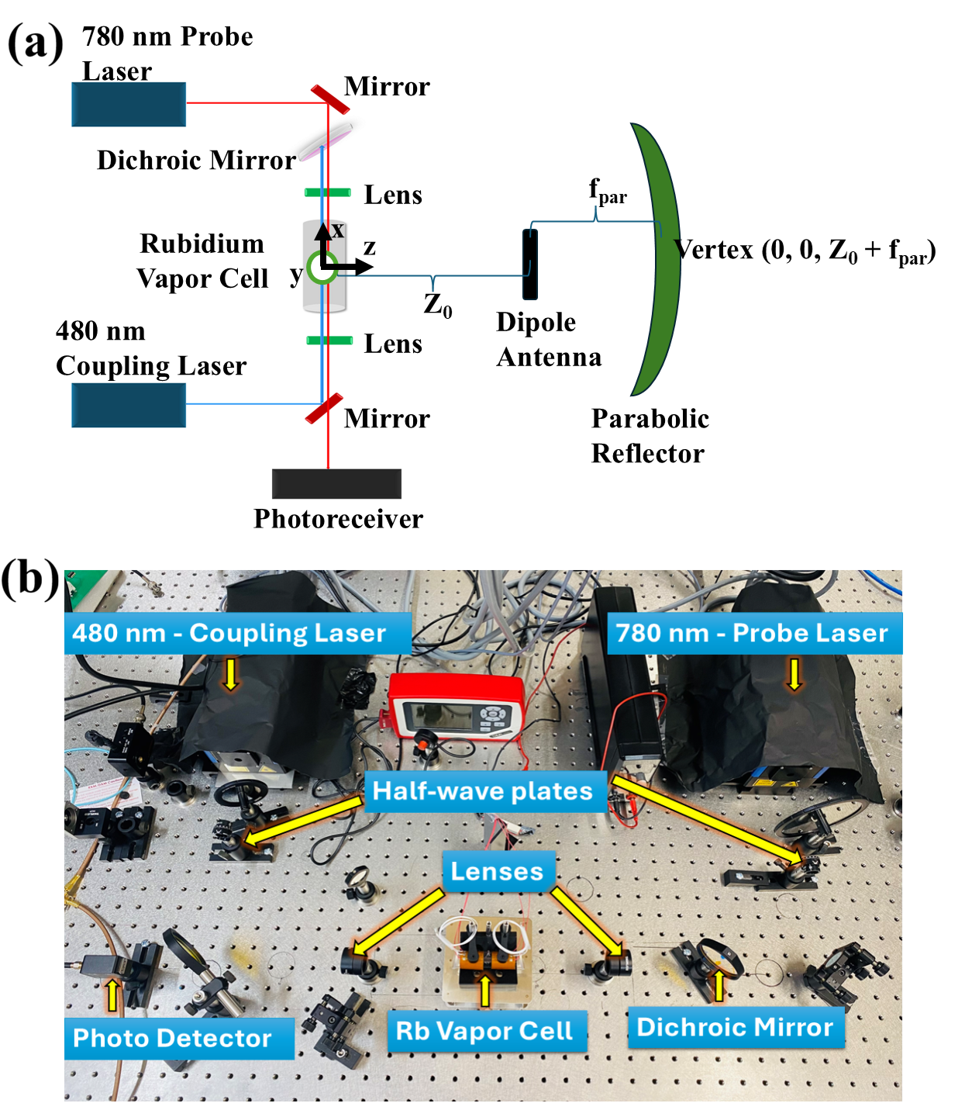
Original setup

Slide 3
1.1 Oversimplified scheme
Fiberport couple into fiber + fiber collimator
DLPro 780 nm
Rubidium
cell
Fiber collimator+fiber
Photodetectors and amplifiers

Slide 4
Feasibility
After purchase 1 if 10 GHz photoreceiver works
Otherwise, must wait until purchase 3 is fulfilled

Slide 5
Additional equipment needed
Toptica FOC-MM-780-FCPC
Price:
or
* PAF 2P- 11B (fiberport) => 689.30 USD
CFC8-B or CFC11P-B (preferrable) (780 nm) – Two (one to collimate and another to collect)
Price:338.29 USD each=> 676.5 USD + posting

Slide 6
Other
Purchase a new DET025AFC 2 GHz Si FC/PC coupled photodetector 400-1100 nm 359.72 USD

Slide 7
Initial results 30 September 2026
Fibeport: Input 6.7 mW and 6 mW coupled through fibeport ~89.6% efficiency
400 uW coupling after rubidium cell: 6% efficiency.

Slide 8
1.2 Oversimplified scheme HALT
Fiberport couple into fiber + fiber collimator
780 nm DBR laser
Rubidium
cell
Fiber collimator+fiber
Photodetectors and amplifiers

Slide 9
Additional equipment needed
Toptica FOC-MM-780-FCPC
Price:
or
* PAF 2P- 11B (fiberport) => 689.30 USD
CFC8-B (780 nm) or CFC11P-B (preferrable)– Two (one to collimate and another to collect)
Price:338.29 USD each=> 676.5 USD + posting
* Thorlabs DBR 780 PN- USD 7202.81

Slide 10
Other
Purchase a new DET025AFC 2 GHz Si FC/PC coupled photodetector 400-1100 nm 359.72 USD

Slide 11
2.1 Complete scheme-> Dirty scheme 1
Fiberport couple into fiber + fiber collimator
Photodetectors and amplifiers
DLPro 780 nm
Rubidium
cell
Fiber collimator+fiber
Fiber collimator+fiber
480 nm DLPro laser

Slide 12
Feasibility
After purchase 1 if 10 GHz photoreceiver works
Otherwise, must wait until purchase 3 is fulfilled

Slide 13
Additional equipment needed- 780 branch
Toptica FOC-MM-780-FCPC
Price:
or
* PAF 2P- 11B (fiberport) => 689.30 USD
CFC8-B (780 nm) or CFC11P-B (preferrable)– – Two (one to collimate and another to collect)
Price:338.29 USD each=> 676.5 USD + posting

Slide 14
Additional equipment needed- 480 branch
Toptica FOC-MM-480-FCPC
Price:
or
1 CFC11P-A (480 nm) or 2 CPC11P-A (480 nm) if collimated

Slide 15
2.2 Complete scheme-> Dirty scheme 2
Fiberport couple into fiber + fiber collimator
Photodetectors and amplifiers
DLPro 780 nm
Rubidium
cell
Fiber collimator+fiber
Fiberport couple into fiber +fiber+collimator
480 nm DLPro laser

Slide 16
Feasibility
After purchases 1 and 2 if 10 GHz photoreceiver works
Otherwise, must wait until purchase 3 is fulfilled

Slide 17
Other
Purchase a new DET025AFC 2 GHz Si FC/PC coupled photodetector 400-1100 nm 359.72 USD

Slide 18
Additional equipment needed- 780 branch
Toptica FOC-MM-780-FCPC
Price:
or
* PAF 2P- 11B (fiberport) => 689.30 USD
CFC8-B (780 nm) or CFC11P-B (preferrable)– – Two (one to collimate and another to collect)
Price:338.29 USD each=> 676.5 USD + posting

Slide 19
Additional equipment needed- 480 branch
Toptica FOC-MM-480-FCPC
Price:
or
* PAF 2P- 11A (fiberport) => 689.30 USD

Slide 20
2.3 Complete scheme TEMP HALT
780 nm DLPro laser
Fiber collimator
Rubidium
cell
Photodetectors and amplifiers
Fiber coupler
480 nm DLPro laser

Slide 21
Additional equipment needed- 780 branch
Toptica FOC-MM-780-FCPC
Price:
or
* PAF 2P- 11B (fiberport) => 689.30 USD
CFC8-B (780 nm) or CFC11P-B (preferrable)– – Two (one to collimate and another to collect)
Price:338.29 USD each=> 676.5 USD + posting

Slide 22
Additional equipment needed- 480 branch
Toptica FOC-MM-780-FCPC
Price:
or
* PAF 2P- 11A (fiberport) => 689.30 USD
CFC8-A (480 nm) or CFC11P-A (preferrable)- One
Price:338.29 USD each=> 338.29 USD

Slide 23
Combined stuff
WDM coupler ???? Chinese companies:
CSRayzer Optical Technology Ltd Haroldo
Flyin optronics co Haroldo
Opto-link corporation Ltd Ishara
Lfiber Optic Limited Ishara
A fiber-pigtailed visible-wavelength dichroic combiner

Slide 24
2.4 Complete scheme HALT
780 nm DBR laser
Fiber collimator
Rubidium
cell
Photodetectors and amplifiers
Fiber coupler
480 nm DBR laser

Slide 25
Additional equipment needed- 780 branch
Toptica FOC-MM-780-FCPC
Price:
or
* PAF 2P- 11B (fiberport) => 689.30 USD
CFC8-B (780 nm) or CFC11P-B (preferrable)– Two (one to collimate and another to collect)
Price:338.29 USD each=> 676.5 USD + posting
* Thorlabs DBR 780 PN- USD 7202.81

Slide 26
Additional equipment needed- 480 branch
Toptica FOC-MM-780-FCPC
Price:
or
* PAF 2P- 11A (fiberport) => 689.30 USD
CFC8-A (480 nm) or CFC11P-A (preferrable)- One
Price:338.29 USD each=> 676.5 USD + posting

Slide 27
Combined stuff
WDM coupler ???? Chinese companies:
CSRayzer Optical Technology Ltd
Flyin optronics co
Opto-link corporation Ltd
Lfiber Optic Limited
A fiber-pigtailed visible-wavelength dichroic combiner

Slide 28
Phase 1
1. It will take time and money to get a WDM coupler
2. Also, the fiber adaptors will take time
Order fibre adaptors and
Multimode fiber: Thorlabs 50 um diameter multimode OM4
Toptica FOC-MM-780-FCPC
Toptica FOC‑MM‑480‑FCPC
Thorlabs CFC5-A (480 nm) and CFC5-B (780 nm)
Multimode coupler (Chinese company CSRayzer)

Slide 29
More
If you drop the lab mounts, then the only things you must still add beyond what’s in your slide are:
Enclosure: Metal box + internal plate to bolt: cell, collimators, photodiode, WDM, and fibre adaptors so nothing moves.
Mechanical fixing of optics (non‑lab style): Custom brackets / 3D‑printed holders / small L‑brackets for:
  rubidium cell
  CFC5‑A / CFC5‑B
  photodetector
  WDM coupler
Strain relief & feedthroughs:
  fibre strain relief points
  holes/feedthroughs for fibres and RF cables
  maybe FC bulkhead feedthroughs on the box wall
Compact heater for the cell (if you don’t reuse the bulk one):
  small resistive heater + temperature controller
  thermal insulation around the cell
Everything else in your PPT—lasers, fibre adaptors, OM4, WDM, collimators, detectors, amplifiers—is conceptually complete.
So in portable terms, what’s missing is only:
A box
Simple mechanical fixtures inside it
Strain relief / feedthroughs
A compact cell heater (if you don’t reuse the bulk hardware)
If you want, we can sketch a one‑page mechanical layout for that box so it’s buildable without any optical mounts at all.

Slide 30
Price list
1. DBR 780 PN- USD 7202.81

Slide 31
items
Critical missing items
Enclosure + internal mounting plate
Custom brackets / 3D‑printed holders
Fiber strain relief + feedthroughs
Compact heater + temperature controller
WDM coupler specification (not just vendor list)
RF amplifier + power supplies
Cell mounting hardware
Assembly tools & documentation

Slide 32
Ordered
UNSW -> fulfilled
One (1) CFC11P-A 480 nm
One (1) M116L02 graded index MM OM4 FC/PC and FC/PC
Haroldo
Two (2) CFC11P-B 780 nm
Two (2) M116L02 graded index MM OM4 FC/PC and FC/PC

Slide 33
Ordered
Haroldo
One (1) CFC11P-A 480 nm
One (1) HCP Post mounting bracket for fiberport
Haroldo
1. One DET025AFC 2 GHz Si FC/PC coupled photodetector 400-1100 nm

Slide 34
Future purchase
1. One (1) PAF 2P- 11A (fiberport) => 689.30 USD
2. One (1) DET025AFC/M Si biased detector for optical fiber

Slide 35
Arrived items
Two CFC11P-A (480 nm) have arrived
ONE 2m OM4 fiber patch has arrived
* ONE HCP fiberport holder

Slide 36
WDM coupler
780 nm beam
780 nm beam
WDM coupler
480 nm beam
480 nm beam

