Slide 1
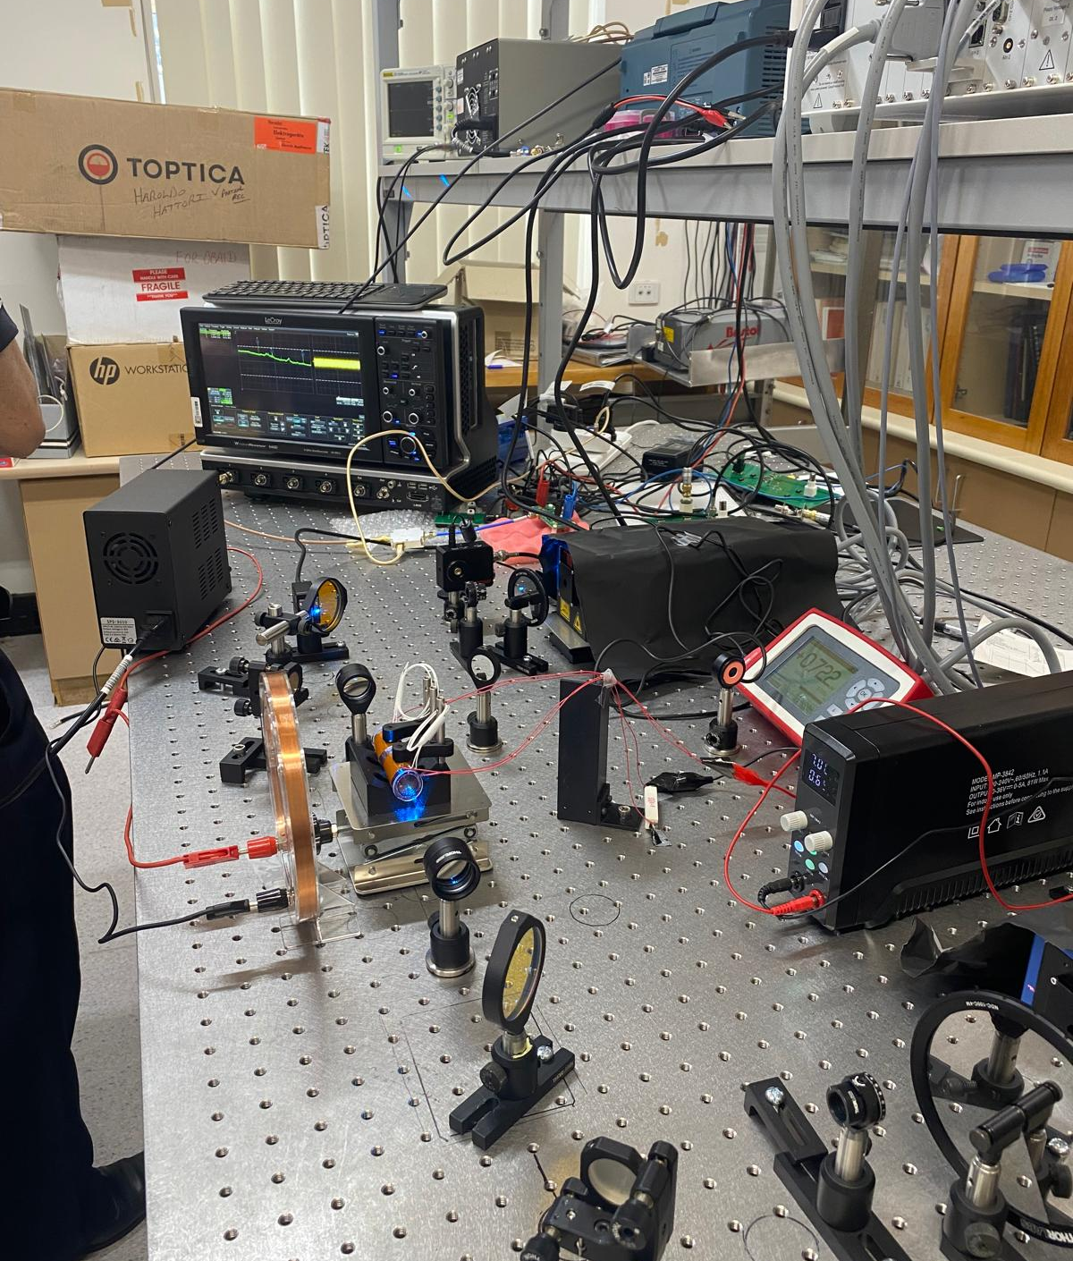

CONFERENCE • ELECTRICAL ENGINEERING
Polarisation estimation in quantum
Rydberg RF sensors
Can a Rydberg radio-frequency receiver recover microwave polarisation?
Angle-of-Arrival • Satellite Communications • RF metrology
Ryan N. Verghese
Supervisors: Dr Haroldo T. Hattori & Prof Andrey E. Miroshnichenko
Rydberg sensing | Conference
Notes:
Good morning, ladies and gentlemen, my name is Ryan Verghese and my thesis is on “Polarisation estimation in quantum Rydberg Radio-Frequency Sensors” or in the most sci-fi way possible “Quantum Radar”. I am supervised by Dr Hattori and Prof Miroshnichenko.
My work asks a simple but demanding question: can a quantum Rydberg RF receiver recover microwave polarisation, not just detect how much of an RF field is present (Power)?
Power tells us how strong a signal is; polarisation tells us something about how the wave is oriented, how it has propagated, and sometimes what sort of emitter or interaction produced it.
First, let’s define the problem.

Slide 2
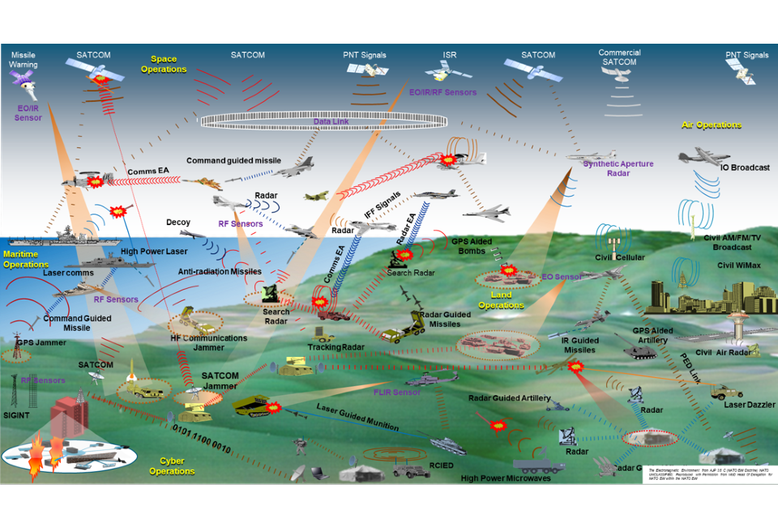
Motivation of the work
Motivation of the work
Crowded RF environments make vector information increasingly valuable.
Modern RF environments are crowded: satellites, radar, aircraft links, mobile systems and interference can overlap.
Why are Rydberg RF sensors exciting?
• Atom-defined interaction with RF fields
• Optical readout of microwave response
• Tunable operating band via Rydberg transition choice
• Potential access to amplitude, phase, frequency, angle-of-arrival and polarisation
Focus here: polarisation — treating the microwave field as a vector, not just power.
Modern RF environments are crowded
Satellites, radar, aircraft links, mobile systems and interference can overlap in frequency, space and time.
Why quantum Rydberg RF sensors are exciting
• Atom-defined interaction with RF fields
• Optical readout of microwave response
• Tunable operating band via transition choice
• Potential access to amplitude, phase, frequency, angle-of-arrival and polarisation
Focus here: polarisation; treating the microwave field as a vector (direction & magnitude).
Vector RF sensing can help separate propagation, orientation and emitter behaviour when power alone is ambiguous. We can track targets of interest quietly, precisely, and flexibly.
Rydberg sensing | Conference
Notes:
Modern RF environments are crowded. Satellites, radar, aircraft links, mobile systems and interference can all occupy the same broad electromagnetic environment. In that setting, measuring power alone is often not enough.
Polarisation gives us an additional layer of information. It can tell us something about propagation, orientation, scattering and emitter behaviour. Put simply: power tells us how much signal is there; polarisation helps tell us what kind of field we are looking at.
This is why Rydberg RF sensing is interesting. The microwave field interacts with atom-defined energy levels, and we read the response optically. That means the sensing element is tied to atomic physics rather than a conventional antenna geometry. My focus here is the vector part of the field: its polarisation, which can help unlock a key degree of freedom when it comes to detecting a target, For instance, we could track targets of interest quietly, precisely, and flexibly across a wide band of frequencies.
So what exactly is Rydberg and how does it work?

Slide 3
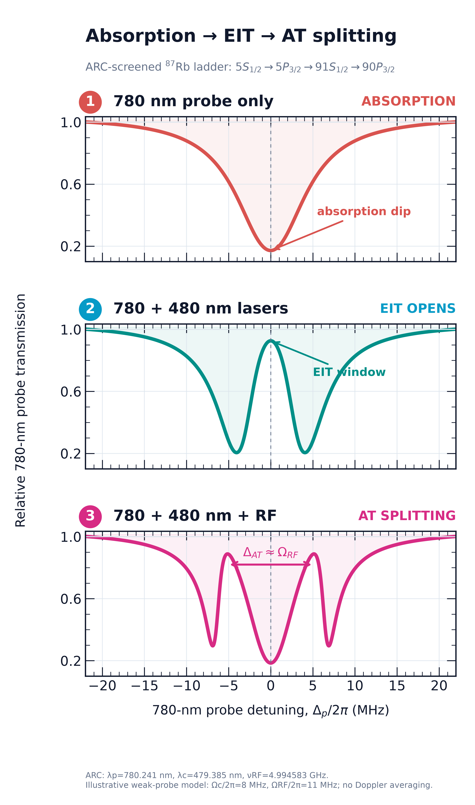
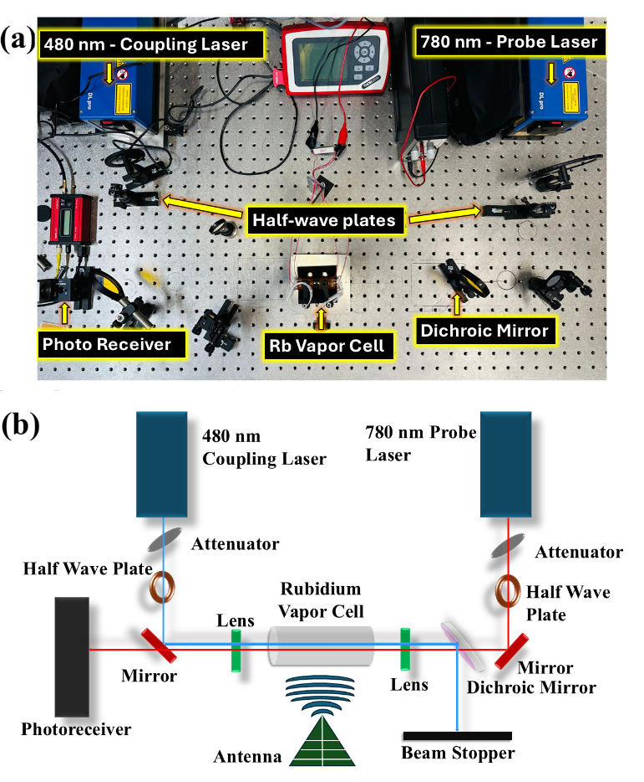
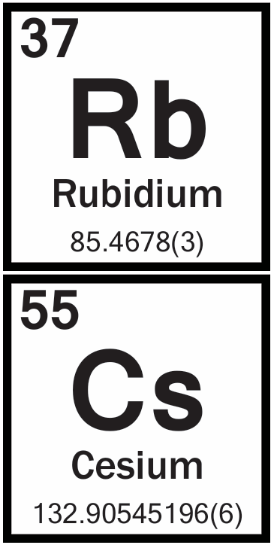
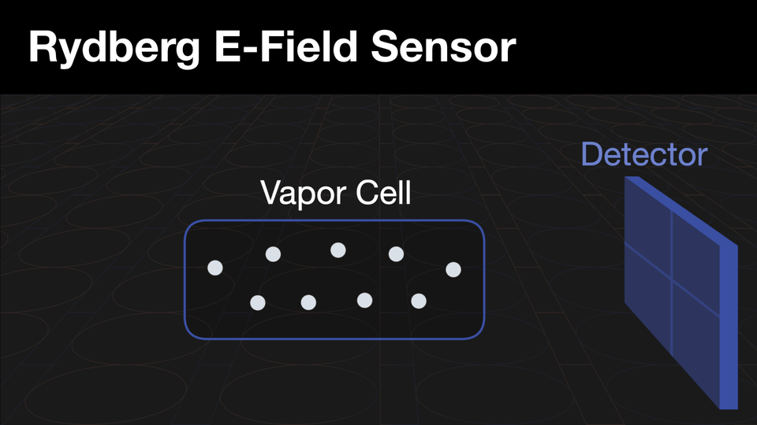
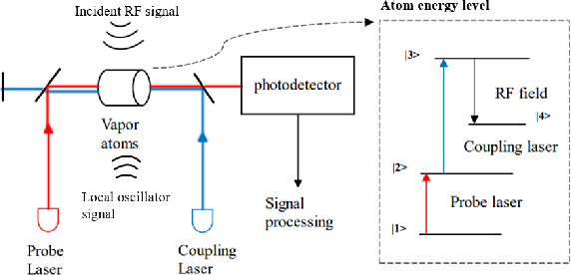
Rydberg sensing in one slide
Atoms convert a microwave field into an optical spectrum
Information chain
780 nm probe
reads optical absorption
480 nm coupling
opens a Rydberg EIT window
RF field
couples neighbouring Rydberg states
photodetector
records optical transmission
Rydberg sensing | Conference
2
Notes:
A Rydberg atom is an atom with a very high principle quantum number (n). Usually a Group 1 element, a Rydberg atom has 1 outer orbiting electron that is far from the nucleus. This causes the atom to be sensitive to perturbations such as RF which is the core idea of how Rydberg works.
So, we get a glass tube and fill it up with Rb (some papers use Cs as they are more sensitive due to the electron being further away from the nucleus) vapour, shine a 780-nanometre probe laser through it to measure how much light goes through, and add another counterpropagating 480-nanometre coupling laser to shift the atoms into a transition phenomena we call Electromagnetically Induced Transparency (EIT) which causes the vapour cell to be more or less transparent as the name suggests.
Click 1, 2: And ultimately, this is what it looks like on a scope. The 780-nanometre probe measures optical absorption. The 480-nanometre laser opens a Rydberg EIT window. And when an RF field couples neighbouring Rydberg states, the optical spectrum changes; in the strong enough regime it produces Autler–Townes splitting. The amount of splitting is proportional to the frequency of the RF signal.

Slide 4



Key players in quantum RF sensing
Major laboratories are actively developing atom-based RF receivers because they offer optically read, atom-defined field measurements in challenging RF environments.
NIST: RF metrology, atom-based receivers and traceable field standards
DEVCOM: resilient communications, spectrum awareness and defence sensing
JPL / NASA: space-relevant sensing and remote electromagnetic environments
Why it matters: RF polarimetry is becoming a topic of interest in the broader regime.
Notes:
Rydberg RF sensing is now being pursued by major organisations because it sits at the intersection of metrology, resilient communications and electromagnetic situational awareness. NIST is strongly associated with traceable RF measurements and atom-based receivers. DEVCOM is interested in defence sensing and resilient communications. JPL and NASA care about remote and space-relevant electromagnetic environments.
The reason I include this slide is to show that the problem is not isolated to one thesis. RF polarimetry is becoming a serious measurement challenge. My project is one piece of that larger question: can we make the polarisation part of the field measurable in a simple and defensible way?

Slide 5
Limitations of Rydberg sensors
Limitation addressed here: polarisation
The platform is powerful, but practical receivers still face system-level constraints.
Weak polarisation detection
1
1 Polarisation is not just power
Polarisation carries information about signal origin, propagation and emitter characteristics that cannot be obtained from received power alone.
Power tells us “how much”. Polarisation helps infer propagation, orientation and emitter behaviour.
2
Limited instantaneous bandwidth
2 Linear measurements are useful but incomplete
A vapour-cell receiver can tune over wide RF bands, but instantaneous modulation bandwidth is still limited for many spread-spectrum or rapidly varying signals.
The present receiver distinguishes linear orientations, but H/V/D/A alone leave circular handedness unobserved.
3
Optical complexity
3 Thesis focus
Current systems require multiple lasers, frequency stabilisation, optical alignment and photodetection, increasing deployment burden.
Use calibrated RF projections with Rydberg optical readout, then reconstruct the Stokes vector with a clear validation path.
This presentation addresses limitation 1: recovering useful polarisation information by viewing the microwave as a vector, not a scalar power reading.
Take-away: the remaining gap is not RF detection itself; it is complete, calibrated polarisation recovery.
Rydberg sensing | Conference
Notes:
Rydberg RF sensors are powerful, but they are not magic. There are practical limitations.
First, polarisation detection is weakly developed. Power tells us how much signal arrived, but polarisation can reveal orientation, propagation and emitter behaviour.
Click 1: Second, instantaneous bandwidth remains a practical issue. The transition can be tuned, but high-speed, wideband operation is still a system challenge.
Click 2: Third, the optical system is still relatively complex, with lasers, stabilisation, alignment and photodetection.
Click 3: This talk addresses the first limitation: how to turn a scalar atomic RF response into a calibrated vector measurement.

Slide 6
Thesis aim: recover unknown microwave polarisation
Turn a scalar RF readout into a calibrated vector measurement.
Unknown RF
polarisation
Calibrated
projections
Atomic
readout
Calibrated
inversion
Stokes
estimate
state
H/V • D/A • R/L
EIT / AT response
matrix + uncertainty
ŝ = [s₁, s₂, s₃]
Key contribution
calibrated RF projections + atomic optical readout → microwave Stokes estimate with explicit validation limits.
Measured now
Inference gap
Why it matters
Linear-polarisation response survives the RF/atomic readout chain.
Linear states span the S₁/S₂ plane; S₃ is still unmeasured.
Richer RF-state information for sensing, discrimination and validation.
Rydberg sensing | Conference
4
Notes:
This is the central architecture of the project. On the left we start with an unknown RF polarisation state. We then need calibrated projections: horizontal/vertical, diagonal/anti-diagonal, and ultimately right/left circular or another independent non-coplanar channel.
The atom provides the optical readout through the EIT or Autler–Townes response. Then, after calibration, we use an inversion matrix to estimate the Stokes vector: s1, s2 and s3.
The key contribution is the chain as a whole: calibrated RF projections plus atomic optical readout, leading to a microwave Stokes estimate with explicit validation limits.

Slide 7
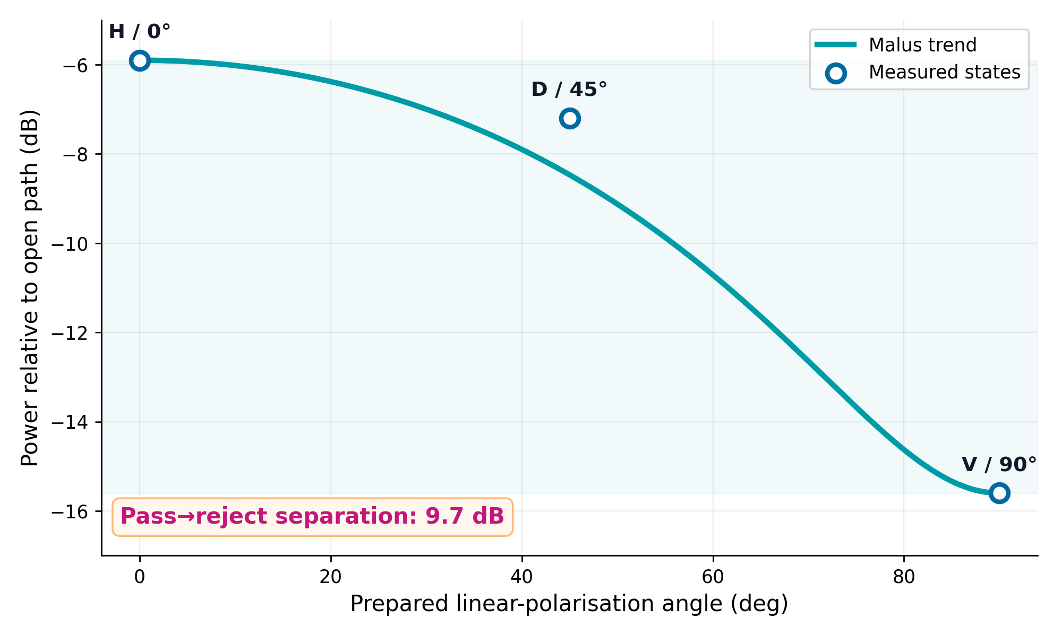
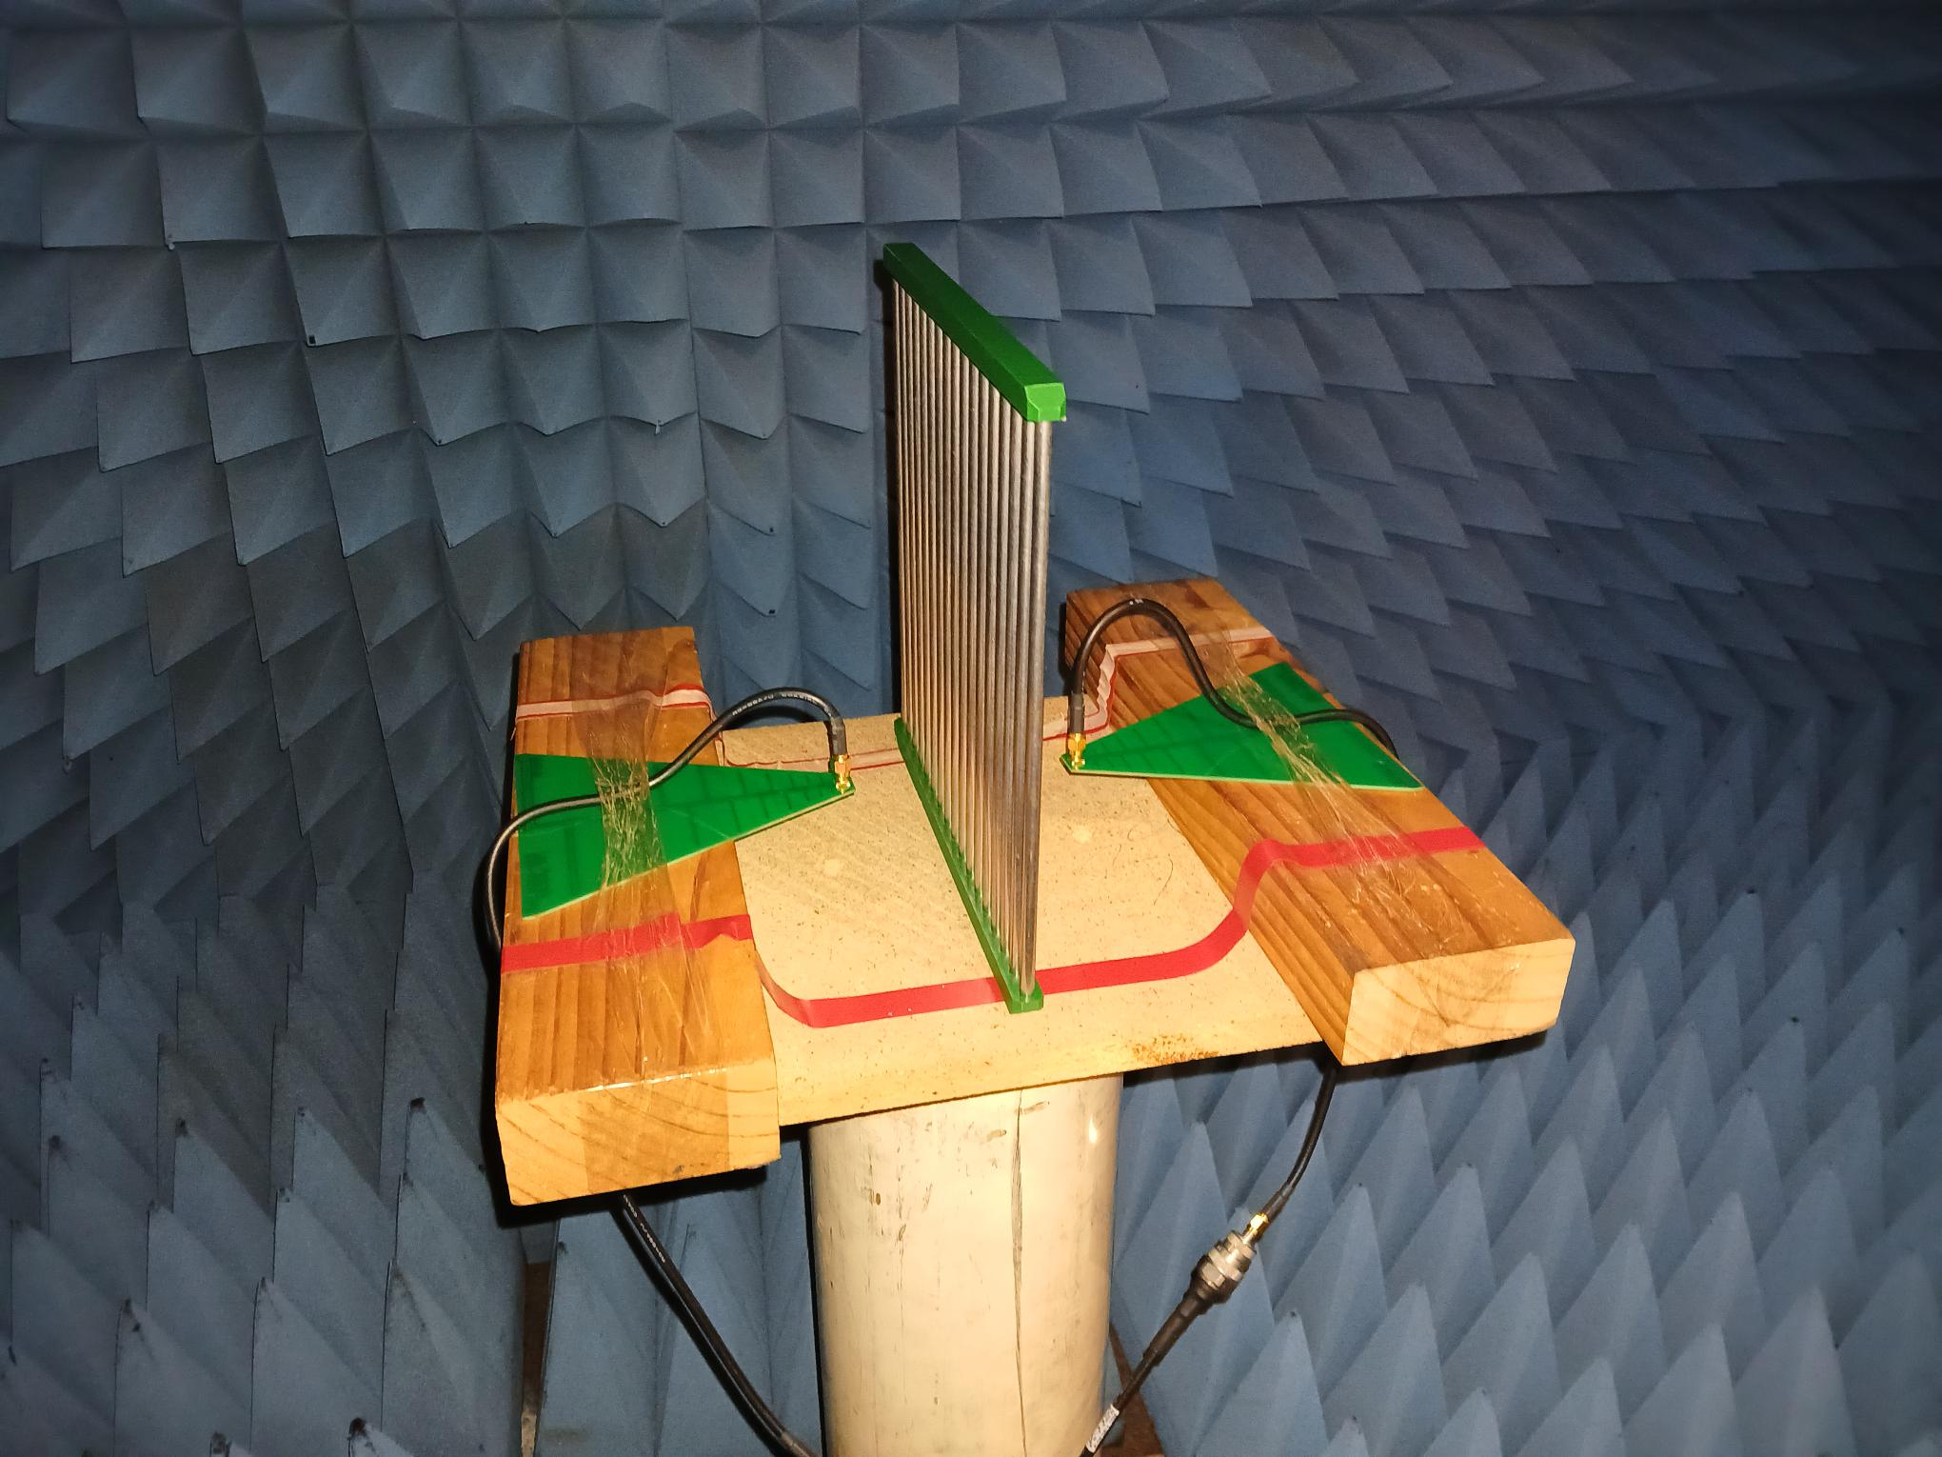
Linear polarisation survives atomic readout
Measured linear states remain ordered through the RF/atomic chain.
1
Measured response
2
Linear polariser hardware/testing
PROVES
linear discrimination survives atomic readout
LIMIT
S₃ / handedness not measured
Pass/reject separation: 9.7 dB | H: −5.9 dB D: −7.2 dB V: −15.6 dB
Measured result: the atom preserves useful linear-polarisation contrast. Full polarimetry still needs one independent S₃-sensitive measurement.
Rydberg sensing | Conference
5
Notes:
This is the main experimental result in the talk. The measured linear states remain ordered through the RF and atomic readout chain. At 2 GHz, the H or 0° state is the strongest, the D or 45° state sits between, and the V or 90° state is strongly rejected.
The useful headline is the pass–reject separation: 9.7 dB. In linear terms that is a strong contrast, and it tells us that useful linear-polarisation information survives the experimental chain.
The photograph on the right is the linear polariser hardware and testing arrangement, not the complete optical setup. That is worth saying clearly because it avoids overclaiming what the image represents.
So the honest conclusion is: this proves linear discrimination survives atomic readout. It does not yet prove full-Stokes polarimetry, because the circular component, S3, is still not measured.

Slide 8
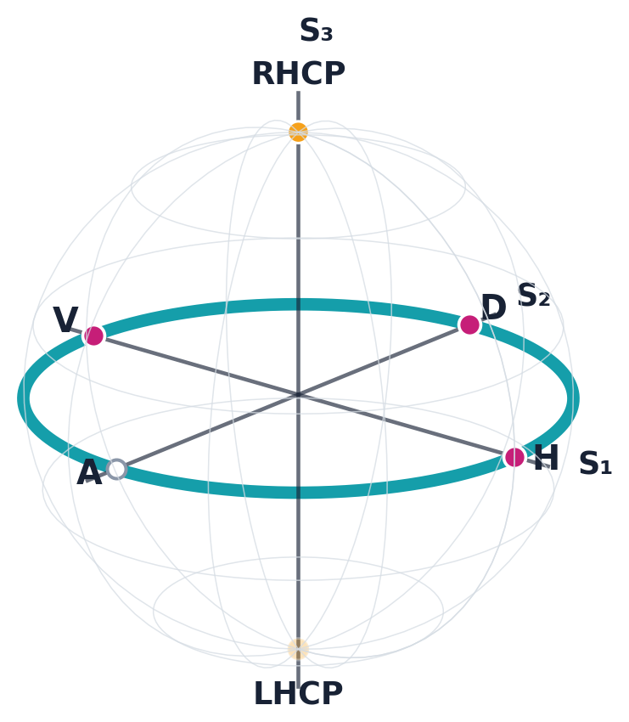
Linear data sample the Stokes equator
A linear analyser explores the S₃ = 0 plane; circular handedness lies off that plane.
Poincaré-sphere view
Stokes estimates from five averaged runs
Metric
Estimate
Theory / test
H
0.811 (−5.9 dB)
high / pass
D
0.590 (−7.2 dB)
intermediate
V
0.029 (−15.6 dB)
low / reject
ŝ₁
+0.93
H − V
ŝ₂
+0.40
D − A; A not yet measured
ŝ₃
not measured
requires R − L channel
Teal ring = every linear state (S₃ = 0)
The limitation is observability: linear measurements estimate S₁/S₂ but cannot uniquely determine the sign or magnitude of S₃.
Rydberg sensing | Conference
6
Notes:
This is the conceptual centre of the presentation. The Poincaré sphere is a map of polarisation states. The teal ring is the equator, where S3 equals zero. Every point on that ring is a linear polarisation state. The circular states sit at the poles, off the equatorial plane.
The table gives the Stokes-related estimates from five averaged runs. The measured H, D and V values follow the expected ordering: H is high, D is intermediate, and V is low. The H/V contrast is the same 9.7 dB result, which is roughly a 9.3 times contrast in linear power.
The statistical point is deliberately conservative. With the averaged values shown here, the strongest defensible statement is an effect-size and ordering check against the theoretical expectation: H greater than D greater than V, consistent with Malus-law behaviour. A formal p-value would require the individual repeat values and their variance, not just the displayed averages.
The deeper message is that this is not a curve-fitting problem. Linear measurements estimate S1 and part of S2, but they cannot uniquely determine the sign or magnitude of S3. The missing information is an observability problem. No clever algorithm can reconstruct a component that was never measured.

Slide 9
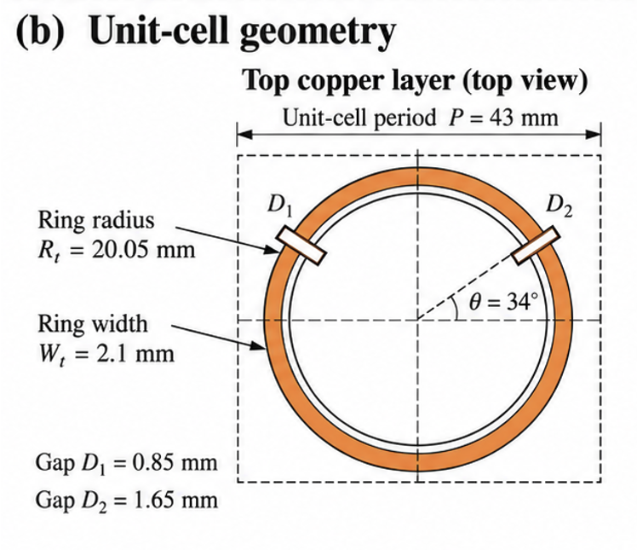
Full-Stokes path: make S₃ observable
The next step is a calibrated switchable analyser — not another linear fit.
1
Observability
2
Reconstruction
3
Hardware route
rank 3
rank 4
q = A·S → Ŝ = A⁺q
Linear projections contain S₀, S₁ and S₂.
A is measured
from calibration
A⁺ maps responses
back to Stokes space
One independent R/L or non-coplanar measurement supplies S₃ and closes the inverse problem.
≈ 1.17°
median angular error
at 1% simulated noise
Electronic bias states change the RF projection before the vapour cell.
Design target: full-rank calibrated response matrix
Repeatable state switching
Four non-coplanar states reduce noise amplification.
Next proof: calibrate the switchable analyser, reconstruct held-out linear + circular states, and verify angular error and handedness.
Rydberg sensing | Conference
7
Notes:
6:30–7:35 | Full-Stokes path
This slide answers the obvious question: what has to change to make S3 observable? Card 1 is the linear-algebra statement. Linear projections give a rank-three view of the full Stokes problem. To solve for the full vector, we need a fourth independent measurement, either an R/L channel or a non-coplanar analyser state.
Card 2 is the reconstruction statement. The calibrated measurements form a response vector q. The analyser matrix A maps Stokes space to those measured responses, and after calibration we use the pseudoinverse A-plus to map back from q to an estimated Stokes vector. The important point is that A should be measured from calibration, not simply assumed from an ideal drawing.
The simulation number, around 1.17 degrees median angular error at 1% readout noise, is a design target showing that a well-conditioned four-state basis can control noise amplification.
Card 3 is the hardware route: a switchable PIN-diode unit cell. The goal is to change the RF projection electronically before the vapour cell, rather than physically rotating the receiver. That makes the next experiment clear: calibrate the switchable analyser, reconstruct held-out linear and circular states, and verify both angular error and handedness.

Slide 10
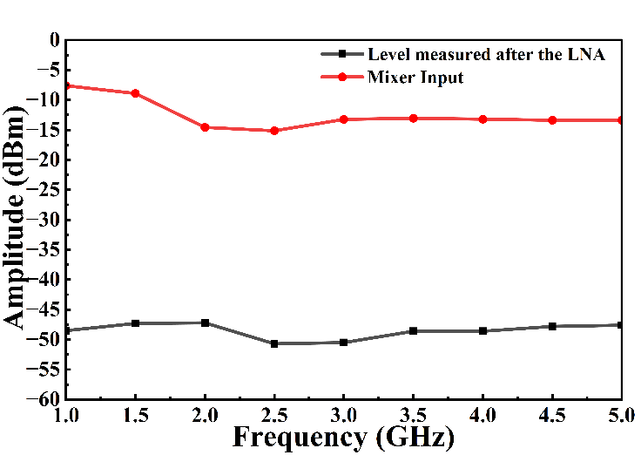
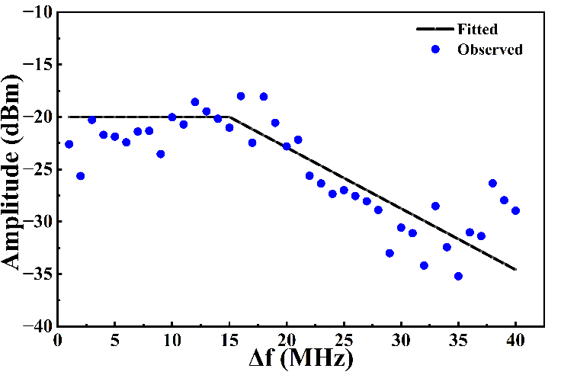
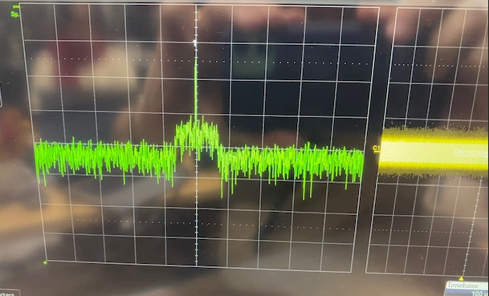
Why add an atomic RF channel?
Atoms provide optical RF observables that can complement conventional front ends
MIXING
ROBUST
TUNABILITY
Atomic mixing can provide an additional RF readout channel and enable frequency translation.
Atomic spectra can retain useful structure when conventional RF measurements are degraded by interference.
Changing the Rydberg transition shifts the operating band without changing the vapour-cell sensing element.
UAV-LIV
Connection to this thesis: use the atom as an optical RF readout, then add calibrated projections so the output carries vector information.
Mobile testbed context: emitter detection, RF discrimination and environmental robustness.
Rydberg sensing | Conference
3
Notes:
7:35–8:20 | Broader atomic RF channel
This slide widens the lens. Even beyond polarisation, atom-based RF sensing can complement conventional front ends. Atomic mixing can provide an additional RF readout channel and enable frequency translation. Atomic spectra can retain useful structure in environments where conventional RF measurements are degraded by interference. And by changing the Rydberg transition, the operating band can shift without replacing the vapour-cell sensing element.
The connection to this thesis is that I am using the atom as an optical RF readout, then adding calibrated projections so that the output carries vector information, not merely scalar field strength.
For an industry or defence audience, this is where the work becomes practical: richer RF-state information can help with discrimination, robustness and validation in complex electromagnetic environments.

Slide 11
Conclusions
What is measured, what is modelled, and what comes next
Measured now
780-nm absorption and EIT-bearing spectra were recorded, and the linear-polariser run demonstrates ordered linear-polarisation response after atomic readout.
MEASURED
Supported by modelling
Observability analysis shows why an independent S₃-sensitive channel is required; Zeeman modelling provides a physically credible route to circular-handedness sensitivity.
MODELLED
What remains
A calibrated R/L-sensitive measurement has not yet been demonstrated. The current experimental result is linear-polarisation discrimination, not complete full-Stokes recovery.
NEXT
Next proof
Calibrate H/V, D/A and R/L projections; measure a stable circular response; invert the calibrated response to a Stokes vector; validate against known RF references.
Take-home message
This work establishes a testable Rydberg-polarimetry architecture, demonstrates the linear-polarisation measurement pathway, and defines the route to calibrated full-Stokes validation.
Rydberg sensing | Conference
8
Notes:
8:20–9:10 | Conclusions
This conclusion is intentionally separated into what is measured, what is modelled and what comes next. Measured now: absorption and EIT-bearing spectra were recorded, and the linear-polariser run demonstrates ordered linear-polarisation response after atomic readout.
Supported by modelling: the observability analysis shows why an independent S3-sensitive channel is required, and the magnetic-bias modelling provides a physically credible route to circular-handedness sensitivity.
What remains: a calibrated R/L-sensitive measurement has not yet been demonstrated. The current experimental result is linear-polarisation discrimination, not complete full-Stokes recovery.
The next proof is beautifully concrete: calibrate H/V, D/A and R/L projections, measure a stable circular response, invert the calibrated response to a Stokes vector, and validate it against known RF references.

Slide 12




Team
Team
Acknowledgements and project context
Ryan Verghese
Ryan Verghese
Dr Haroldo T. Hattori
Ishara Somaweera
Prof Andrey E. Miroshnichenko
Ishara Weerasinghe
Presenter
Supervisor
Supervisor
PhD Student
This work sits within the wider UNSW/DSTG quantum RF sensing programme: receiver physics, calibrated RF projections, and practical sensing architectures.
This work sits within the wider UNSW/DSTG quantum RF sensing programme: receiver physics, calibrated RF projections, and practical sensing architectures.
This work sits within the wider UNSW quantum RF sensing programme
This work sits within the wider UNSW/DSTG quantum RF sensing programme: receiver physics, calibrated RF projections, and practical sensing architectures.
Andrey Miroshnichenko
Rydberg sensing | SET HDR Conference
Haroldo Hattori
Rydberg sensing | SET HDR Conference
Rydberg sensing | SET HDR Conference
Rydberg sensing | Conference
Notes:
9:10–9:35 | Team
I want to acknowledge the team behind the work. Dr Haroldo Hattori and Prof Andrey Miroshnichenko supervised the project, and Ishara Weerasinghe contributed valuable group context and support.
And this young and handsome fella on the left is me a few years ago — clearly before thesis writing aged me in real time. Jokes aside, this work sits within the wider UNSW quantum RF sensing programme, and I am grateful to everyone who helped make the experimental and theoretical pieces possible.

Slide 13
References
1. Sedlacek et al., “Microwave electrometry with Rydberg atoms in a vapour cell using bright atomic resonances,” Nature Physics 8, 819–824 (2012).
10. Goldstein, Polarized Light, 3rd ed., CRC Press (2011) — Stokes parameters and Poincaré-sphere formalism.
2. Holloway et al., “Sub-wavelength imaging and field mapping via EIT and Autler–Townes splitting in Rydberg atoms,” Applied Physics Letters 104, 244102 (2014).
11. Chipman, Lam and Young, Polarized Light and Optical Systems, CRC Press (2018) — analyser matrices and polarimetric instrumentation.
3. Gordon et al., “Millimeter wave detection via Autler–Townes splitting in rubidium Rydberg atoms,” Applied Physics Letters 105, 024104 (2014).
12. Balanis, Antenna Theory: Analysis and Design, 4th ed., Wiley (2016) — antenna polarisation, gain and RF link assumptions.
4. Holloway et al., “A Rydberg atom-based mixer: measuring the phase of a radio frequency wave,” Applied Physics Letters 114, 114101 (2019).
13. Hamaker, Bregman and Sault, “Understanding radio polarimetry. I. Mathematical foundations,” Astronomy & Astrophysics Supplement Series 117, 137–147 (1996).
5. Gordon et al., “Weak electric-field detection with sub-1 Hz resolution at radio frequencies using a Rydberg atom-based mixer,” AIP Advances 9, 045030 (2019).
14. Elgee et al., “Complete three-dimensional vector polarimetry with a Rydberg-atom RF electrometer,” Physical Review Applied 22, 064012 (2024).
6. Holloway et al., “Detecting and receiving phase-modulated signals with a Rydberg atom-based receiver,” NIST / atom-based receiver demonstration (2019).
15. Chiccot et al., “Quantum-enabled complete RF-polarimetry with an optically-wired atomic sensor,” arXiv:2505.14259 (2025).
7. Robinson et al., “Determining the angle-of-arrival of a radio-frequency source with a Rydberg atom-based sensor,” Applied Physics Letters 118, 114001 (2021).
16. Šibalić et al., “ARC: An open-source library for calculating properties of alkali Rydberg atoms,” Computer Physics Communications 220, 319–331 (2017).
8. Berweger et al., “Independent Rydberg atom sensing using a dual-ladder scheme,” Applied Physics Letters, DOI: 10.1063/5.0206004 (2024).
17. Rydiqule documentation and density-matrix modelling workflows used for EIT / AT spectral simulations and forward-model checks.
9. Holloway, Simons and colleagues, NIST Rydberg electrometry, mixer, antenna and receiver publications used as the RF-sensing baseline.
18. Internal UNSW/DSTG group material: Weerasinghe, Muthugala, Verghese et al. manuscripts and preprints supplied to author (2026).
Rydberg sensing | Conference
9
Notes:
9:35–9:45 | References
I will not walk through every reference during the talk, but this slide documents the foundations: Rydberg electrometry, Autler–Townes field measurement, Rydberg receivers, Stokes polarimetry, analyser matrices and the recent work on complete RF polarimetry with atomic sensors.
If a question comes up about precedent or novelty, this is the slide I can point to. The novelty here is not that Rydberg atoms sense RF fields; it is the calibrated polarimetric pathway from an atomic optical response toward microwave Stokes recovery.

Slide 14

QUESTIONS
Explore the wider Quantum RF Sensing programme
Scan to explore
1
THIS THESIS
Linear-polarisation discrimination • Stokes observability • full-Stokes validation path
2
GROUP PROGRAMME
Wideband reception • atomic mixing • interference studies • simplified optics • field enhancement
3
NEXT PLATFORMS
Quantum RF Sensing
Drone RF signatures • environmental robustness • metasurface enhancement • active sensing concepts
Thesis notes • group projects • deployment concepts
Rydberg sensing | Conference
10
Notes:
9:45–10:00 | Questions
To close: the one idea I want you to remember is that the atom already preserves useful linear-polarisation information, but full polarimetry requires observability of S3. The path forward is a calibrated switchable analyser that makes that missing component measurable.
Thank you very much. I would be happy to take questions.

Slide 15
Appendix
Notes:
Appendix divider
This is the start of the backup material. Do not present it in the main 10-minute talk unless asked. Use it as a signal that the main story is complete and that technical details are available for questions.

Slide 16
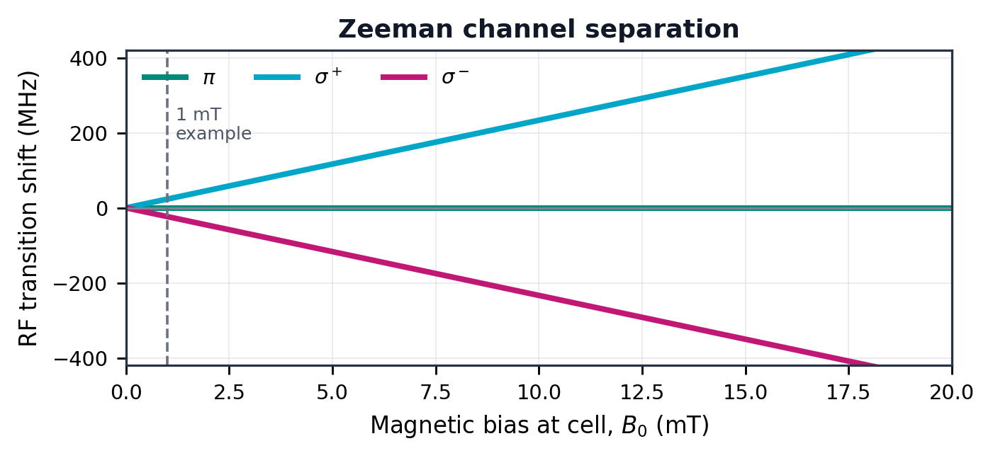
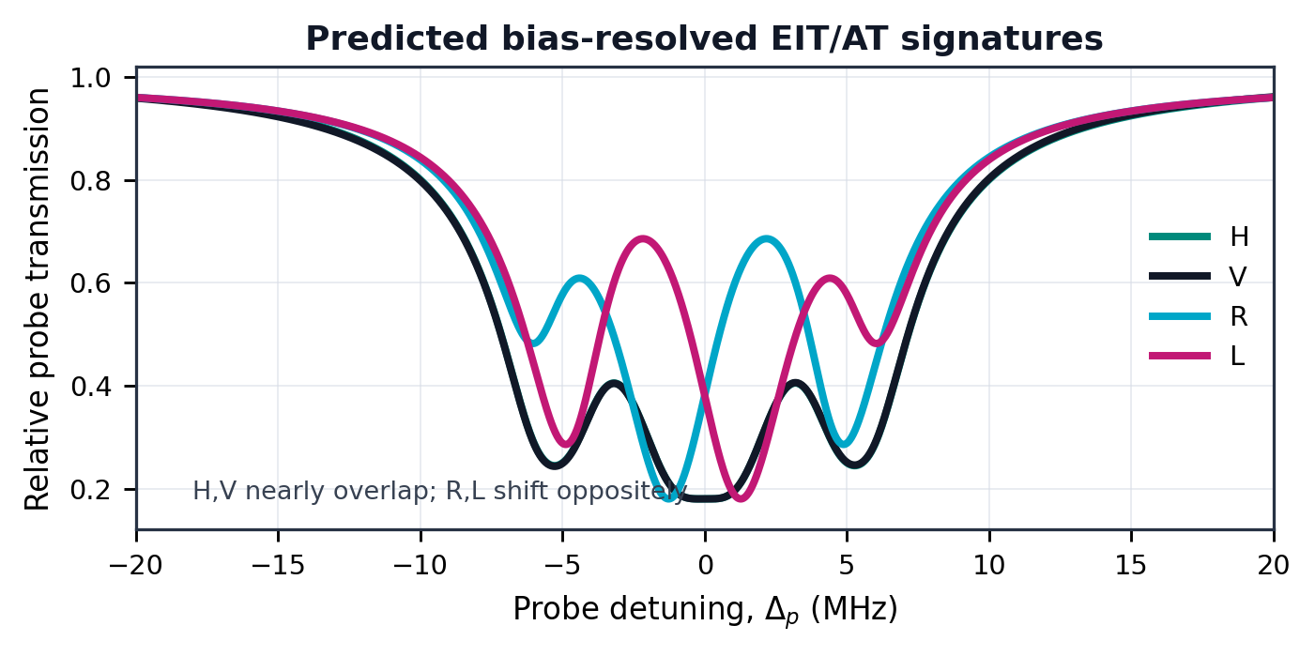
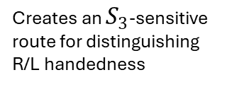
Why magnetic biasing matters
A DC bias can define a quantisation axis for circular-handedness sensitivity
Physical idea
Modelled mechanism — not experimental proof
1
What the bias enables
Bias defines a quantisation axis
σ⁺
incident
microwave
polarisation
Δm = +1
Defines a quantisation
axis for the Rydberg
transition
⁸⁷Rb
cell
1
π
R/L
Δm = 0
σ⁻
Δm = −1
Can separate σ⁺/σ⁻
channels so R and L
map to different spectra
B₀ ∥ k
2
With no bias, circular components can overlap. With stable bias, σ⁺ and σ⁻ can move to different atomic resonances.
Creates an $S_{3}$-sensitive route for distinguishing R/L handedness
3
!
Message:
magnetic biasing can turn circular microwave polarisation into measurable atomic spectral contrast when stability and calibration are sufficient.
Rydberg sensing | SET HDR Conference
5
Notes:
Backup: magnetic biasing matters
Use this slide if someone asks how circular handedness could become visible to the atom. The key answer is that a DC magnetic bias defines a quantisation axis. With sufficient stability and calibration, sigma-plus and sigma-minus pathways can map right- and left-handed circular components to different spectral responses.
Be conservative: this is a modelled mechanism and physical route, not a completed experimental proof in the current dataset.

Slide 17
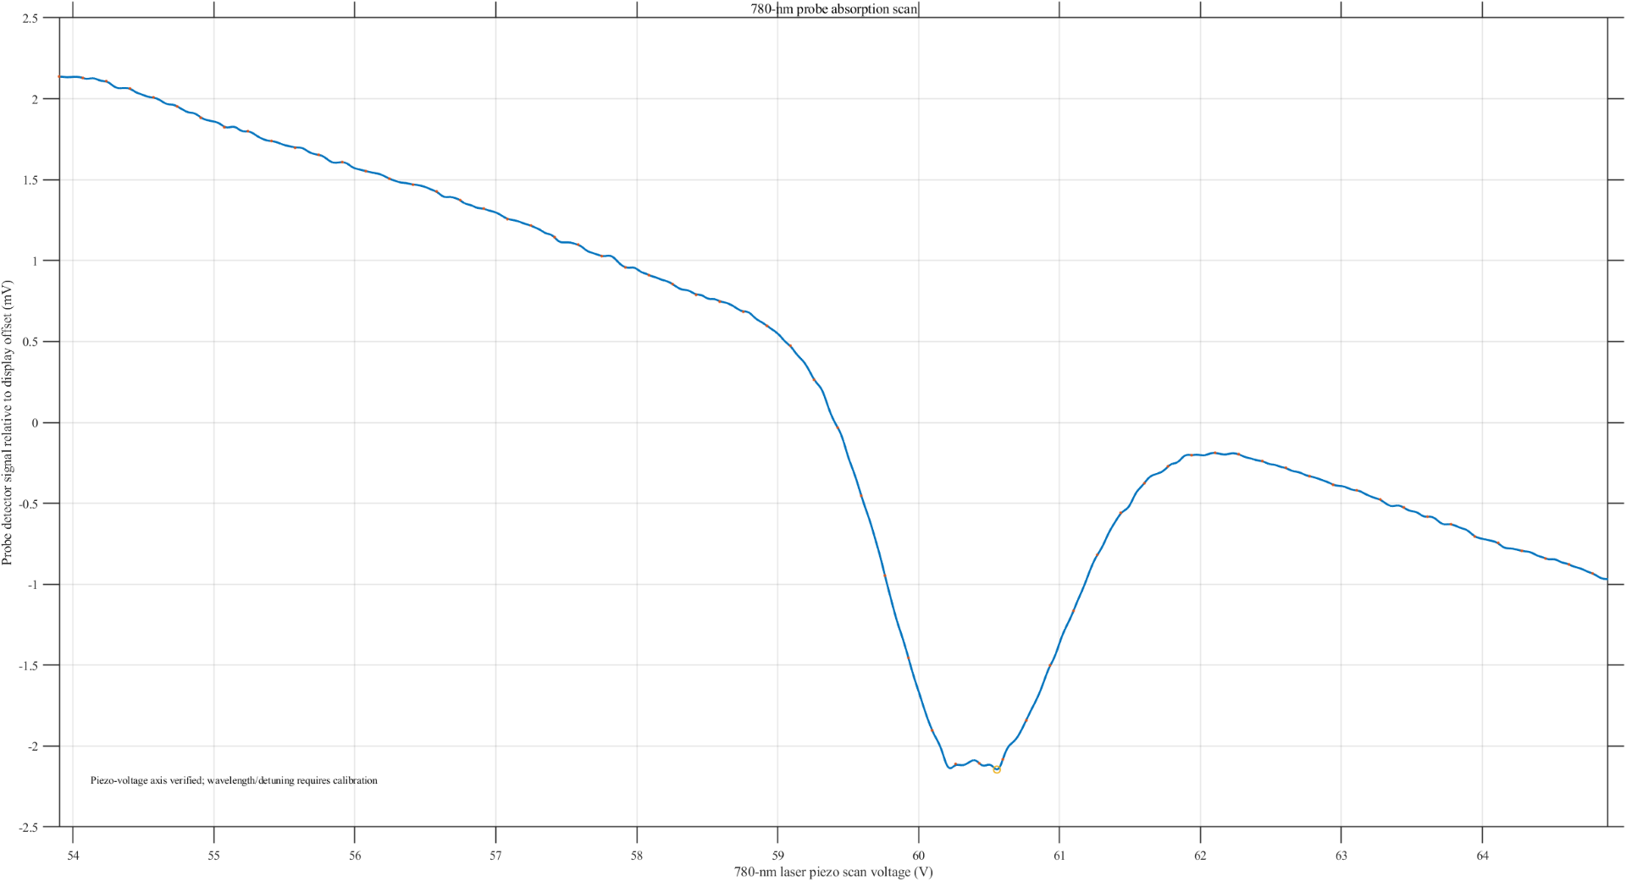
Backup: raw optical traces
Rydberg sensing | SET HDR Conference
A1
Notes:
Backup: raw optical trace
Use this if asked whether the optical signal was actually observed. The main point is that the photodetector records an optical transmission feature, and the raw trace is the experimental basis for extracting EIT or related spectral structure.
Keep the answer short: raw traces are evidence of the optical readout chain, not by themselves proof of full polarimetry.

Slide 18
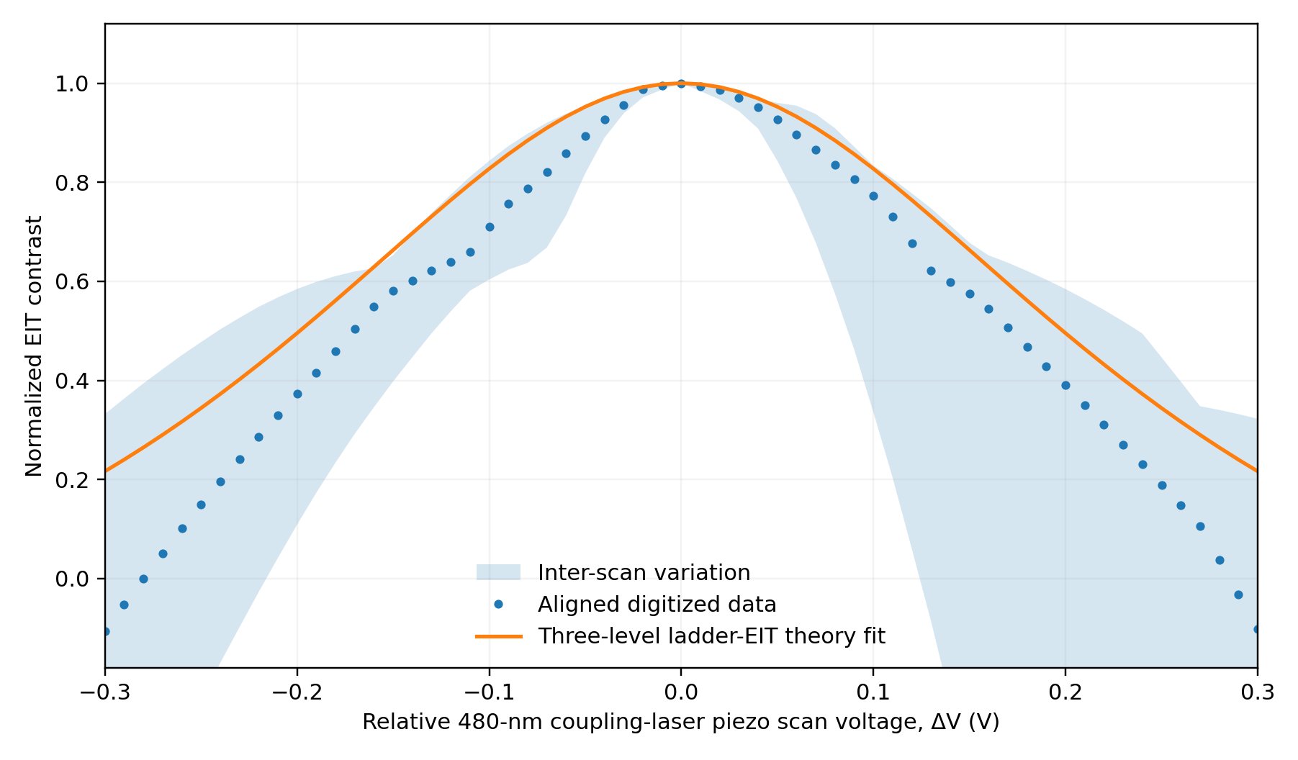
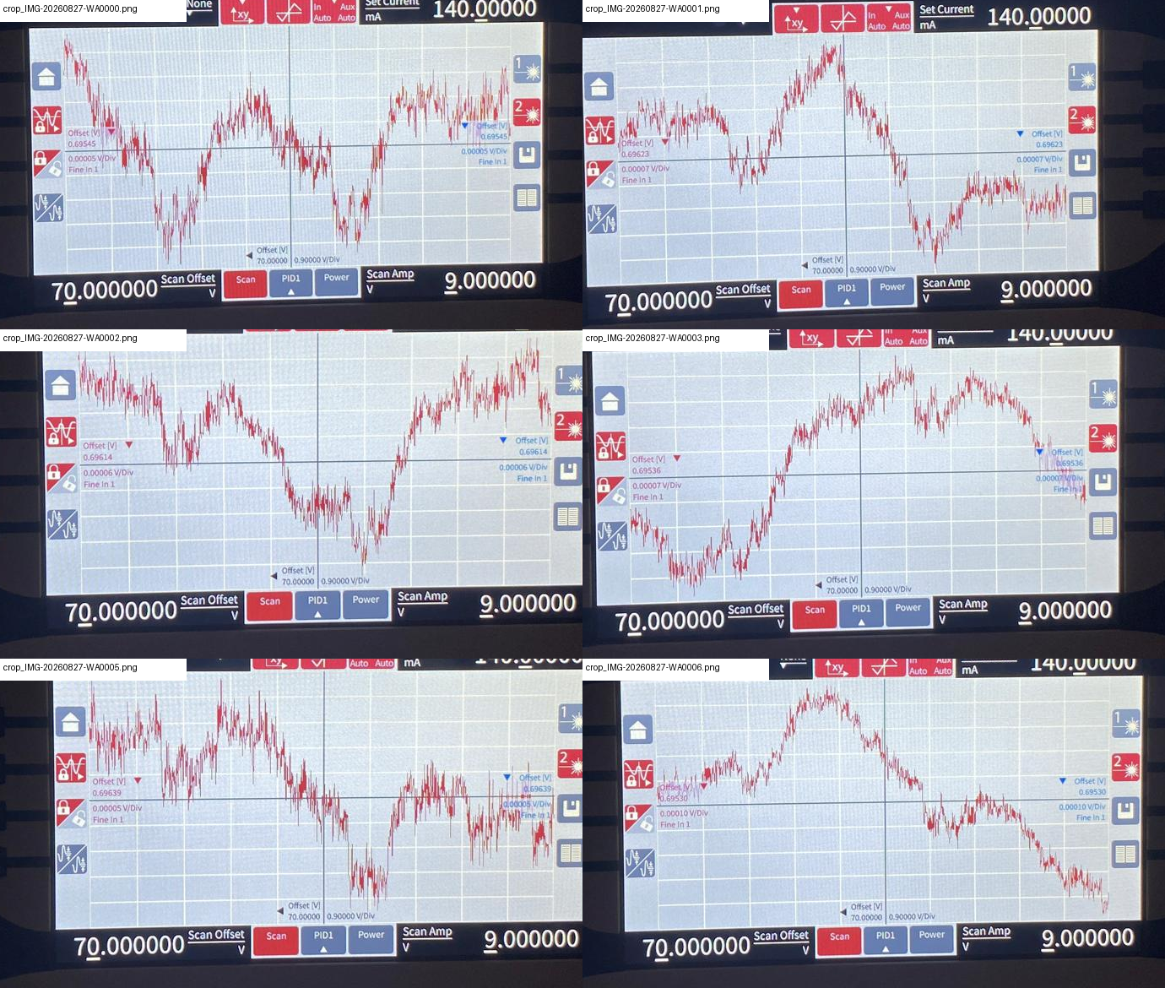
Backup: raw optical traces
Rydberg sensing | SET HDR Conference
A1
Notes:
Backup: raw optical traces and variation
Use this if asked about repeatability or scan-to-scan variability. The figure is useful for explaining that real vapour-cell EIT data are not perfectly clean; drift, noise and scan variation are part of the measurement environment.
This supports the cautious wording in the main talk: I claim ordered linear discrimination, not a fully validated circular-handedness measurement.

Slide 19
Backup: field-level calibration
Why source power is not the same as RF field at the atom
What determines AT splitting?
Needed for exact prediction
ΔAT ∝ ΩRF = d·E / ℏ
local electric field at cell, not generator display only
antenna gain/losses and polariser insertion loss
transition dipole matrix element
beam waist and optical Rabi frequencies
linewidth, Doppler and cell reflections
Safe statement
Safe approach: simulate as a function of ΩRF, then calibrate ΩRF from measured Autler–Townes splitting rather than generator power alone.
Rydberg sensing | SET HDR Conference
A2
Notes:
Backup: field-level calibration
Use this if asked why generator power is not equal to field at the atoms. The safe statement is that Autler–Townes splitting depends on the local electric field at the cell, the transition dipole moment and the optical/RF environment, not just the signal generator display.
The correct strategy is to simulate as a function of RF Rabi frequency, then calibrate the effective field from measured splitting where possible.

Slide 20
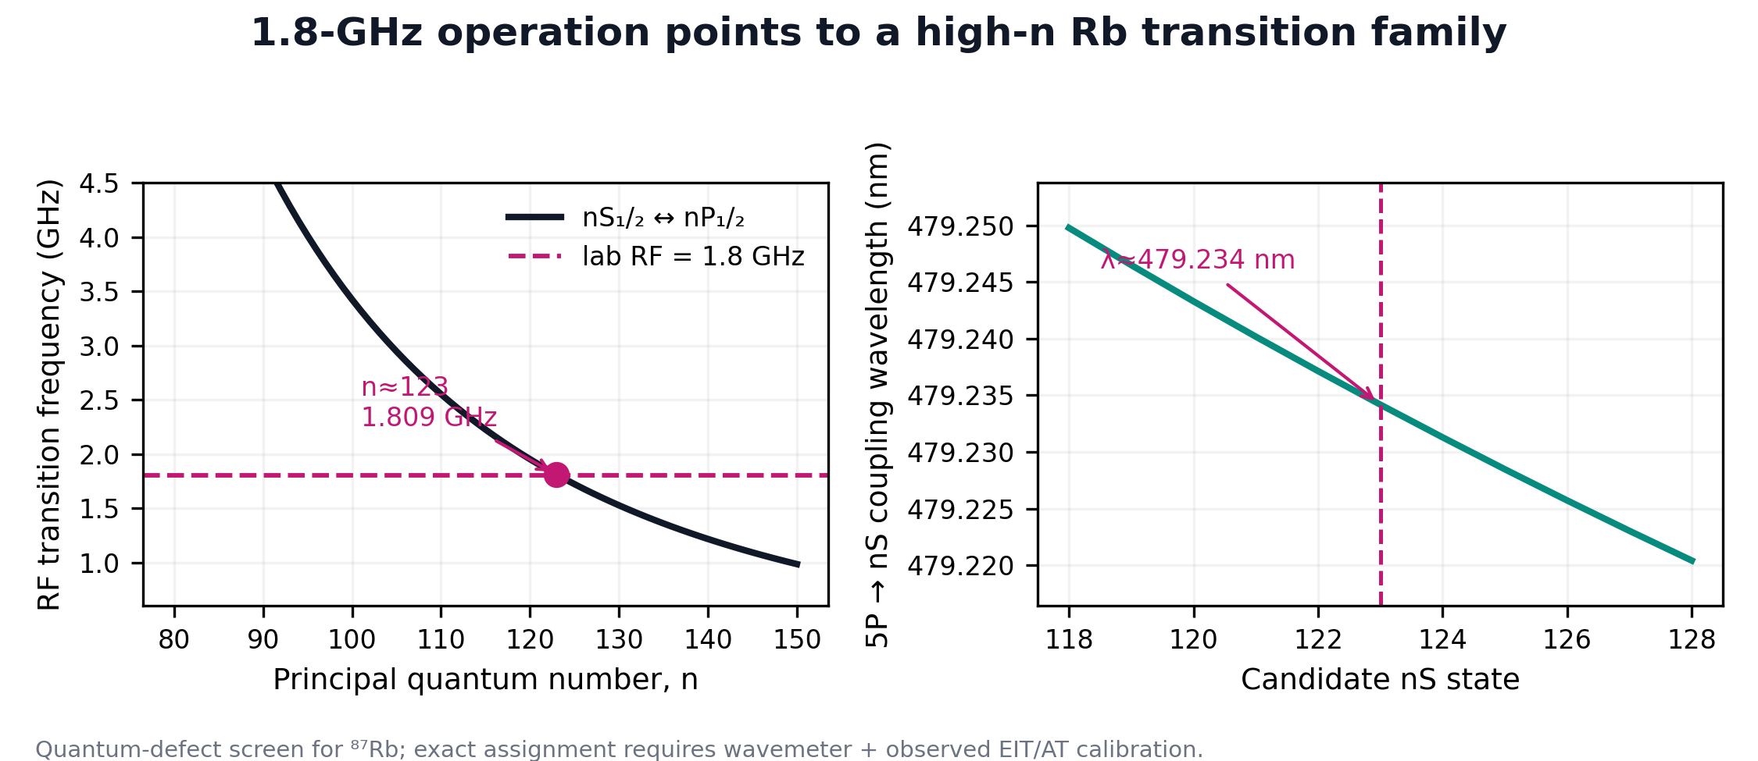
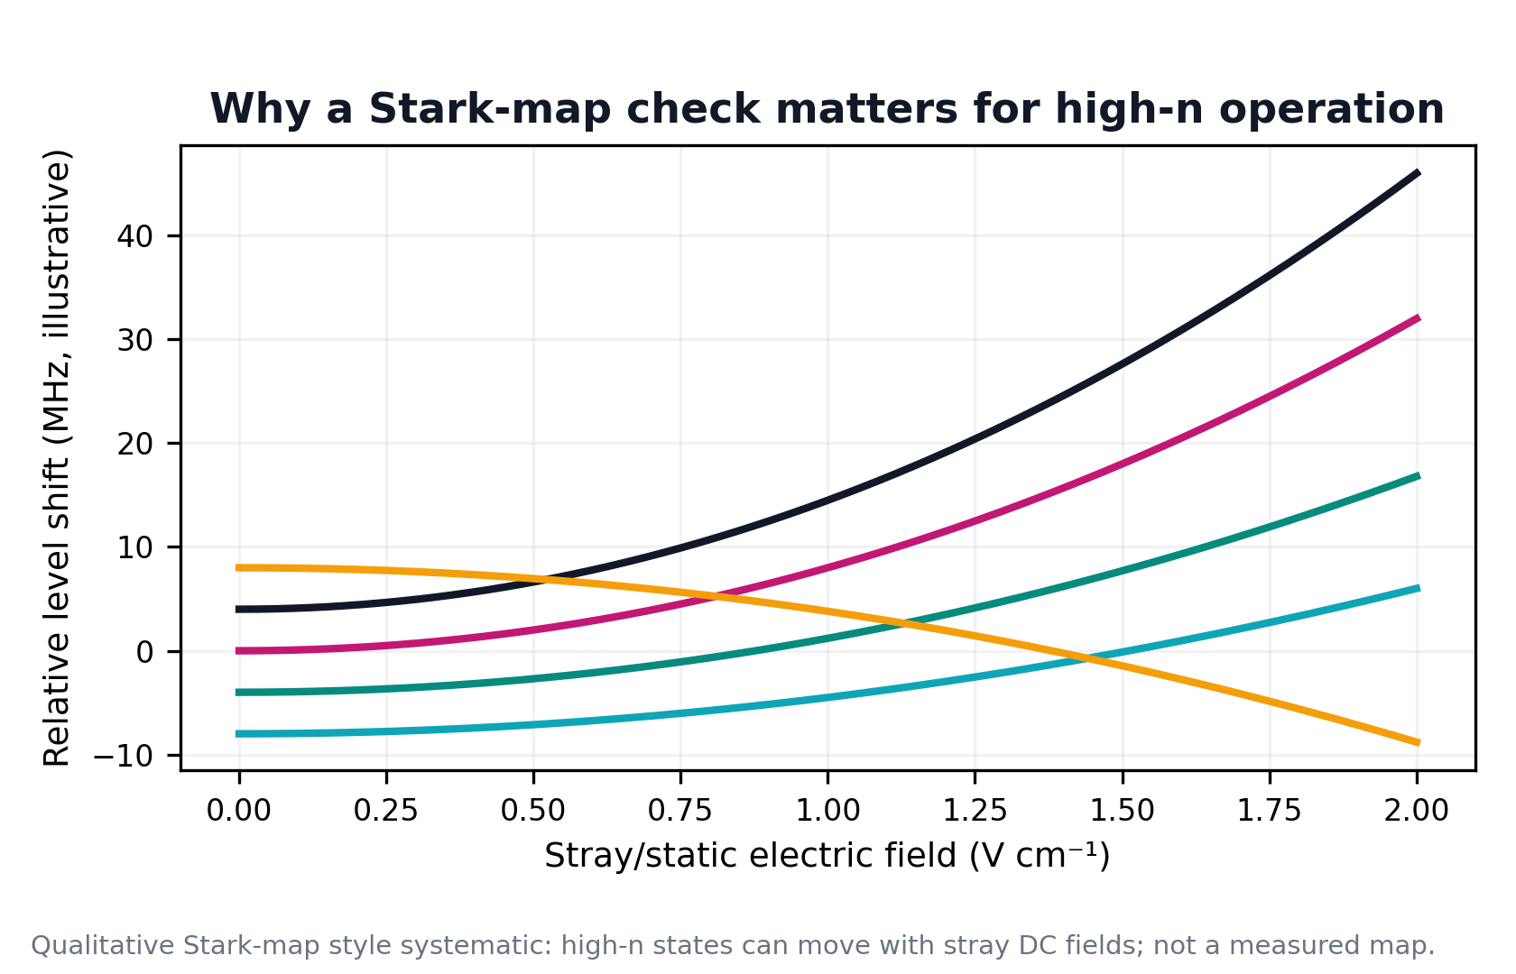
Backup: level/systematic screening
Transition choice and environment both matter at high n
Transition screen
Stark screen
The 1–2 GHz band points to high-n candidates; final assignment requires wavemeter-verified optical tuning and observed EIT/AT calibration.
High-n states are sensitive to stray static fields; Stark-map checks are useful for deployment and reflector/metasurface environments but are not the main novelty here.
Rydberg sensing | SET HDR Conference
A3
Notes:
Backup: level and systematic screening
Use this if asked about transition choice. The 1–2 GHz range points to high-n Rydberg candidates, but final assignment needs wavemeter-verified optical tuning and observed EIT or Autler–Townes calibration.
Also mention that high-n states are sensitive to stray fields, so Stark-map checks are useful for deployment or metasurface environments, even though they are not the main novelty of the thesis.

Slide 21
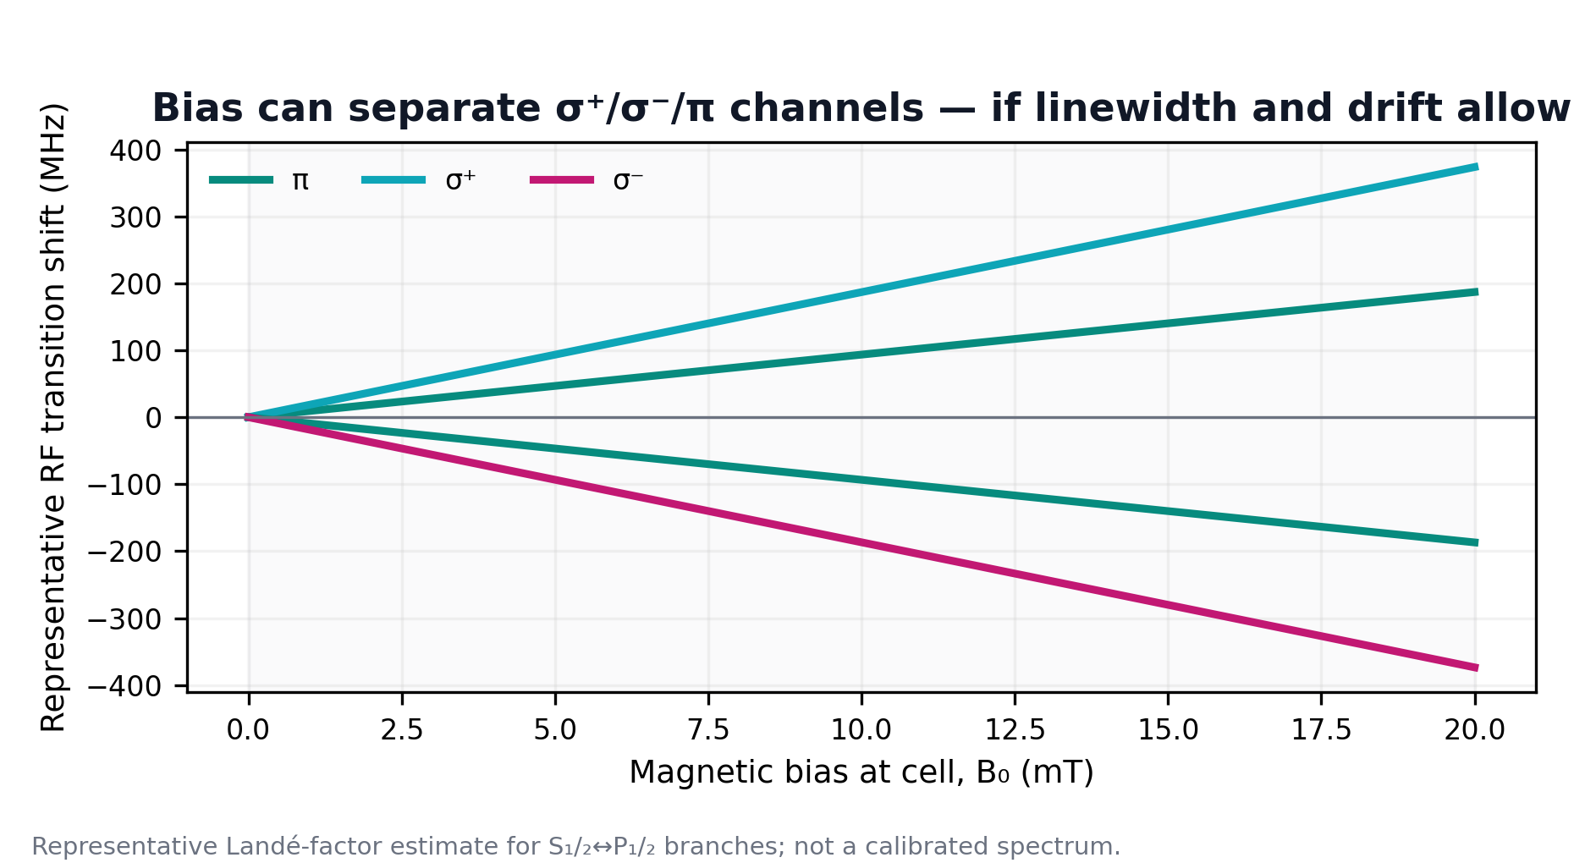
Backup: magnetic-bias mechanism
Modelled channel separation, not full experimental proof
Interpretation
A calibrated bias can define a quantisation axis and separate σ/π branches in principle; present data should be described conservatively.
Rydberg sensing | SET HDR Conference
A4
Notes:
Backup: magnetic-bias mechanism
Use this if someone wants the atomic-selection-rule explanation. A calibrated bias can define the quantisation axis and separate sigma and pi branches in principle. That gives a route to making circular components spectrally distinguishable.
Again, keep the boundary clear: this explains mechanism and design logic, not a claim that the present magnetic-bias experiment conclusively demonstrated handedness detection.

Slide 22
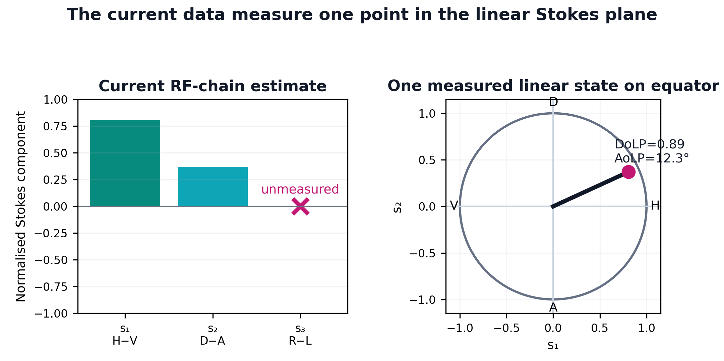
Backup: Stokes inversion convention
dBm is converted to linear power before any Stokes calculation
Projection equations
S₀ = P_H + P_V
S₁ = P_H − P_V
S₂ ≈ 2P_D − S₀ (until A = −45° is measured)
S₃ = P_R − P_L (not yet measured)
Current convention
s₁ = H−V and s₂ = D−A. The current single-run estimate is one point on the linear equator, not a full-sphere polarisation reconstruction.
Rydberg sensing | SET HDR Conference
A5
Notes:
Backup: Stokes inversion convention
Use this if asked how dBm values enter Stokes calculations. The answer is that dBm must be converted to linear power before forming Stokes projections.
The convention here is s1 from H minus V and s2 from D minus A, while s3 requires R minus L. In the current main dataset, the result is an equatorial estimate, not a full-sphere reconstruction.

Slide 23
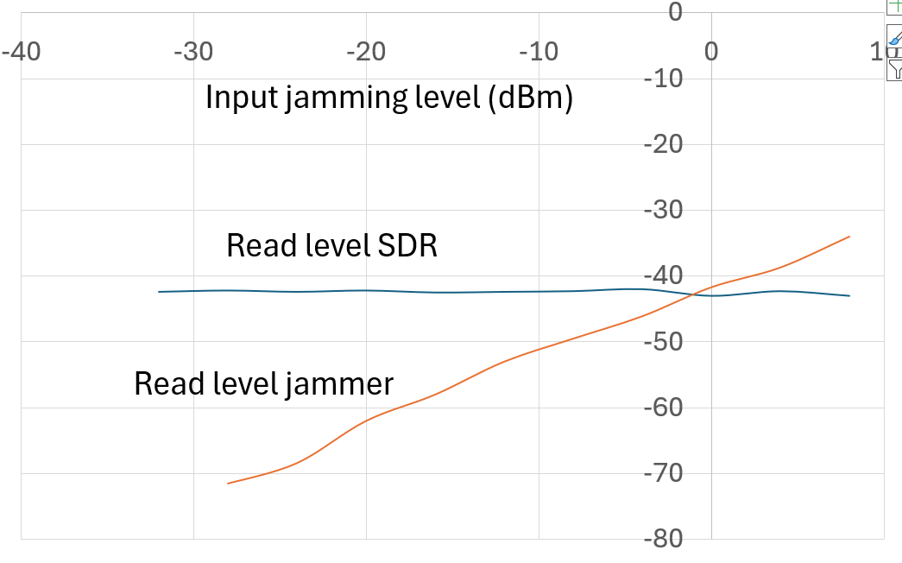
Backup: broader programme evidence
Used for context only, not as thesis polarimetry results
Rydberg sensing | SET HDR Conference
A6
Notes:
Backup: broader programme evidence
Use this only for context. The slide supports the wider UNSW quantum RF sensing programme, but do not present these as the thesis polarimetry results.
A good one-sentence answer is: these results show why the group is interested in atom-based RF sensing more broadly, while my thesis focuses specifically on polarisation observability and calibrated Stokes recovery.

Slide 24
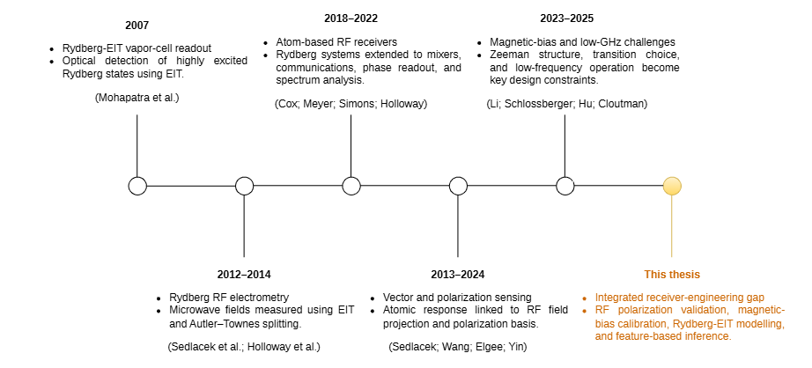
RESEARCH GAP
Research gap and open questions
Literature map
What the field now shows
Polarisation-sensitive RF measurement with Rydberg atoms is feasible, but many demonstrations rely on mixer, heterodyne or more complex receiver architectures.
Magnetic bias can improve observability by revealing polarisation-dependent spectral structure, but it also increases calibration and stability requirements.
Recent receiver designs improve GHz-range sensing and practical operation, but experimentally simple polarisation inference remains underdeveloped.
What observables best encode RF polarization?
What level of architecture complexity is truly necessary?
Can calibrated projections enable feasible 1–2 GHz Rydberg polarisation inference?
Rydberg sensing | SET HDR Conference
A7
Notes:
Backup: research gap
Use this if asked what remains open in the literature. The central gap is not whether Rydberg sensors can detect RF fields; it is how to recover polarisation in an experimentally simple, calibrated and validated way.
The three questions to emphasise are: what observables encode RF polarisation, how much architecture complexity is necessary, and can calibrated projections enable feasible Rydberg polarisation inference?

Slide 25
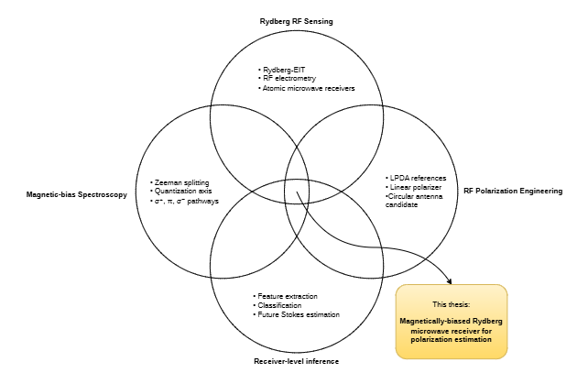
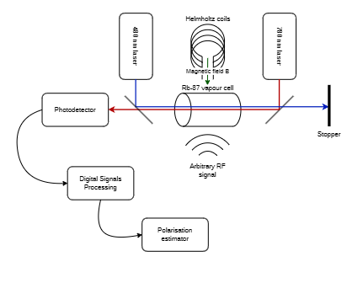
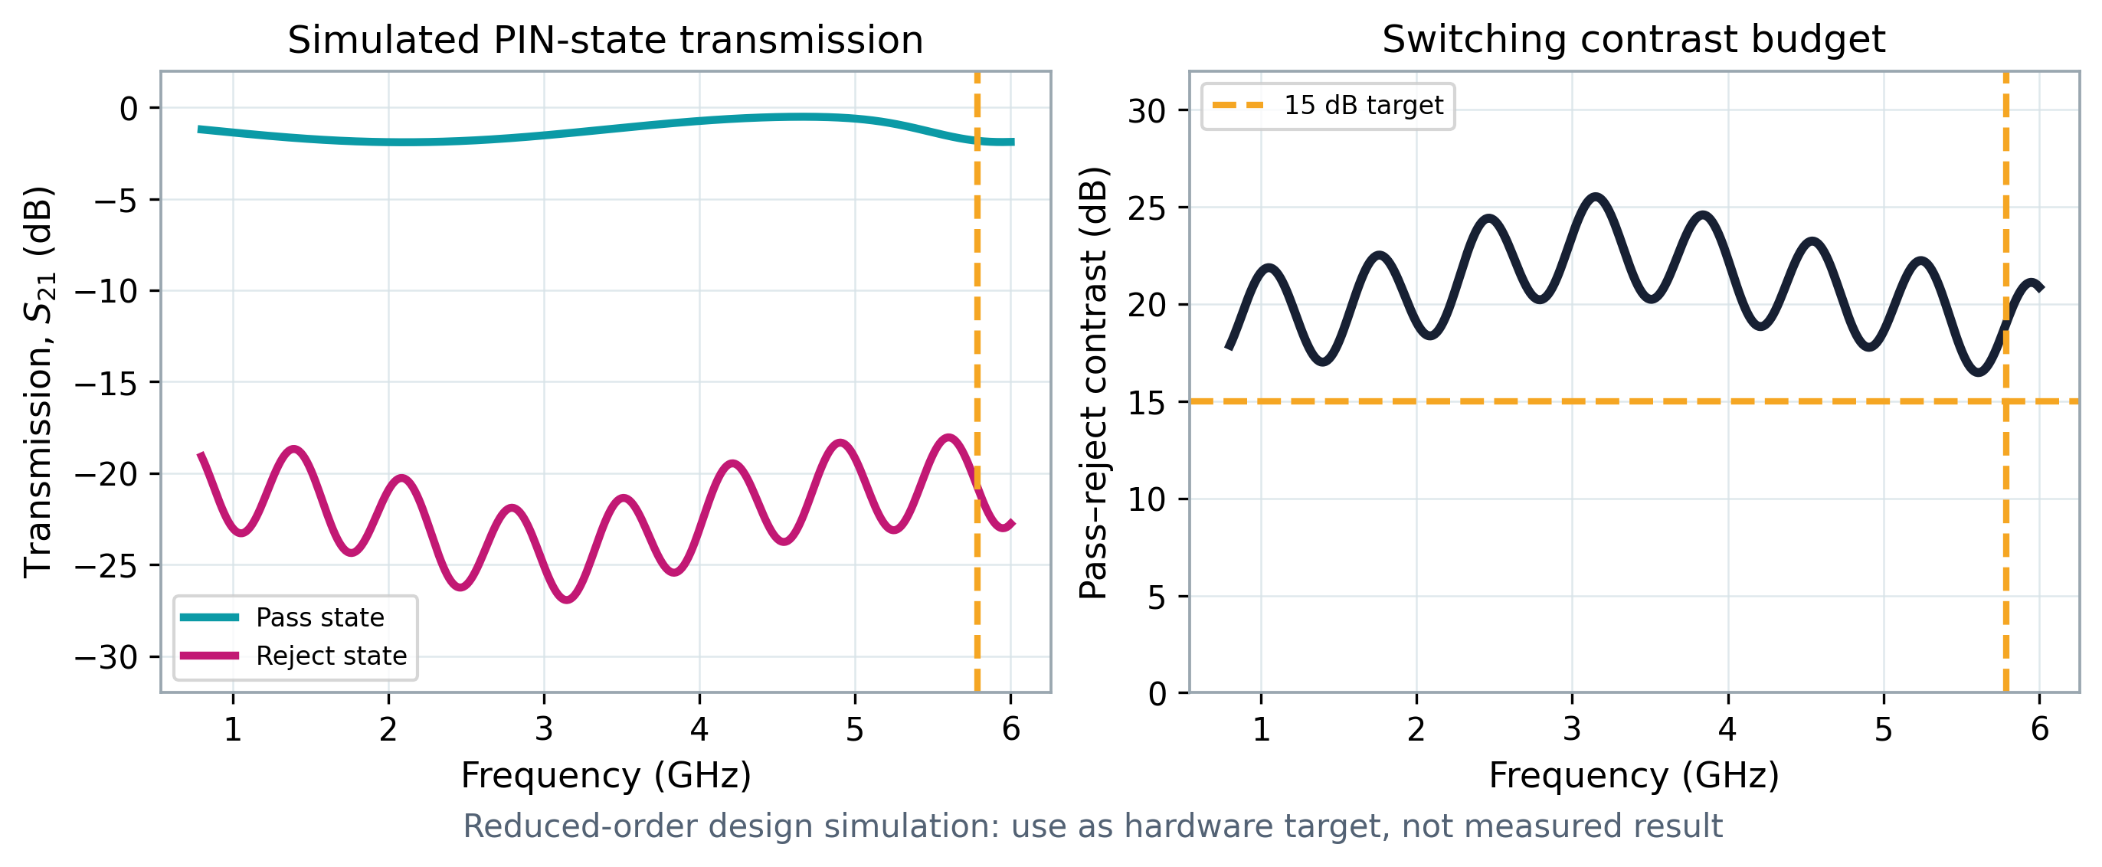
APPENDIX
Receiver Architecture
Proposed switchable analyser path
Unknown RF
PIN-diode
metasurface
Rb vapour cell
Estimator
→
→
→
unknown polarisation
switch H/V/D/A/R/L states
EIT / AT optical readout
calibrated matrix → Stokes vector
Validation checklist
• Four states transmit measurable signal
• Calibrated analyser matrix is full-rank
• Aperture field is stable over the vapour cell
• Held-out H/V/D/A/R/L states reconstruct correctly
Reduced-order design target only: pass/reject contrast and low insertion loss must be verified in CST/VNA before optical validation.
Point for Q&A: this is the hardware bridge from the measured linear result to future full-Stokes validation.
Rydberg sensing | SET HDR Conference
A8
Notes:
Backup: receiver architecture
Use this if someone asks how the proposed switchable analyser would sit in the system. The architecture is: unknown RF field, switchable analyser or metasurface projection, vapour-cell atomic readout, calibrated response matrix, Stokes reconstruction.
Make clear that this is the proposed validation path, not a claim that every component has already been experimentally completed.

Slide 26
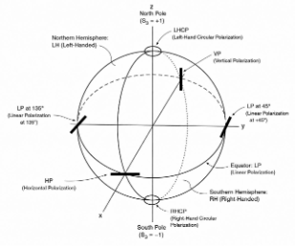
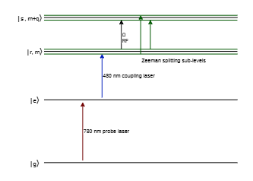
APPENDIX
Poincaré sphere
Rydberg sensing | SET HDR Conference
A8
Notes:
Backup: Poincaré sphere
Use this if someone wants the geometry explained more slowly. Linear states lie on the equator; circular states lie at the poles. A set of analyser states confined to the equator cannot distinguish the two poles.
This is the visual reason why S3 is unobservable from H/V/D/A alone.

Slide 27
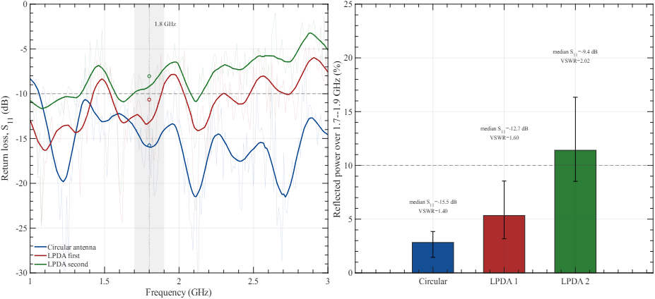
APPENDIX
Antenna S11
Rydberg sensing | SET HDR Conference
A8
Notes:
Backup: antenna S11
Use this for RF-hardware questions. S11 describes how well the antenna is matched over frequency. A poor match reduces delivered RF power and complicates interpretation of field strength at the cell.
Tie it back to calibration: the atomic response must be interpreted through the actual RF chain, not just ideal source settings.

Slide 28
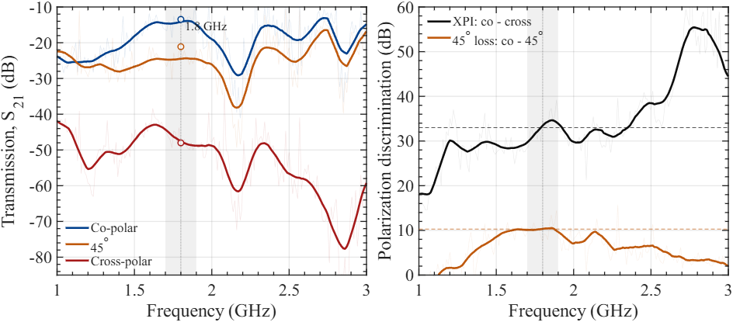
APPENDIX
Linear-to-linear S21
Rydberg sensing | SET HDR Conference
A8
Notes:
Backup: linear-to-linear S21
Use this if asked about transmission through the linear path. S21 gives the forward transmission behaviour and helps show how much signal reaches the receiver after the analyser or fixture.
This is supporting RF characterisation; the thesis claim still comes from calibrated polarisation-dependent response.

Slide 29
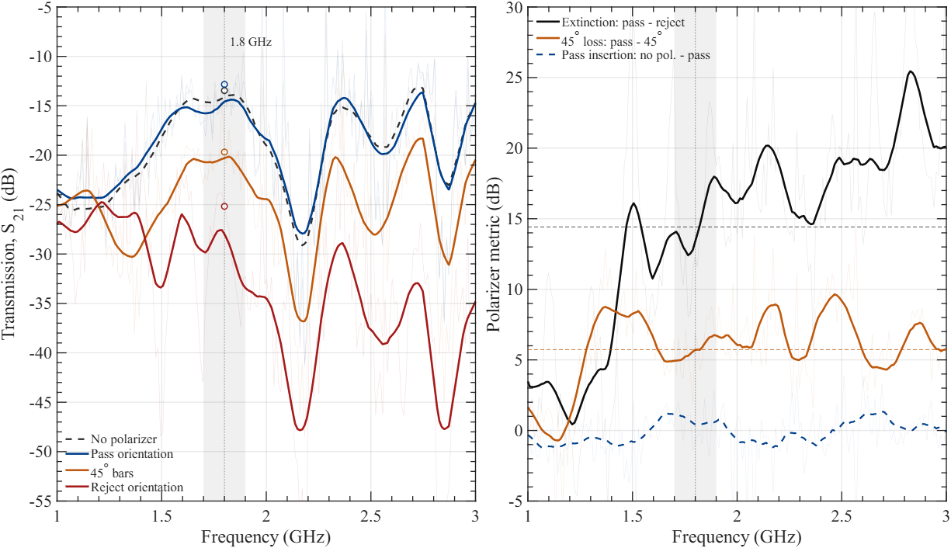
APPENDIX
Linear polarizer S21
Rydberg sensing | SET HDR Conference
A8
Notes:
Backup: linear polariser S21
Use this if asked how the polariser behaves as an RF component. The purpose is to demonstrate pass and reject behaviour for orthogonal linear orientations.
If time is short, summarise it as: the hardware creates a measurable projection before the atomic readout, which is exactly what a Stokes analyser needs.

Slide 30
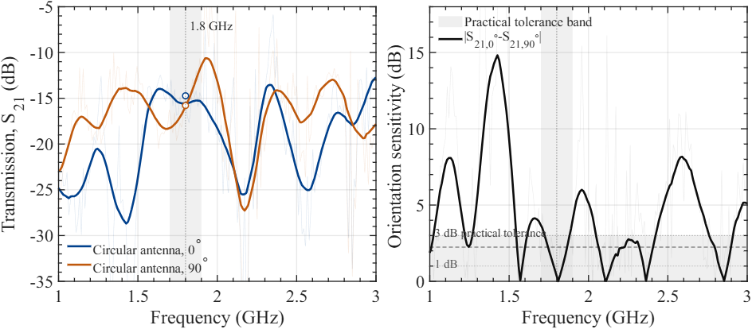
APPENDIX
Linear-to-circular S21
Rydberg sensing | SET HDR Conference
A8
Notes:
Backup: linear-to-circular S21
Use this if asked about circular or hybrid analyser behaviour. The key issue is whether the hardware can create an independent channel that is sensitive to circular handedness or non-coplanar Stokes information.
Be careful not to overstate: it is part of the route to S3 sensitivity, not a completed full-Stokes validation by itself.

Slide 31
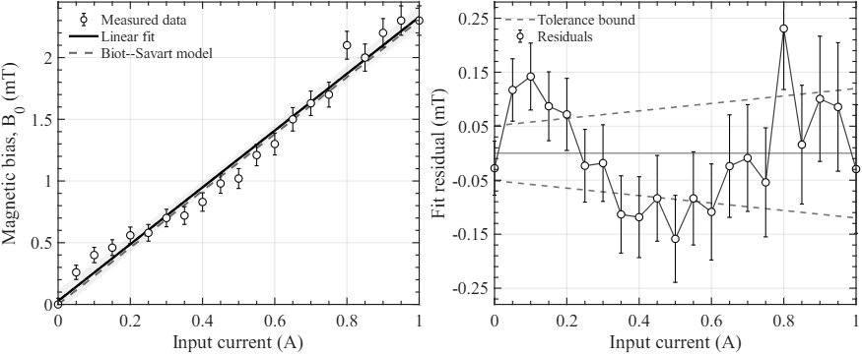
APPENDIX
Magnetic calibration
Rydberg sensing | SET HDR Conference
A8
Notes:
Backup: magnetic calibration
Use this if asked about how magnetic-field strength relates to spectral shift. The purpose of magnetic calibration is to connect the applied bias to predictable Zeeman shifts or channel separation.
The important caveat is stability: without stable bias and repeatable optical readout, magnetic effects can be difficult to separate from drift.

Slide 32
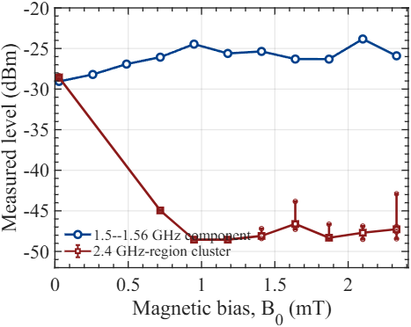
APPENDIX
Magnetic experiments with Rydberg
Rydberg sensing | SET HDR Conference
A8
Notes:
Backup: magnetic experiments with Rydberg
Use this if asked what happened experimentally with magnetic bias. The safe answer is that magnetic bias is physically motivated and modelled, but the available data should be described conservatively.
The present thesis can strongly claim linear-polarisation discrimination and a full-Stokes validation path. It should not claim completed magnetic-bias handedness detection unless additional stable R/L data are available.

