Slide 1
DROWSINESS DETECTION
Name: Ranvir Singh Rawat
Roll no: 2018624
B.Tech(CSE) Sem-6
Class Roll No- 41

Slide 2
INTRODUCTION
Most of accidents involve drowsy driving
Lack of concentration during driving
Drowsiness can be easily detected by facial expressions
Closed eyes
Open mouth (yawning)

Slide 3
Problem Statement
Objective
Most of the accidents involve drowsy or sleepy behaviour of the driver. There should be some solution to avoid such accidents.
To develop Application capable of detecting drowsiness of a person using Eye Aspect Ratio using 68 facial landmark detection in Dlib.

Slide 4
Tools used
Language :
Python
Environment :
VS Code
Modules :
Dlib- for deep learning based modules and face landmark detection
Cv2- importing opencv library for basic image processing functions
Numpy- for array related functions
Imutils - face utils for basic operations of conversion
Tkinter - for creating gui

Slide 5
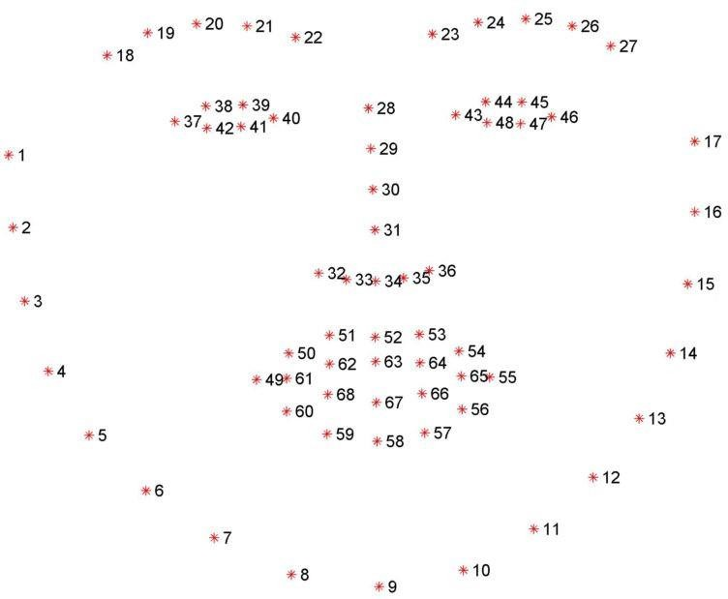
Facial Landmarks
68 coordinates that map facial points on a person’s face

Slide 6

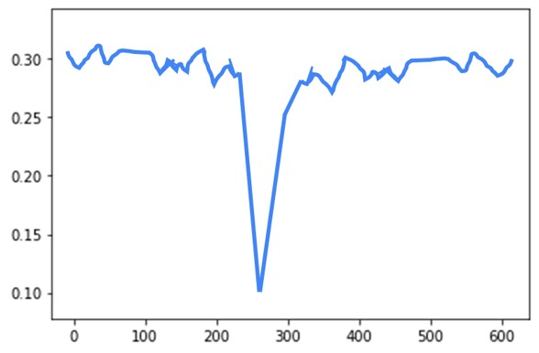
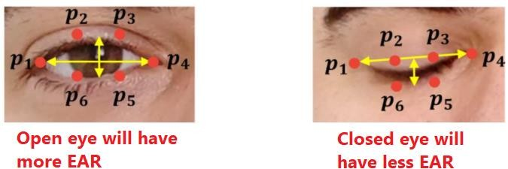
Eye Aspect Ratio
EAR Graph
EAR > 0.25, person is active
0.20< EAR < 0.25, person is drowsy
EAR > 0.25, person is sleeping

Slide 7
Future works
Alerting drivers while driving
Yawning detection
Implementation in Online classes
Face Recognition

